Slide 1
Spatially variable gene (SVG) expression analysis
Jean Fan, PhD
Assistant Professor
JEFworks Lab
Center for Computational Biology
Department of Biomedical Engineering
Johns Hopkins University

Slide 2
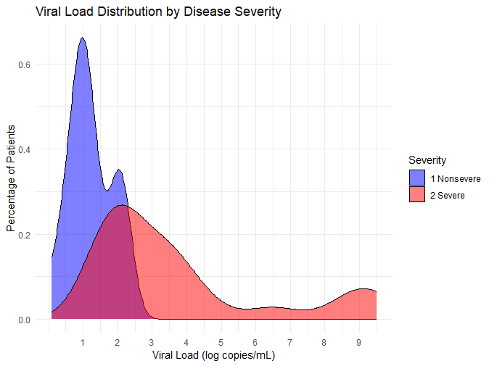
Quiz Feedback

Slide 3
HW5 and HWEC
HW4 - due tonight
HW5 – switch teams and identify the same cell-type in the other dataset. Explain what parts of your code you had to change. Due Saturday night.
HWEC1 – use gganimate to explore the questions from HW3

Slide 4
Reminder
Please fill out your reflection cards → we use it to gauge attendance
If you have no questions, put NA

Slide 5
Volcano Plot

Slide 6
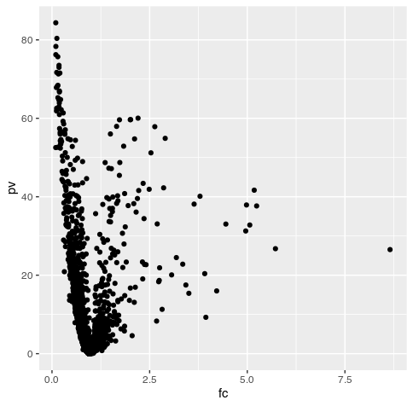
Volcano Plot

Slide 7
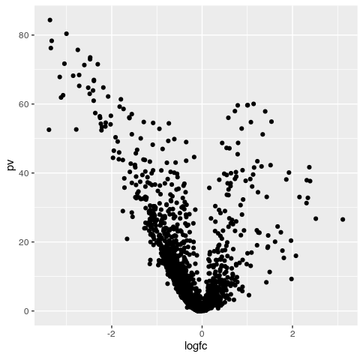
Volcano Plot

Slide 8
Volcano Plot
https://training.galaxyproject.org/training-material/topics/transcriptomics/tutorials/rna-seq-viz-with-volcanoplot/tutorial.html

Slide 9
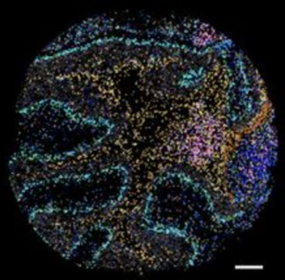
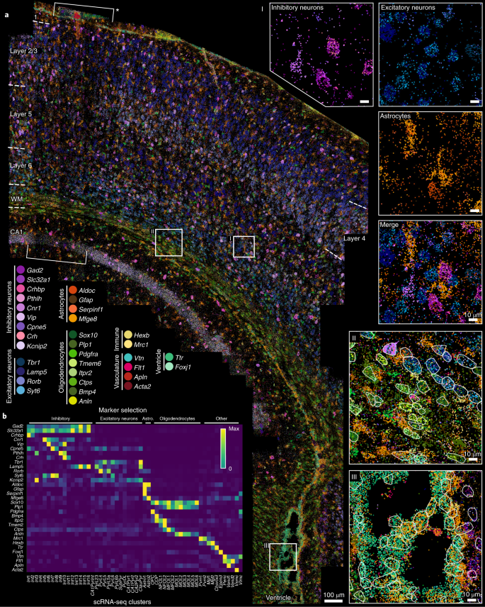
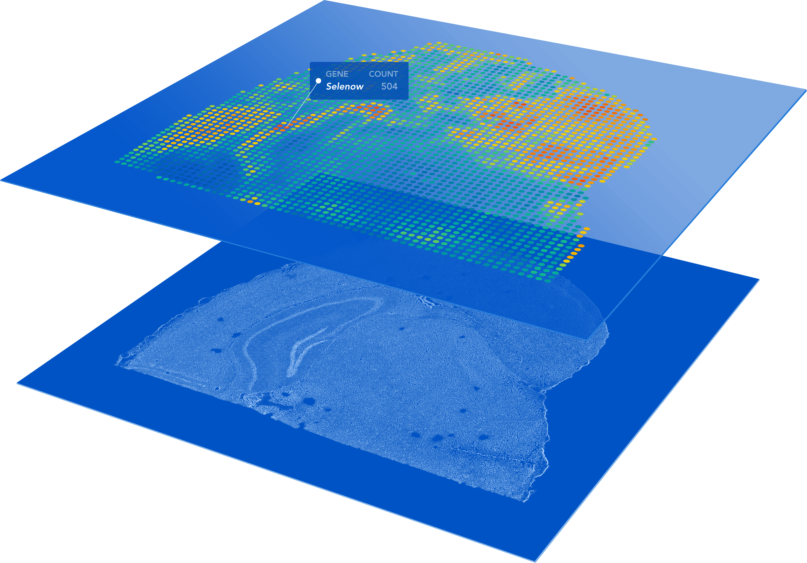
preoptic region (MERFISH)
(Moffitt*, Bambah-Mukku*
et al., Science 2018)
motor cortex (MERFISH)
(Zhang et al., bioRxiv 2020)
somatosensory cortex (osmFISH)
(Codeluppi et al, Nature Methods 2018)
embryo (DBiT-seq)
(Liu et al, Cell 2020)
cerebellum (SlideSeq)
(Rodriques et al, Science 2019)
olfactory bulb (Spatial Transcriptomics)
(Stahl et al, Science 2016)
SVZ (seqFISH/seqFISH+)
(Eng et al, Nature 2019)
V1 cortex (STARmap)
(Wang et al, Science 2018)
cortex (Visium)
liver (XYZeq)
Lee et al, Science Advances 2021)
embryo (sci-space)
Lee et al, Science Advances 2021)
… and
more!

Slide 10
(Vizgen 2021)
Notes:
But we can see how genes are expressed within these cells within the tissues
With red being high expression and blue being low expression f
or a targeted set of genes

Slide 11
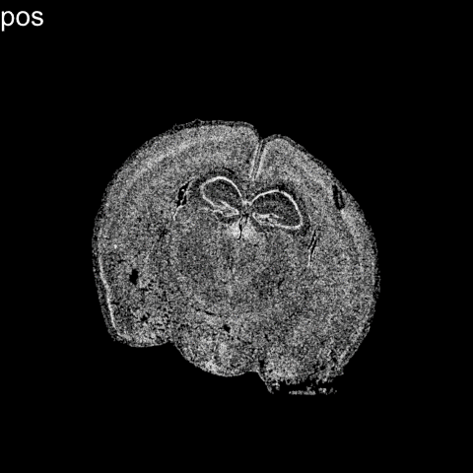
Notes:
Further we can perform dimensionality reduction and clustering analysis as we do with non-spatially resolved single-cell transcriptomics data to identify transcriptionally distinct cell-types
But now we can further explore how these cell-types are spatially organize in the original tissue

Slide 12
Notes:
So we can see that different cell-types within tissues such as the brain are often spatially organized
And given these cell-types are transcriptionally distinct, we would expect genes that mark these different cell-types to also be spatially organized
However, if we focus on an individual cell-type

Slide 13
Notes:
Such as the pyramidal layer of the hippocampus
Can we identify additional gene expression heterogeneity that are coordinated in some spatial manner??

Slide 14
Motivation: Why might we be interested in identifying (cell-type-specific) spatially variable genes?

Slide 15
Motivation: How can we identify (cell-type-specific) spatially variable genes?

Slide 16
Moran’s I helps us identify genes with significant spatial autocorrelation
Moran’s I (spatial auto-correlation)
(Miller et al, Genome Research Oct 2021)
Notes:
MERINGUE draw inspiration from Geospatial analysis
Where a statistic called Moran's I has been used to evaluate whether a particular quantity, say income, exhibits significant non-random spatial variation via spatial autocorrelation
In this case, each square is a county
Color denotes income level
We can see in this visualization that income isn’t random
it is highly correlated with the income of the neighboring county
(income exhibits high spatial autocorrelation and this high spatial autocorrelation can be quantified as a high Moran’s I)
For us of course, we're not as interested in income, but we are interested in gene expression
So if a cell's expression for a particular gene is highly correlated with that gene's expression in the cell's neighbors, then the gene would be highly spatially autocorrelated
distinguish genes that are variable in a spatial coordinated manner
with genes that are variable but not in a spatially coordinated manner

Slide 17
Moran’s I helps us identify genes with significant spatial autocorrelation
Moran’s I (spatial auto-correlation)
(Miller et al, Genome Research Oct 2021)
Notes:
MERINGUE draw inspiration from Geospatial analysis
Where a statistic called Moran's I has been used to evaluate whether a particular quantity, say income, exhibits significant non-random spatial variation via spatial autocorrelation
In this case, each square is a county
Color denotes income level
We can see in this visualization that income isn’t random
it is highly correlated with the income of the neighboring county
(income exhibits high spatial autocorrelation and this high spatial autocorrelation can be quantified as a high Moran’s I)
For us of course, we're not as interested in income, but we are interested in gene expression
So if a cell's expression for a particular gene is highly correlated with that gene's expression in the cell's neighbors, then the gene would be highly spatially autocorrelated
distinguish genes that are variable in a spatial coordinated manner
with genes that are variable but not in a spatially coordinated manner

Slide 18
Moran’s I helps us identify genes with significant spatial autocorrelation
Moran’s I (spatial auto-correlation)
(Miller et al, Genome Research Oct 2021)
Notes:
MERINGUE draw inspiration from Geospatial analysis
Where a statistic called Moran's I has been used to evaluate whether a particular quantity, say income, exhibits significant non-random spatial variation via spatial autocorrelation
In this case, each square is a county
Color denotes income level
We can see in this visualization that income isn’t random
it is highly correlated with the income of the neighboring county
(income exhibits high spatial autocorrelation and this high spatial autocorrelation can be quantified as a high Moran’s I)
For us of course, we're not as interested in income, but we are interested in gene expression
So if a cell's expression for a particular gene is highly correlated with that gene's expression in the cell's neighbors, then the gene would be highly spatially autocorrelated
distinguish genes that are variable in a spatial coordinated manner
with genes that are variable but not in a spatially coordinated manner

Slide 19
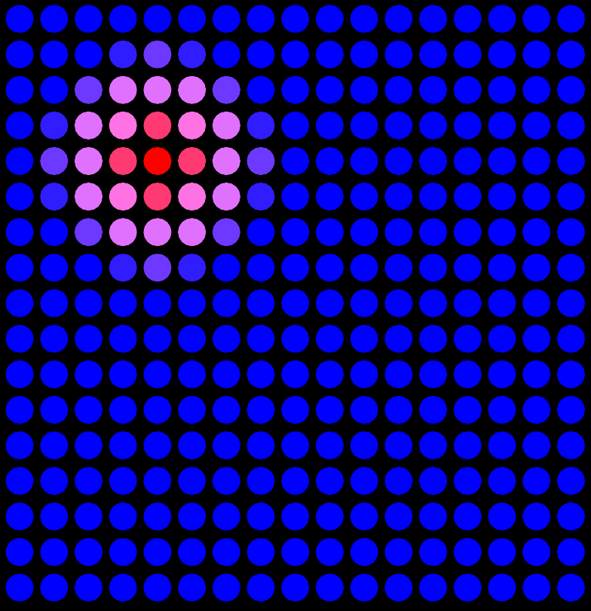
Practice

Slide 20
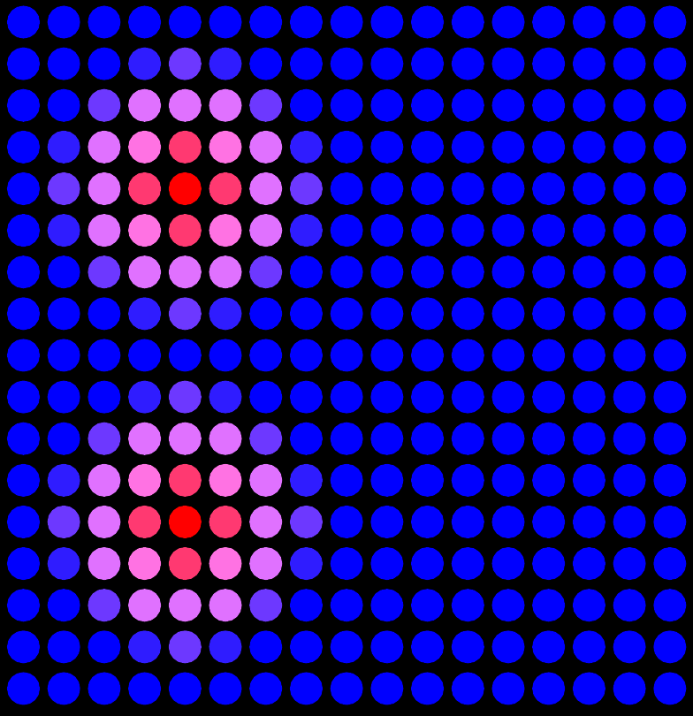
Practice

Slide 21
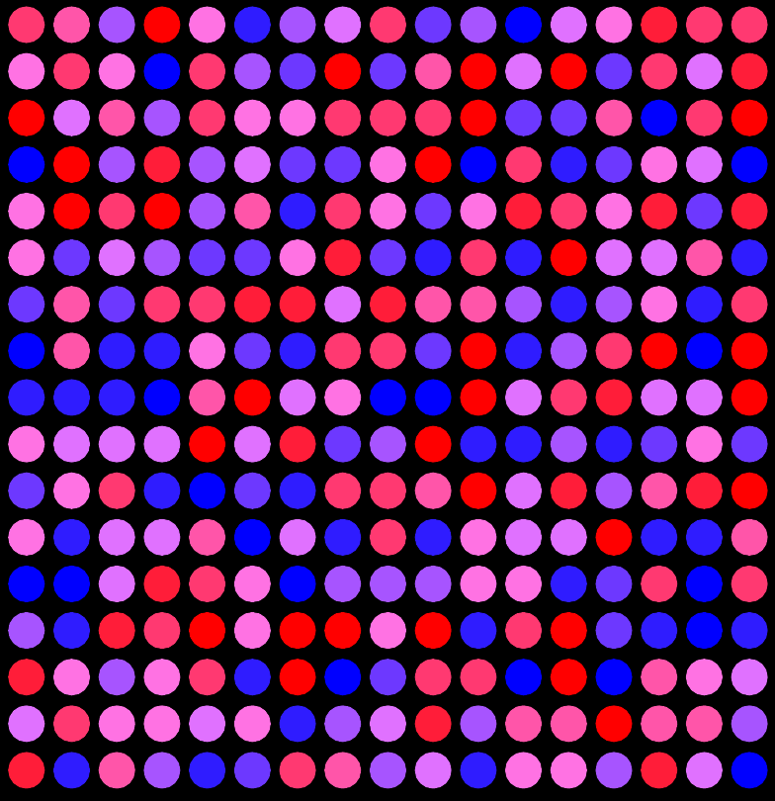
Practice

Slide 22
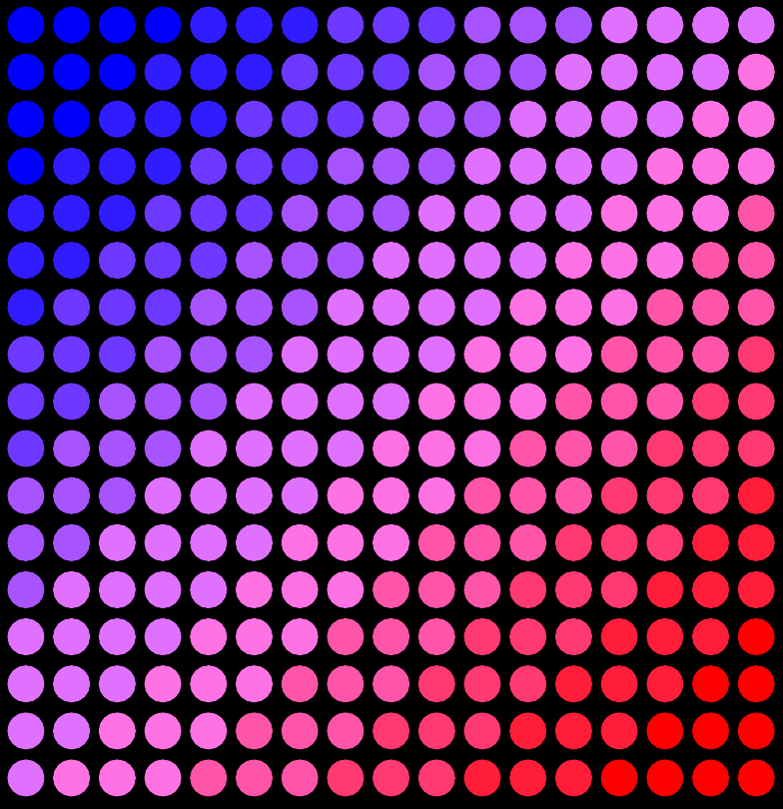
Practice

Slide 23
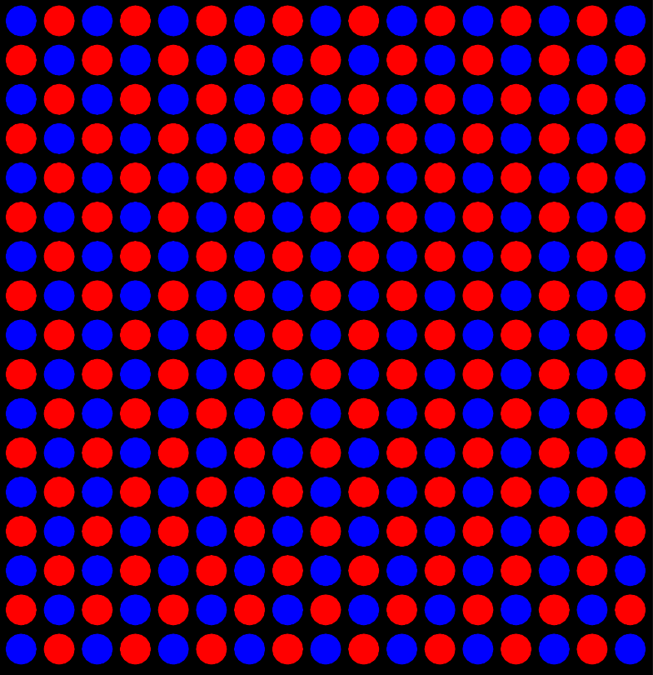
Practice

Slide 24
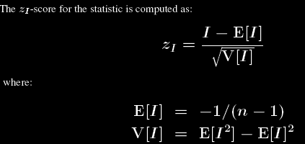
Moran’s I has a closed form that we can compute to solve for the distribution and obtain a p-value

Slide 25
Practice

Slide 26
MERINGUE uses a Voronoi tessellation-based approach for identifying spatial neighbors in a manner that is robust to variation in cellular density
(Miller et al, Genome Research Oct 2021)
Notes:
Well what does it mean for cells to be neighbors?
MERINGUE uses Voronoi tesslation (also sometimes called Delayney triangulation) to identify spatial neighbors
Each cell as a neighborhood
These neighborhoods can vary in sizes
But two cells are considered spatial neighbors if their neighborhoods share an edge
This particular way of defining spatial neighbors is very flexible for 2D, 3D, and also robust to deformation

Slide 27
MERINGUE uses a Voronoi tessellation-based approach for identifying spatial neighbors in a manner that is robust to variation in cellular density
Other Methods
(Miller et al, Genome Research Oct 2021)
Notes:
So if we warp the spatial location of cells as seen here in the olfactory bulb, re-evaluate Moran’s I for each gene and plot their –log10(adjusted p-values), we see a strong correlation under the uniform and warped spatial cases, suggesting that we can still identify the same spatially heterogeneous genes as expected
Whereas other approaches relying on gaussian distances are no longer able to

Slide 28
Not all spatially heterogeneous gene expression are equal. MERINGUE uses LISA to characterize the scale of spatial patterns to remove false discoveries.
LISA
Random gene
Scale of spatial pattern == % of cells with significant LISA
(Miller et al, Genome Research Oct 2021)
Notes:
Ok but not all spatially heterogeneous gene expression patterns are equal
In biology, we are generally interested in spatial patterns that are not just small hotspots
So MERINGUE builds on another geospatial statistic LISA to characterize the scale of spatial patterns
We can show that by randomly shuffling gene expression, that as expected under the null distribution we obtain a 5% type I error or false positive rate
But if we look at the scale of these significant false positive spatial patterns
They’re mostly being driven by a small percentage of cells
So by requiring both significant spatial auto-correlation, as well as for the auto-correlation to be driven by a certain number of cells
We can effectively eliminates false discoveries
Quite useful for prioritizing genes for validation

Slide 29
We apply MERINGUE to identify genes with spatially heterogeneous patterns in 2D, 3D, multi-section, and more
3D drosophila
Multi-section breast cancer
Within cell-types in the hypothalamic preoptic region
(Moffitt*, Bambah-Mukku*
et al., Science 2018)
(Fowlkes et al, Cell 2008; Karaiskos et al Science, 2017)
(Stahl et al, Science 2016)
(Miller et al, Genome Research Oct 2021)
Notes:
In our paper, we apply MERINGUE to many organisms, technologies,
In particular the Moran’s I equation is also very flexible and amenable to adaptations that allow us to
To identify genes with spatially heterogeneous gene expression patterns in 3D,
In multi-section data where we can specifically look for spatial patterns that are consistent across sections
Or even between pairs of receptor and ligand genes among spatially co-localized cell-types to look for potential cell-cell communication
Please check out…

Slide 30
Notes:
So returning to our hippocampal pyramidal cells
when we apply MERINGUE

Slide 31
Gpr161
Notes:
We indeed can find additional aspects of gene expression heterogeneity that are coordinated in a spatial manner

Slide 32
Amigo2
Notes:
We indeed can find additional aspects of gene expression heterogeneity that are coordinated in a spatial manner

Slide 33
Tmem108
Notes:
We indeed can find additional aspects of gene expression heterogeneity that are coordinated in a spatial manner
Appear to visually correspond with different hippocampal subfields which receive inputs from different regions of the brain

Slide 34
MERINGUE proposes an inter-cell-type spatial cross correlation statistic to identify gene expression patterns indicative of cell-cell communication
Moran’s I (spatial auto-correlation)
inter-cell-type spatial cross-correlation
(Miller et al, Genome Research Oct 2021)
Notes:
Finally, building on Moran's I, we can modify this equation slightly
and take advantage of the flexibility of this adjacency weight matrix definition
to specifically propose an inter-cell-type spatial cross correlation statistic
To look for genes that are cross correlated for spatially co-localized cell-types that may be indicative of cell-cell communication
Rather than autocorrelation x with itself, we now have a second gene
W is limited to spatial neighbors of different cell-types
So consider cell-type A and B that spatially adjacent to each other
Cell-type A expresses a gene, perhaps a receptor
and Cell-type B expresses the complementary ligand
and we are looking to find situations where cells of cell-type A
expressing the receptor are always co-localized with cells of
cell-type B expressing the correpsonding ligand
even though these receptor and ligand genes are expressed in different cells
so their expressions across cells are actually negatively correlated
when we evaluate their inter-cell-type spatial cross-correlation,
it is very significantly positive
potentially indicative of cell-cell communication via this particular receptor-ligand interaction

Slide 35
MERINGUE identifies spatial gene expression heterogeneity suggestive communication between spatially co-localized cells
(Miller et al, Genome Research Oct 2021)
Notes:
We first apply our approach identify gene expression patterns that may be indicative of putative 399 cell-cell communication between cells on beads corresponding to the Purkinje layer with cells on spatially 400 adjacent beads in Slide-Seq data of the mouse cerebellum (Fig. 5A). We use a set of over 2,500 known 401 receptor-ligand pairs previously supported by orthogonal biological validations (Ramilowski et al. 402 2015a). Restricting to well detected (CPM > 0 in more than 30 cells) receptor genes in the Purkinje layer 403 beads and well detected ligand genes in the spatially adjacent beads, we applied MERINGUE to test for 404 significant spatial cross correlation between all receptor and ligand gene pairs.
We identified statistically significant inter-cell-type spatial cross-correlation between expression of Ptprz1 (Protein Tyrosine 406 Phosphatase Receptor Type Z1 i.e. PTPζ) in beads corresponding to Purkinje layer and expression of its ligand Ptn (secreted growth factor pleiotrophin) in spatially adjacent beads (Fig. 5B-C). Ptprz1 has been previously identified to be expressed by Purkinje neurons while Ptn has been previously identified to distribute along Bergmann glial fibers in postnatally developing cerebellum (

Slide 36
Resources
Try out the software: https://github.com/JEFworks-Lab/MERINGUE
Little challenging to install so we will skip this
Hands on component
Interactive visualizations with gganimate
https://jef.works/blog/2021/08/12/story-telling-with-data-visualization/

Slide 37
Reflection card
https://bit.ly/GDV24_rc

