Slide 1
Deconvolving multi-cellular pixel-resolution spatial transcriptomics data
Jean Fan, PhD
Assistant Professor
JEFworks Lab
Center for Computational Biology
Department of Biomedical Engineering
Johns Hopkins University

Slide 2
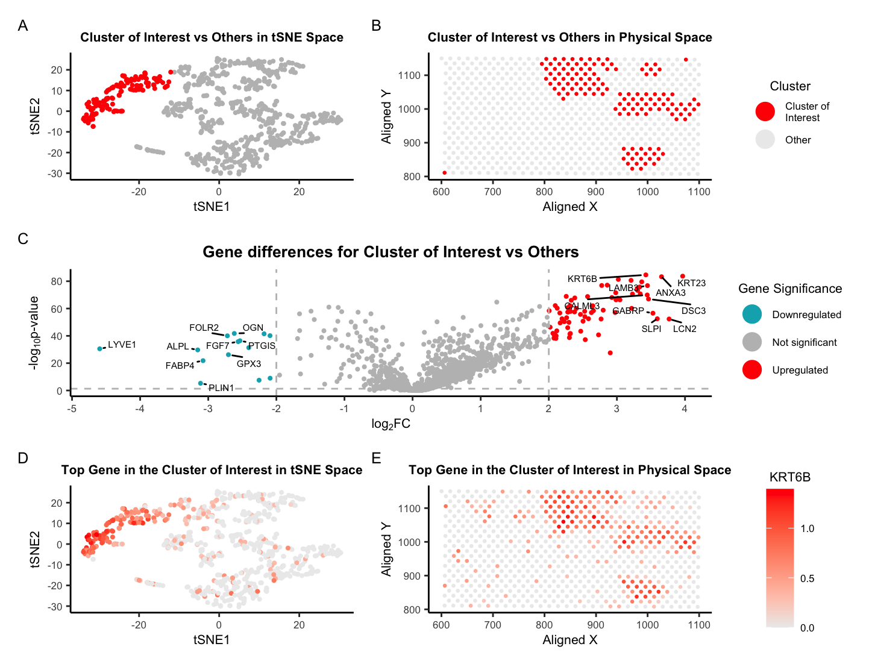
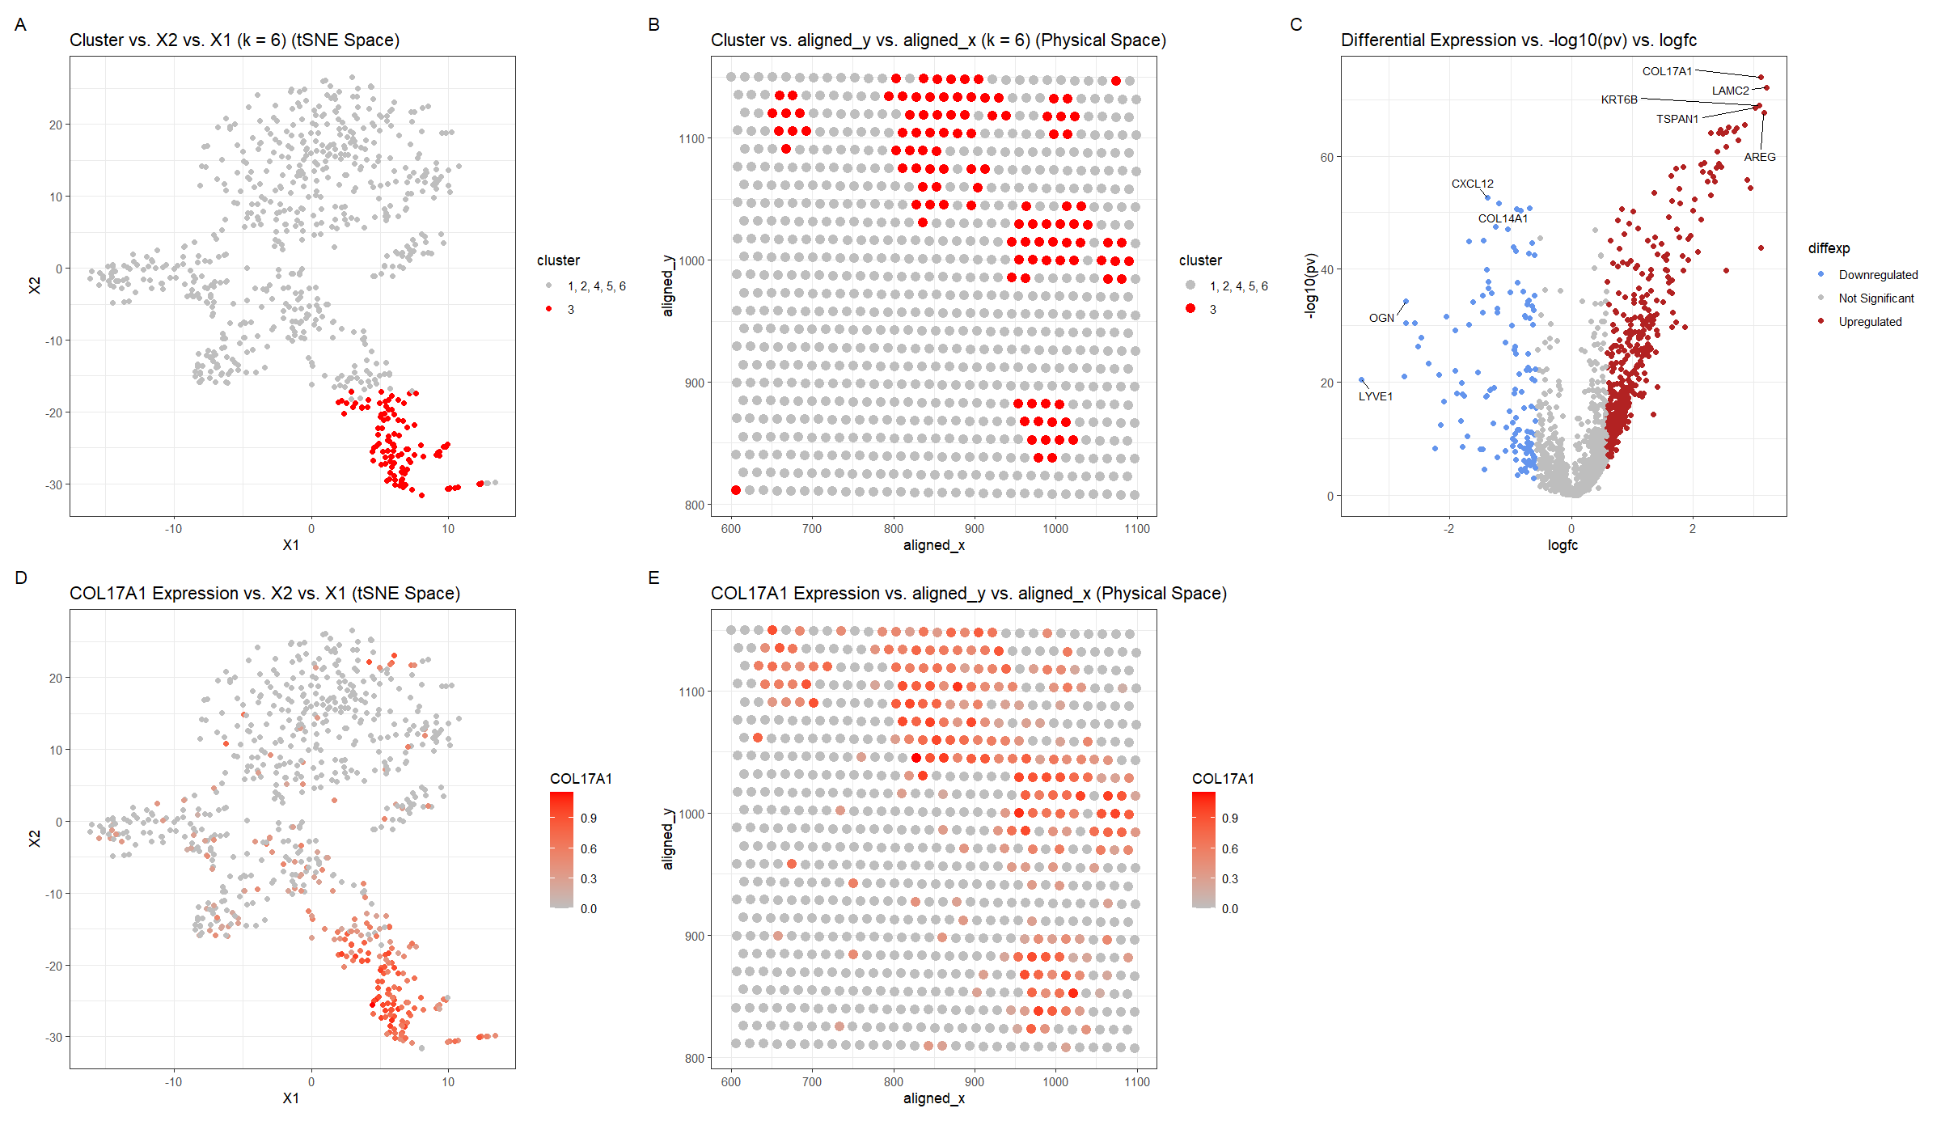

Slide 3
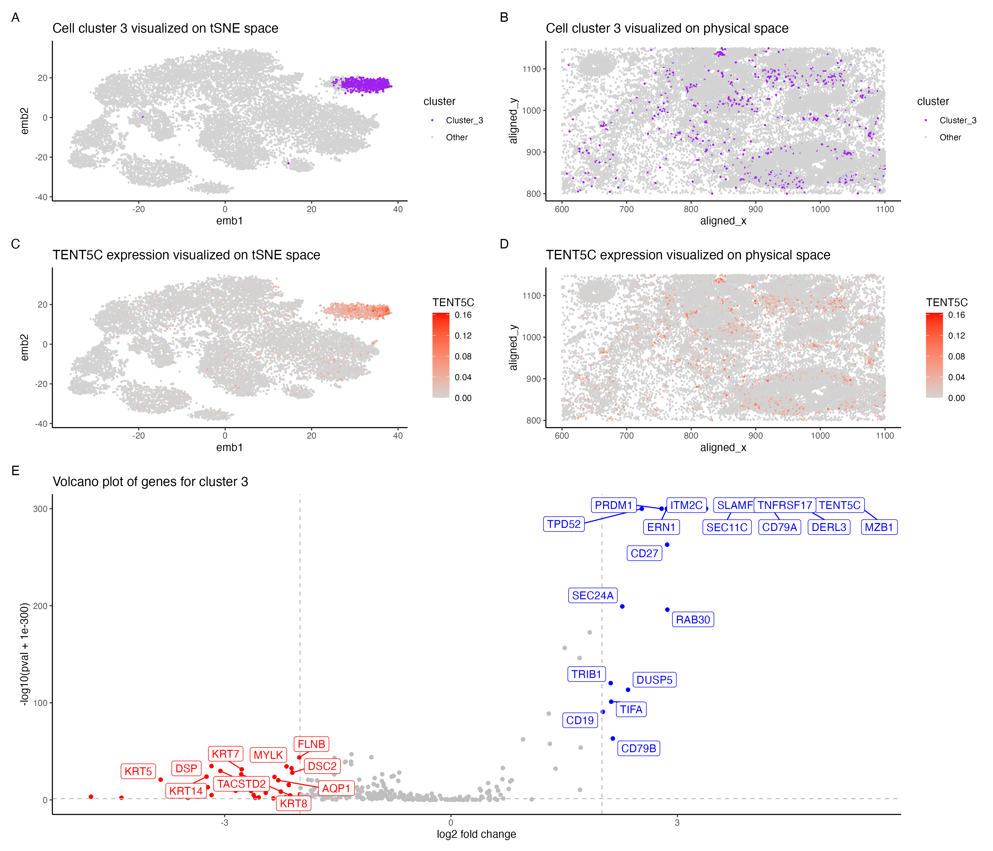
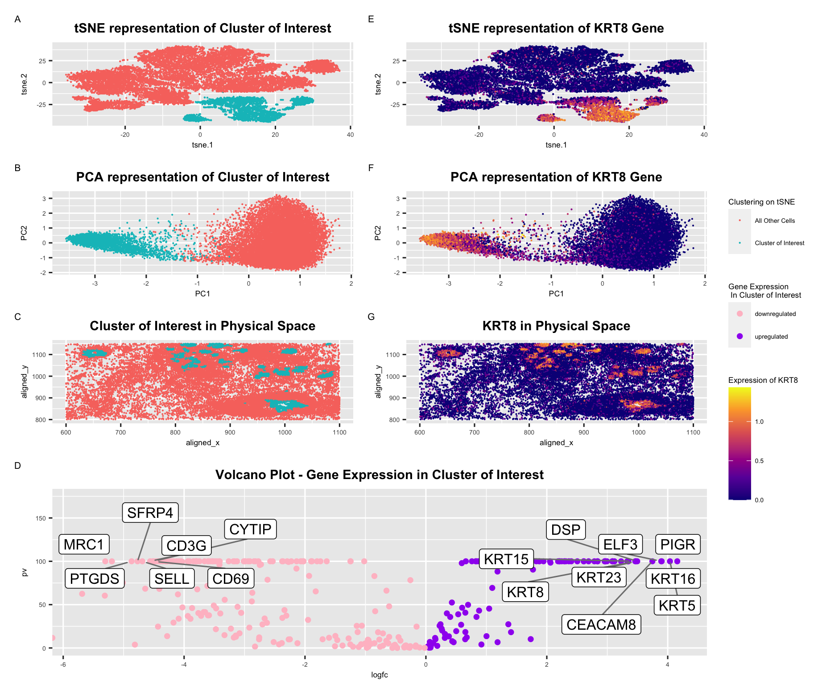

Slide 4
Visually interpreting our results
K-means
Gene X
tSNE 2
tSNE 2
tSNE1
tSNE1

Slide 5
Visually interpreting our results
K-means
Gene Y
tSNE 2
tSNE 2
tSNE1
tSNE1

Slide 6
Review: Moran’s I
Moran’s I (spatial auto-correlation)
Notes:
MERINGUE draw inspiration from Geospatial analysis
Where a statistic called Moran's I has been used to evaluate whether a particular quantity, say income, exhibits significant non-random spatial variation via spatial autocorrelation
In this case, each square is a county
Color denotes income level
We can see in this visualization that income isn’t random
it is highly correlated with the income of the neighboring county
(income exhibits high spatial autocorrelation and this high spatial autocorrelation can be quantified as a high Moran’s I)
For us of course, we're not as interested in income, but we are interested in gene expression
So if a cell's expression for a particular gene is highly correlated with that gene's expression in the cell's neighbors, then the gene would be highly spatially autocorrelated
distinguish genes that are variable in a spatial coordinated manner
with genes that are variable but not in a spatially coordinated manner

Slide 7
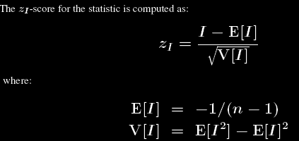
Review: Moran’s I
Moran’s I (spatial auto-correlation)
Notes:
MERINGUE draw inspiration from Geospatial analysis
Where a statistic called Moran's I has been used to evaluate whether a particular quantity, say income, exhibits significant non-random spatial variation via spatial autocorrelation
In this case, each square is a county
Color denotes income level
We can see in this visualization that income isn’t random
it is highly correlated with the income of the neighboring county
(income exhibits high spatial autocorrelation and this high spatial autocorrelation can be quantified as a high Moran’s I)
For us of course, we're not as interested in income, but we are interested in gene expression
So if a cell's expression for a particular gene is highly correlated with that gene's expression in the cell's neighbors, then the gene would be highly spatially autocorrelated
distinguish genes that are variable in a spatial coordinated manner
with genes that are variable but not in a spatially coordinated manner

Slide 8
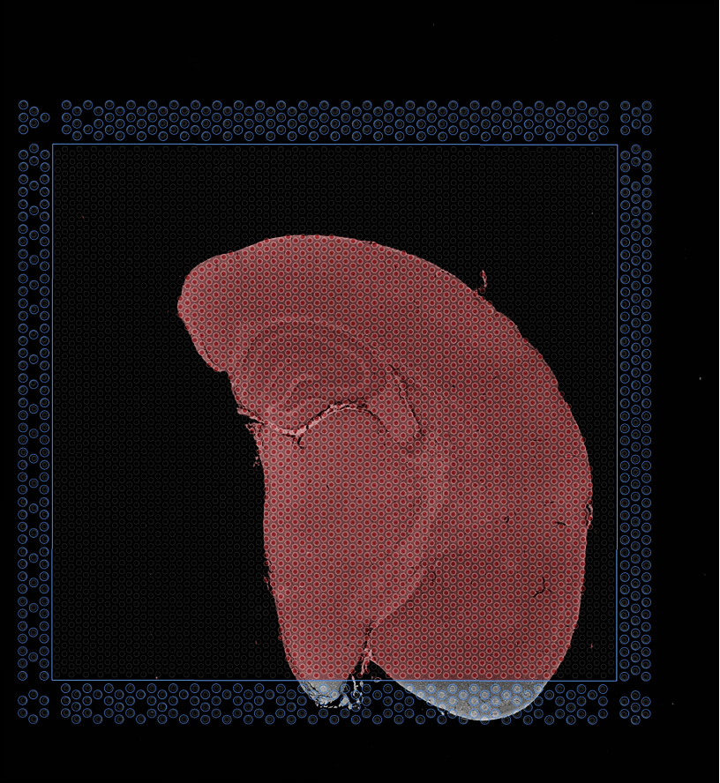
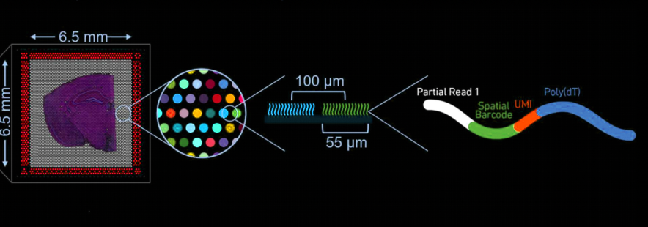
(ST/Visium: Stahl et al, Science 2016)
(SlideSeq: Rodriques et al, Science 2019)
(DBiT-Seq: Liu et al, Cell 2020)
(XYZseq: Lee et al, Science Advances 2021)
(Visium FFPE data)
Notes:
And capture the mRNAs that are present at each pixel or spot

Slide 9
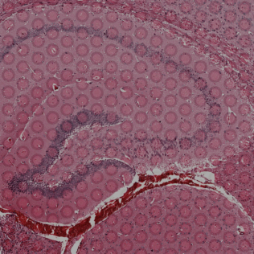
(Visium FFPE data)

Slide 10
(Visium FFPE data)
Notes:
Therefore the processed information we end up with comprises the spatial coordinates of each pixel
As well as the gene expression observed at each pixel

Slide 11
(Visium FFPE data)
Notes:
Therefore the processed information we end up with comprises the spatial coordinates of each pixel
As well as the gene expression observed at each pixel

Slide 12
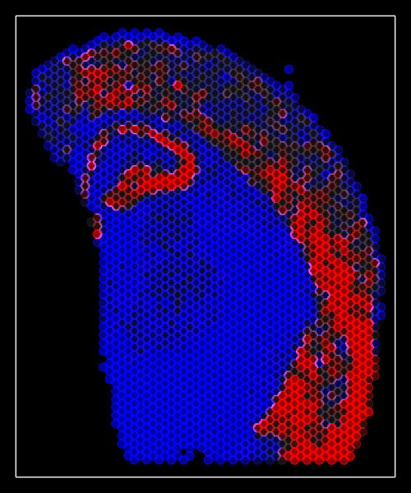
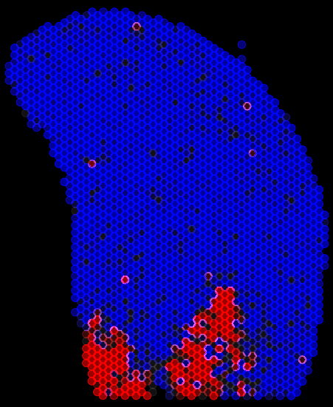
Full Transcriptome Profiling by Sequencing
Slc17a7
Peg10
…and many more
(Visium FFPE data)
Notes:
For the untargeted full transcriptome

Slide 13
Can we use the same computational analysis tools like for clustering to identify transcriptionally distinct cell-types as in single-cell data?
UMAP
capture-and-seq
spatially resolved transcriptomics
Single-cell
resolution
Full trans
criptome
(Visium FFPE data)
https://jef.works/blog/2022/05/03/deconvolution-vs-clustering/

Slide 14
Pixels/spots comprise many cells; may comprise multiple cell-types.
Gene expression measurements may reflect mixtures of cell-types.
(Visium FFPE data)
Notes:
The measured gene expression at each spot comes from multiple cells potentially representing multiple cell types

Slide 15
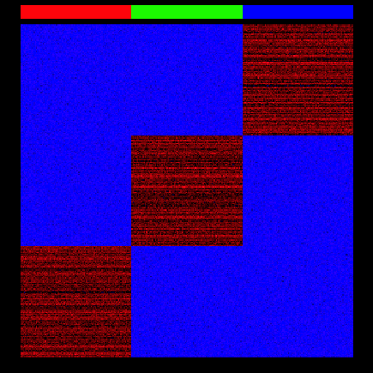
Why might this present a challenge? Let’s explore using a simulation!
https://jef.works/blog/2022/07/11/deconvolution-vs-clustering-2/

Slide 16
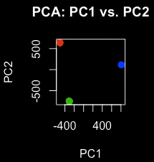
Why might this present a challenge? Let’s explore using a simulation!
https://jef.works/blog/2022/07/11/deconvolution-vs-clustering-2/

Slide 17
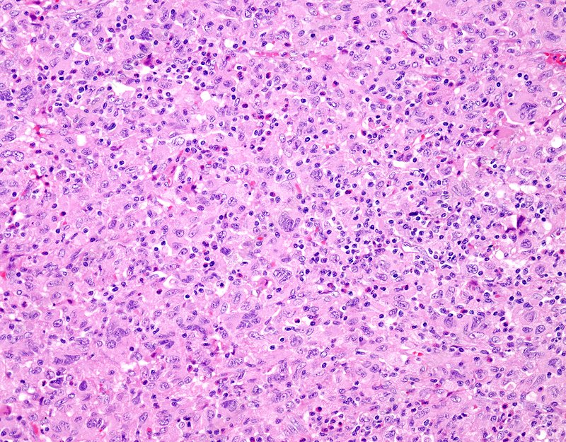
Why might this present a challenge? Let’s explore using a simulation!
https://jef.works/blog/2022/07/11/deconvolution-vs-clustering-2/

Slide 18
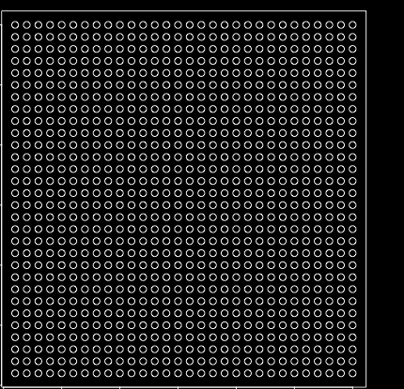
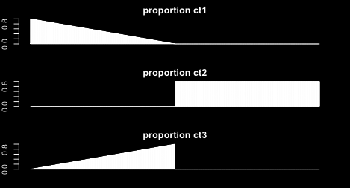
Why might this present a challenge? Let’s explore using a simulation!
https://jef.works/blog/2022/07/11/deconvolution-vs-clustering-2/

Slide 19
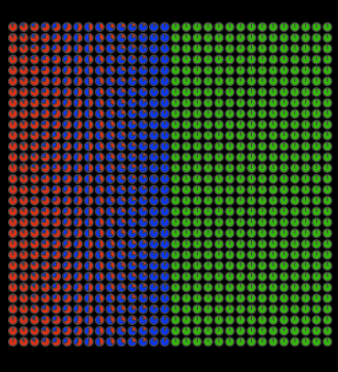
Why might this present a challenge? Let’s explore using a simulation!
https://jef.works/blog/2022/07/11/deconvolution-vs-clustering-2/

Slide 20
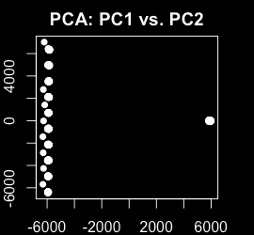
Why might this present a challenge? Let’s explore using a simulation!
https://jef.works/blog/2022/07/11/deconvolution-vs-clustering-2/

Slide 21
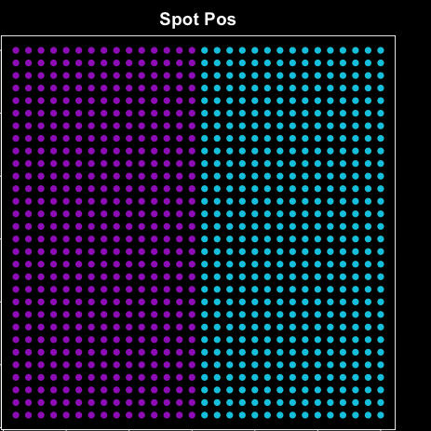
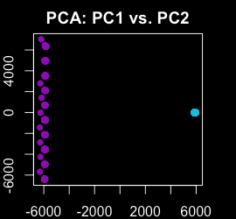
Why might this present a challenge? Let’s explore using a simulation!
https://jef.works/blog/2022/07/11/deconvolution-vs-clustering-2/

Slide 22
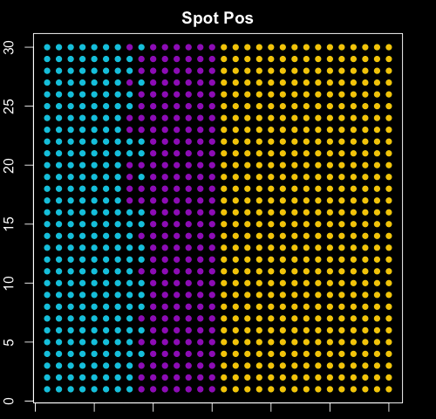
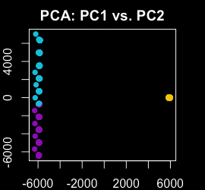
Why might this present a challenge? Let’s explore using a simulation!
https://jef.works/blog/2022/07/11/deconvolution-vs-clustering-2/

Slide 23
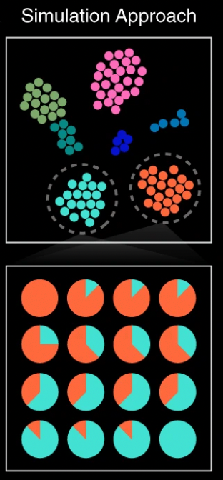
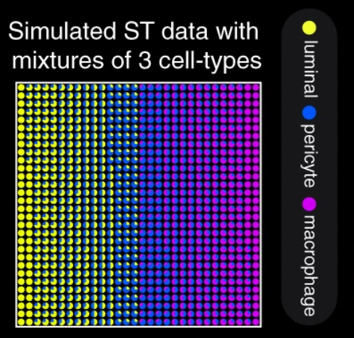
Cell-type mixtures confound transcriptional clustering analysis, impacting downstream biological interpretation
(Miller et al, Nature Communications April 2022)

Slide 24
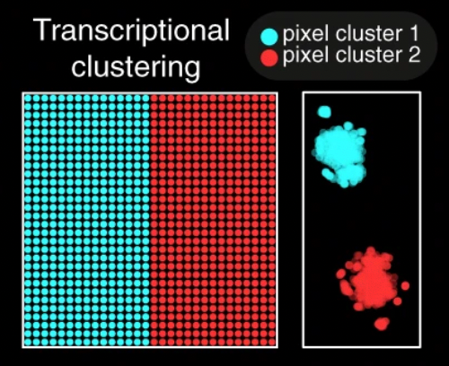
Cell-type mixtures confound transcriptional clustering analysis, impacting downstream biological interpretation
(Miller et al, Nature Communications April 2022)

Slide 25
What is “deconvolution”?
Common in signal processing

Slide 26
What is “reference-based deconvolution”?
 | Observed | Reference X | Reference Y
Gene A | 5 | 10 | 0
Gene B | 2.5 | 5 | 0
Gene C | 2.5 | 0 | 5
Gene D | 5 | 0 | 10
Observed = α * Reference_X + β * Reference_Y

Slide 27
What is the problem with reference-based deconvolution? Let’s explore using a simulated example
(Miller et al, Nature Communications, April 2022)

Slide 28
Performance of reference-based deconvolution of cell-type proportions depends on quality of reference transcriptomic profiles
(Miller et al, Nature Communications, April 2022)

Slide 29
What if we use “reference-based deconvolution” on this data?
 | Observed | Reference X | Reference Y
Gene A | 5 | 10 | 0
Gene B | 2.5 | 5 | 0
Gene C | 2.5 | 0 | 5
Gene D | 5 | 0 | 10
Observed = α * Reference_X + β * Reference_Y

Slide 30
What is “reference-free deconvolution”?
 | Observed1 | Observed2 | Observed3
Gene A | 5 | 10 | 0
Gene B | 2.5 | 5 | 0
Gene C | 2.5 | 0 | 5
Gene D | 5 | 0 | 10
…
If I tell you there are 2 cell-types, what is the most likely
- gene expression profile of these cell-types?
- cell-type proportions in each observed spot?

Slide 31
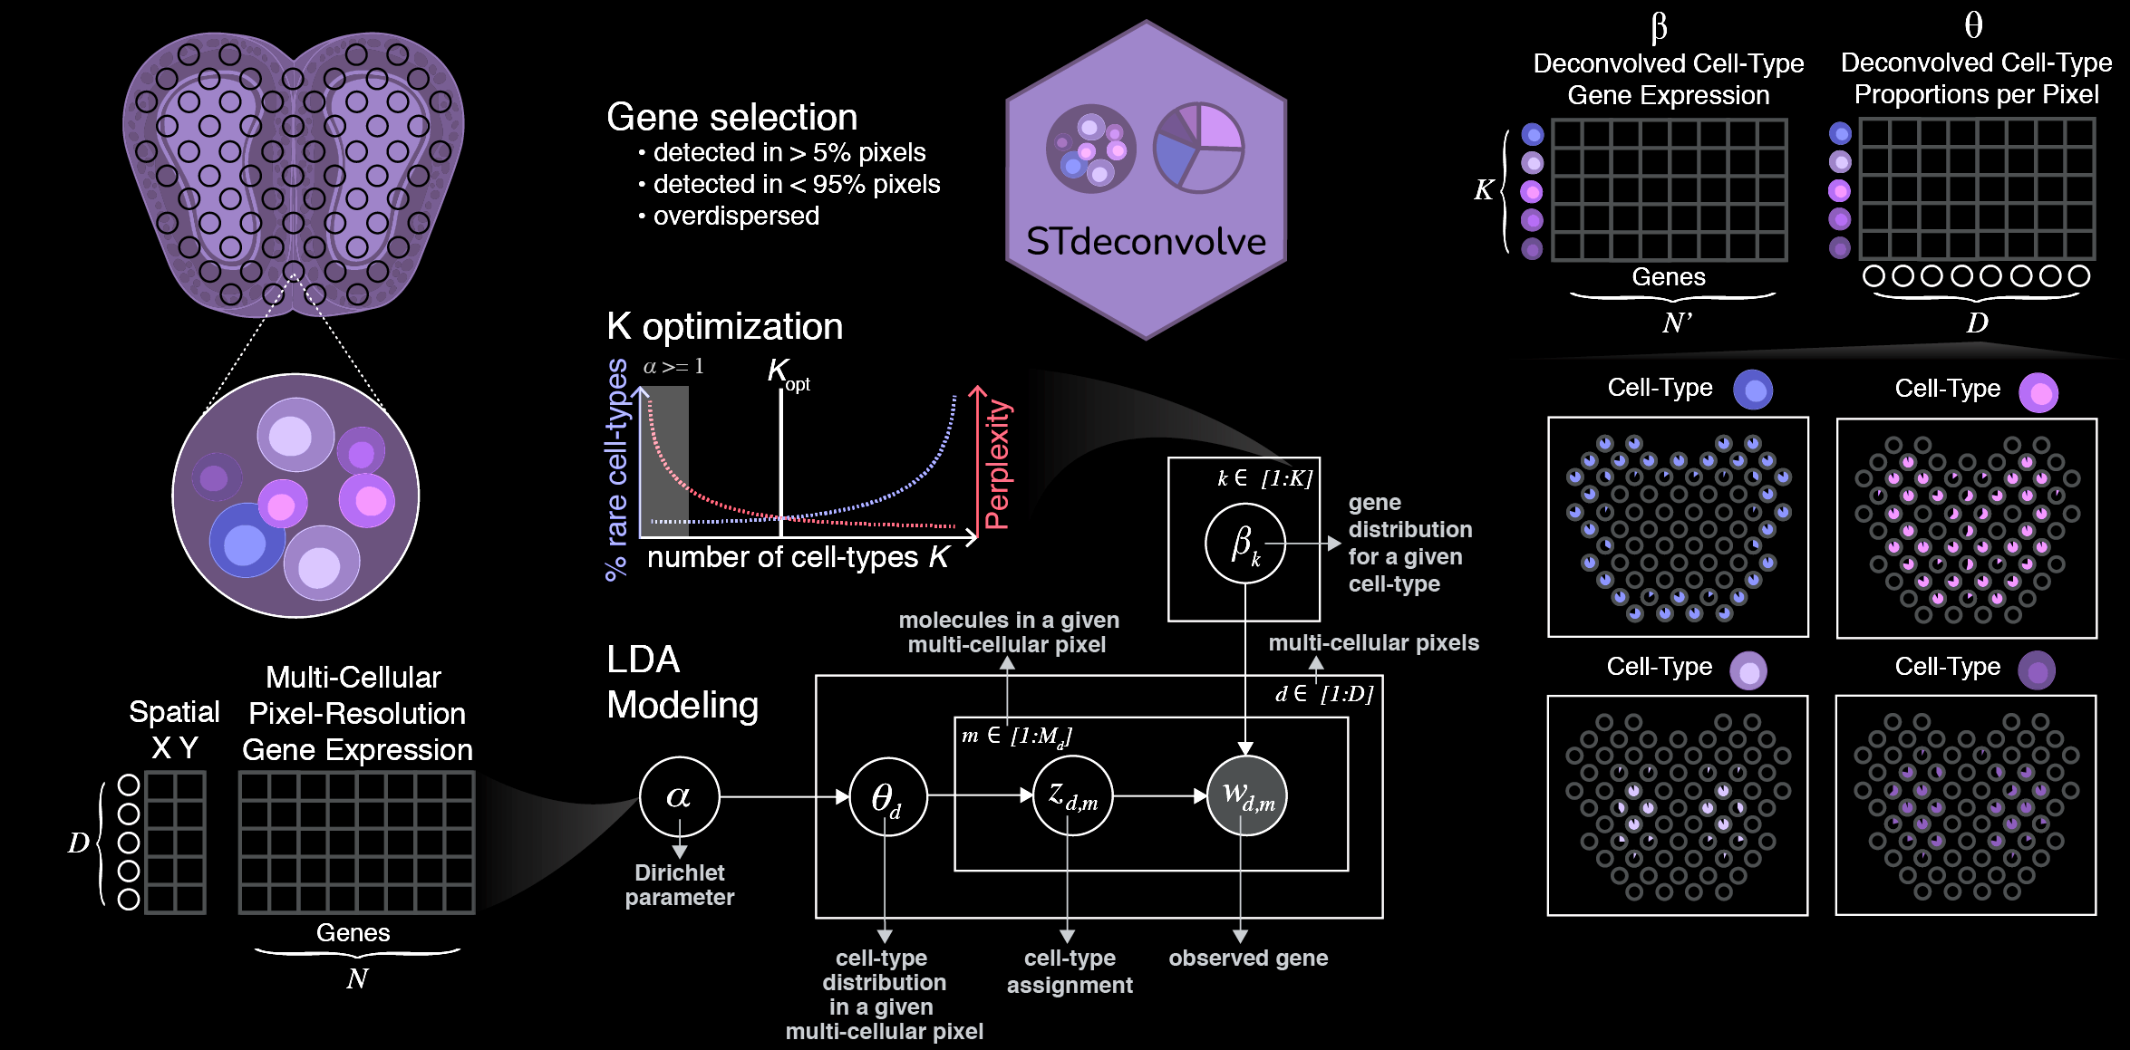
We developed STdeconvolve to recover cell-type-specific gene expression and proportions within multi-cellular pixels without reliance on external single-cell references
Brendan Miller
Feiyang Huang
Lyla Atta
Arpan Sahoo
(Miller et al, Nature Communications, April 2022)

Slide 32
STdeconvolve builds on Latent Dirichlet Allocation (LDA) to estimate cell-type specific gene expression profiles and cell-type proportions per pixel
(Miller et al, Nature Communications, April 2022)

Slide 33
STdeconvolve builds on Latent Dirichlet Allocation (LDA) to estimate cell-type specific gene expression profiles and cell-type proportions per pixel
Use word frequencies to infer the latent topics
Documents are mixtures of topics
Each document is a collections of words
topics are distributions over words
Blei et al. Journal of Machine Learning Research. (2003)
(Miller et al, Nature Communications, April 2022)
Notes:
Builds on a generative modeling approach called latent direchlet allocation (or LDA) commonly used for topic modeling
In the context of topic modeling, given a count matrix of words in documents,
LDA infers the distribution of words for different topics topic
and the distribution of topics in each document.
In the context of spatial transcriptomics data, given a count matrix of gene expression in multi-cellular pixels,
STdeconvolve builds on LDA to infer the distribution of genes for different cell-types (cell-type specific gene expression profiles)
and the distribution of cell-types in each multi-cellular pixel (cell-type proportions per pixel)

Slide 34
STdeconvolve builds on Latent Dirichlet Allocation (LDA) to estimate cell-type specific gene expression profiles and cell-type proportions per pixel
Use word frequencies to infer the latent topics
Use gene frequencies to infer the latent cell-types
Documents are mixtures of topics
Pixels are mixtures of cell-types
Each document is a collections of words
Each pixel has
gene counts
topics are distributions over words
cell-types are distributions
over genes
Blei et al. Journal of Machine Learning Research. (2003)
(Miller et al, Nature Communications, April 2022)
Notes:
Builds on a generative modeling approach called latent direchlet allocation (or LDA) commonly used for topic modeling
In the context of topic modeling, given a count matrix of words in documents,
LDA infers the distribution of words for different topics topic
and the distribution of topics in each document.
In the context of spatial transcriptomics data, given a count matrix of gene expression in multi-cellular pixels,
STdeconvolve builds on LDA to infer the distribution of genes for different cell-types (cell-type specific gene expression profiles)
and the distribution of cell-types in each multi-cellular pixel (cell-type proportions per pixel)

Slide 35
https://jef.works/blog/2022/07/11/deconvolution-vs-clustering-2/
(Miller et al, Nature Communications, April 2022)

Slide 36
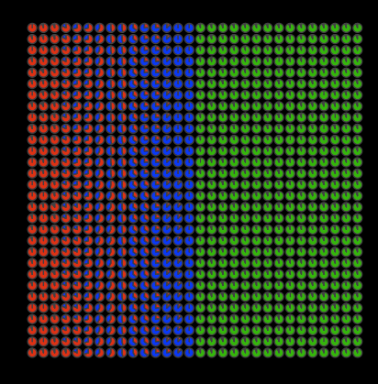
Clustering
STdeconvolve
https://jef.works/blog/2022/07/11/deconvolution-vs-clustering-2/
(Miller et al, Nature Communications, April 2022)

Slide 37
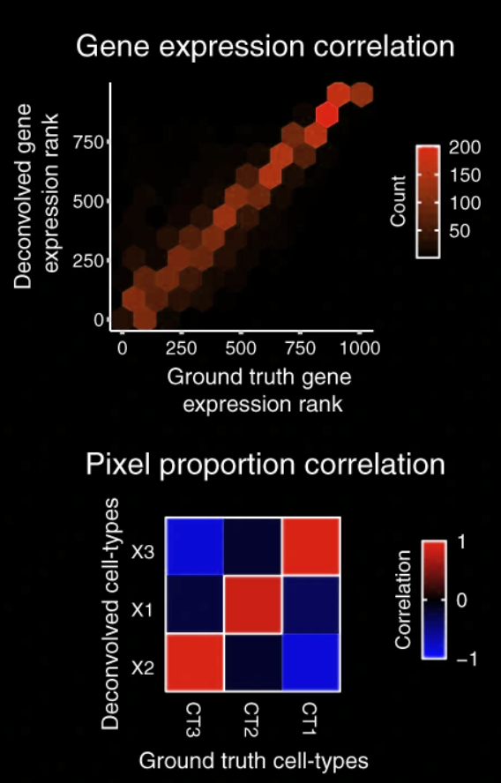
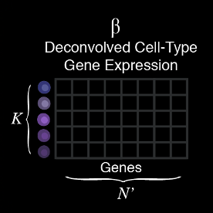
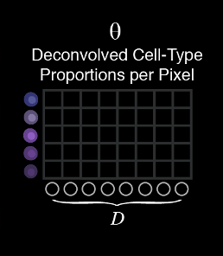
Deconvolution correctly resolved cell-type proportion mixtures and further provides correct cell-type-specific gene expression
(Miller et al, Nature Communications, April 2022)

Slide 38
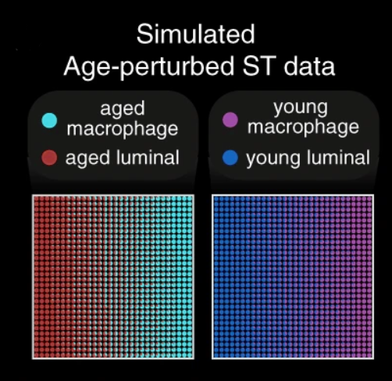
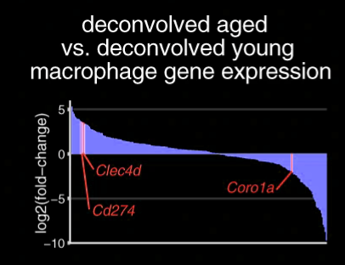
Reference-free deconvolution means we can recover gene signatures not found in references
(Miller et al, Nature Communications, April 2022)

Slide 39
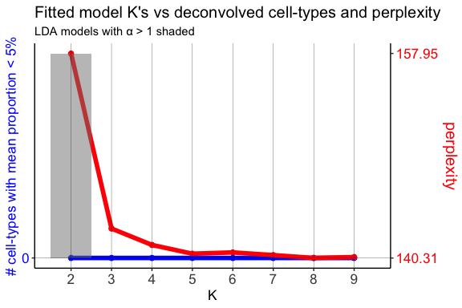
How do we pick the optimal number of cell-types to deconvolve K?

Slide 40
(Miller et al, Nature Communications, April 2022)

Slide 41
Clustering
STdeconvolve
(Miller et al, Nature Communications, April 2022)
Notes:
And this allows us to recover the cell-type spatial spatial organizational patterns

Slide 42
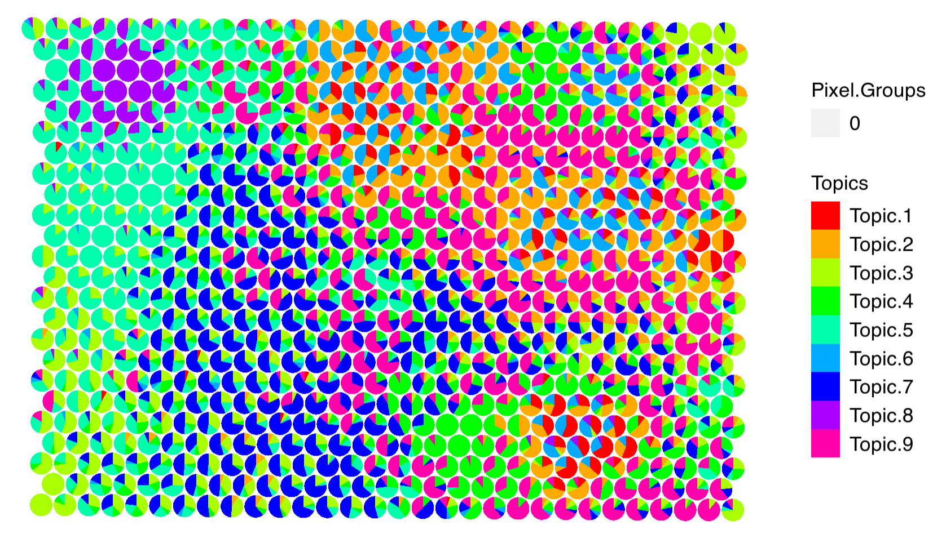
Hands-on component: Visualizing results from STdeconvolve require(remotes) remotes::install_github('JEFworks-Lab/STdeconvolve')
data <- read.csv('~/Desktop/genomic-data-visualization-2024/data/eevee.csv.gz', row.names=1)
head(data)
pos <- data[,2:3]
colnames(pos) <- c('x', 'y')
cd <- data[, 4:ncol(data)]
rownames(pos) <- rownames(cd) <- data$barcode
library(STdeconvolve)
## remove pixels with too few genes
counts <- cleanCounts(t(cd), min.lib.size = 100)
## feature select for genes
corpus <- restrictCorpus(counts, removeAbove=1.0, removeBelow = 0.05)
## choose optimal number of cell-types
ldas <- fitLDA(t(as.matrix(corpus)), Ks = seq(2, 9, by = 1))
## get best model results
optLDA <- optimalModel(models = ldas, opt = "min")
## extract deconvolved cell-type proportions (theta) and transcriptional profiles (beta)
results <- getBetaTheta(optLDA, perc.filt = 0.05, betaScale = 1000)
deconProp <- results$theta
deconGexp <- results$beta
## visualize deconvolved cell-type proportions
vizAllTopics(deconProp, pos,
r=8, lwd=0)
save(deconProp, deconGexp, pos, file="~/Desktop/genomic-data-visualization-2024/data/stdeconvolve.RData")

Slide 43
Reflection card
https://bit.ly/GDV24_rc

