Slide 1

Spatial Proteomics
Prof. Jean Fan

Slide 2
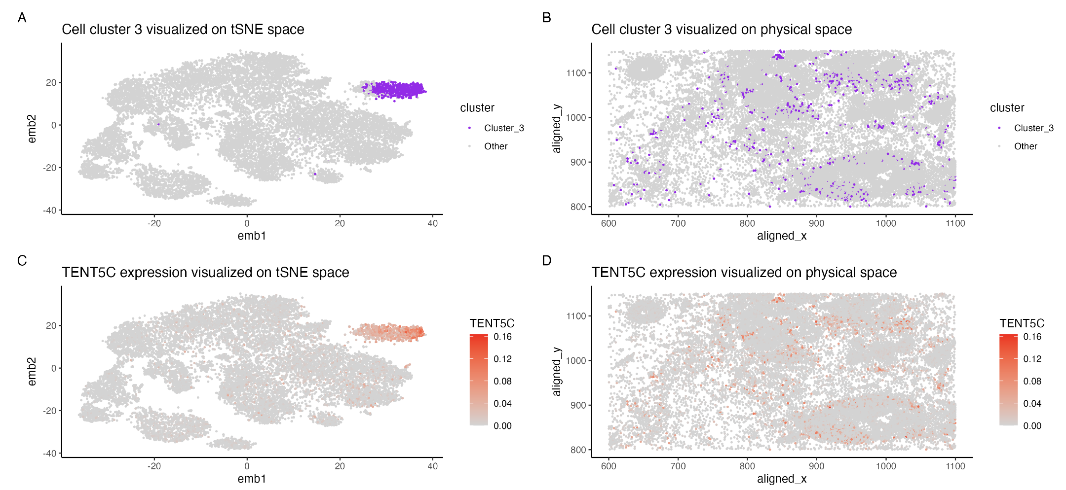
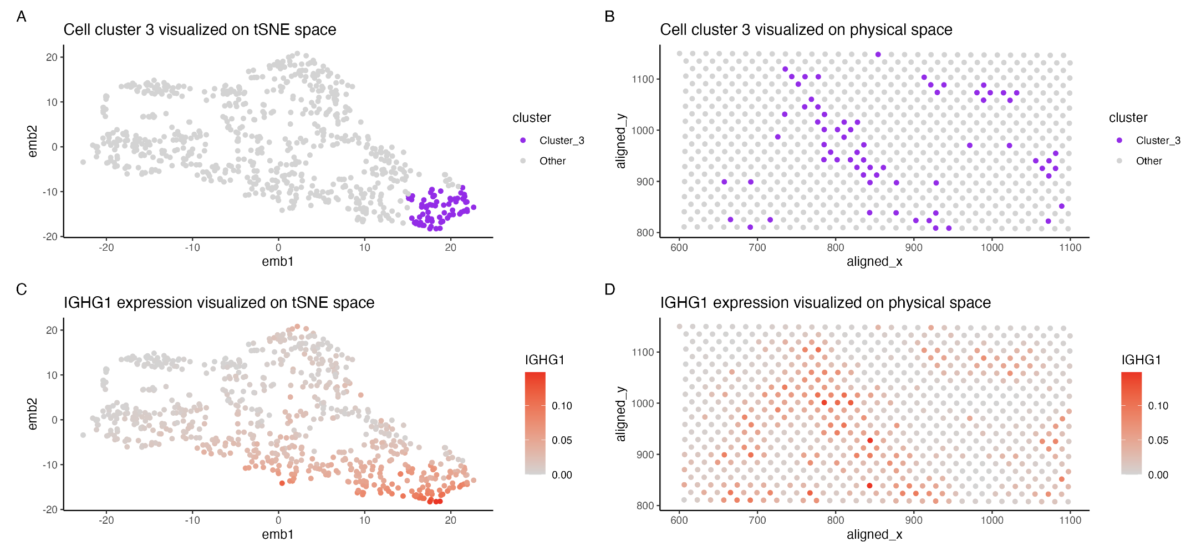

Homework tips: Your goal is to convince me that your cell-type interpretation is correct (actually being correct is not important here; your process and use of data visualization is key)
Single-cell resolution
Spot resolution

Slide 3
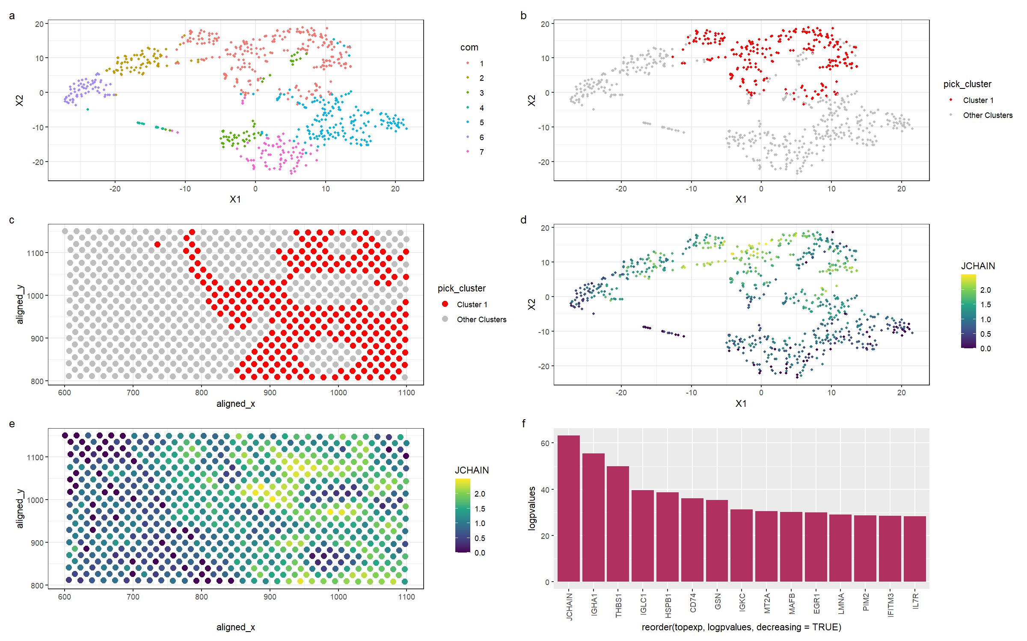
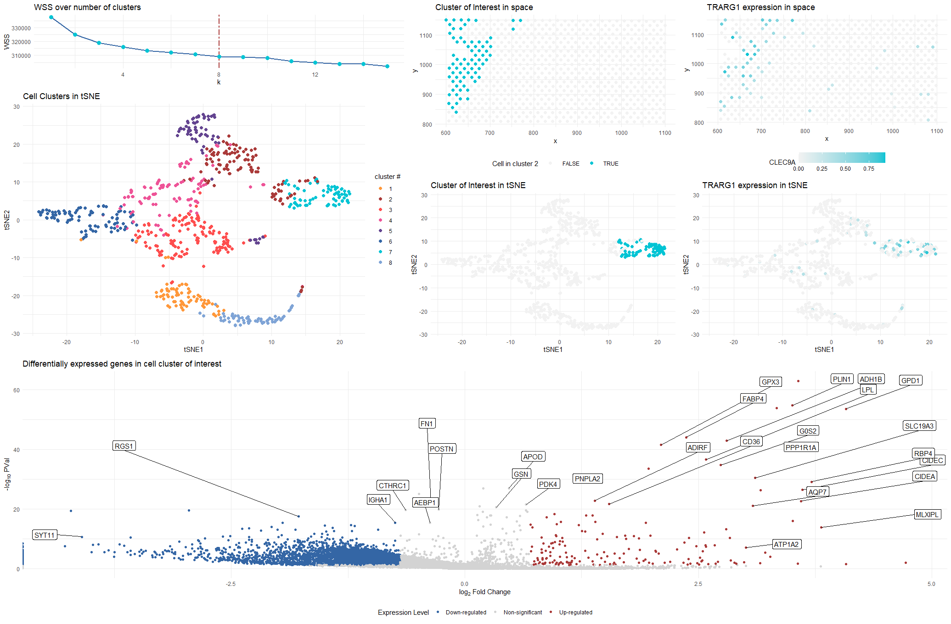
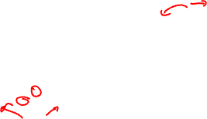
Homework tips: Your goal is to convince me that your cell-type interpretation is correct (actually being correct is not important here; your process and use of data visualization is key)

Slide 4
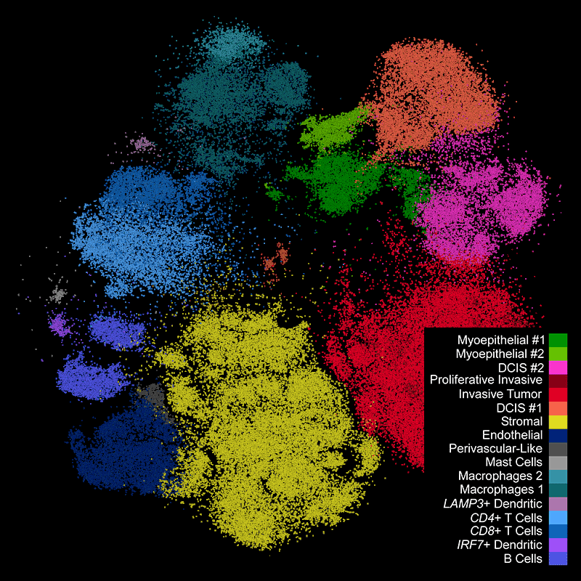

If you do want to know the “correct” answer: https://www.10xgenomics.com/products/xenium-in-situ/human-breast-dataset-explorer

Slide 5
Lesson Objectives
Learn about spatial proteomics
Analyze and visualize a spatial proteomics dataset

Slide 6
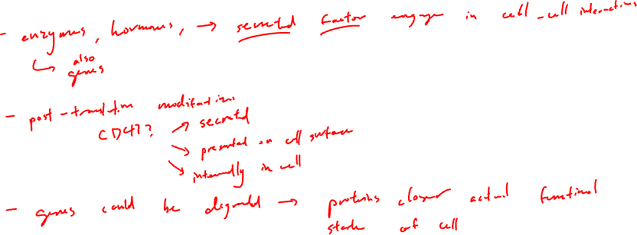
Why protein?

Slide 7
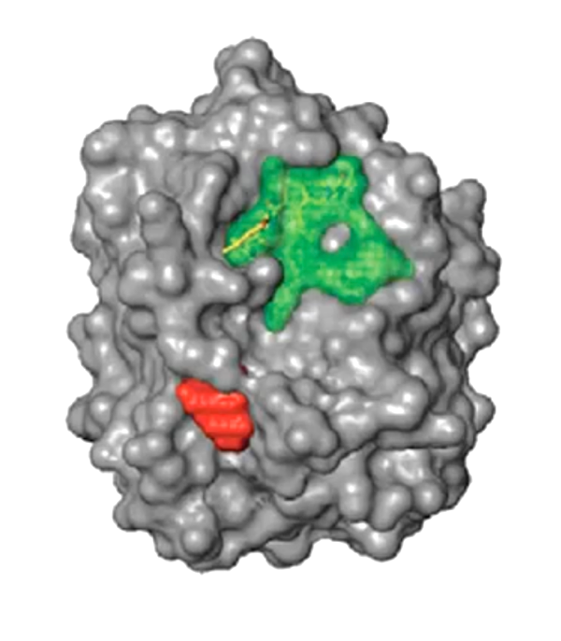
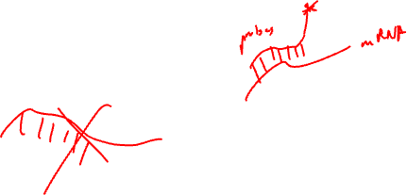
How can we detect proteins?
Protein
Epitope
(antigenic determinant)

Slide 8
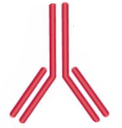
Protein epitopes can be identified with antibodies
(primary) Antibody

Slide 9
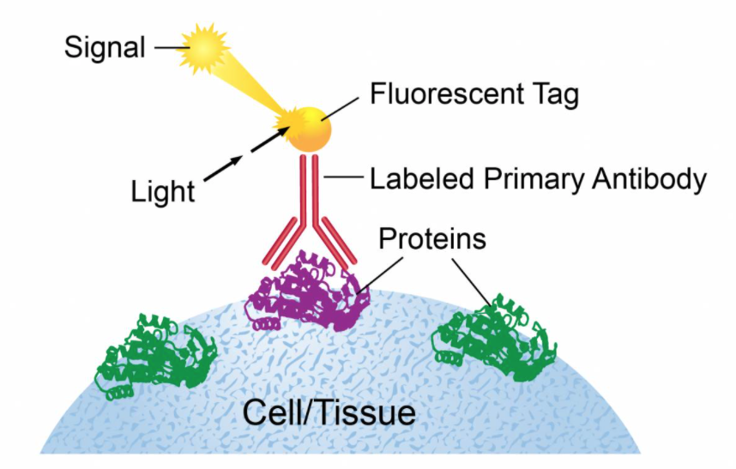
Ex. Immunofluorescence

Slide 10
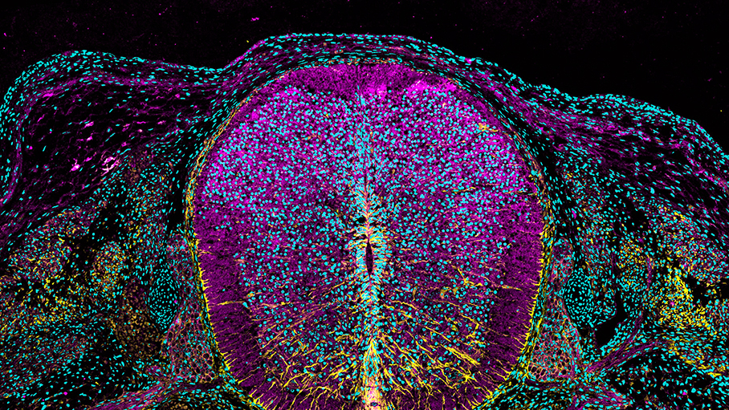
https://www.cell.com/pictureshow/immunofluorescence-ii
Vimentin (yellow)
N-cadherin (magenta)
Dapi (cyan)

Slide 11
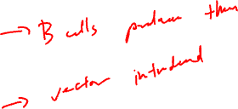
What are antibodies? How are they made?

Slide 12
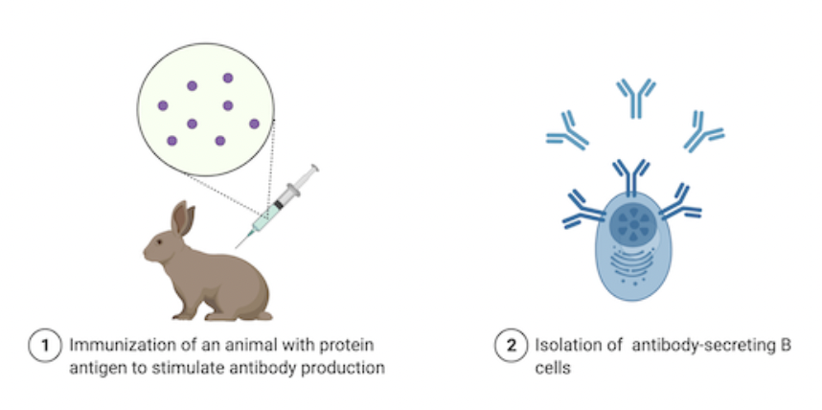
What are antibodies? How are they made?
Can stop here
but b-cells
are polyclonal
+ don’t live long
Source: https://blog.addgene.org/antibodies-101-monoclonal-antibodies

Slide 13
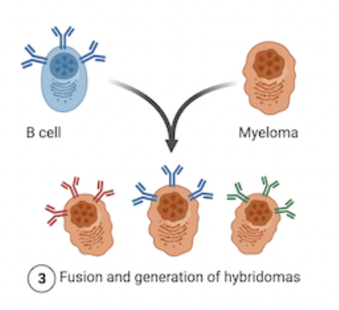
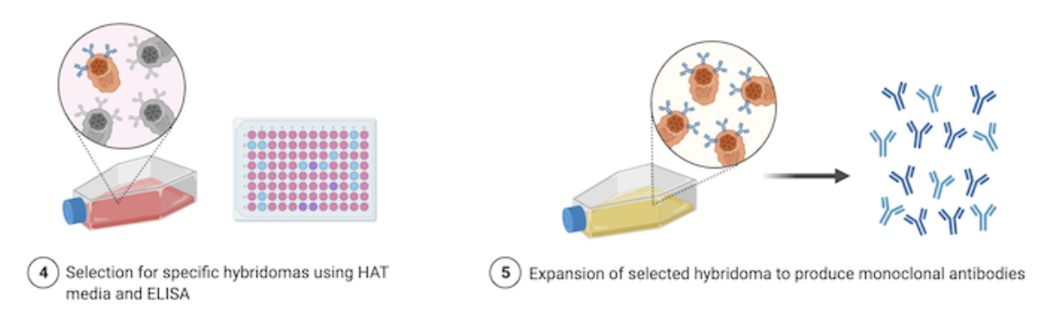

What are antibodies? How are they made?
1970s (Nobel Prize of 1984)
Source: https://blog.addgene.org/antibodies-101-monoclonal-antibodies

Slide 14
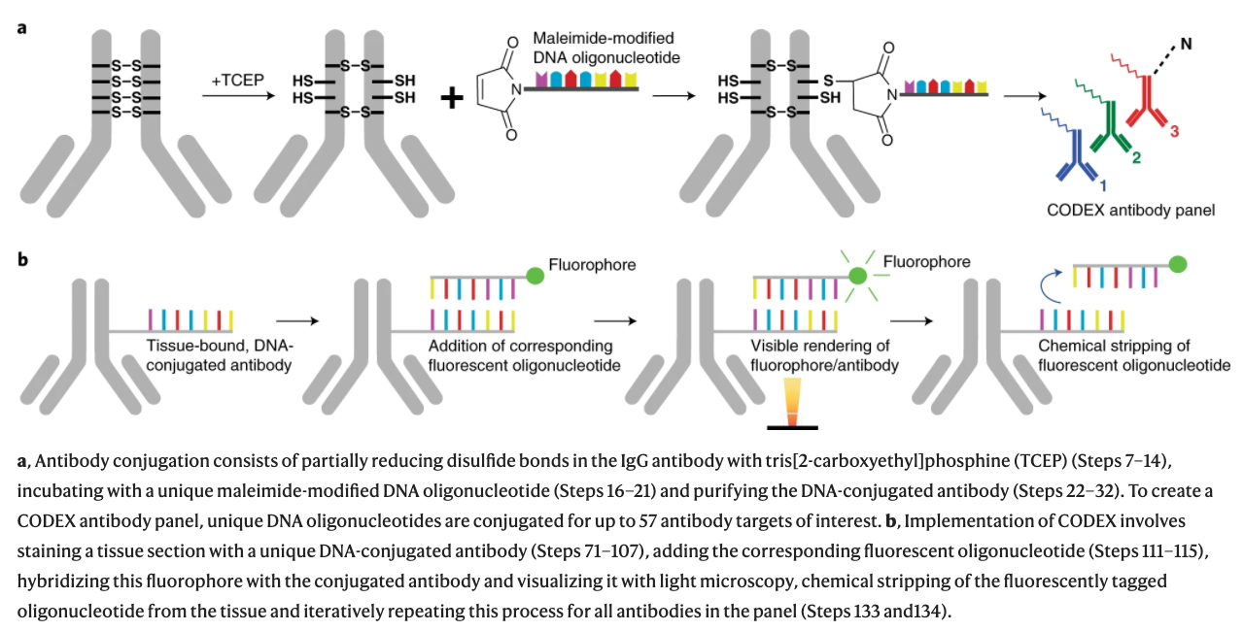

CODEX (CO-Detection by indEXing)
Dr. Gary Nolan at Stanford
Black, et al. Nat Protoc 2021

Slide 15

CODEX (CO-Detection by indEXing)
Dr. Gary Nolan at Stanford
Black, et al. Nat Protoc 2021

Slide 16
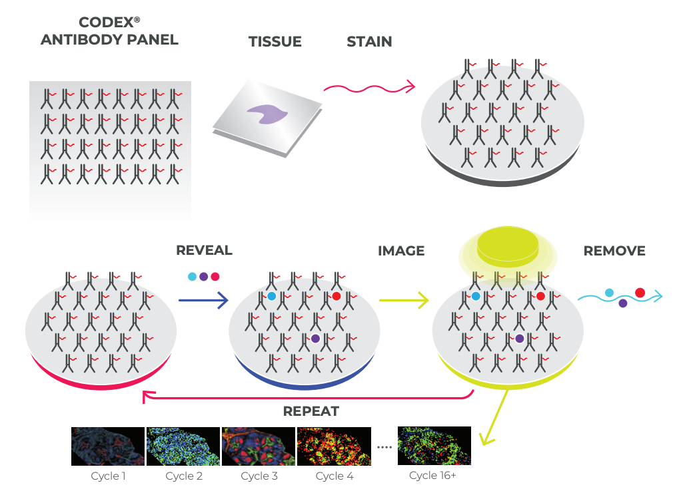
CODEX (CO-Detection by indEXing)
Akoya. Technical Note. Validation of CODEX Antibodies

Slide 17
CODEX (CO-Detection by indEXing)
~40 proteins
Akoya. Technical Note. Validation of CODEX Antibodies

Slide 18
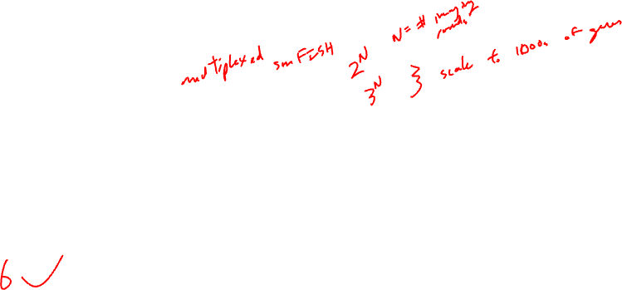
Practice
We want to measure 18 proteins in a tissue
Using CODEX with 3 colors, we can measure 3 proteins in each imaging round
How many rounds of imaging do we need to image all 18 proteins?

Slide 19

Practice
Recall: multiplexed smFISH useds a multiplexing scheme to increase the number of different genes that can be measured
Why do we not using multiplexing for proteins?

Slide 20
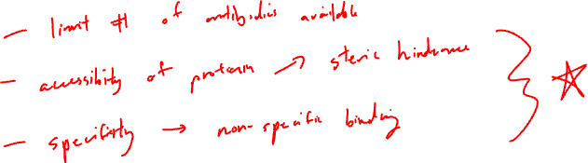
What are some potential challenges for characterizing the proteome?

Slide 21
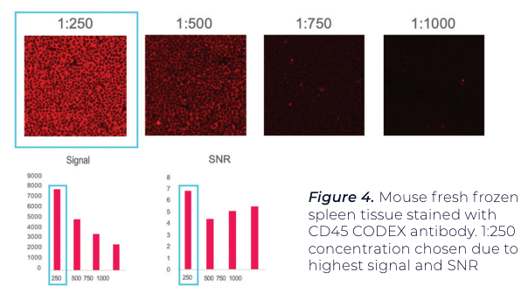
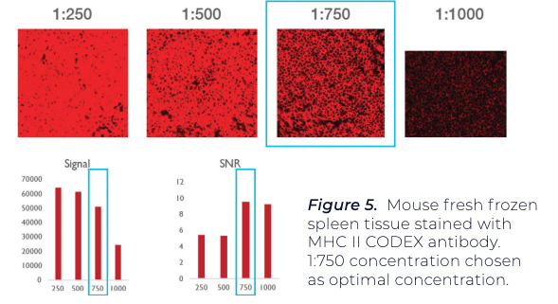

Antibody titration needed to minimize non-specific binding and improve signal to noise ratio
Using positive test tissue, maximize signal-to-noise ratio (SNR) and average signal.
A threshold is set for both signal and noise.
A binary map is used to confirm that pixels associated with signal and noise
Antibody A
Antibody B

Slide 22
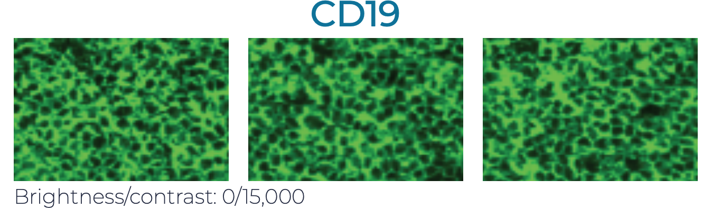
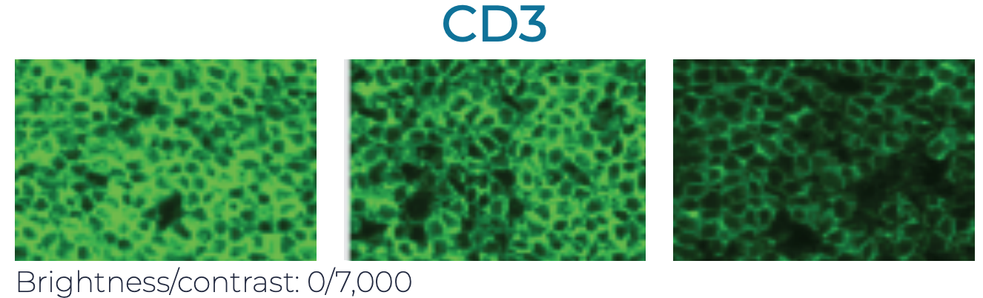

Antibodies may interfere with each other (steric hindrance)
  Even if it works well by itself, it may not give the same performance when used in combination with others. Therefore need to test:
  Individually
  In the presence of a few other antibodies (positive and negative counterstains)
  In the presence of many other antibodies
1
2
3

Slide 23
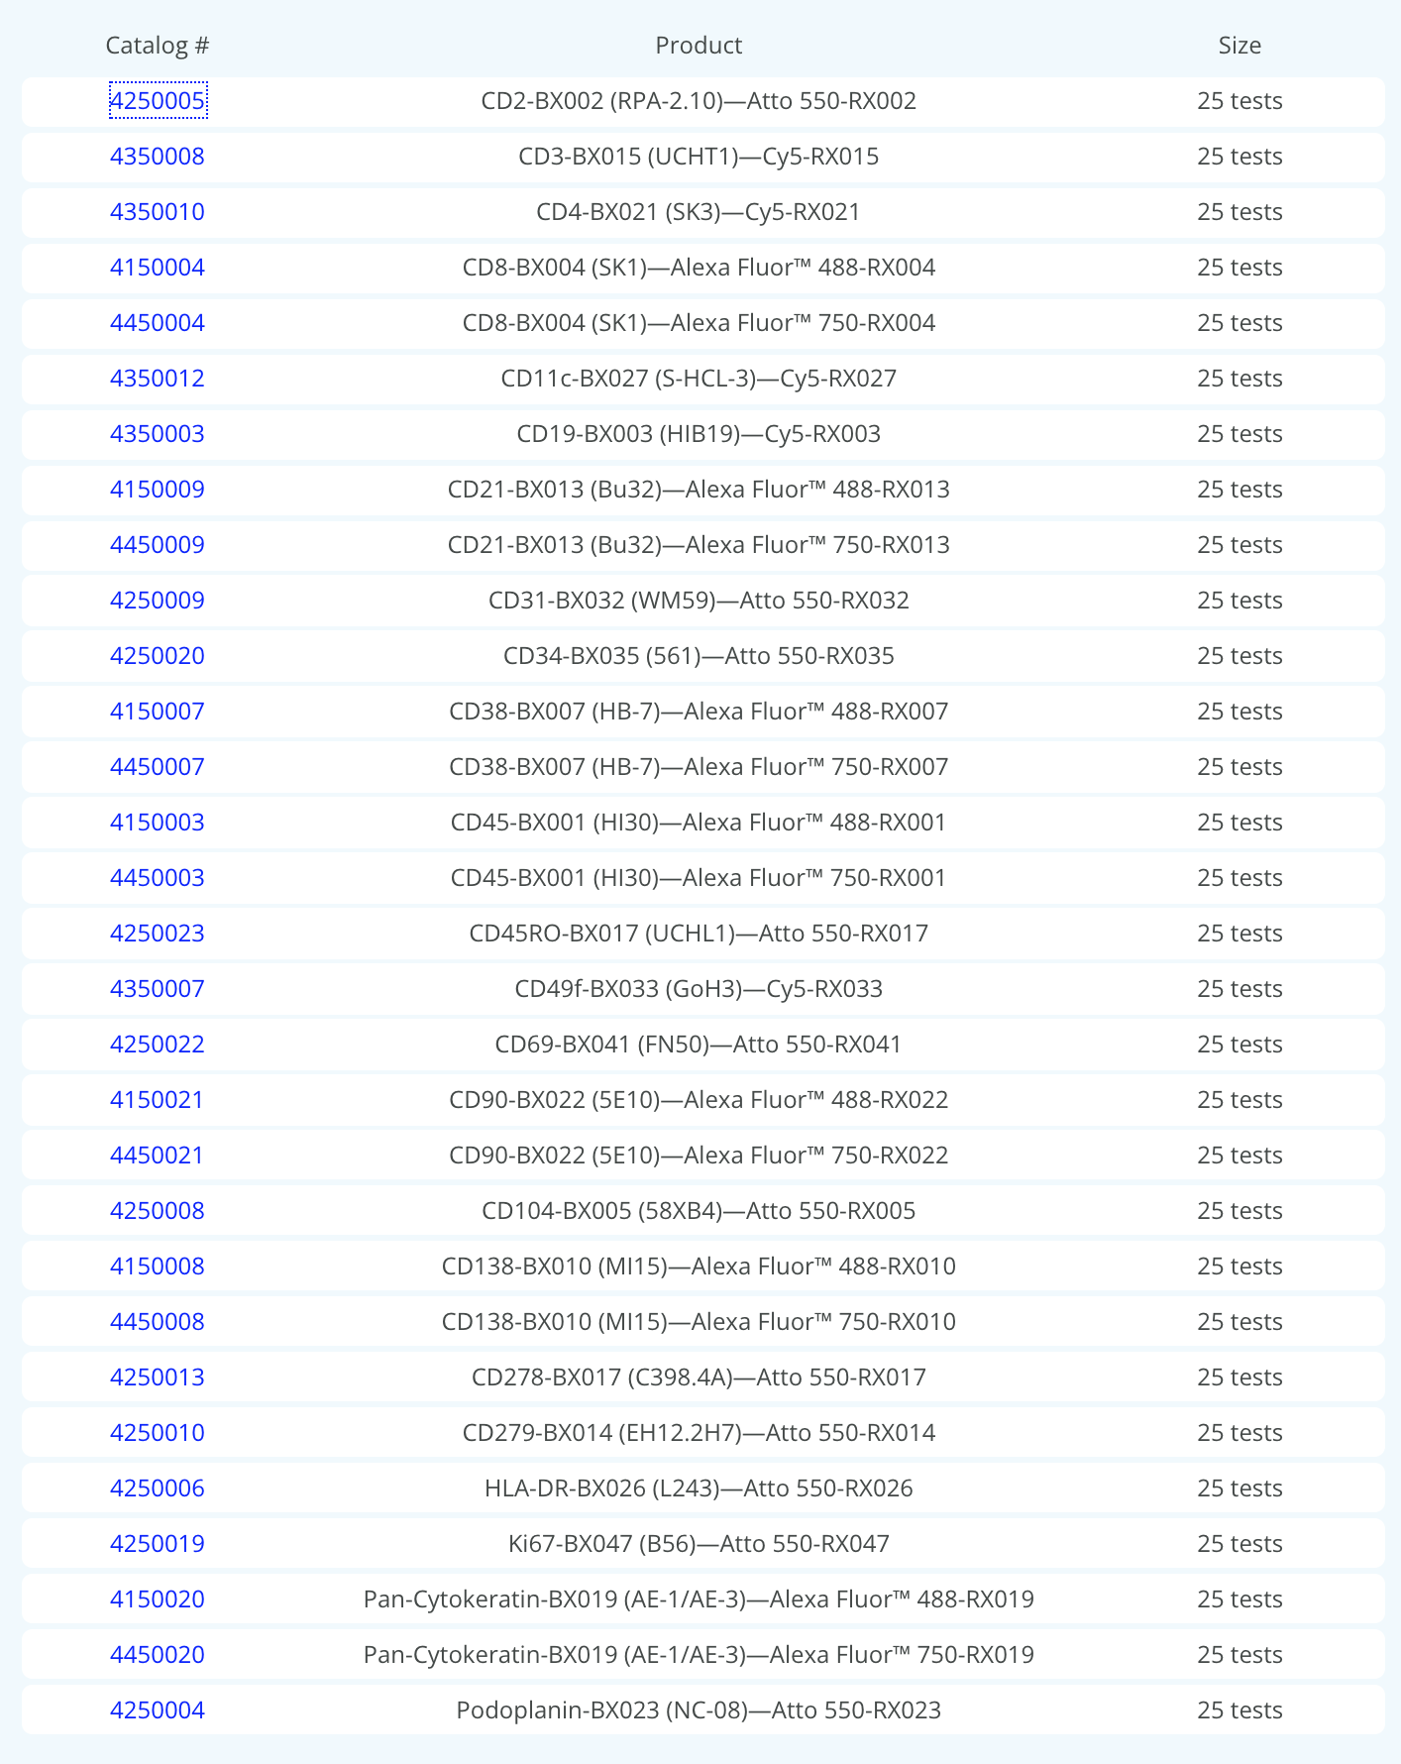
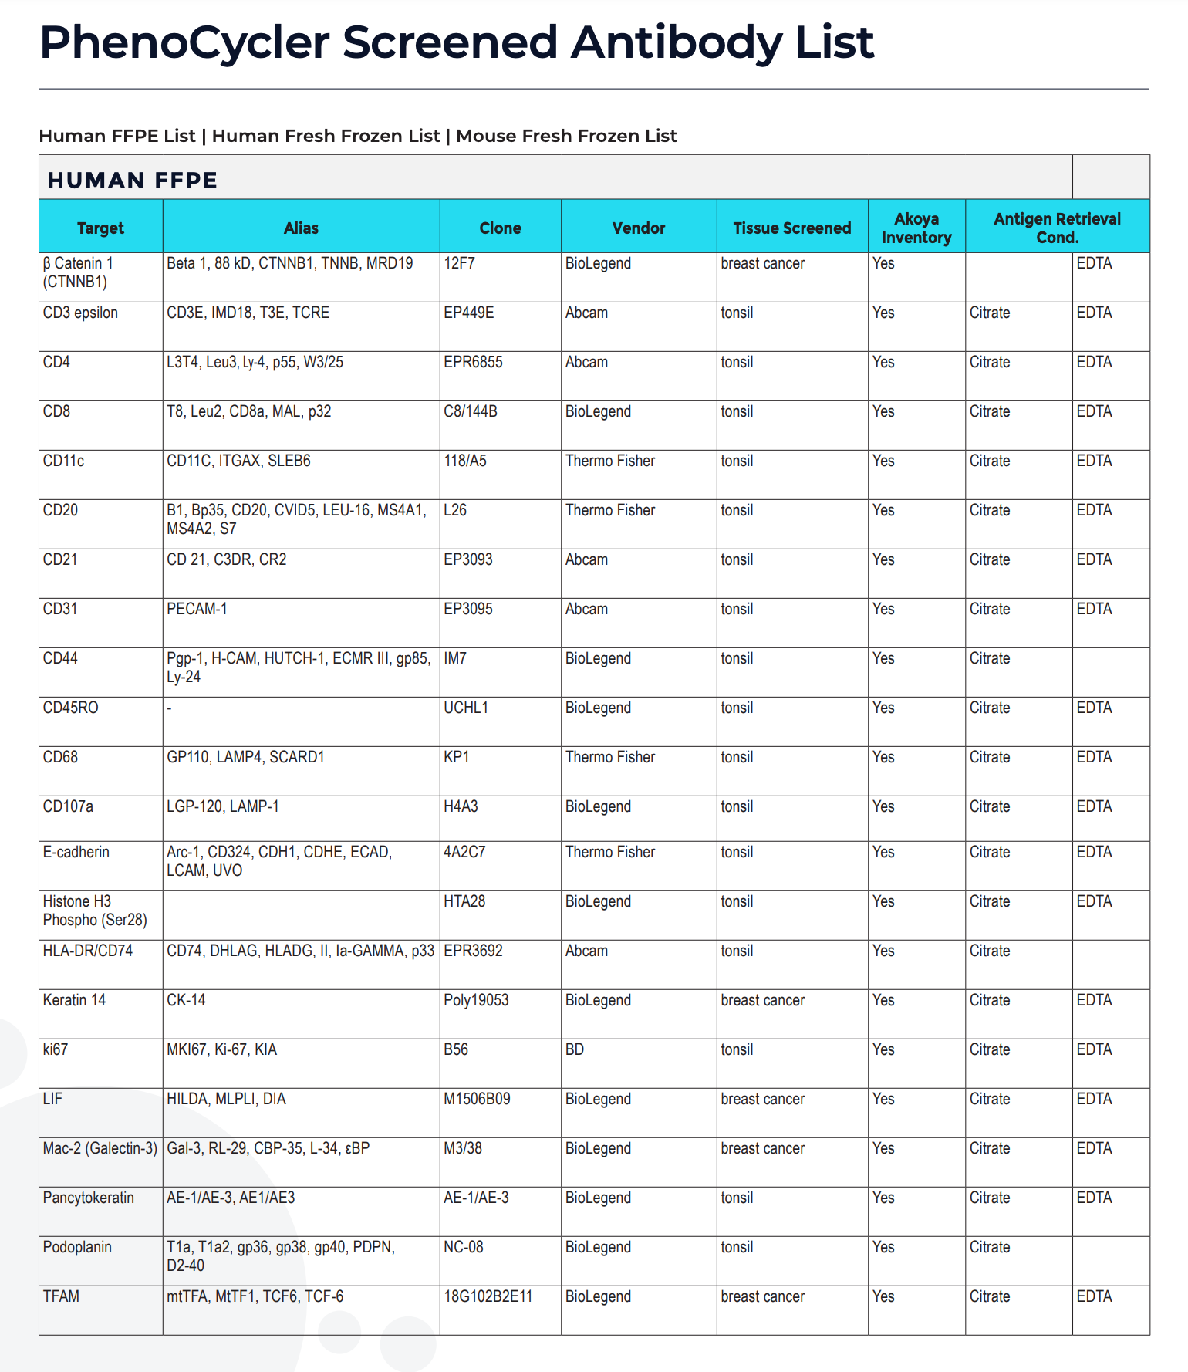
Antibodies for proteins of interest may not be available
~ 30 approved (work well together)
~ 300 screened (unclear if will work well together)
How many different proteins are in the proteome?
(on the order of)
Recall we have ~20k different RNAs
Notes:
80,000 to 400,000 proteins

Slide 24
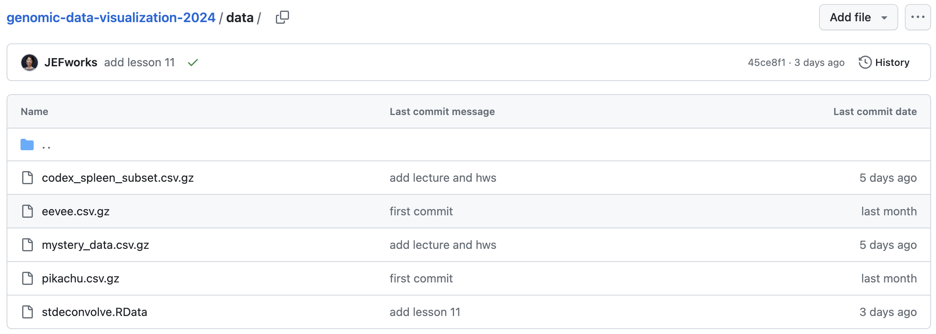
Today’s hands on component:
Look at spatial proteomics data
HW6: interpret multiple cell-types to figure out what we’re looking at (due Thursday night)

Slide 25
Reflection card
https://bit.ly/GDV24_rc

