Slide 1

Spatial epigenomics
Prof. Jean Fan

Slide 2
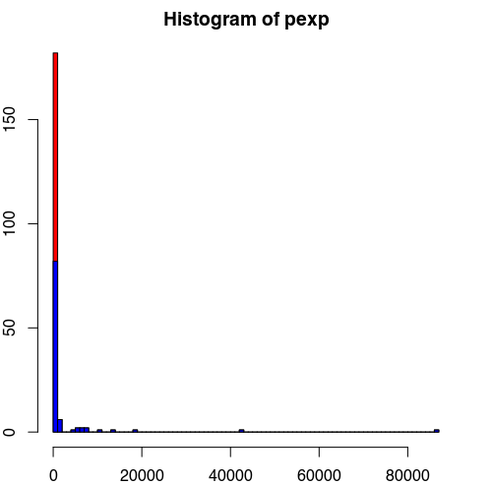
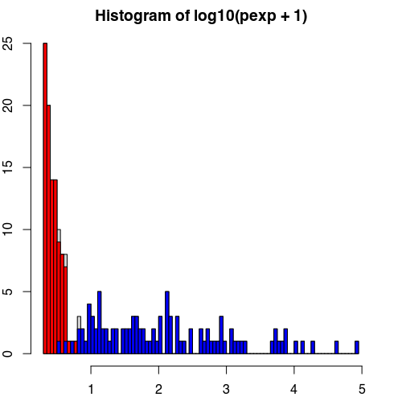

Why normalize data?
Improve signal to noise ratio, remove confounders

Slide 3
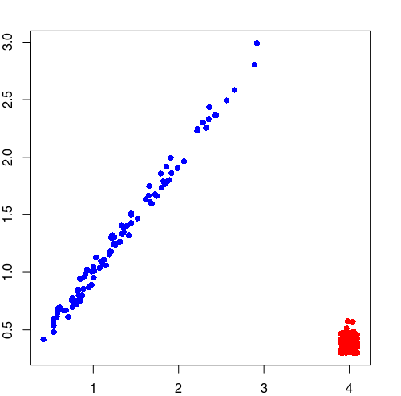
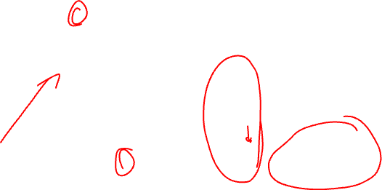
Why normalize data?
Improve signal to noise ratio, remove confounders
log10(pexp + 1)
area

Slide 4
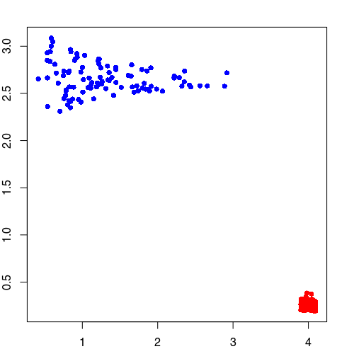
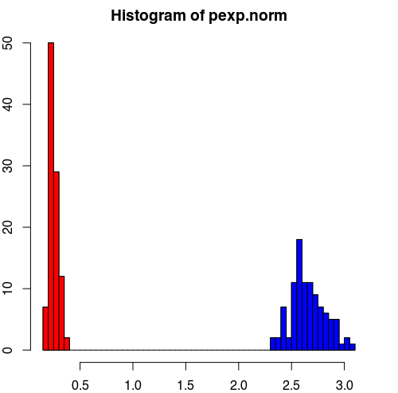
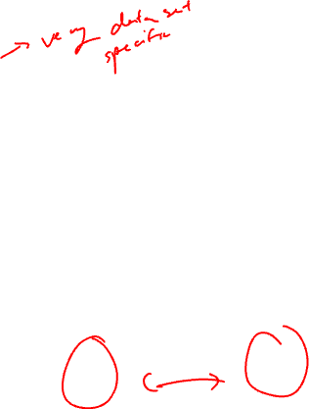
Why normalize data?
Improve signal to noise ratio, remove confounders
pexp.norm
area

Slide 5
Try out the simulation for yourself
set.seed(0)
pexp <- c(rnorm(100, 10, sd=10), rnorm(100, 100, sd=50))
pexp[pexp < 0] <- 0
pexp <- 1.03^pexp
col <- c(rep('red', 100), rep('blue', 100))
hist(pexp, breaks=100, col='red')
hist(pexp[col=='blue'], breaks=100, add=TRUE, col='blue')
hist(log10(pexp+1), breaks=100)
hist(log10(pexp+1)[col=='red'], breaks=10, add=TRUE, col='red')
hist(log10(pexp+1)[col=='blue'], breaks=100, add=TRUE, col='blue')
area = c(jitter(rep(4, 100), amount=0.1), jitter(log10(pexp[101:200]+1), amount=0.1))
plot(area, log10(pexp+1), col=col, pch=16)
pexp.norm <- log10(pexp+1)/area * mean(area)
plot(area, pexp.norm, col=col, pch=16)
hist(pexp.norm, breaks=100)
hist(pexp.norm[col=='red'], breaks=5, add=TRUE, col='red')
hist(pexp.norm[col=='blue'], breaks=15, add=TRUE, col='blue')

Slide 6
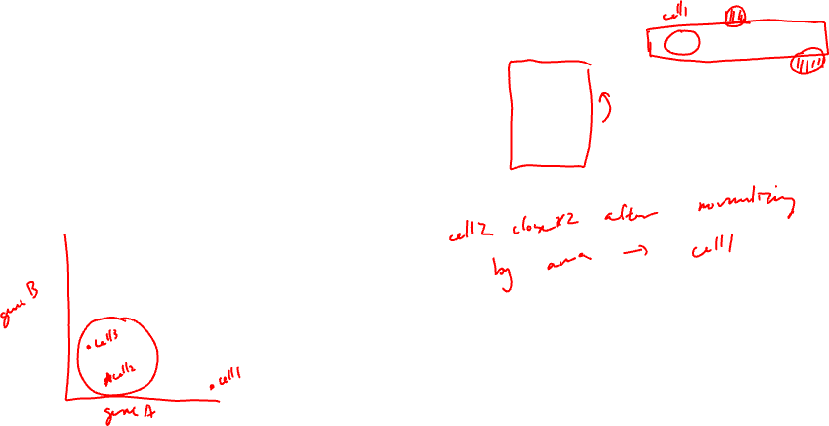
Should I normalize this data?
 | Gene A | Gene B | Cell Area
Cell 1 | 100 | 0 | 100
Cell 2 | 10 | 0 | 10
Cell 3 | 0 | 10 | 10

Slide 7
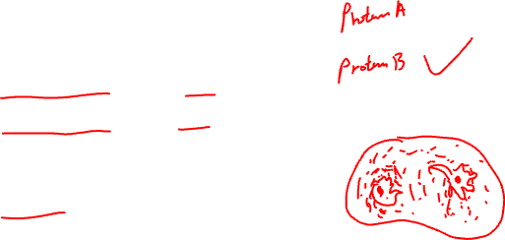
Practice question
GeneA and GeneB are upregulated in microglia, Prof. Fan’s cell-type of interest
GeneA encodes for a secreted protein ProteinA
GeneB encodes for a nuclear protein ProteinB
Good antibodies are available for both proteins
Prof. Fan wants to stain for one of these proteins to identify microglia in the brain and study their spatial organization
Which protein should she stain for and why?

Slide 8
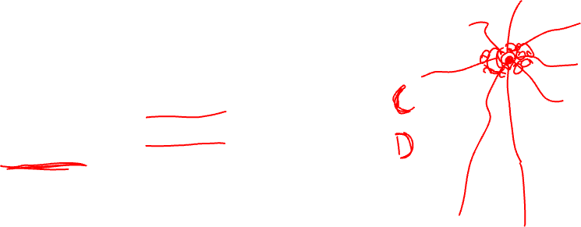
Practice question
GeneC and GeneD are upregulated in Purkinje neurons, Prof. Fan’s cell-type of interest
GeneC encodes for an axonal protein ProteinC
GeneD encodes for a nuclear protein ProteinD
Good antibodies are available for both proteins
Prof. Fan wants to stain for one of these proteins to identify Purkinje neurons in the brain and study their spatial organization
Which protein should she stain for and why?

Slide 9
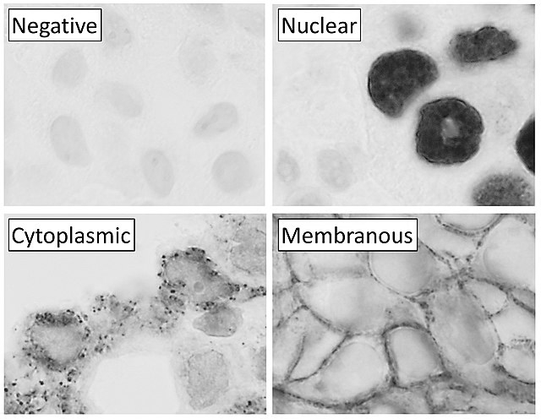


Slide 10
Lesson Objectives
Learn about spatial epigenomics
Analyze a new mystery dataset together

Slide 11
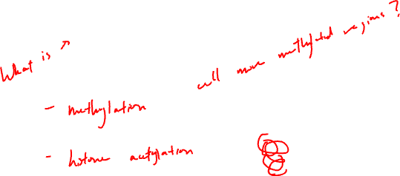
Why epigenetics?

Slide 12
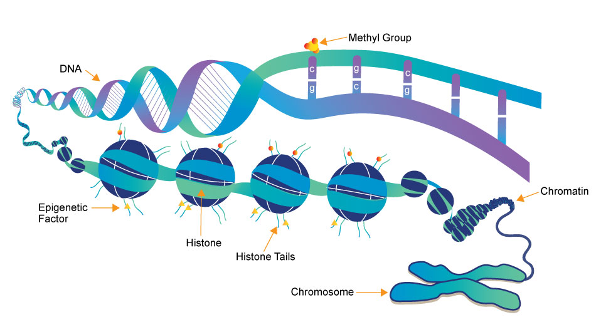
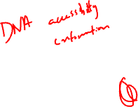
(a type of
protein)
Source: https://www.whatisepigenetics.com/fundamentals/

Slide 13
First: epigenetic profiling in a non-spatially resolved manner in bulk tissue

Slide 14
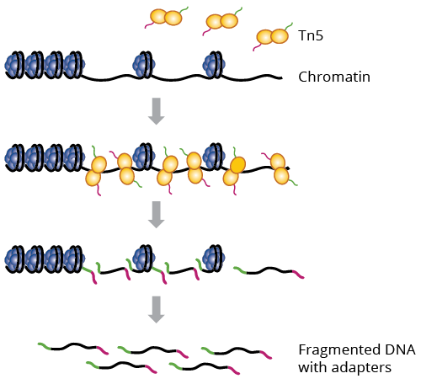
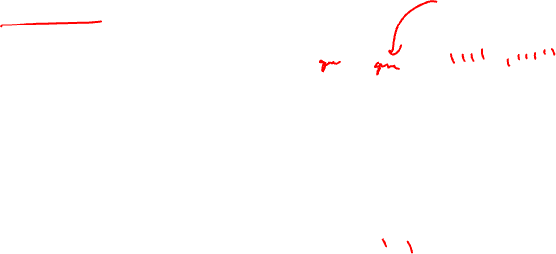
What parts of DNA are accessible for transcription?
ATAC-seq: Assay for Transposase-Accessible Chromatin using Sequencing
Why could this be interesting?
a genetically engineered hyperactive Tn5 transposase (2013) that simultaneously cuts open chromatin leaving a staggered nick and ligates sequencing adapters to these regions

Slide 15

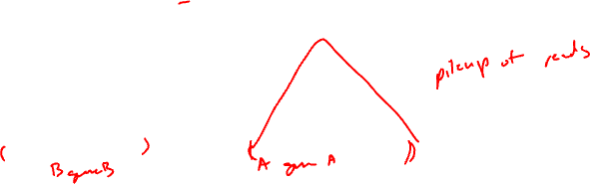
Interpreting ATAC-seq data
Sequence:
Alignment:
Genome

Slide 16

Visualizing ATAC-seq data
Cell-type A
Cell-type B
genes
Genome

Slide 17
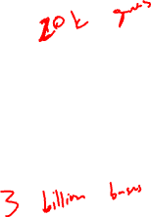
Food for thought
Many many RNA molecules are in a typical mammalian cell?
How many accessible regions are in the genome of a mammalian cell?
Notes:
Approximately 360,000 mRNA molecules are present in a single mammalian cell, made up of approximately 12,000 different transcripts with a typical length of around 2 kb.

Slide 18

Food for thought
If I want to sequence every RNA molecule, at least how many reads do I need to sequence?
If I want to sequence every accessible region, at least how many reads do I need to sequence?

Slide 19
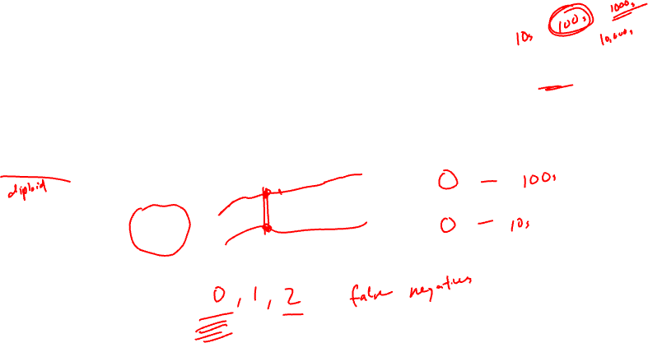
Food for thought
We’ve seen a range of measurements for gene expression (0 to X copies) in a single cell
What is the range of measurements you expect for accessibility data in a single cell?

Slide 20
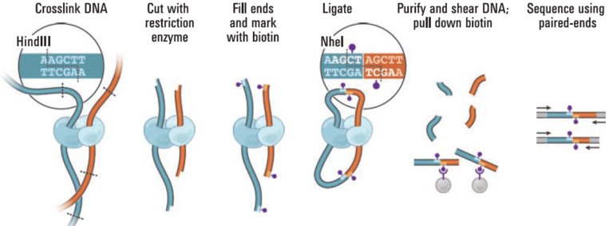

How is DNA organized in 3D? Which parts are touching?
Hi-C: chromosome conformation capture by high-throughput sequencing
Why could this be interesting?
Source: https://www.science.org/doi/10.1126/science.1181369

Slide 21

Interpreting Hi-C data
Sequence:
Alignment:
Genome

Slide 22
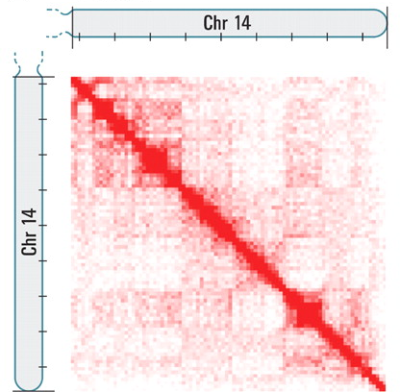
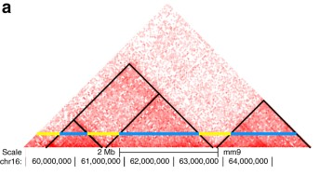
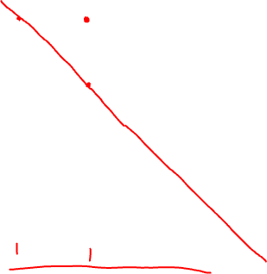
Visualizing Hi-C data
Source: https://www.nature.com/articles/s41467-017-02386-3

Slide 23
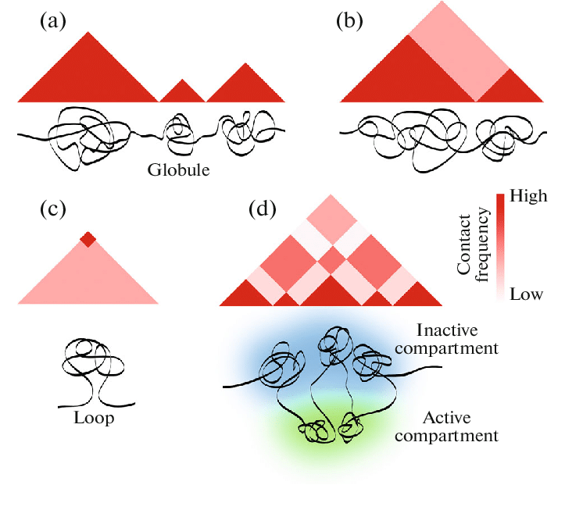
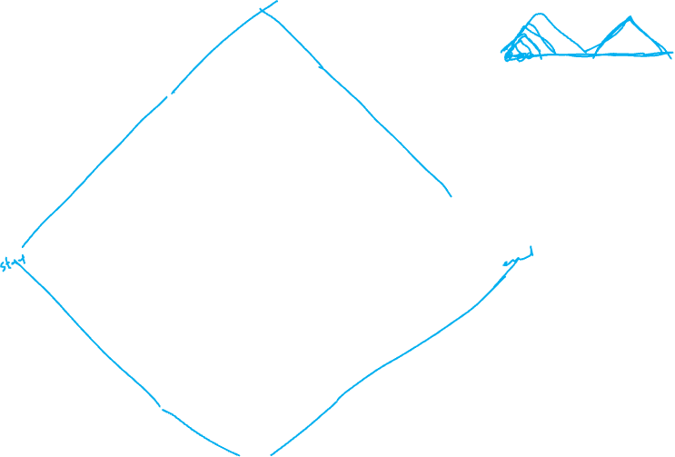
Interpreting Hi-C data visualizations
One chromosome

Slide 24
Interpreting Hi-C data visualizations
One chromosome

Slide 25
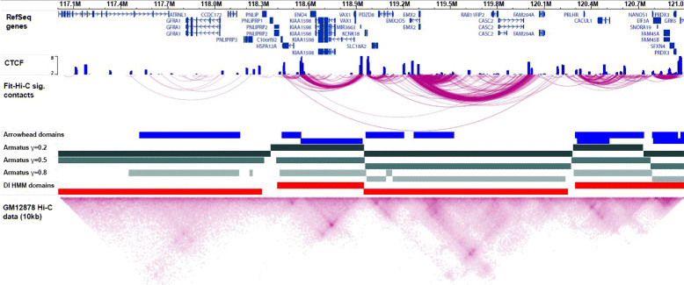
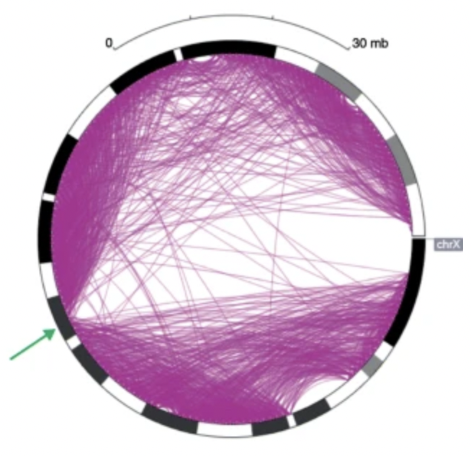

Other visualizations people have made
A
C
B

Slide 26
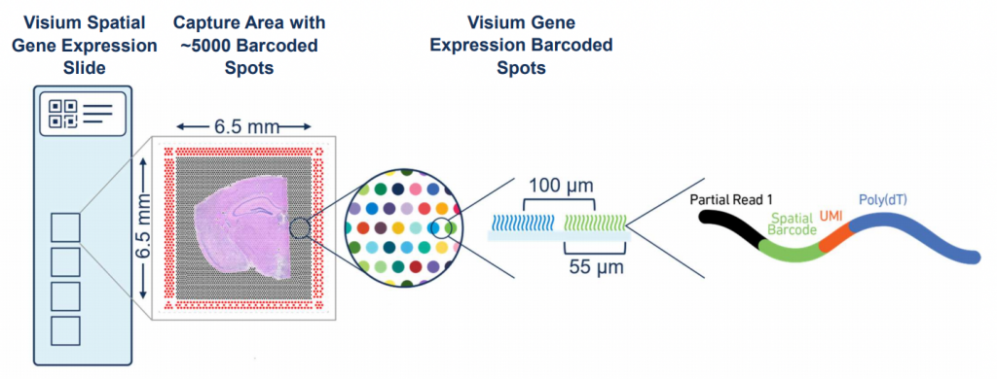
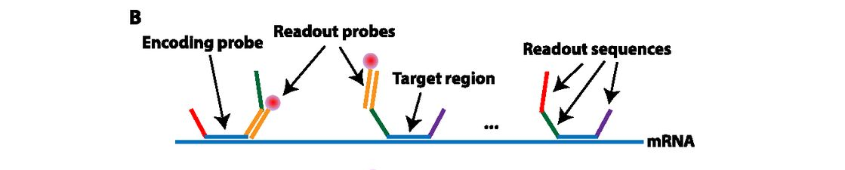
How do we get to spatially resolved?
Sequencing?
Imaging?

Slide 27
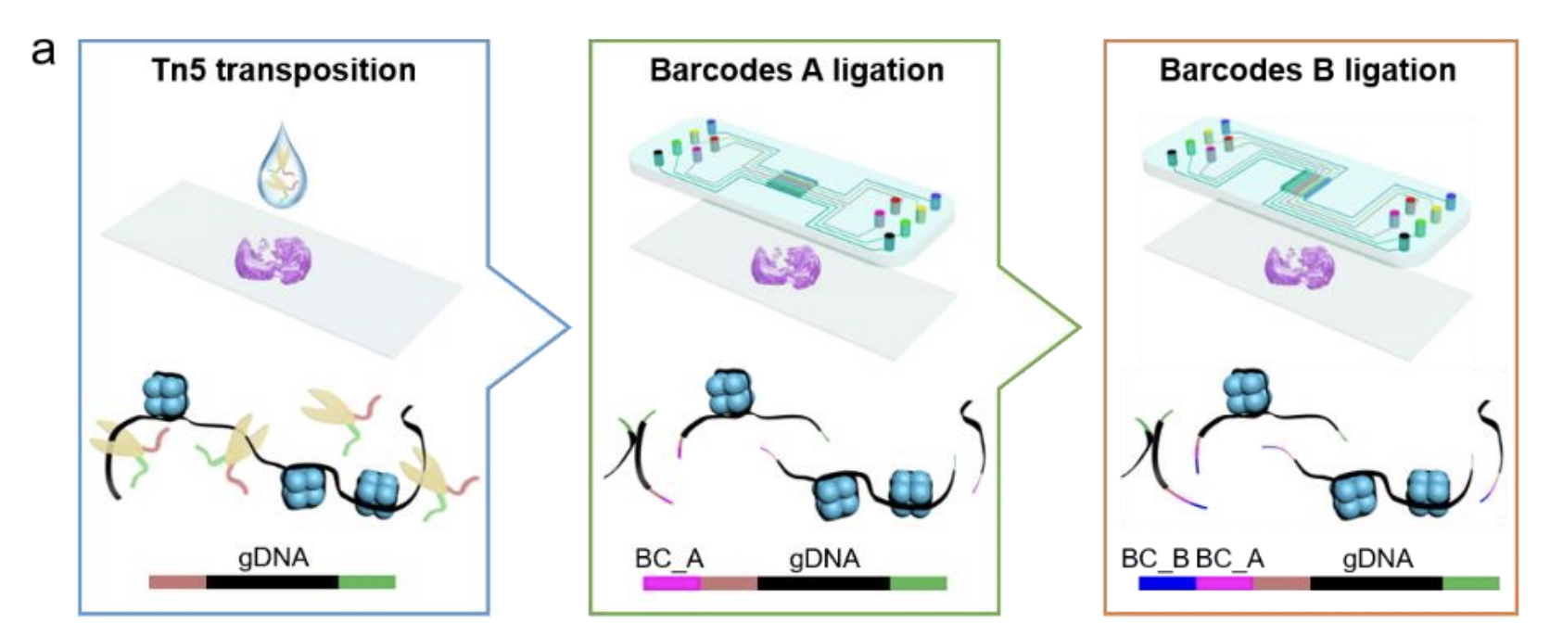
Getting to spatially resolved by sequencing (spatial ATAC-seq via DBiT-seq)
Source: https://www.biorxiv.org/content/10.1101/2021.06.06.447244v1

Slide 28
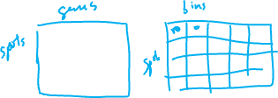
Spatial ATAC-seq
Still get count and position matrix
Instead of spot by gene, we get spot by DNA region
In theory, we can cluster and do all the same analyses as spatial transcriptomics

Slide 29
Practice Question
In spatial transcriptomics analysis, clusters of cells are transcriptionally similar (express similar genes). What do these spatial ATAC-seq clusters mean?

Slide 30
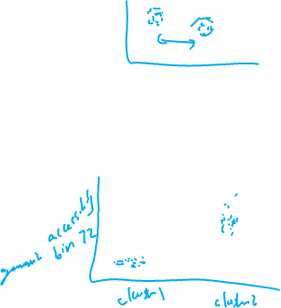
Practice Question
In spatial transcriptomics analysis, differential testing could help us identify which genes were upregulated in clusters. Can we do differential testing with ATAC-seq?
How would you interpret the results?

Slide 31
Food for thought
In spatial proteomics, we talked about how if we don’t titrate antibodies appropriately, we can get a lot of non-specific binding resulting in false positives (detecting proteins where there are none)
Are we more likely to get false positives or false negatives with spatial atac-seq?

Slide 32
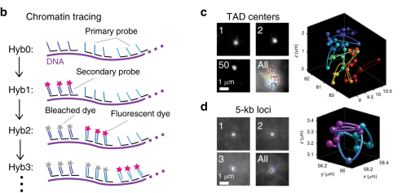

Getting to spatially resolved DNA conformation by imaging
Source: https://www.nature.com/articles/s41467-020-16732-5

Slide 33
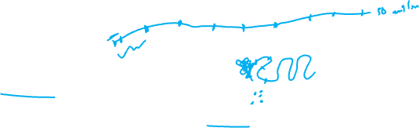
Practice question
Chromosome 19 is ~50 million base pairs
From multiplexed smFISH, we can measure 2^10-1 unique RNA species across 10 rounds of imaging
If I wanted to use multiplexed smFISH to use 10 rounds of imaging to trace out unique regions evenly spaced along chromosome 19 to determine its conformation, what resolution can I trace out chromosome 19?
  Can I tell if base pair 1,000,059 is touching 2,002,394 but not 1,000,238?
Notes:
5 kb resolution

Slide 34
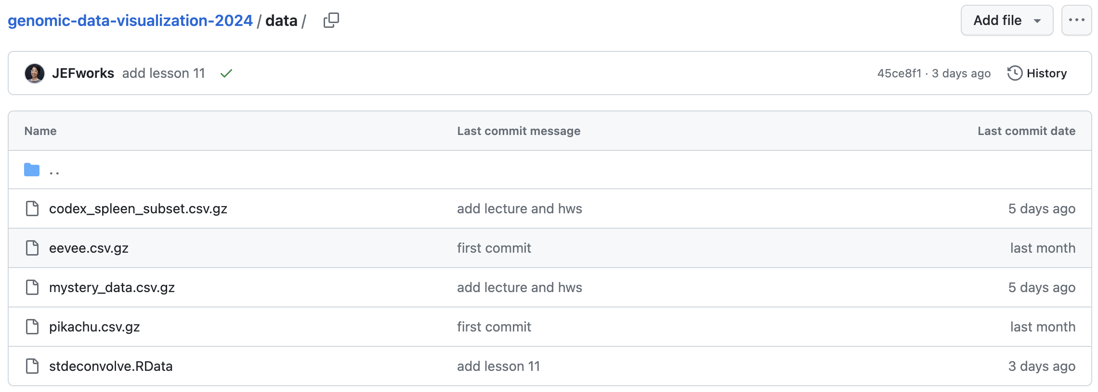
Today’s hands on component:
Interpret a mystery dataset together

Slide 35
Reflection card
https://bit.ly/GDV24_rc
Virtual Office Hours today and Friday
Email Rafael to schedule

