Slide 1
EN.580.428 Genomic Data Visualization Lesson 14 Review II
Prof. Jean Fan

Slide 2
Technologies

Slide 3
Multiplexed smFISH

Slide 4
DNA conformation
Source: https://www.nature.com/articles/s41467-020-16732-5

Slide 5
Proteomics
Dr. Gary Nolan at Stanford
Black, et al. Nat Protoc 2021

Slide 6
Use antibody for endoplasmic reticulum (ER) and combine with multiplexed smFISH to address what mRNAs are localized to the ER
ER-specific oligo-antibody labeling
(Xia*, Fan*, Emanuel*, et al PNAS 2019)
Notes:
First see if we could identify what mRNA are localized to the ER
The translation of mRNAs that encode secreted, glycosylated, and/or transmembrane proteins, collectively termed the secretome, has been shown to take place on the rough ER
We have prior expectation that these mRNAs by virtue of being cotrnaslationally transported, should be found on the ER
Provides us with a positive control to assess whether we are able to recapitulate known biology

Slide 7
Use antibody for endoplasmic reticulum (ER) and combine with multiplexed smFISH to address what mRNAs are localized to the ER
…
…
1,000 cells
10,000 genes
(Xia*, Fan*, Emanuel*, et al PNAS 2019)

Slide 8
Use antibody for endoplasmic reticulum (ER) and combine with multiplexed smFISH to address what mRNAs are localized to the ER
(Xia*, Fan*, Emanuel*, et al PNAS 2019)
Notes:
Network of the rough ER

Slide 9
Spot-based-capture and next-gen sequencing
Each of the Capture Areas has 5,000 uniquely spatially barcoded spots
Each spot contains on the order of millions of oligos

Slide 10
Spot-based-capture and next-gen sequencing
spatial
barcode
gene
UMI
ATCGGATCGTATAAATGCGTAGCTAGTC----AATG----AGTT
ATCGGATCGTATAAATGCGTAGCTAGTC----TTTG----AGTT
ATCGGATCGTATAAATGCGTAGCTAGTC----TTTG----AGTT
TTGAGTATATGATGAAGATGAAAGGAT----AGGT----AGTT
TTGAGTATATGATGAAGATGAAAGGAT----ATTG----GTAA
TTGAGTATATGATGAAGATGAAAGGAT----GATA----GTAA
…
…

Slide 11
Spatial ATAC-seq via DBiT-seq

Slide 12
Single-cell transcriptomics and single-cell epigenomics data can be analyzed in similar ways
Why do these tSNEs look different?
(Lake*, Chen*, Sos*, Fan*, et al, Nature Biotech 2018)

Slide 13
Single-cell transcriptomics and single-cell epigenomics data can be analyzed in similar ways
Gene Expression
Accessibility
 | Gene A | Gene B | Gene C | Gene D
Cell 1 | 100 | 0 | 0 | 20
Cell 2 | 80 | 0 | 0 | 50
Cell 3 | 0 | 100 | 50 | 50
Cell 4 | 0 | 100 | 40 | 30
Cell 5 | 0 | 100 | 50 | 50
Cell 6 | 0 | 100 | 40 | 30
 | Gene A | Gene B | Gene C | Gene D
Cell 1 | 2 | 0 | 0 | 0
Cell 2 | 1 | 0 | 0 | 1
Cell 3 | 0 | 1 | 0 | 1
Cell 4 | 0 | 0 | 1 | 1
Cell 5 | 0 | 1 | 0 | 1
Cell 6 | 0 | 0 | 0 | 1
Why do these tSNEs look different?
(Lake*, Chen*, Sos*, Fan*, et al, Nature Biotech 2018)

Slide 14
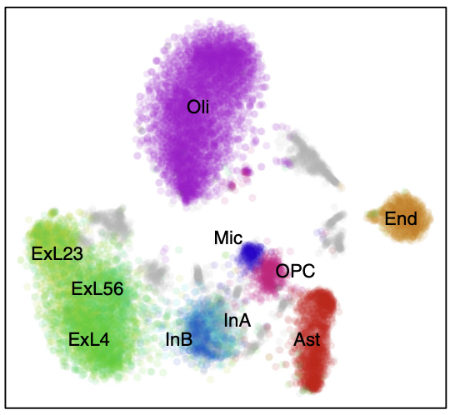
Use differentially expressed genes to predict differentially accessible promoters to improve clustering of noisy epigenetics data
(Lake*, Chen*, Sos*, Fan*, et al, Nature Biotech 2018)

Slide 15
Analysis

Slide 16
How does normalization affect k-means clustering?
 | Gene A | Gene B | Gene C | Cell Area
Cell 1 | 100 | 0 | 0 | 100
Cell 2 | 10 | 0 | 0 | 10
Cell 3 | 0 | 10 | 10 | 10
Cell 4 | 0 | 10 | 10 | 10

Slide 17
How does normalization affect k-means clustering?
 | Gene A | Gene B | Gene C | Cell Area
Cell 1 | 100 | 0 | 0 | 100
Cell 2 | 10 | 0 | 0 | 10
Cell 3 | 0 | 10 | 10 | 10
Cell 4 | 0 | 10 | 10 | 10
> data <- rbind(c(100, 0, 0),
+ c(10,0,0),
+ c(0,10,10),
+ c(0,10,10))
> rownames(data) <- paste0('cell', 1:4)
> colnames(data) <- paste0('gene', c('A', 'B', 'C'))
> data
geneA geneB geneC
cell1 100 0 0
cell2 10 0 0
cell3 0 10 10
cell4 0 10 10
> dist(data)
cell1 cell2 cell3
cell2 90.00000
cell3 100.99505 17.32051
cell4 100.99505 17.32051 0.00000
> kmeans(data, 2)$cluster
cell1 cell2 cell3 cell4
2 1 1 1

Slide 18
How does normalization affect k-means clustering?
 | Gene A | Gene B | Gene C | Cell Area
Cell 1 | 100 | 0 | 0 | 100
Cell 2 | 10 | 0 | 0 | 10
Cell 3 | 0 | 10 | 10 | 10
Cell 4 | 0 | 10 | 10 | 10
> cellarea <- c(100,10,10,10)
> dist(data/cellarea)
cell1 cell2 cell3
cell2 0.000000
cell3 1.732051 1.732051
cell4 1.732051 1.732051 0.000000
> kmeans(data/cellarea, 2)$cluster
cell1 cell2 cell3 cell4
2 2 1 1

Slide 19
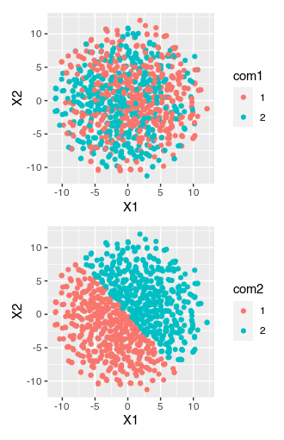
Can you do k-means clustering on the tSNE embedding?
data <- do.call(rbind, lapply(1:1000, function(i) {
runif(100) ## random uniform data
}))
emb <- Rtsne::Rtsne(data)$Y
com1 <- as.factor(kmeans(data, 2)$cluster)
com2 <- as.factor(kmeans(emb, 2)$cluster)
df <- data.frame(emb, com1, com2)
ggplot(df) + geom_point(aes(x=X1, y=X2, col=com1))
ggplot(df) + geom_point(aes(x=X1, y=X2, col=com2))

Slide 20
RNA velocity in situ analysis leverages nuclear and cytoplasmic gene expression to predict the future transcriptional state of cells
(La Manno, et al Nature 2018)
(Xia*, Fan*, Emanuel*, et al PNAS 2019)

Slide 21
Moran’s I helps us identify genes with significant spatial autocorrelation
Moran’s I (spatial auto-correlation)
(Miller et al, Genome Research Oct 2021)
Notes:
MERINGUE draw inspiration from Geospatial analysis
Where a statistic called Moran's I has been used to evaluate whether a particular quantity, say income, exhibits significant non-random spatial variation via spatial autocorrelation
In this case, each square is a county
Color denotes income level
We can see in this visualization that income isn’t random
it is highly correlated with the income of the neighboring county
(income exhibits high spatial autocorrelation and this high spatial autocorrelation can be quantified as a high Moran’s I)
For us of course, we're not as interested in income, but we are interested in gene expression
So if a cell's expression for a particular gene is highly correlated with that gene's expression in the cell's neighbors, then the gene would be highly spatially autocorrelated
distinguish genes that are variable in a spatial coordinated manner
with genes that are variable but not in a spatially coordinated manner

Slide 22
Neighbors can be defined in 2D, 3D, multi-section, within cell-types, etc
3D drosophila
(Fowlkes et al, Cell 2008; Karaiskos et al Science, 2017)
(Miller et al, Genome Research Oct 2021)
Notes:
In our paper, we apply MERINGUE to many organisms, technologies,
In particular the Moran’s I equation is also very flexible and amenable to adaptations that allow us to
To identify genes with spatially heterogeneous gene expression patterns in 3D,
In multi-section data where we can specifically look for spatial patterns that are consistent across sections
Or even between pairs of receptor and ligand genes among spatially co-localized cell-types to look for potential cell-cell communication
Please check out…

Slide 23
Neighbors can be defined in 2D, 3D, multi-section, within cell-types, etc
3D drosophila
Multi-section breast cancer
(Fowlkes et al, Cell 2008; Karaiskos et al Science, 2017)
(Stahl et al, Science 2016)
(Miller et al, Genome Research Oct 2021)
Notes:
In our paper, we apply MERINGUE to many organisms, technologies,
In particular the Moran’s I equation is also very flexible and amenable to adaptations that allow us to
To identify genes with spatially heterogeneous gene expression patterns in 3D,
In multi-section data where we can specifically look for spatial patterns that are consistent across sections
Or even between pairs of receptor and ligand genes among spatially co-localized cell-types to look for potential cell-cell communication
Please check out…

Slide 24
Neighbors can be defined in 2D, 3D, multi-section, within cell-types, etc
3D drosophila
Multi-section breast cancer
Within cell-types in the hypothalamic preoptic region
(Moffitt*, Bambah-Mukku*
et al., Science 2018)
(Fowlkes et al, Cell 2008; Karaiskos et al Science, 2017)
(Stahl et al, Science 2016)
(Miller et al, Genome Research Oct 2021)
Notes:
In our paper, we apply MERINGUE to many organisms, technologies,
In particular the Moran’s I equation is also very flexible and amenable to adaptations that allow us to
To identify genes with spatially heterogeneous gene expression patterns in 3D,
In multi-section data where we can specifically look for spatial patterns that are consistent across sections
Or even between pairs of receptor and ligand genes among spatially co-localized cell-types to look for potential cell-cell communication
Please check out…

Slide 25
If you understand how a method works, you can modify it!
Moran’s I (spatial auto-correlation)
inter-cell-type spatial cross-correlation
(Miller et al, Genome Research Oct 2021)
Notes:
Finally, building on Moran's I, we can modify this equation slightly
and take advantage of the flexibility of this adjacency weight matrix definition
to specifically propose an inter-cell-type spatial cross correlation statistic
To look for genes that are cross correlated for spatially co-localized cell-types that may be indicative of cell-cell communication
Rather than autocorrelation x with itself, we now have a second gene
W is limited to spatial neighbors of different cell-types
So consider cell-type A and B that spatially adjacent to each other
Cell-type A expresses a gene, perhaps a receptor
and Cell-type B expresses the complementary ligand
and we are looking to find situations where cells of cell-type A
expressing the receptor are always co-localized with cells of
cell-type B expressing the correpsonding ligand
even though these receptor and ligand genes are expressed in different cells
so their expressions across cells are actually negatively correlated
when we evaluate their inter-cell-type spatial cross-correlation,
it is very significantly positive
potentially indicative of cell-cell communication via this particular receptor-ligand interaction

Slide 26
Inter-cell-type spatial cross correlation statistic identifies gene expression patterns indicative of cell-cell communication
(Miller et al, Genome Research Oct 2021)
Notes:
We first apply our approach identify gene expression patterns that may be indicative of putative 399 cell-cell communication between cells on beads corresponding to the Purkinje layer with cells on spatially 400 adjacent beads in Slide-Seq data of the mouse cerebellum (Fig. 5A). We use a set of over 2,500 known 401 receptor-ligand pairs previously supported by orthogonal biological validations (Ramilowski et al. 402 2015a). Restricting to well detected (CPM > 0 in more than 30 cells) receptor genes in the Purkinje layer 403 beads and well detected ligand genes in the spatially adjacent beads, we applied MERINGUE to test for 404 significant spatial cross correlation between all receptor and ligand gene pairs.
We identified statistically significant inter-cell-type spatial cross-correlation between expression of Ptprz1 (Protein Tyrosine 406 Phosphatase Receptor Type Z1 i.e. PTPζ) in beads corresponding to Purkinje layer and expression of its ligand Ptn (secreted growth factor pleiotrophin) in spatially adjacent beads (Fig. 5B-C). Ptprz1 has been previously identified to be expressed by Purkinje neurons while Ptn has been previously identified to distribute along Bergmann glial fibers in postnatally developing cerebellum (

Slide 27
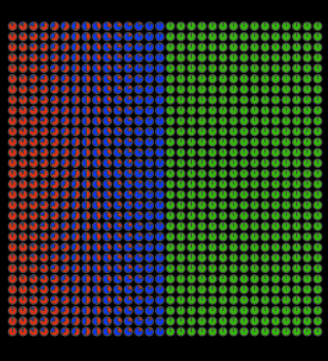
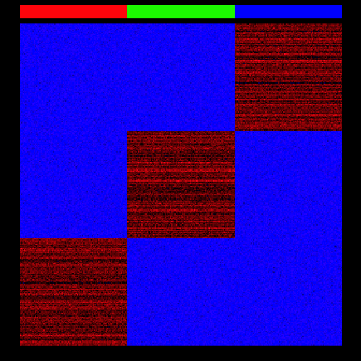
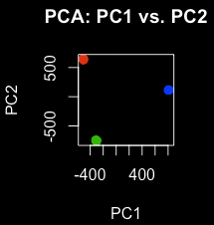
Can you apply Moran’s I to spot-resolution data?

Slide 28
Final hint
Always visualize your data ;)

