Slide 1
EN.580.428 Genomic Data Visualization Lesson 2 Spatially Resolved Transcriptomic Data
Prof. Jean Fan

Slide 2
Announcements
Hope HW0 helped everyone practice HW submission. We will not be able to merge pull requests for the purpose of checking HWs before the HW deadline in the future. Come to office hours if you need help.

Slide 3
Lesson learning objectives
understand what is spatially resolved transcriptomic data
different kinds of spatial transcriptomics technologies
how the data is generated
begin visualizing and interacting with the data
assign HW datasets

Slide 4
What are some different cell-types?

Slide 5
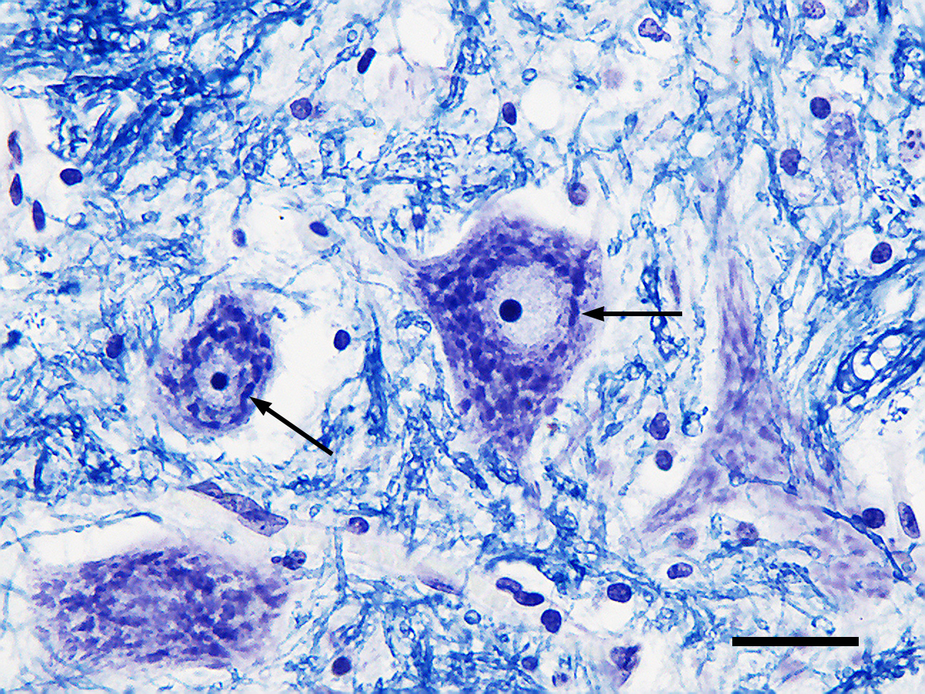
What are some different cell-types?
H&E
Nissl
(Source: Wikipedia)

Slide 6
How can we distinguish these cell-types (and cell-states) from each other?

Slide 7
Why spatially-resolved profiling?

Slide 8
Low-throughput imaging-based spatial transcriptomic profiling techniques: single molecule fluorescence in situ hybridization

Slide 9
Question: I design 5 smFISH probes to target the same gene. How many spots will I see when I take a picture?

Slide 10
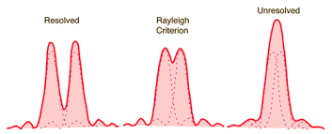
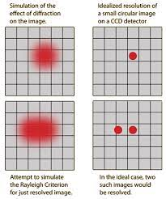
Recall: diffraction limit
1D
2D
diffraction limit for a microscope ~ 250nm

Slide 11
Question: I design 5 smFISH probes to target the same gene. How many spots will I see when I take a picture?

Slide 12
How many genes can we image simultaneously with smFISH depends on how many colors we can visually distinguish

Slide 13
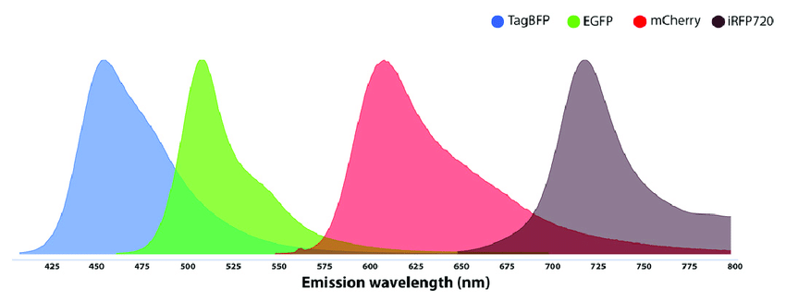
How many genes can we image simultaneously with smFISH depends on how many colors we can visually distinguish
Spectral overlap

Slide 14
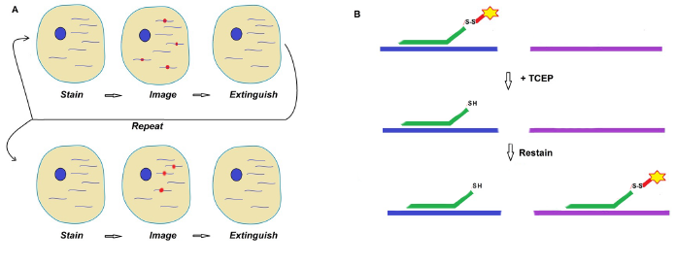
Sequential smFISH

Slide 15
Sequential smFISH
Practice
Consider I am imaging 1 fluorescence probe color. I can do 10 rounds of imaging.
Using sequential smFISH, how many different gene species can I detect?

Slide 16
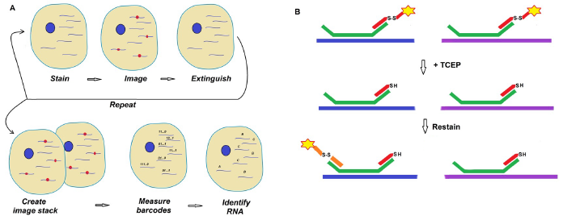
Multiplexed smFISH

Slide 17
Sequential vs multiplexed smFISH
Practice
Consider I am imaging 1 fluorescence probe color. I can do 10 rounds of imaging.
Using multiplexed smFISH, how many different gene species can I detect? (recall combinatorics)

Slide 18
(Xia*, Fan*, Emanuel*, et al PNAS 2019)

Slide 19
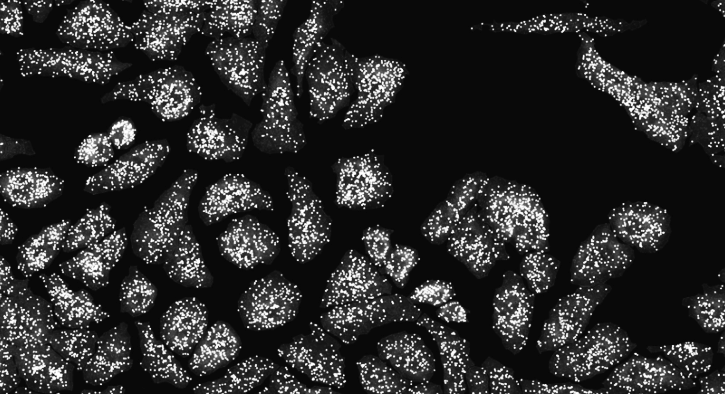

Slide 20
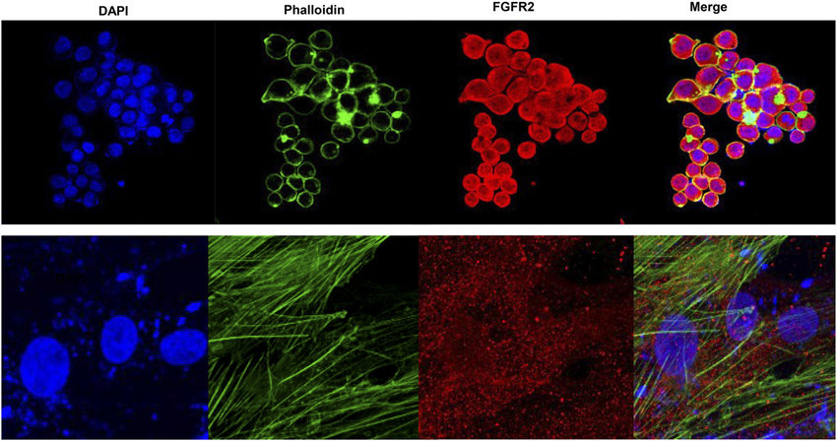
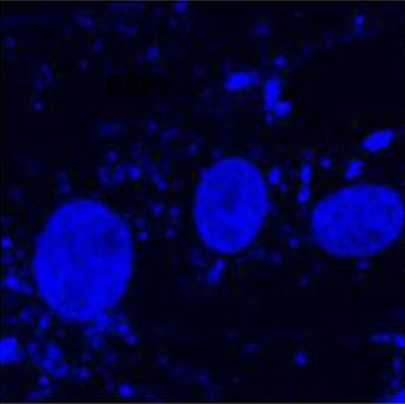
Water-shedding dapi-based cell segmentation

Slide 21
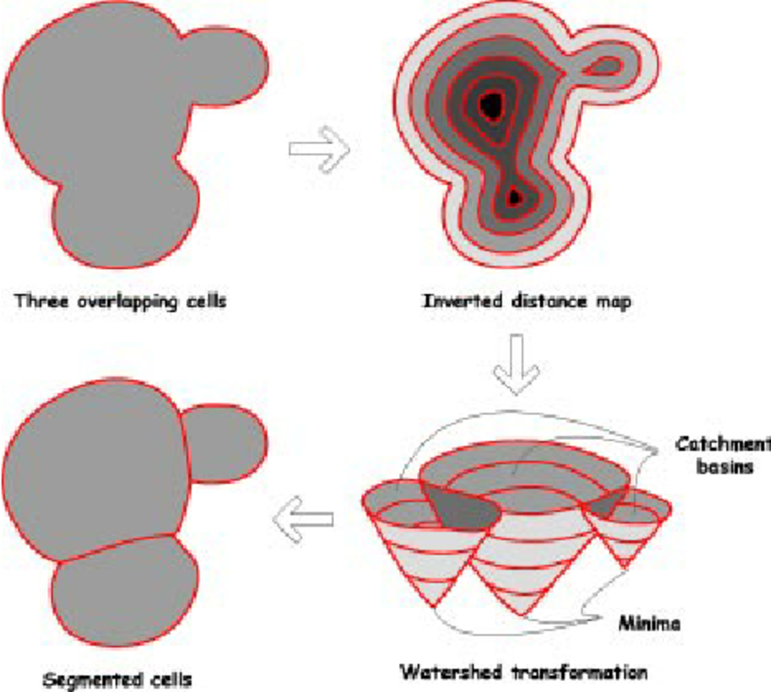
Water-shedding dapi-based cell segmentation

Slide 22
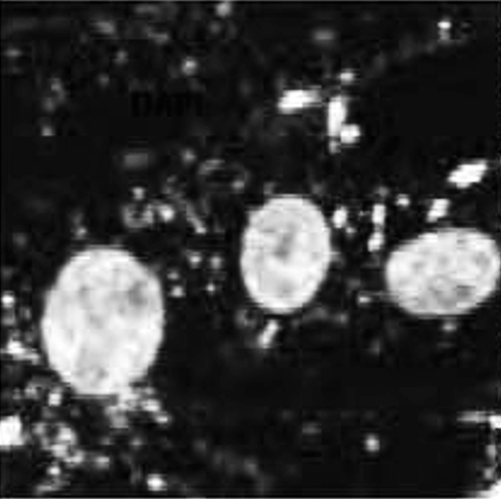
Water-shedding dapi-based cell segmentation

Slide 23
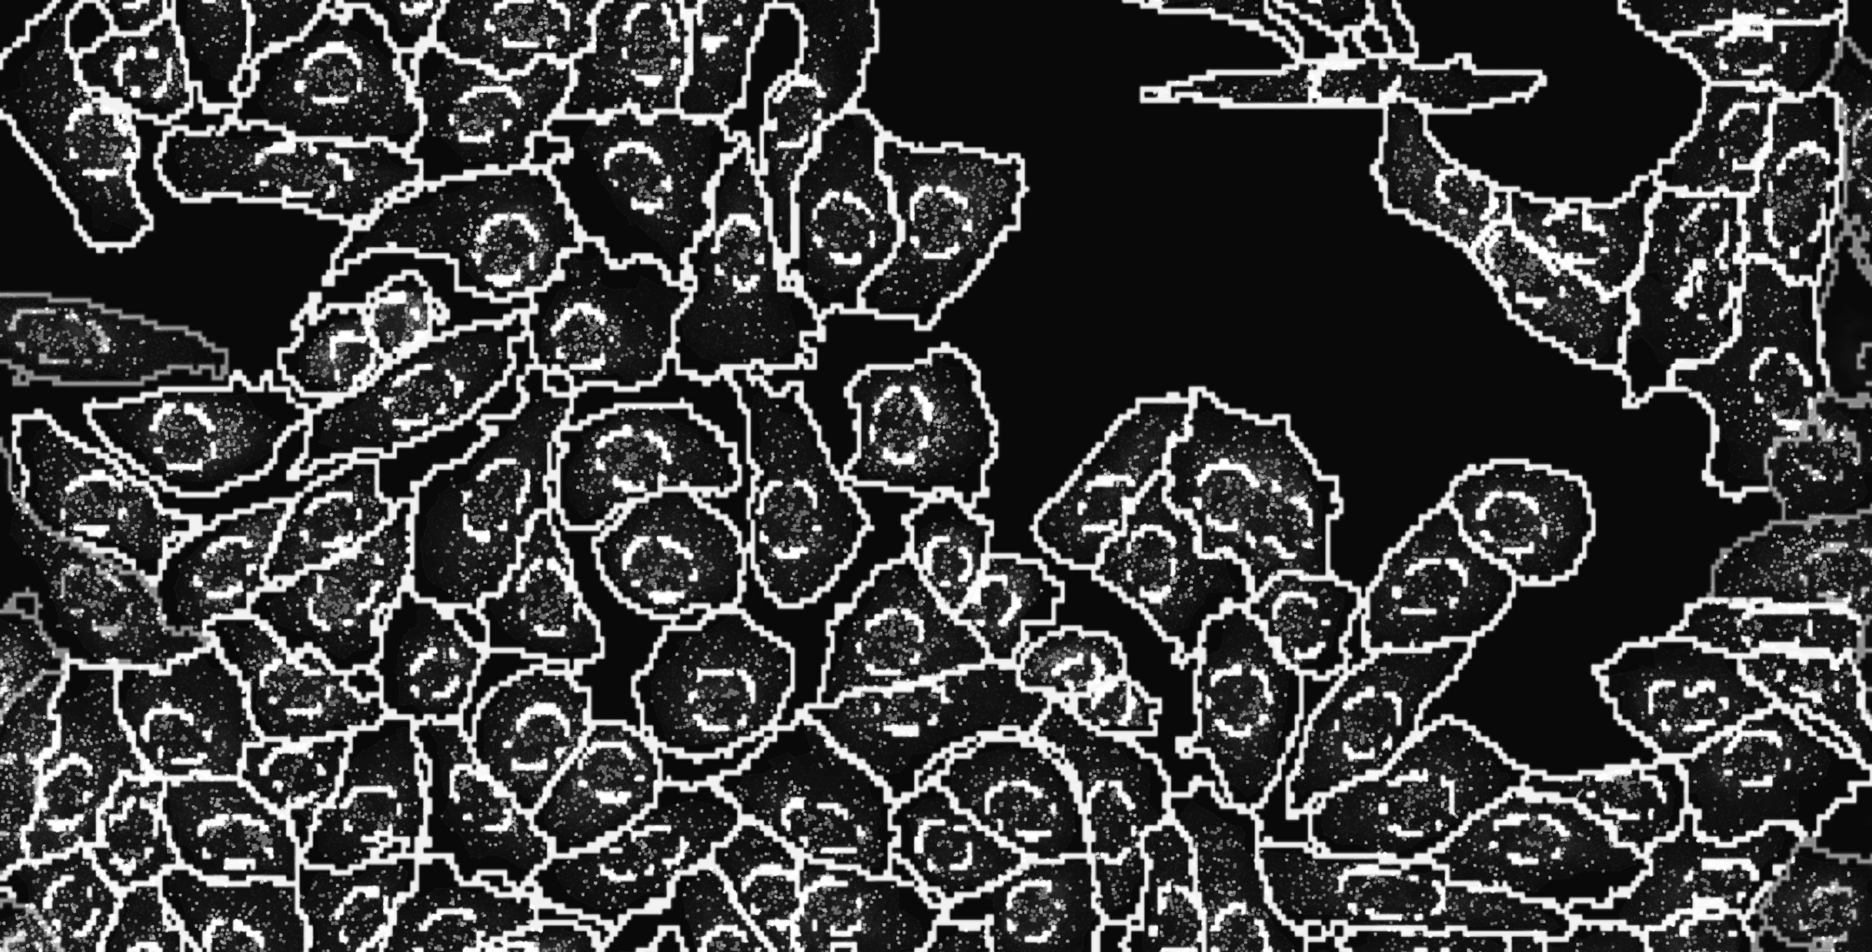
Notes:
and count how many copies of each gene we detect in each cell

Slide 24
Cell segmentation + spot detection + gene counting within cells = cell x gene count matrix

Slide 25
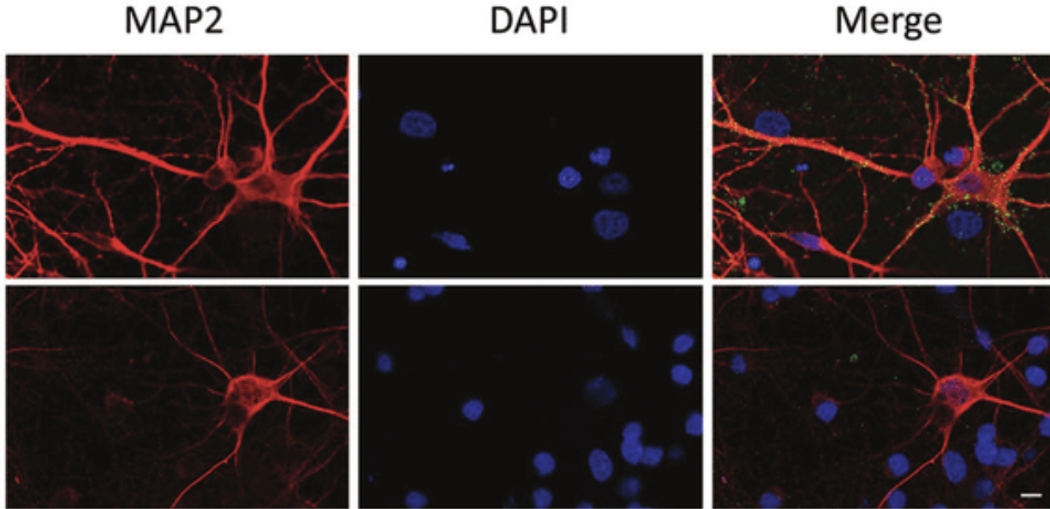
What if you have a cell like a neuron with axon and dendrites?
Practice

Slide 26
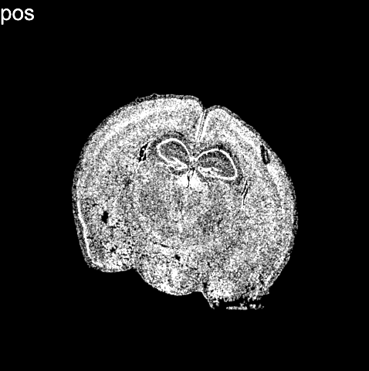
(Vizgen data)
Notes:
What we end up with is not only an image of where cells are within fixed tissues (here we have a cortical section of the mouse cortex)

Slide 27
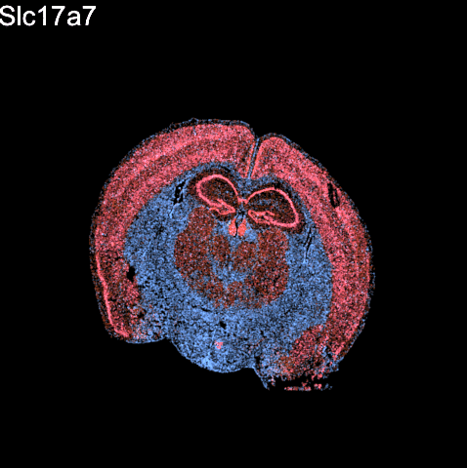
(Vizgen data)
Notes:
But we can see how targeted sets of genes are expressed within these cells within the tissues

Slide 28
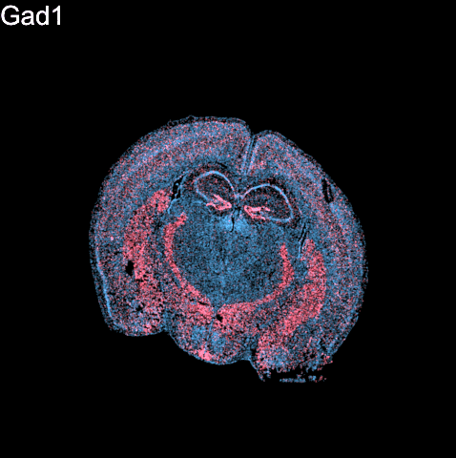
(Vizgen data)
Notes:
But we can see how targeted sets of genes are expressed within these cells within the tissues
For 100s to 1000s genes

Slide 29
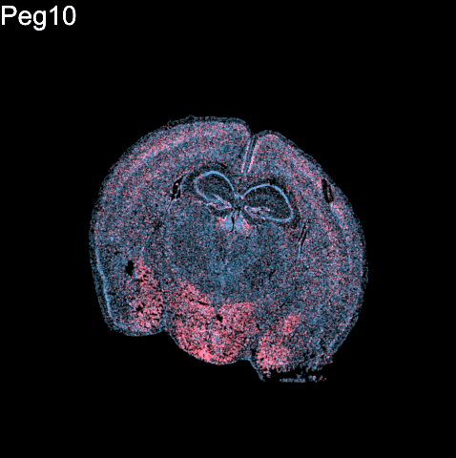
(Vizgen data)
Notes:
But we can see how targeted sets of genes are expressed within these cells within the tissues
For 100s to 1000s genes

Slide 30
Questions before we move onto sequencing-based spatial transcriptomics?

Slide 31
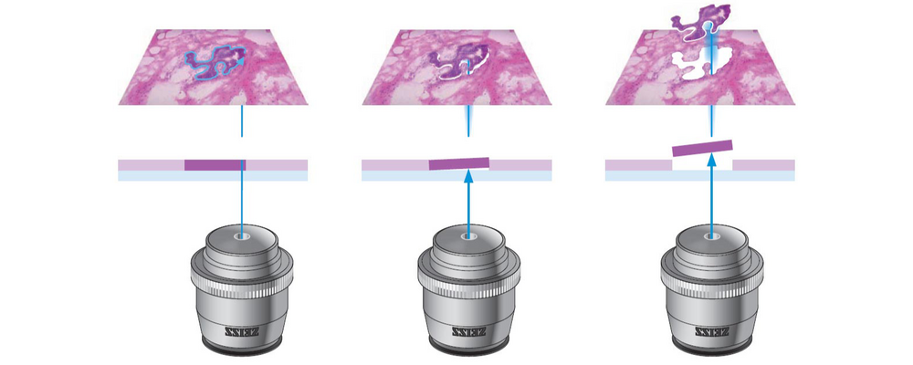
Low-throughput sequencing-based spatial transcriptomic profiling techniques: micro-dissection

Slide 32
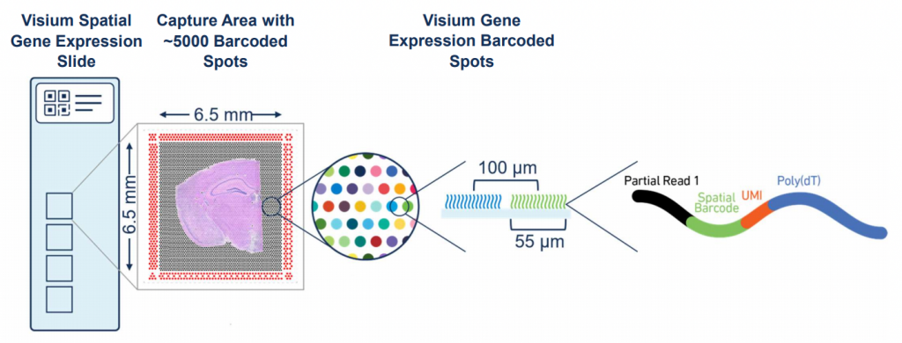
Spatial-barcode bead capture

Slide 33
Recall: mRNAs have poly(A)-tails

Slide 34
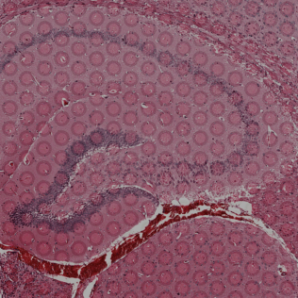
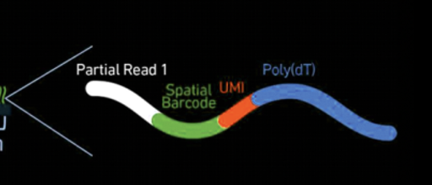
Spatial-barcode bead capture

Slide 35
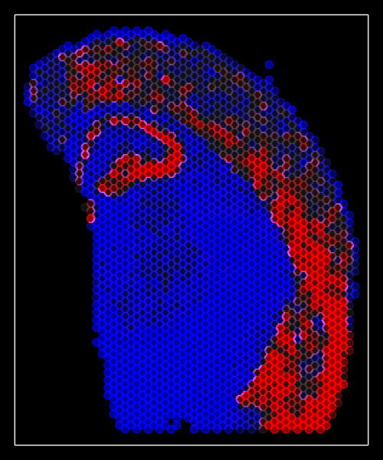
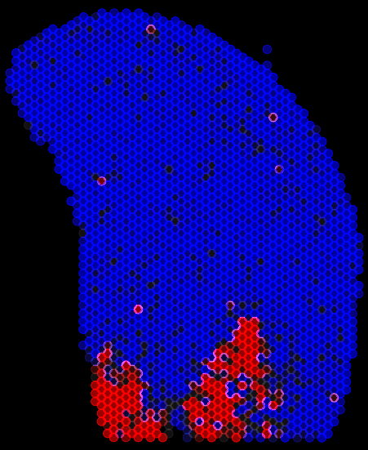
Spatial-barcode bead capture
Slc17a7
Peg10
…

Slide 36
What happens if you have multiple cells in the same spatial spot?
Practice

Slide 37
Questions before we move analyzing our own spatial transcriptomics datasets?

Slide 38
begin your adventure with your starter pokemon dataset
imaging
sequencing
abalan2
acheng41
akwok1
aperei13
coconn20
eholter1
jmoor185
kbowden5
stripat9
syuxuan1
wyang51
yyan67
aying2
cchen260
challin1
dvelazq5
ewhang2
jwang428
kmukund1
nsoley1
psangkh1
szhan128
tsinha5
zzaidi3
phariha4

Slide 39
HW1

Slide 40
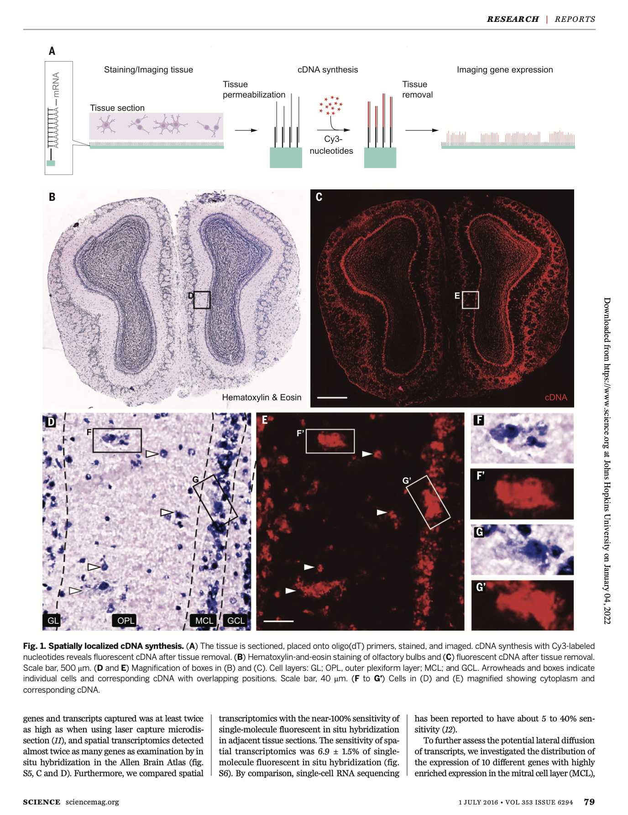
If you want to learn more, original scientific papers are available on class website

Slide 41
Reflection card
https://bit.ly/GDV24_rc

