Slide 1
EN.580.428 Genomic Data Visualization Lesson 3 Review
Prof. Jean Fan

Slide 2
Announcements
HW1 due tonight
Goal is to practice describing data visualizations and working with your spatial transcriptomics dataset
Hint: I should be able to recreate your data visualization from your description without seeing it
Hint: For “knowledge about perceptiveness of visual encodings”, refer to this. If you choose color hues as your encoding, why did you choose it? Your design choices should be intentional.

Slide 3
Lesson learning objectives
Review concepts learned so far
Have an “optionally graded” quiz
If you do well and it improves your final grade, we will keep it
If you do poorly and it hurts your final grade, we will drop it

Slide 4
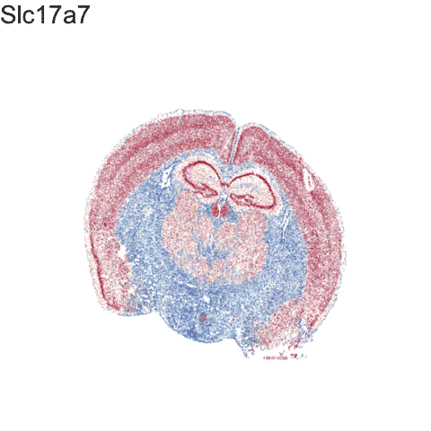
What is data visualization?
Data visualization == “the graphical display of data”

Slide 5
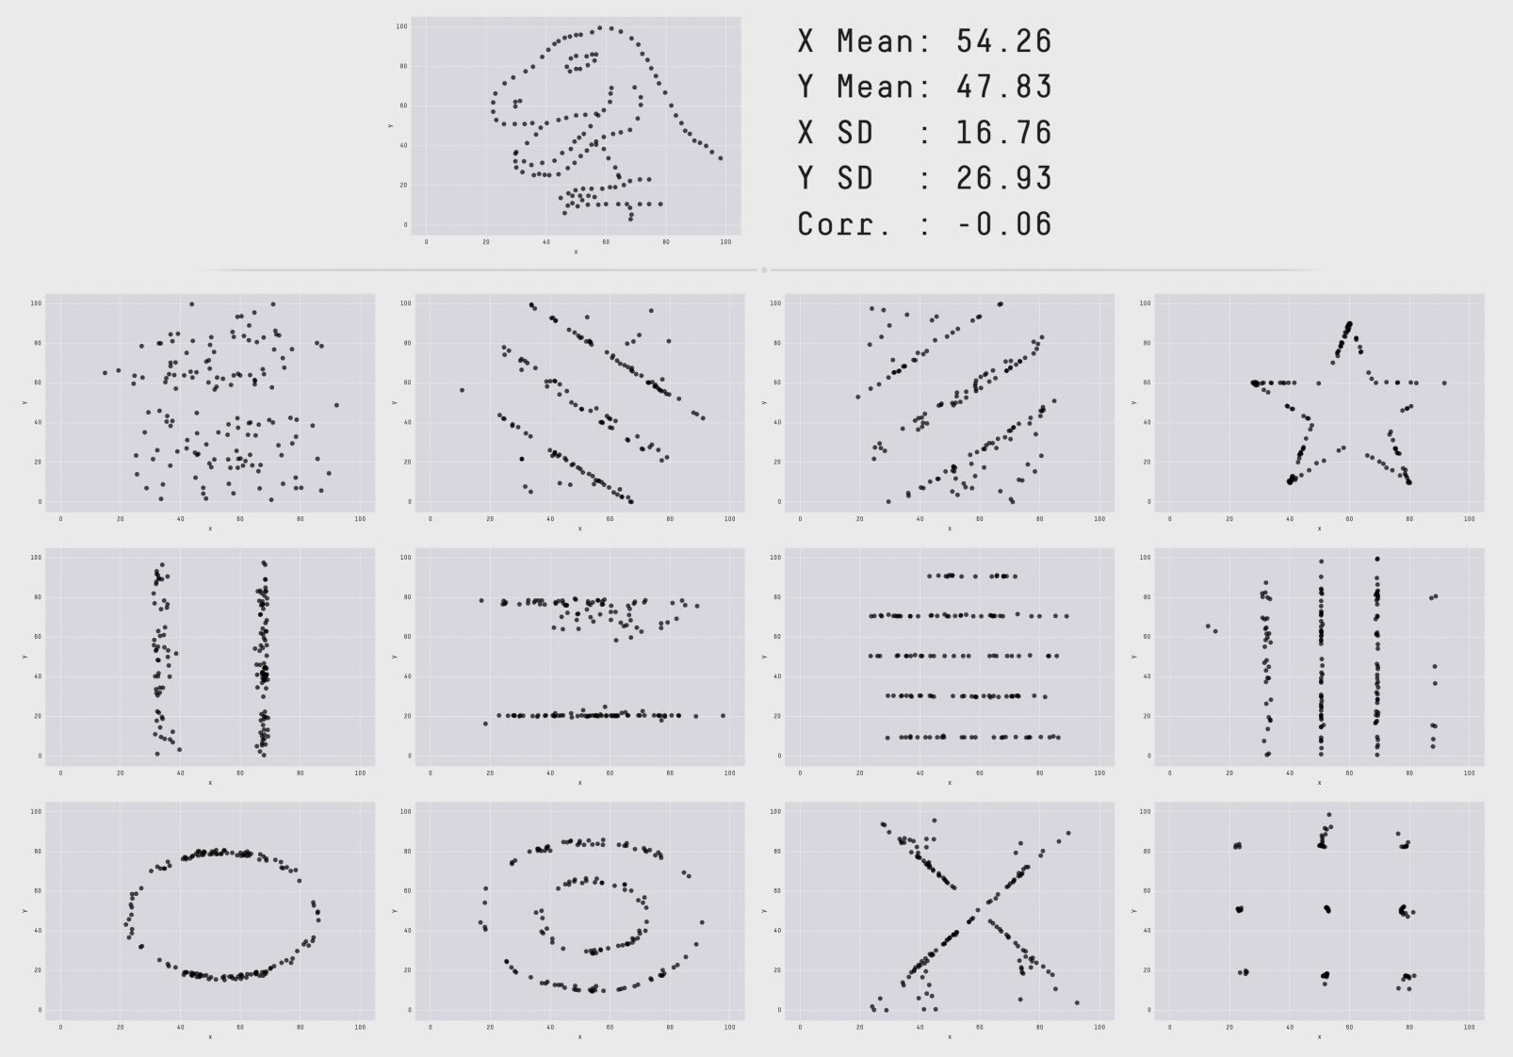
How does data visualizations work?
Visualization uses perception to free up cognition
Trends, gaps, outliers, clusters
Confirm, explore, present information
https://www.research.autodesk.com/publications/same-stats-different-graphs/

Slide 6
Data types

Slide 7
Types of encodings for different data types: Geometric Primitives
(Credit: Nils Gehlenborg, ISMB/ECCB 2011)

Slide 8
Types of encodings for different data types: Visual Channels (control geometric primitives)
(Credit: Nils Gehlenborg, ISMB/ECCB 2011)

Slide 9
Ranking of encodings
(Credit: Nils Gehlenborg, ISMB/ECCB 2011; Munzner 2009, in Fundamentals of Computer Graphics (redrawn from Mackinlay 1986))

Slide 10
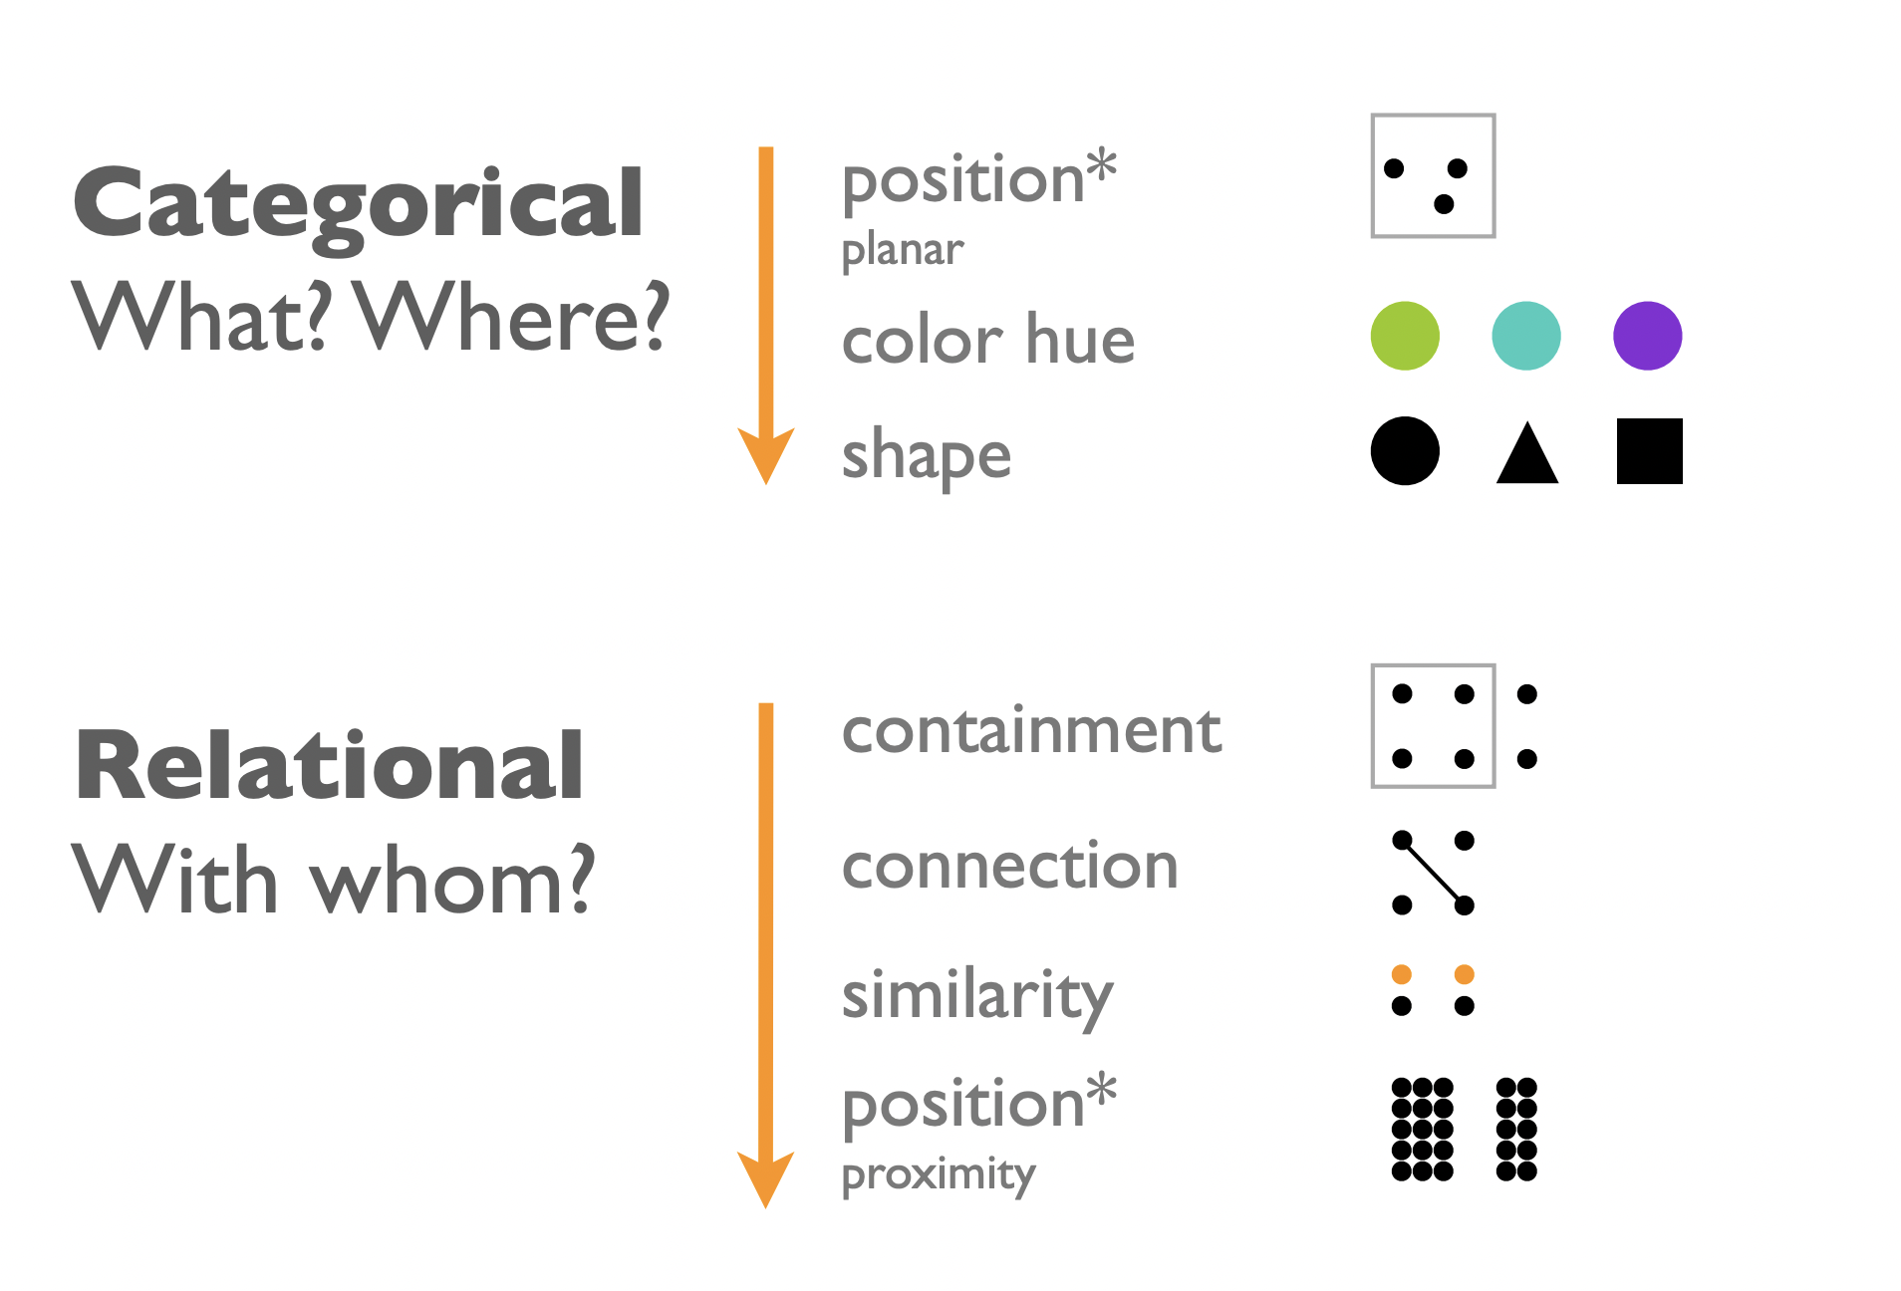
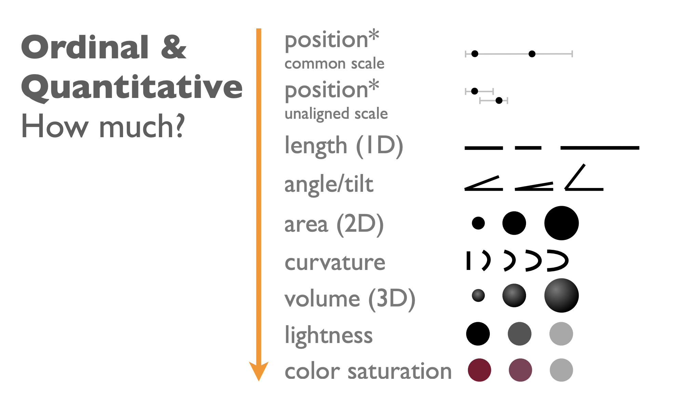
Ranking of encodings
Better encodings encode more important information more effectively →
data can be read more accurately from some encodings than others

Slide 11
We can make data visualization design choices to make certain features of our data more salient

Slide 12
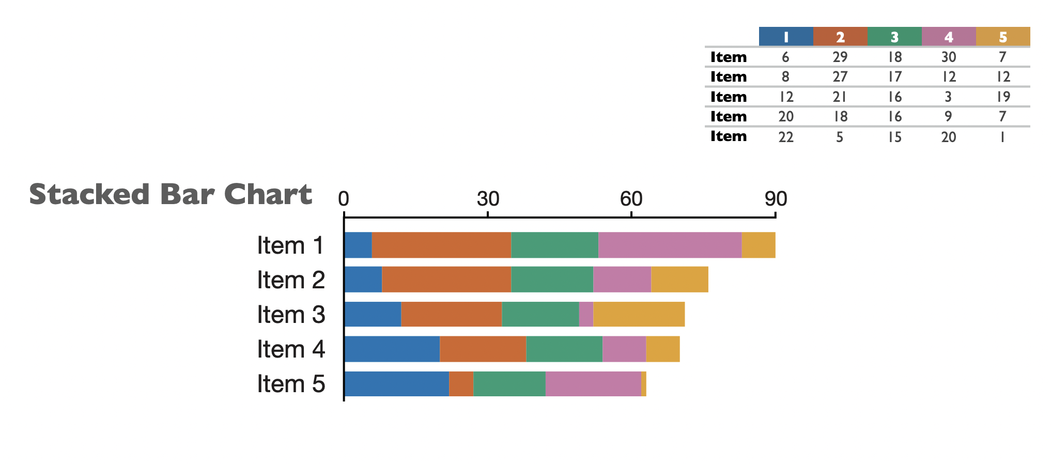
We can make data visualization design choices to make certain features of our data more salient

Slide 13
Questions?

Slide 14
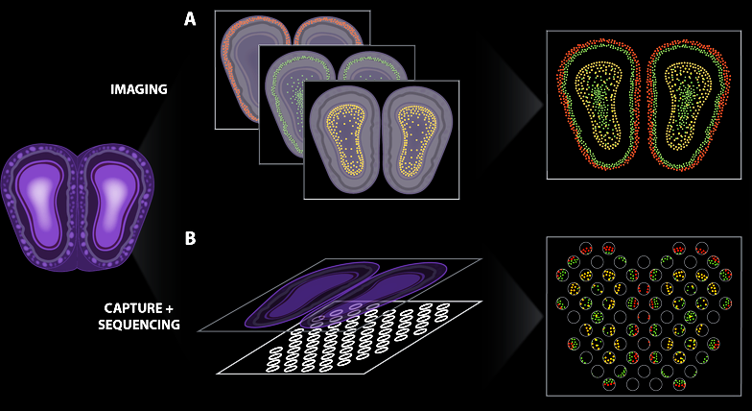
Spatially resolved transcriptomic technologies enable us to profile what genes are expressed by cells in tissues
Lyla Atta
(Atta and Fan, Nature Communications, Sept 2021)
Notes:
different technologies
vary in terms of throughput, sensitivity, resolution
statistical analysis methods will be different
7

Slide 15
Spatially resolved transcriptomic technologies enable us to profile what genes are expressed by cells in tissues
Lyla Atta
(Atta and Fan, Nature Communications, Sept 2021)
Notes:
different technologies
vary in terms of throughput, sensitivity, resolution
statistical analysis methods will be different
7

Slide 16
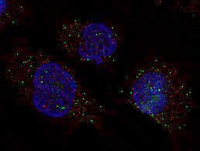
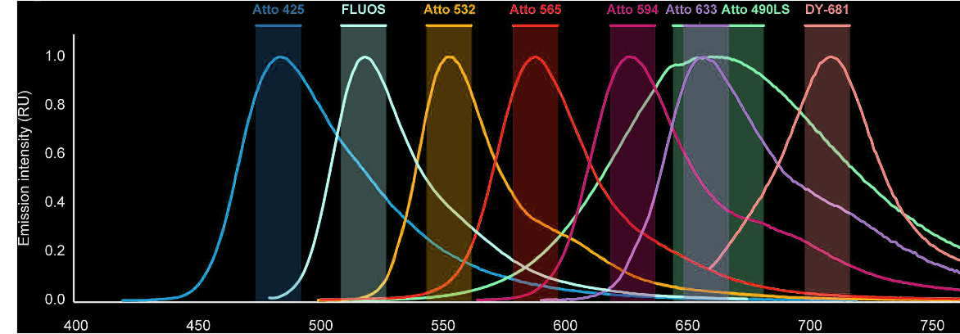
smFISH enables imaging of single mRNA molecules
Fluorophore
Oligonucleotide
RNA1
RNA2
RNA3
(Femino et al., Science, 1998)
(Raj et al., Nature Methods, 2008)
(Lukumbuzya et al., Front. Microbiol, 2019)

Slide 17
(Slide courtesy of Chenglong Xia)

Slide 18
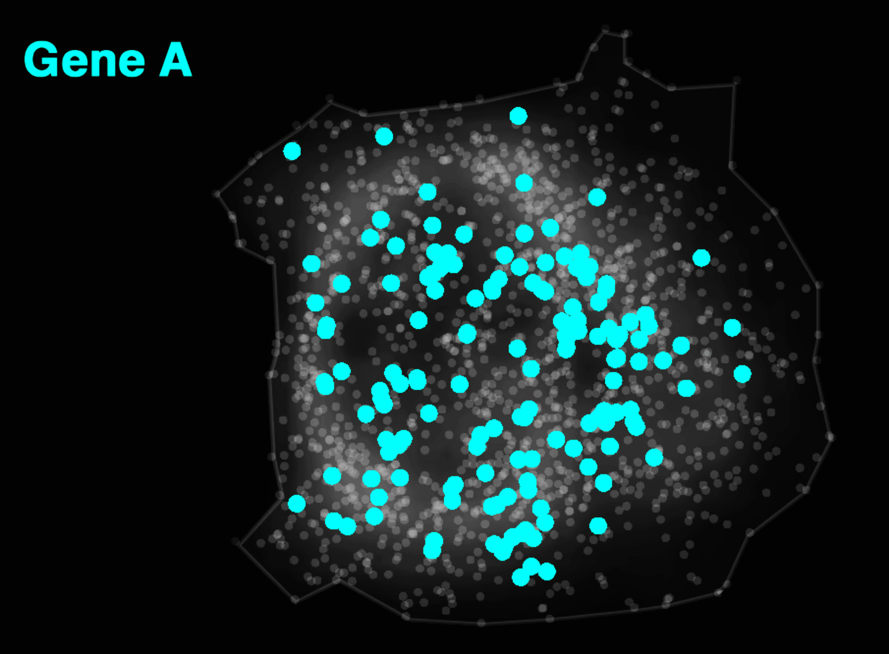
Decoded MERFISH Data
(MERFISH: Chen et al, Science 2015)
(SeqFISH: Lubeck et al, Nature Methods, 2014)
(osmFISH: Codeluppi et al, Nature Methods 2018)
(STARmap: Wang et al, Science 2018)
(Xia*, Fan*, Emanuel*, et al PNAS, Sept 2019)
Notes:
rely on designing oligonucleotide probes complementary to known RNA targets
reading them out with various types of multiplexed flourescent imaging

Slide 19
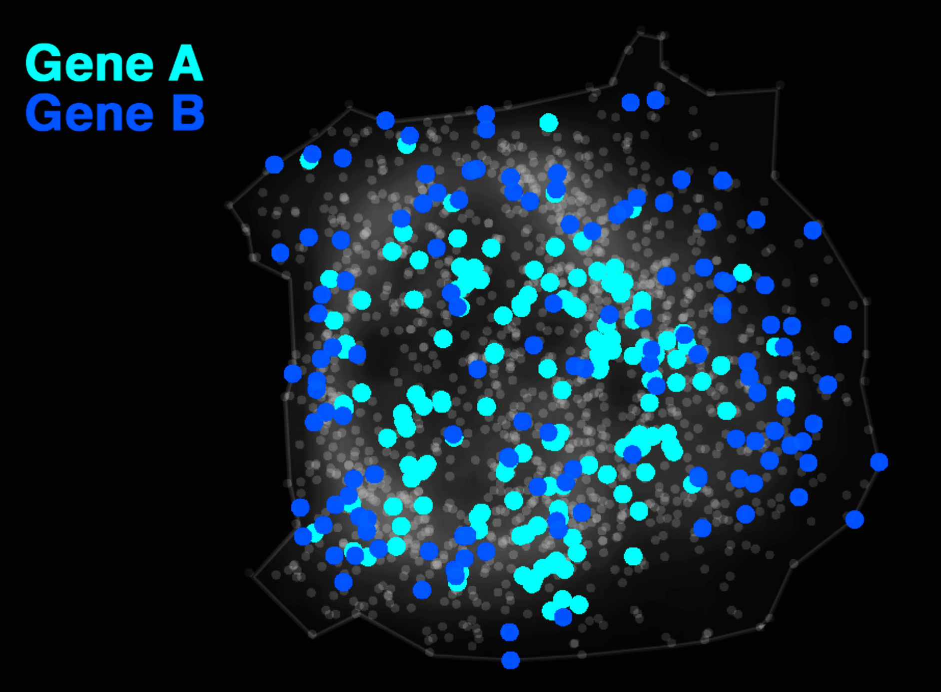
Decoded MERFISH Data
(MERFISH: Chen et al, Science 2015)
(SeqFISH: Lubeck et al, Nature Methods, 2014)
(osmFISH: Codeluppi et al, Nature Methods 2018)
(STARmap: Wang et al, Science 2018)

Slide 20
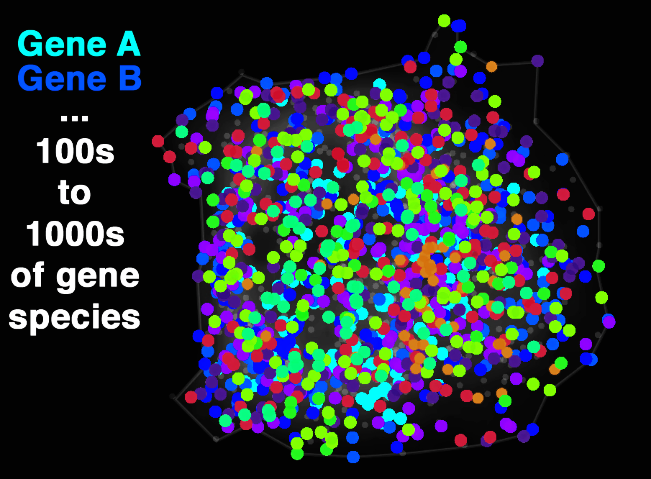
Decoded MERFISH Data
Decoded MERFISH Data
(MERFISH: Chen et al, Science 2015)
(SeqFISH: Lubeck et al, Nature Methods, 2014)
(osmFISH: Codeluppi et al, Nature Methods 2018)
(STARmap: Wang et al, Science 2018)

Slide 22
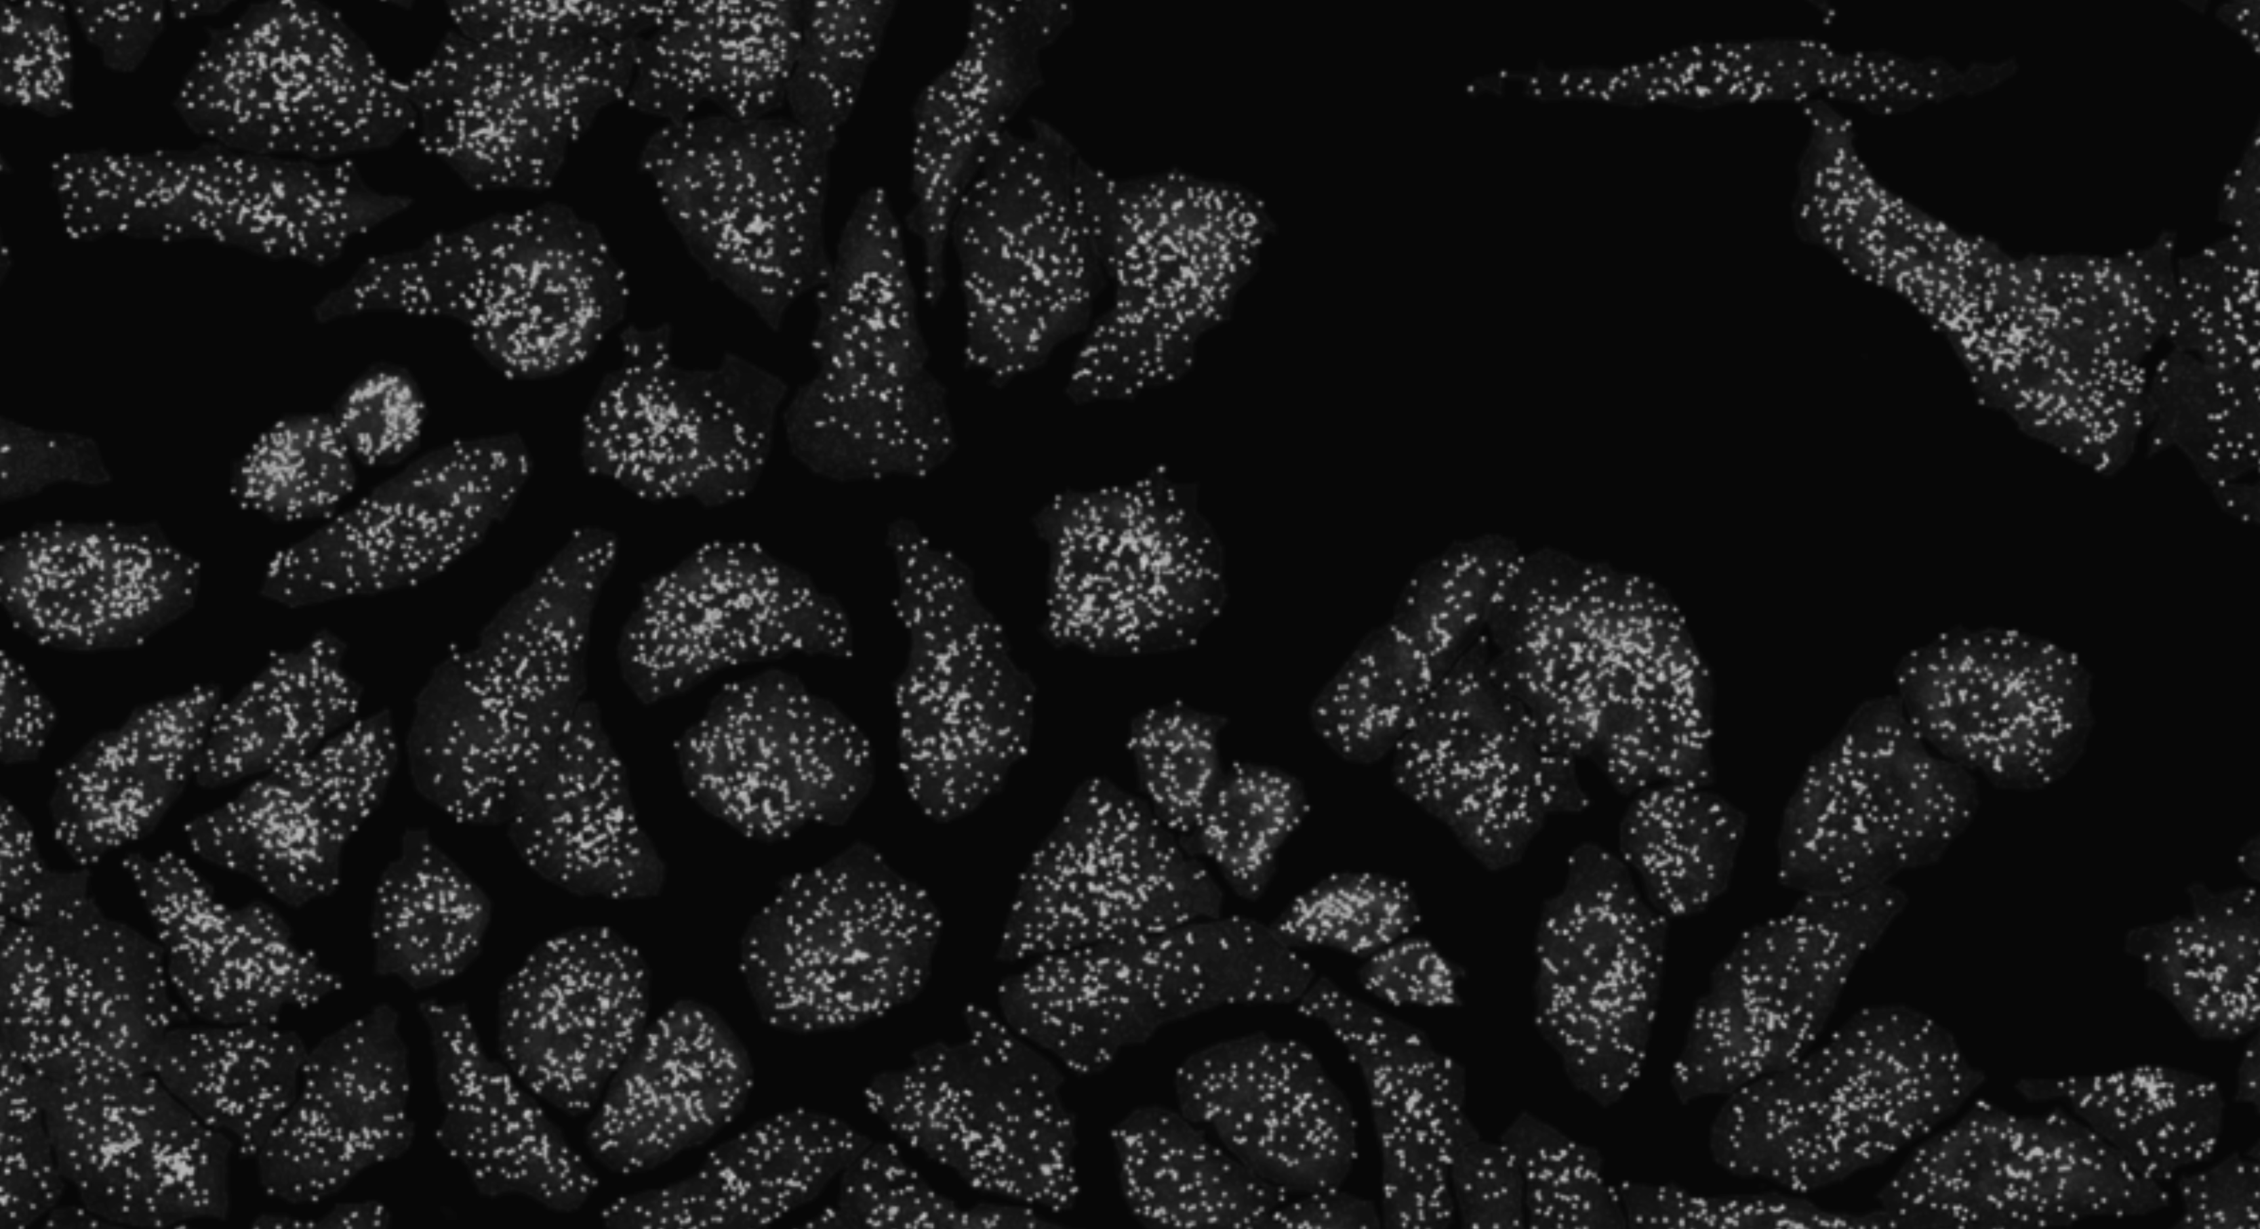

Slide 23
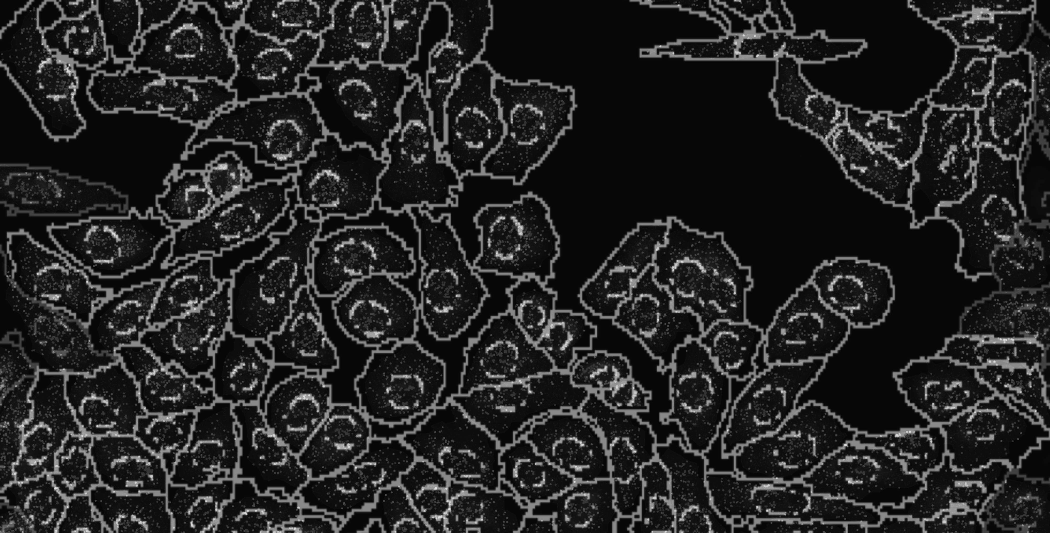
Notes:
and count how many copies of each gene we detect in each cell

Slide 24
Spatially resolved transcriptomic technologies enable us to profile what genes are expressed by cells in tissues
Lyla Atta
(Atta and Fan, Nature Communications, Sept 2021)
Notes:
different technologies
vary in terms of throughput, sensitivity, resolution
statistical analysis methods will be different
7

Slide 25
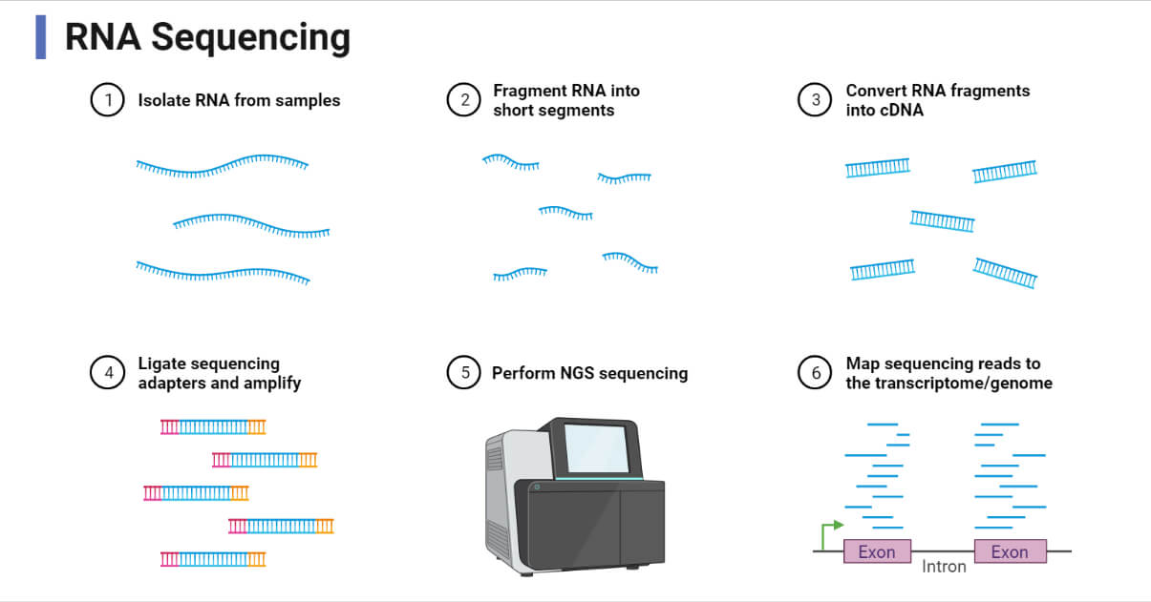
Microdissection allows small chunks of tissues to be sequenced for transcriptome profiling

Slide 26
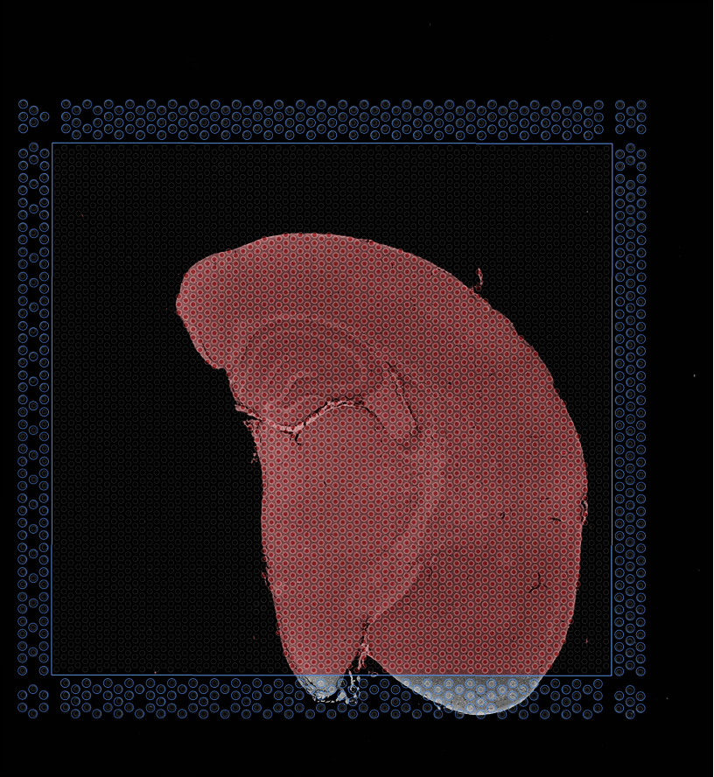
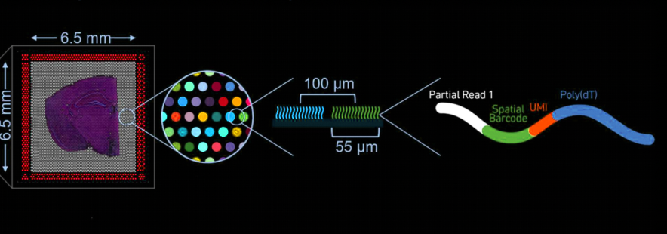
(ST/Visium: Stahl et al, Science 2016)
(SlideSeq: Rodriques et al, Science 2019)
(DBiT-Seq: Liu et al, Cell 2020)
(XYZseq: Lee et al, Science Advances 2021)
(Visium FFPE data)
Notes:
And capture the mRNAs that are present at each pixel or spot

Slide 27
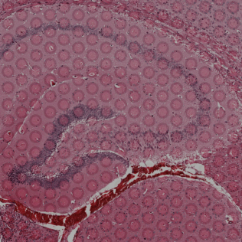
(Visium FFPE data)

Slide 28
(Visium FFPE data)
Notes:
Therefore the processed information we end up with comprises the spatial coordinates of each pixel
As well as the gene expression observed at each pixel

Slide 29
(Visium FFPE data)
Notes:
Therefore the processed information we end up with comprises the spatial coordinates of each pixel
As well as the gene expression observed at each pixel

Slide 30
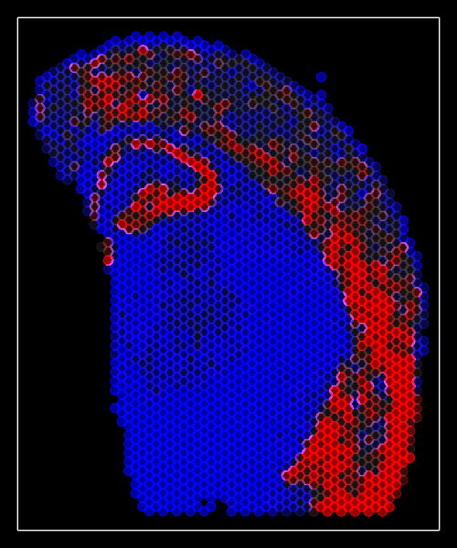
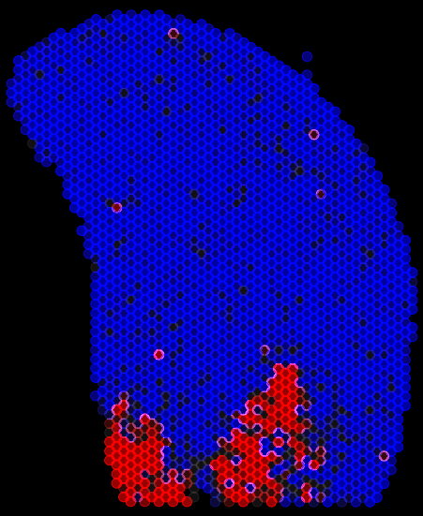
Untargeted Transcriptome-wide Profiling by Sequencing
Slc17a7
Peg10
…and many more
(Visium FFPE data)
Notes:
For the untargeted full transcriptome

Slide 31
Final questions?

