Slide 1

EN.580.428
Genomic Data Visualization
Lesson 7
Differential Expression
Prof. Jean Fan

Slide 2
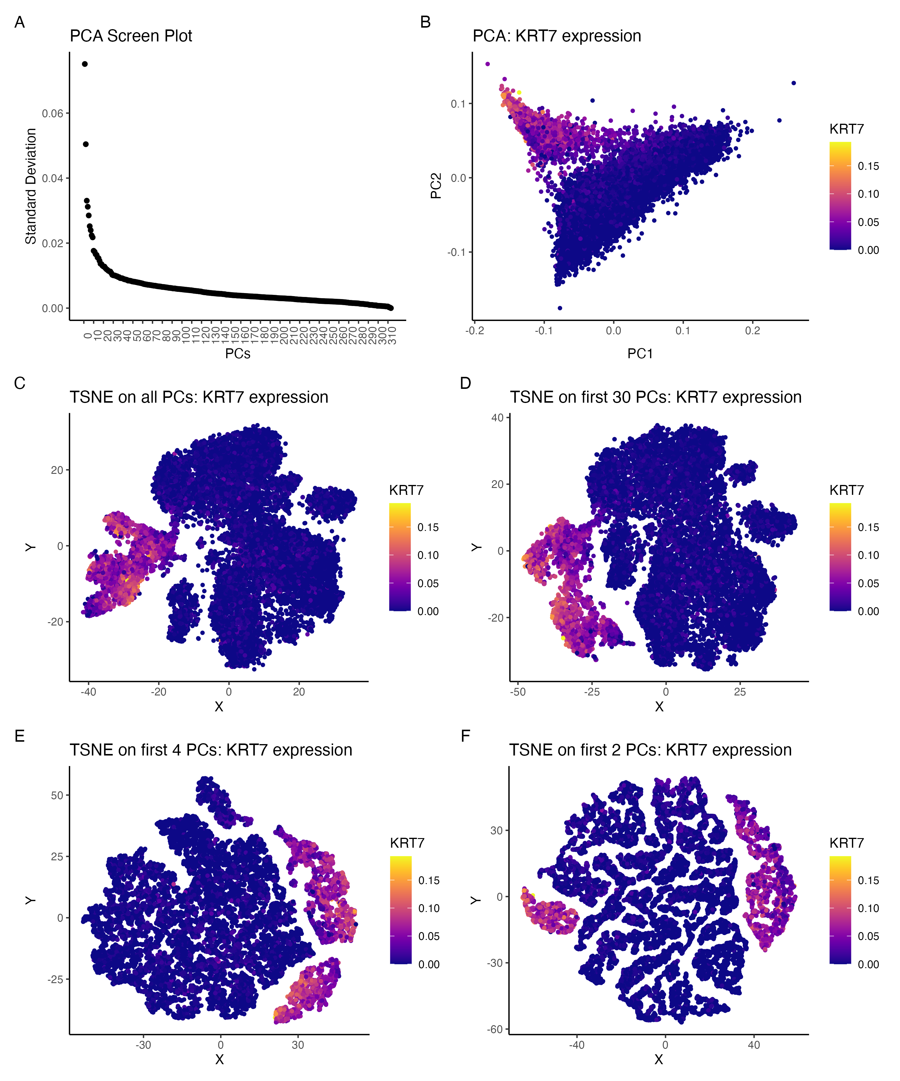
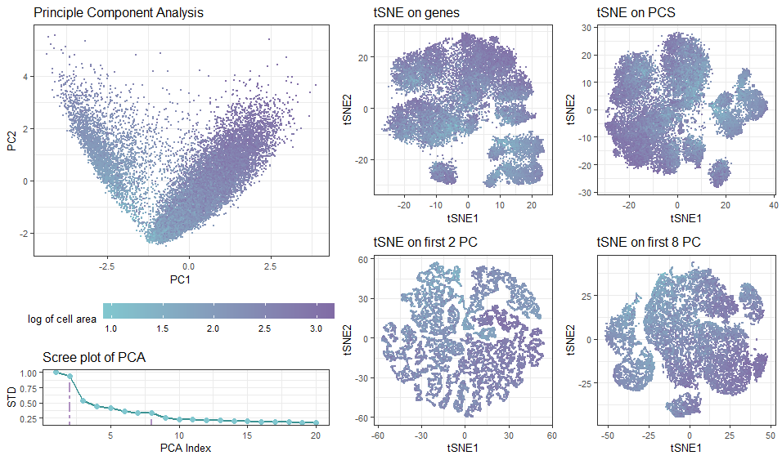
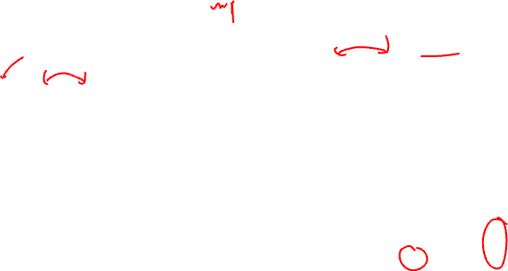
Linear vs non-linear dimensionality reduction

Slide 3
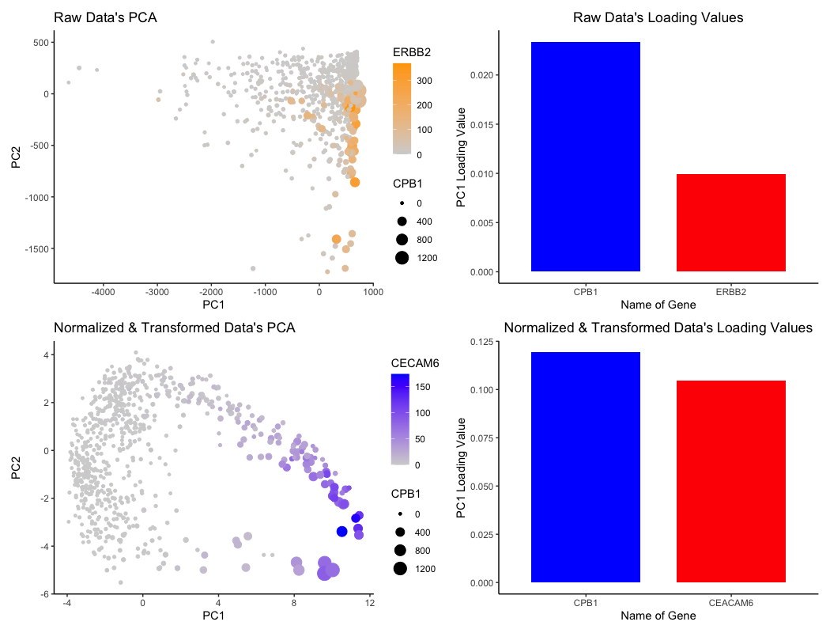
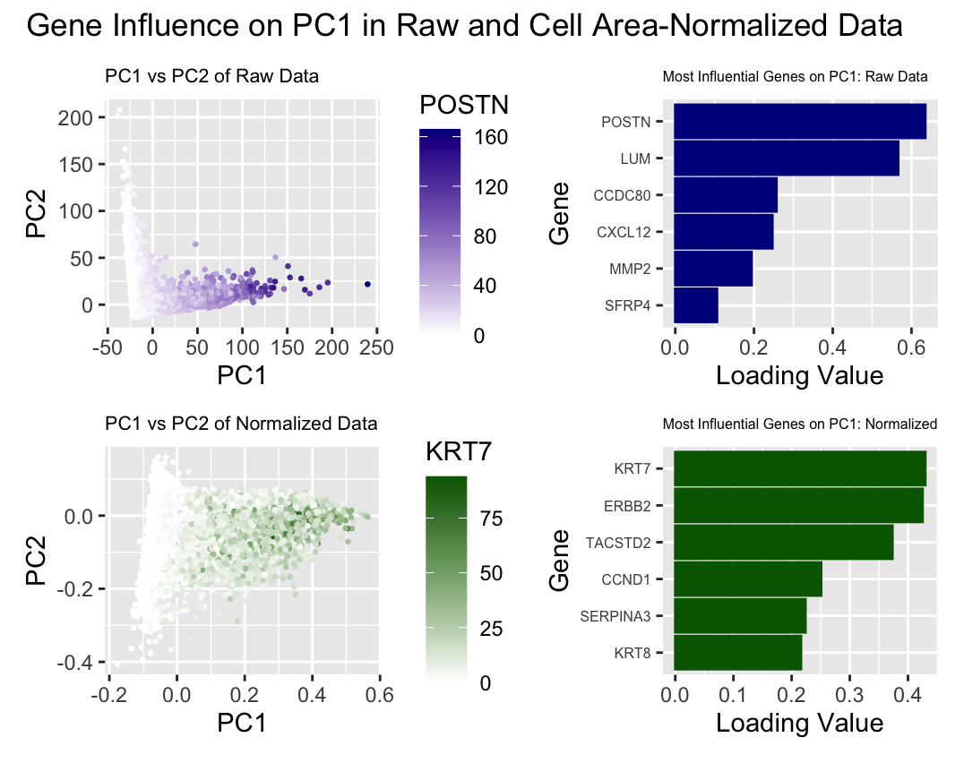
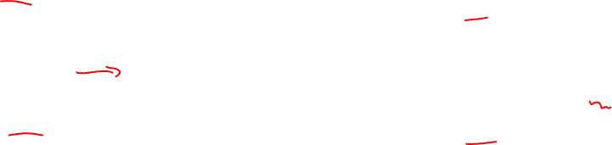
Loading values with normalized vs. non-normalized data

Slide 4
Few notes
Position along PC1, PC2, tSNE1, tSNE2 are quantitative but not spatial (not a physical interpretation)

Slide 5
Announcements
Wyman building may be closed
Office hours will need to be relocated

Slide 6

Quiz 2 Friday
Move to take home
  ~1.5 hours
  Coding element may take some students longer
Will be due Saturday at noon
  If you have a preapproved accommodation, due date will be Sunday at noon
Will cover everything up to k-means (not including today’s material)
If there is certain material you want to make sure we cover in the review, please let me know in your reflection cards

Slide 7
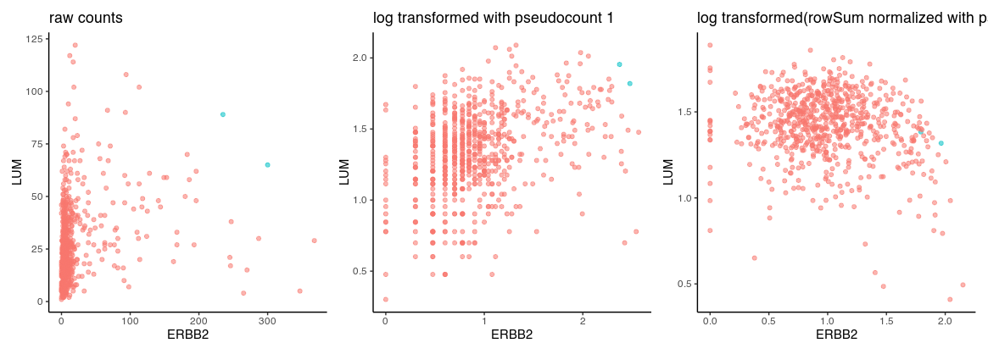
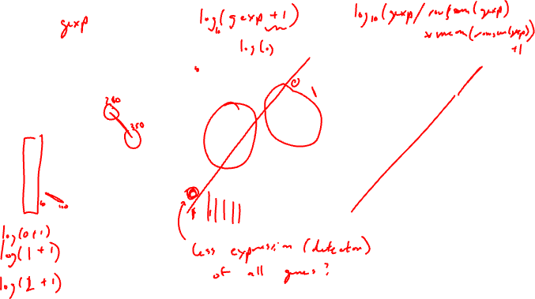
Normalized versus non-normalized data
library(ggplot2)
data <- read.csv('~/Desktop/genomic-data-visualization-2024/data/eevee.csv.gz', row.names=1)
dim(data)
data[1:5,1:5]
pos <- data[,2:3]
gexp <- data[, 4:ncol(data)]
rownames(pos) <- rownames(gexp) <- data$barcode
ct <- as.factor(gexp[,'ERBB2'] > 200 & gexp[,'LUM']>50)
table(ct)
df <- data.frame(ERBB2=gexp[,'ERBB2'], LUM=gexp[,'LUM'], celltype=ct)
p1 <- ggplot(df) + geom_point(aes(x=ERBB2, y=LUM, col=celltype, alpha=0.5), show.legend = FALSE) +
theme_classic() + ggtitle('raw counts')
gexpnorm <- log10(gexp+1)
df <- data.frame(ERBB2=gexpnorm[,'ERBB2'], LUM=gexpnorm[,'LUM'], celltype=ct)
p2 <- ggplot(df) + geom_point(aes(x=ERBB2, y=LUM, col=celltype, alpha=0.5), show.legend = FALSE) +
theme_classic() + ggtitle('log transformed with pseudocount 1')
gexpnorm2 <- log10(gexp/rowSums(gexp)*mean(rowSums(gexp))+1)
df <- data.frame(ERBB2=gexpnorm2[,'ERBB2'], LUM=gexpnorm2[,'LUM'], celltype=ct)
p3 <- ggplot(df) + geom_point(aes(x=ERBB2, y=LUM, col=celltype, alpha=0.5), show.legend = FALSE) +
theme_classic() + ggtitle('log transformed(rowSum normalized with pseudocount 1)')
p1+p2+p3

Slide 8
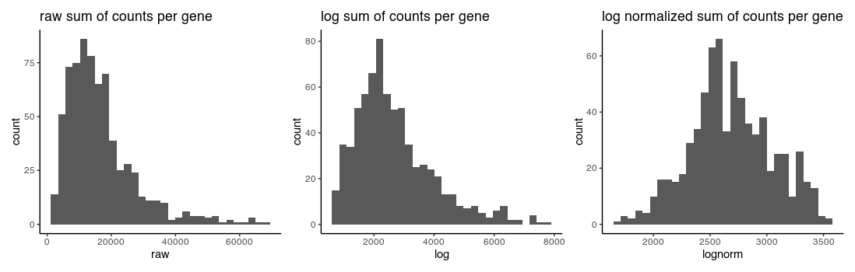
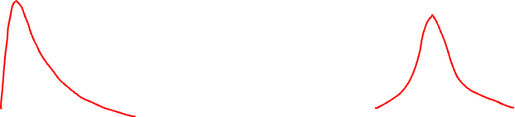
Normalized versus non-normalized data
df <- data.frame(raw = rowSums(gexp),
log = rowSums(gexpnorm),
lognorm = rowSums(gexpnorm2))
p1 <- ggplot(df, aes(x=raw)) + geom_histogram() + theme_classic() + ggtitle('raw sum of counts per gene')
p2 <- ggplot(df, aes(x=log)) + geom_histogram() + theme_classic() + ggtitle('log sum of counts per gene')
p3 <- ggplot(df, aes(x=lognorm)) + geom_histogram() + theme_classic() + ggtitle('log normalized sum of counts per gene')
p1+p2+p3

Slide 9
Learning objectives
Learn about and apply statistical approaches to identify differentially expressed genes

Slide 10
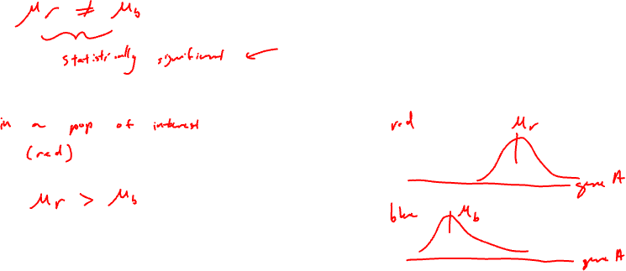
Definitions
Gene B
Differentially expressed genes
Differentially upregulated genes
Gene A

Slide 11
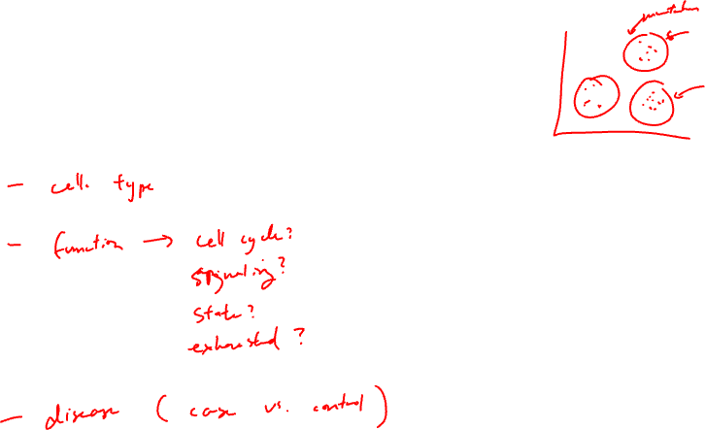
Motivation
Why identify differentially expressed genes?
Notes:
Differentially expressed genes
Differentially upregulated genes

Slide 12
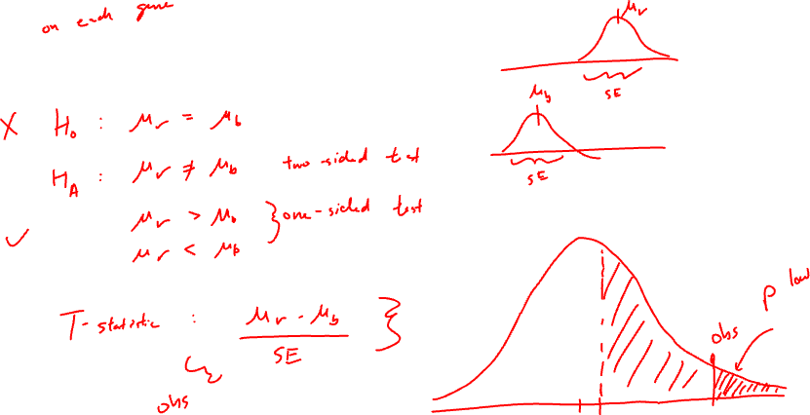
T-test: testing a difference of means

Slide 13
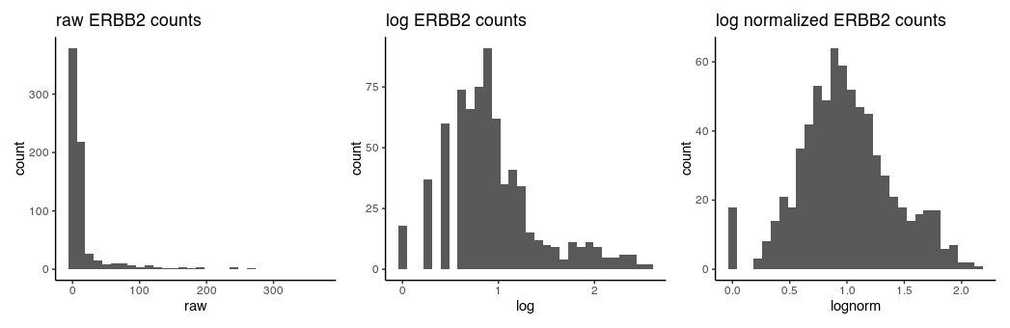
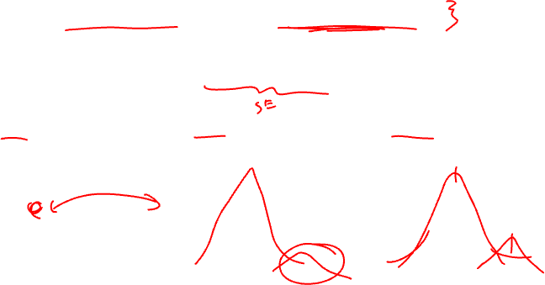
T-test assumptions and data visualization
that the data are quantitative and plausibly Gaussian
that the two samples come from distributions that may differ in their mean value, but not in the standard deviation

Slide 14
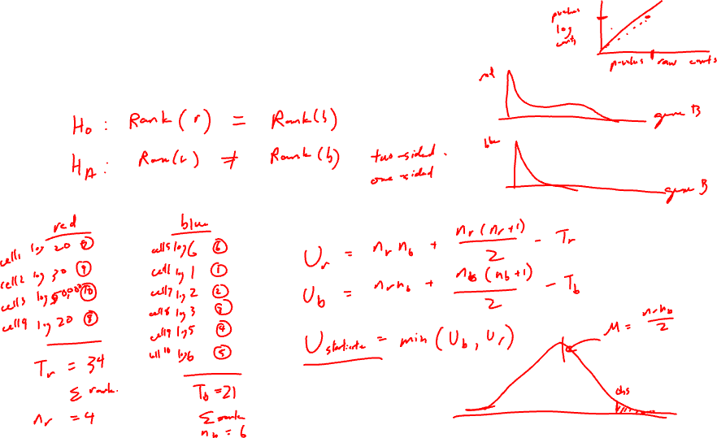
Wilcoxon Rank Sum Test (Mann–Whitney U test ): testing a difference in ranks

Slide 15
Other statistical tests
Many other tests that incorporate different normalizations, error modeling, Bayesian approaches, etc
Goal is to improve our statistical power in detecting true positives and true negatives while minimizing false positives and false negatives
  Often becomes a trade-off with speed and computational complexity

Slide 16
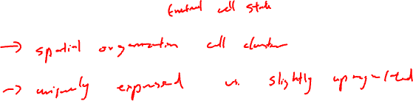
Discussion (no right answer)
In a spatial transcriptomics experiment, we perform k-means clustering to identify 10 cell clusters. For one cell cluster, there is only 1 gene significantly upregulated. Do you believe this cell cluster represents a distinct cell-type? Why or why not?

Slide 17
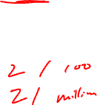
Discussion (no right answer)
In a spatial transcriptomics experiment, we perform k-means clustering to identify 10 cell clusters. For one cell cluster, there are are 100 genes significantly upregulated. But this cell cluster only has 2 cells. Do you believe this cell cluster represents a distinct cell-type? Why or why not?

Slide 18
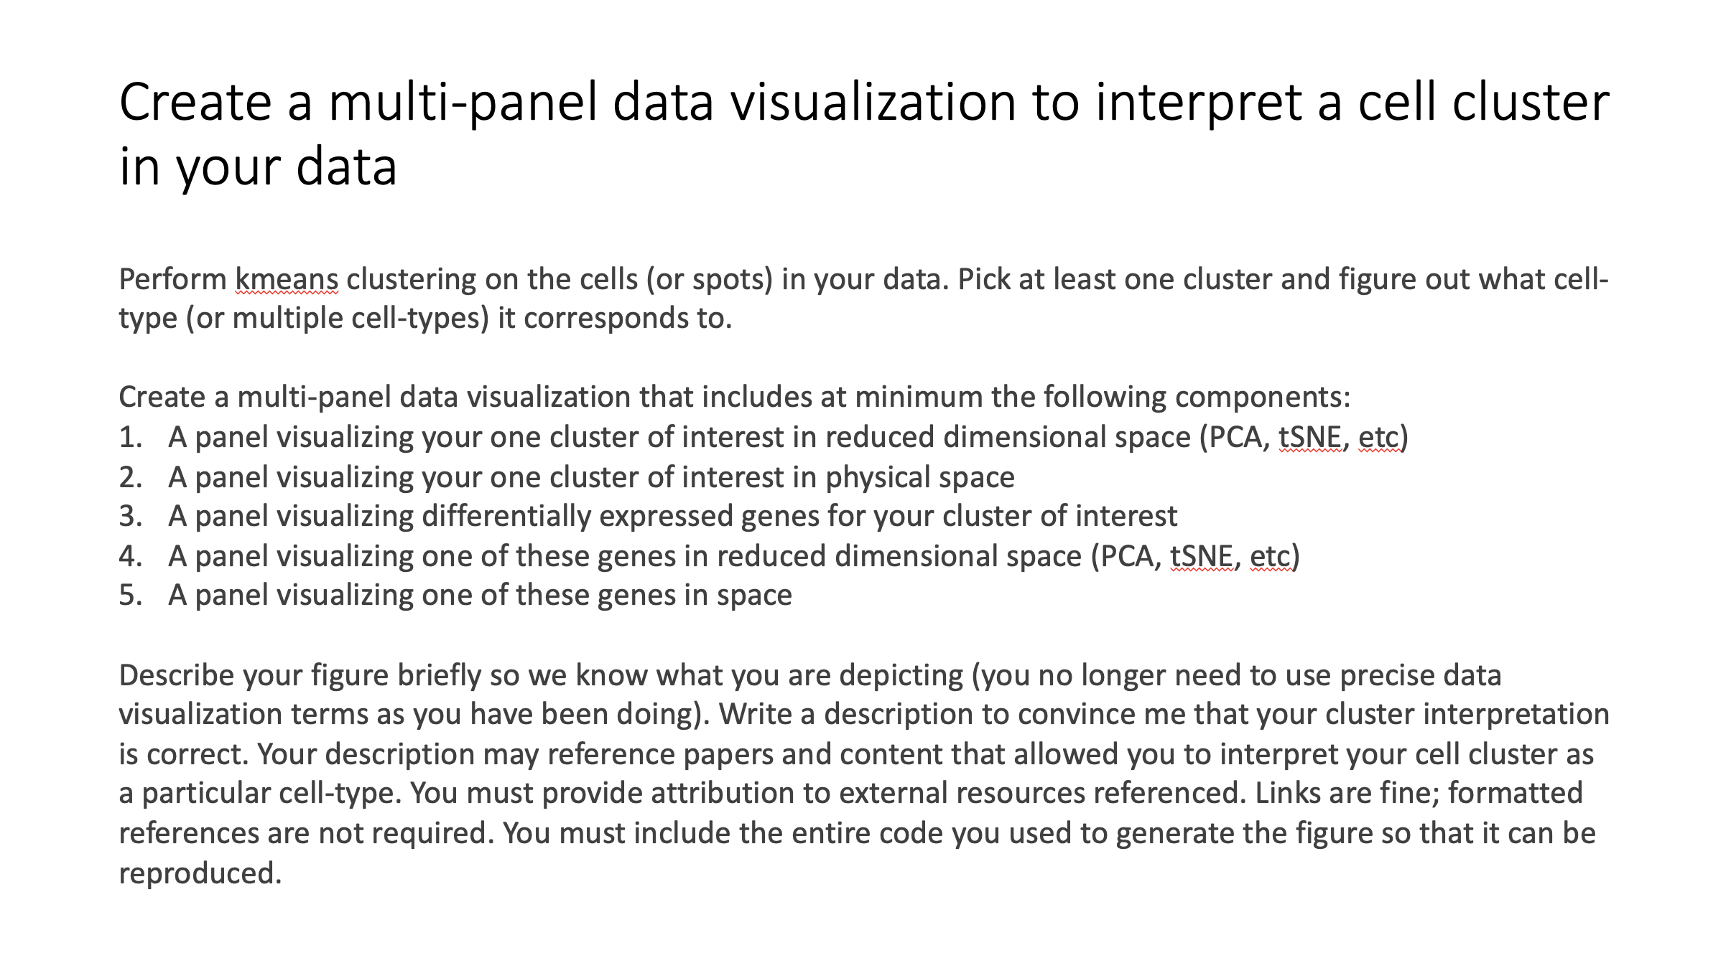
HW3 assigned (due next Wednesday)

Slide 19
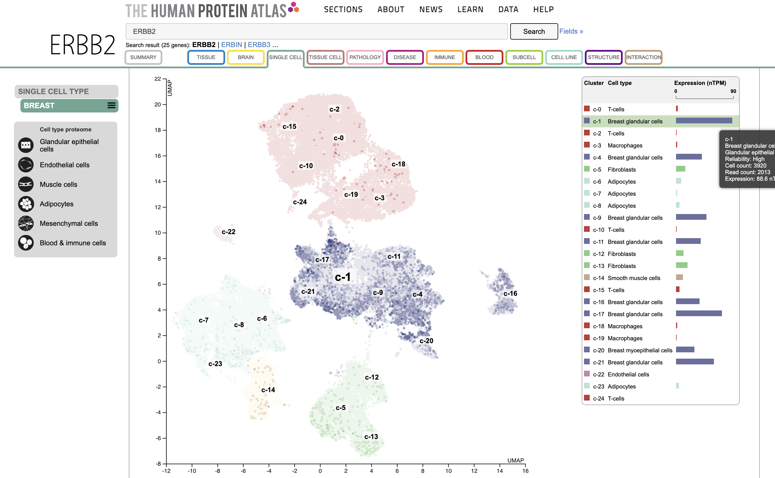
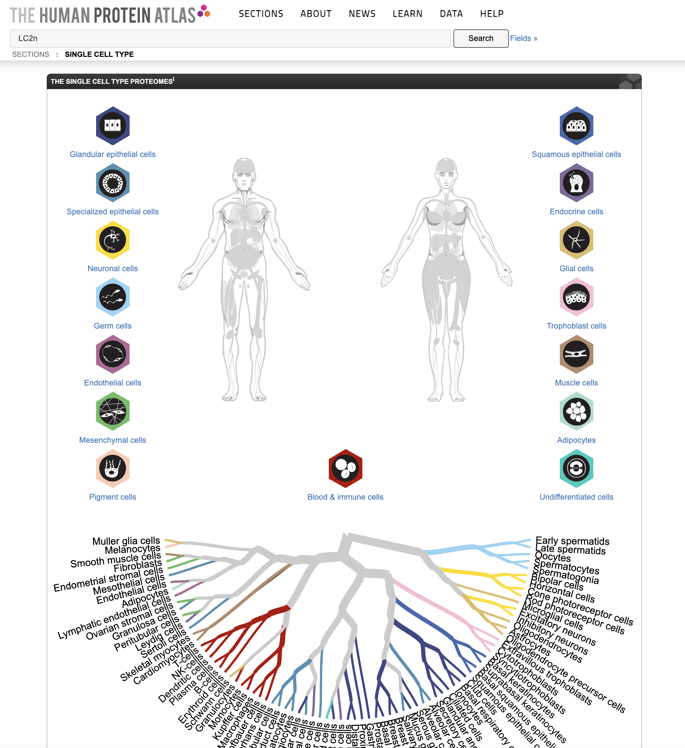
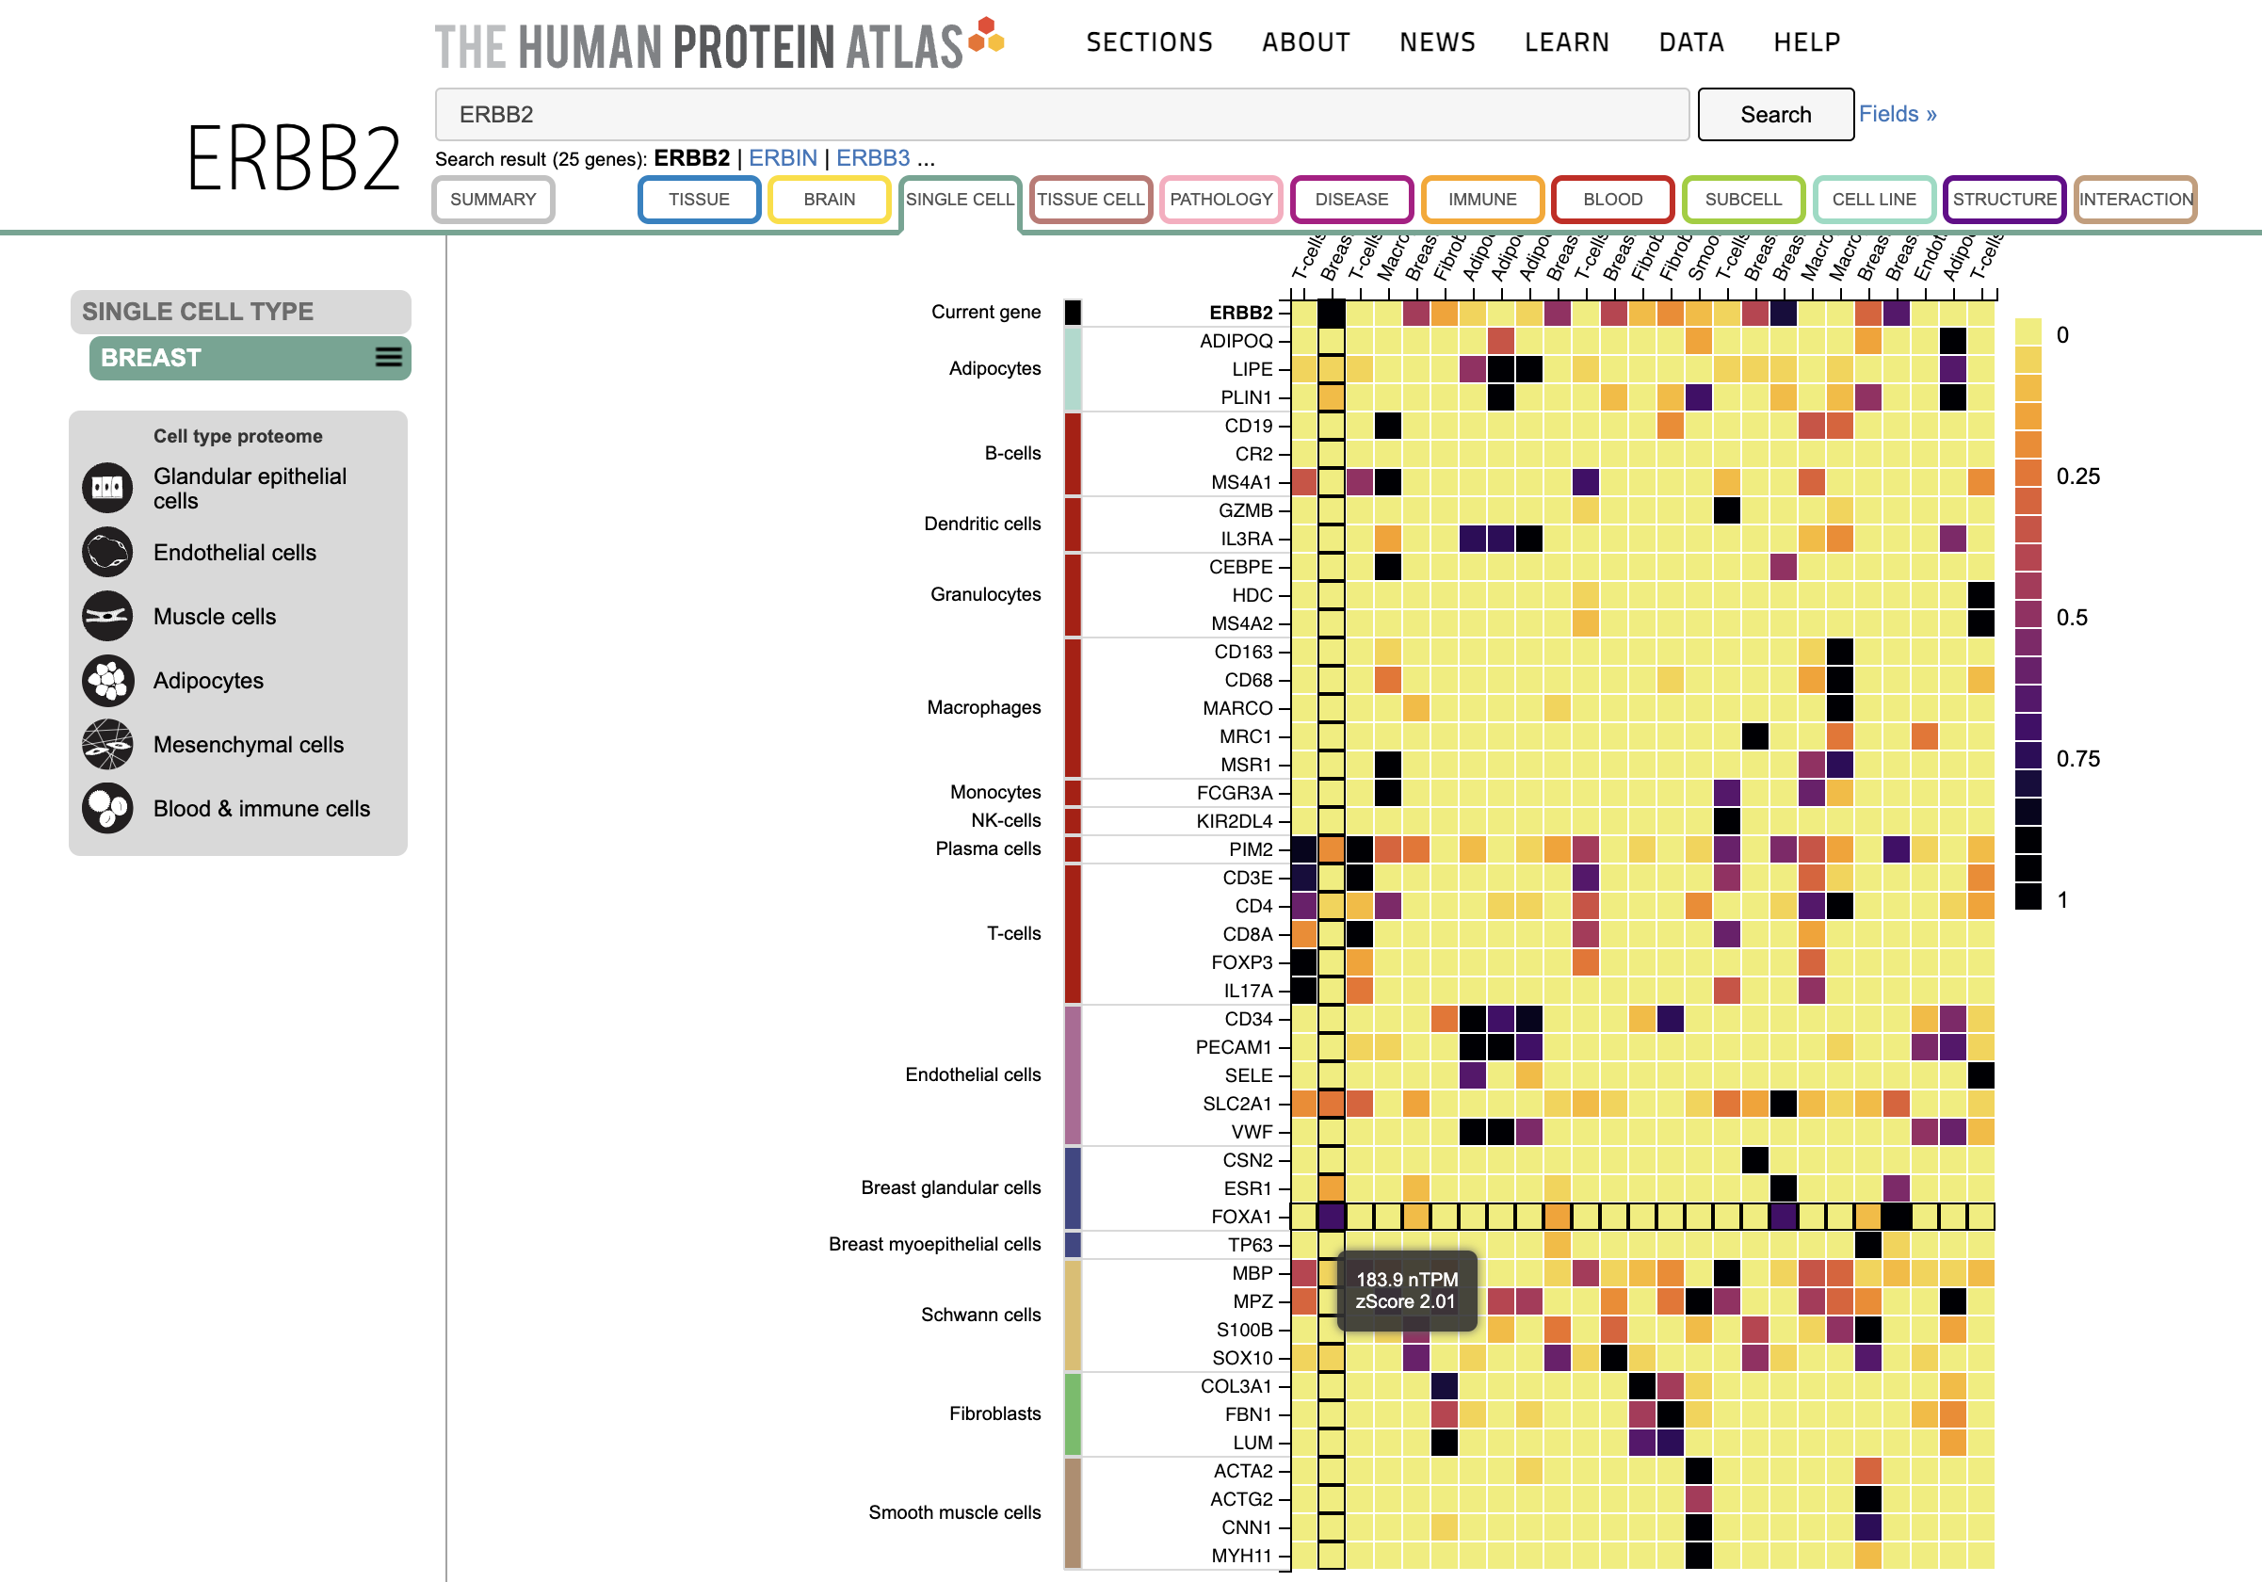
https://www.proteinatlas.org/humanproteome/single+cell+type

Slide 20
Reflection card
https://bit.ly/GDV24_rc

