Slide 1
EN.580.428 Genomic Data Visualization Lesson 8 Review
Prof. Jean Fan

Slide 2
Data Visualization Theory

Slide 3
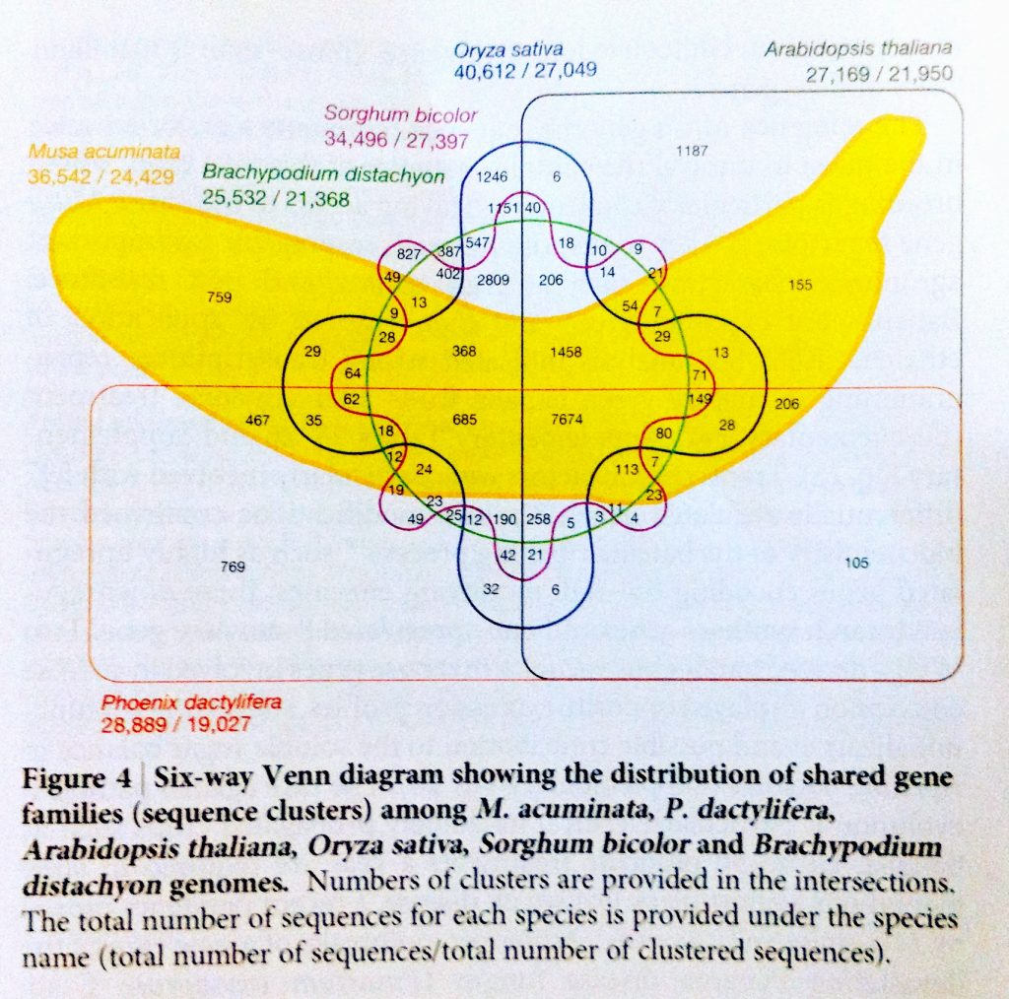
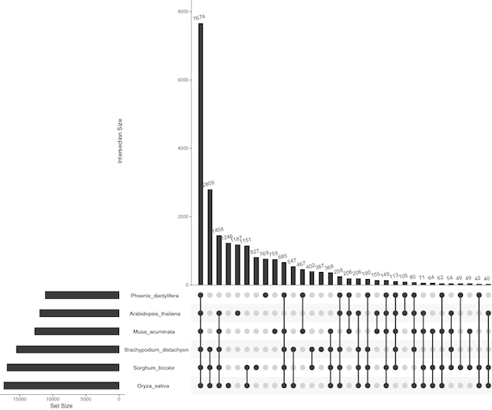

Slide 4
Hue vs saturation

Slide 5
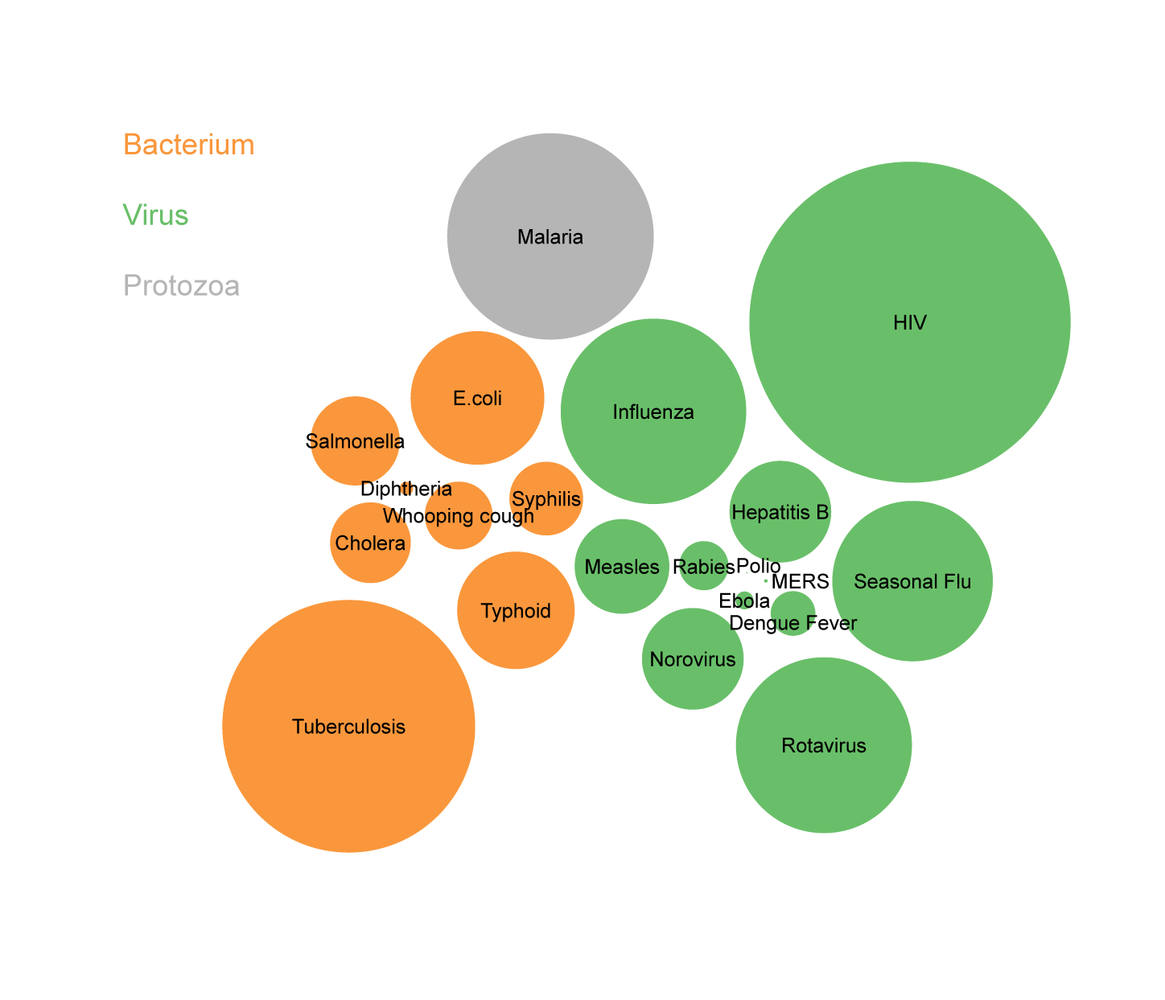
Position vs area

Slide 8
You are the designer, you make the choice

Slide 9
Single molecule fluorescence in situ hybridization
green spots correspond to Suz12 mRNA
red spots correspond to JAZF1 mRNA
nuclei stained blue by DAPI
(Raj et al. 2008)

Slide 10
Multiplexed smFISH

Slide 11
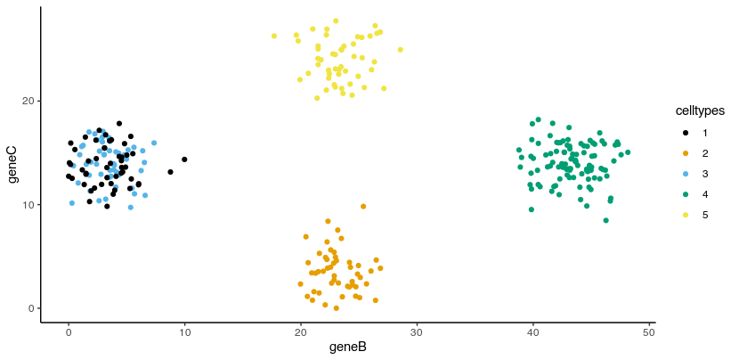
Linear dimensionality reduction: PCA

Slide 12
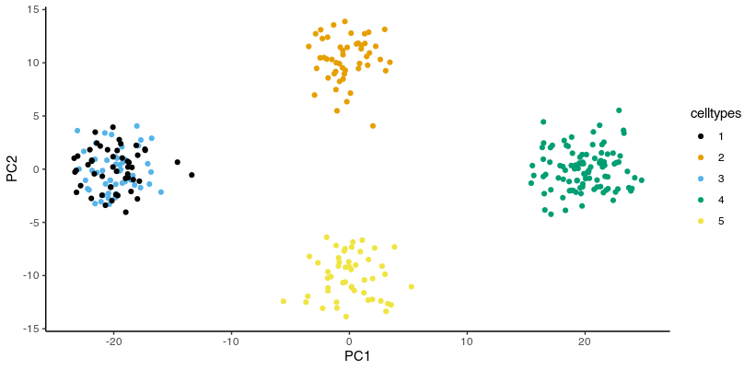
Linear dimensionality reduction: PCA
PC1 PC2
geneB 0.999986905 0.005117549
geneC 0.005117549 -0.999986905

Slide 13
Non-linear dimensionality reduction: tSNE

Slide 14
K-means clustering

Slide 15
Differential Expression

