Slide 1
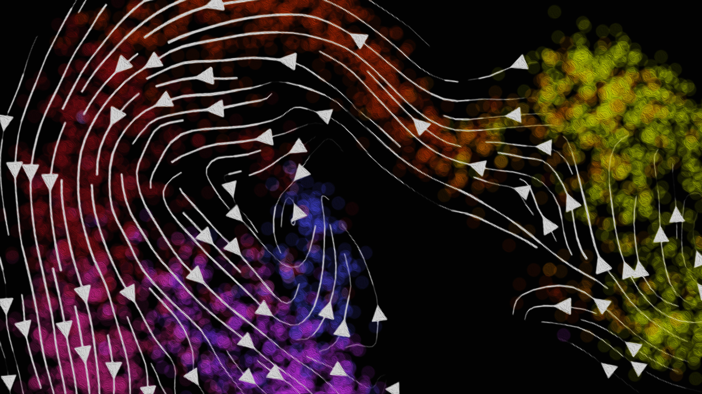
Modeling and Visualizing
RNA Velocity
Jean Fan, PhD
Assistant Professor
Center for Computational Biology
Department of Biomedical Engineering
Johns Hopkins University

Slide 2
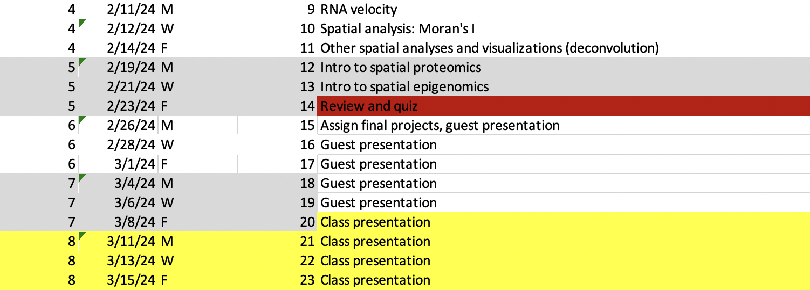
Slight updates to course topics

Slide 3
Multiplexed smFISH IRL

Slide 4
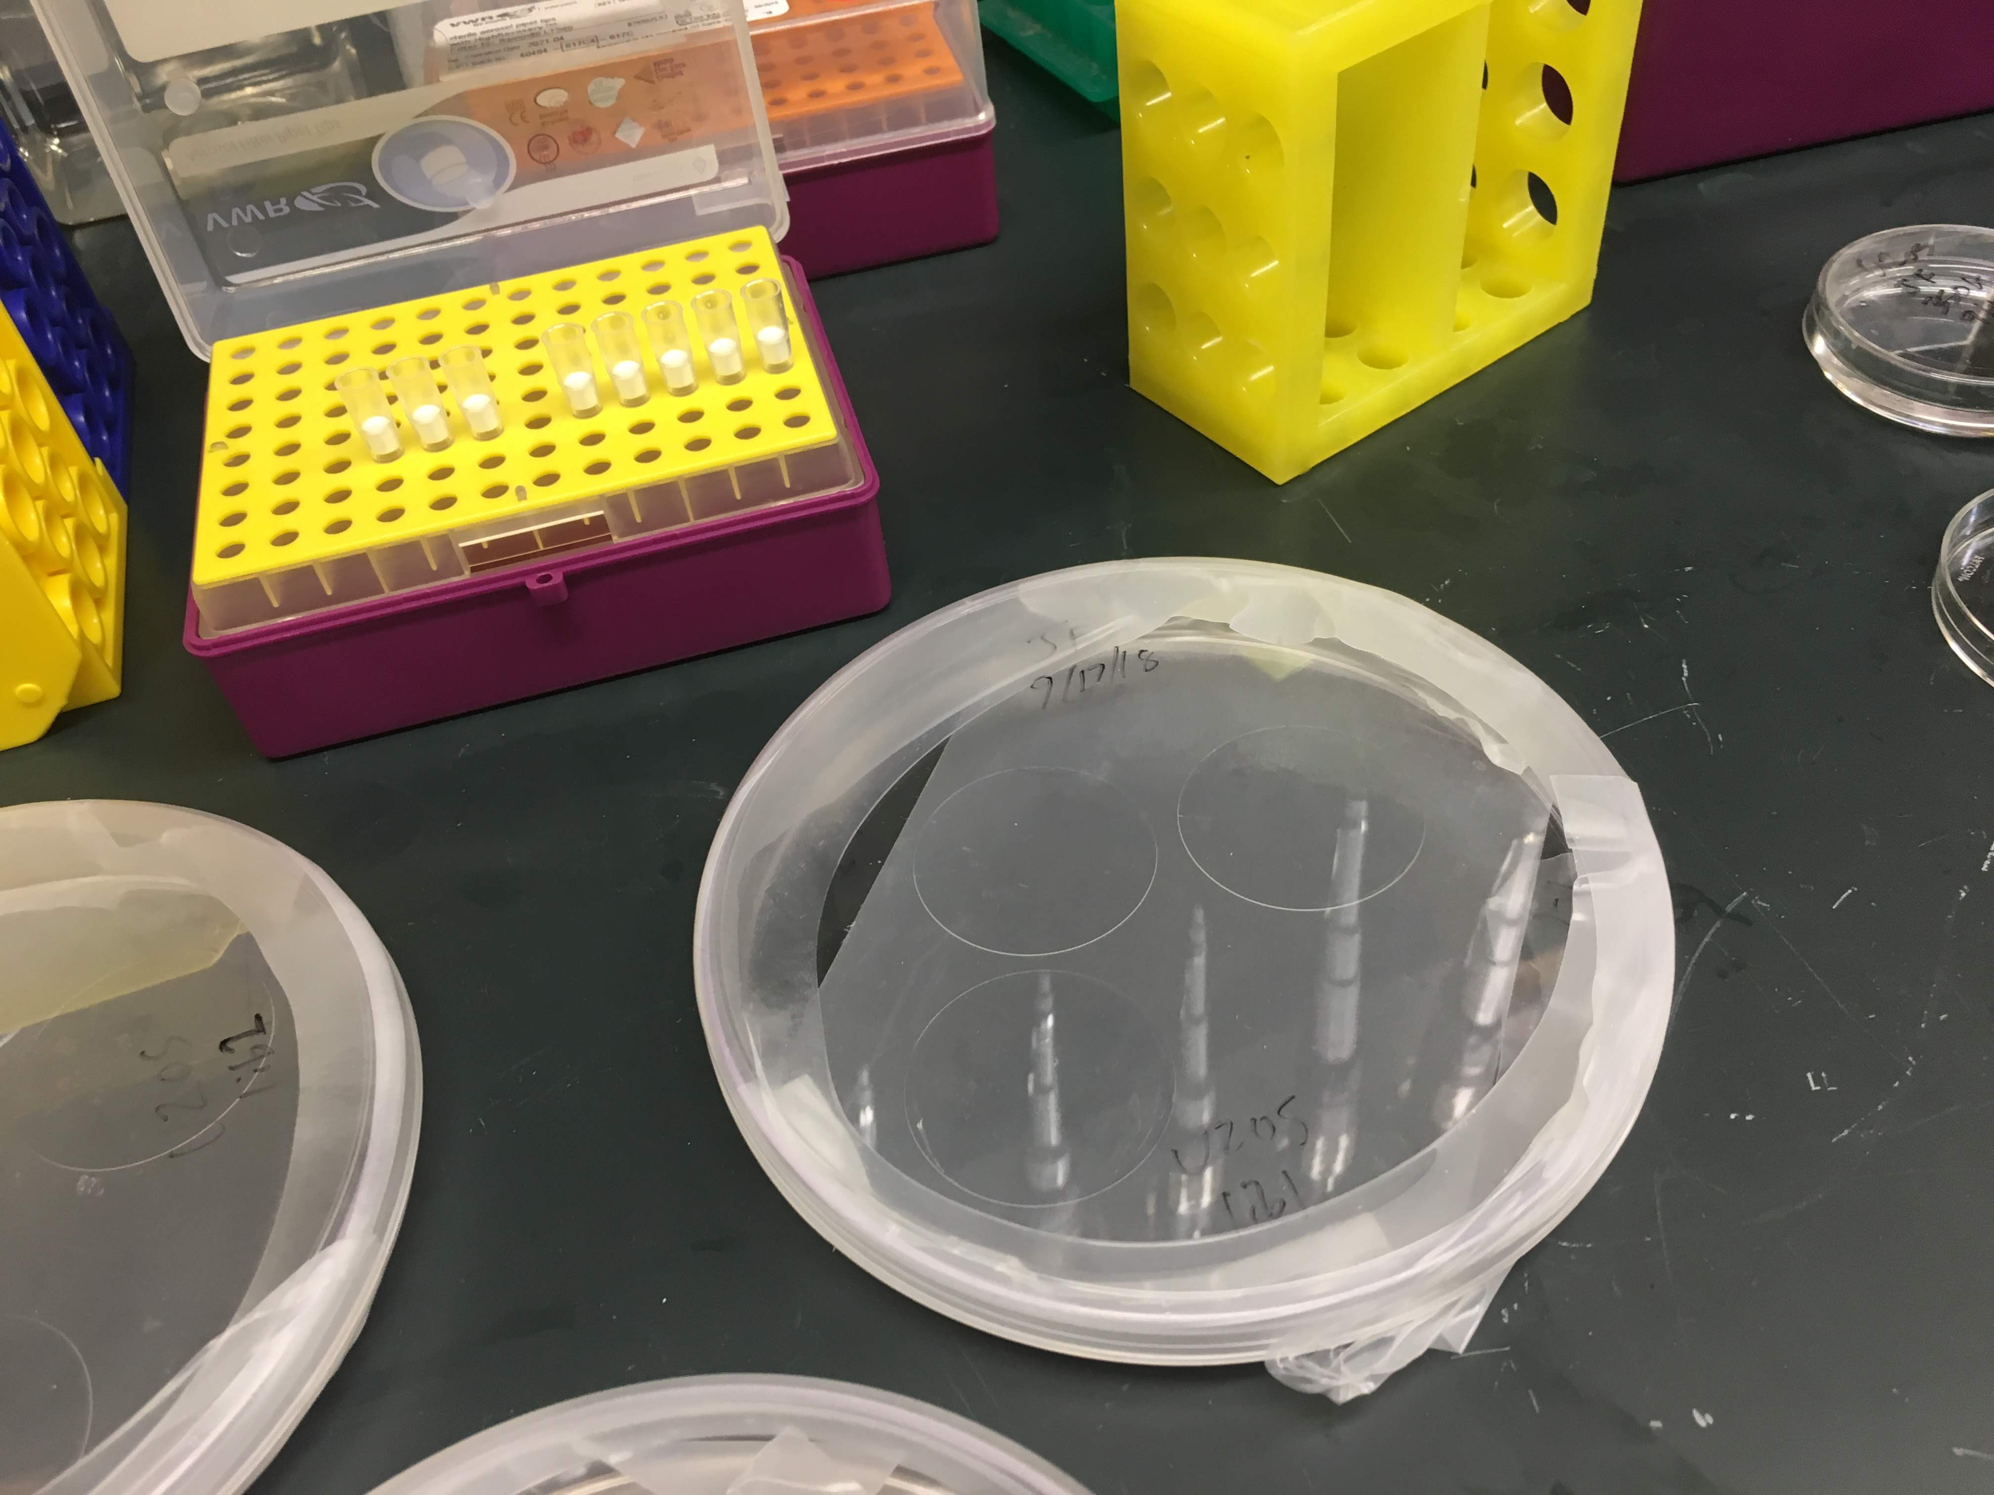
fix cells, hybridize encoding probe @46C over night, wash away unbound probes

Slide 5
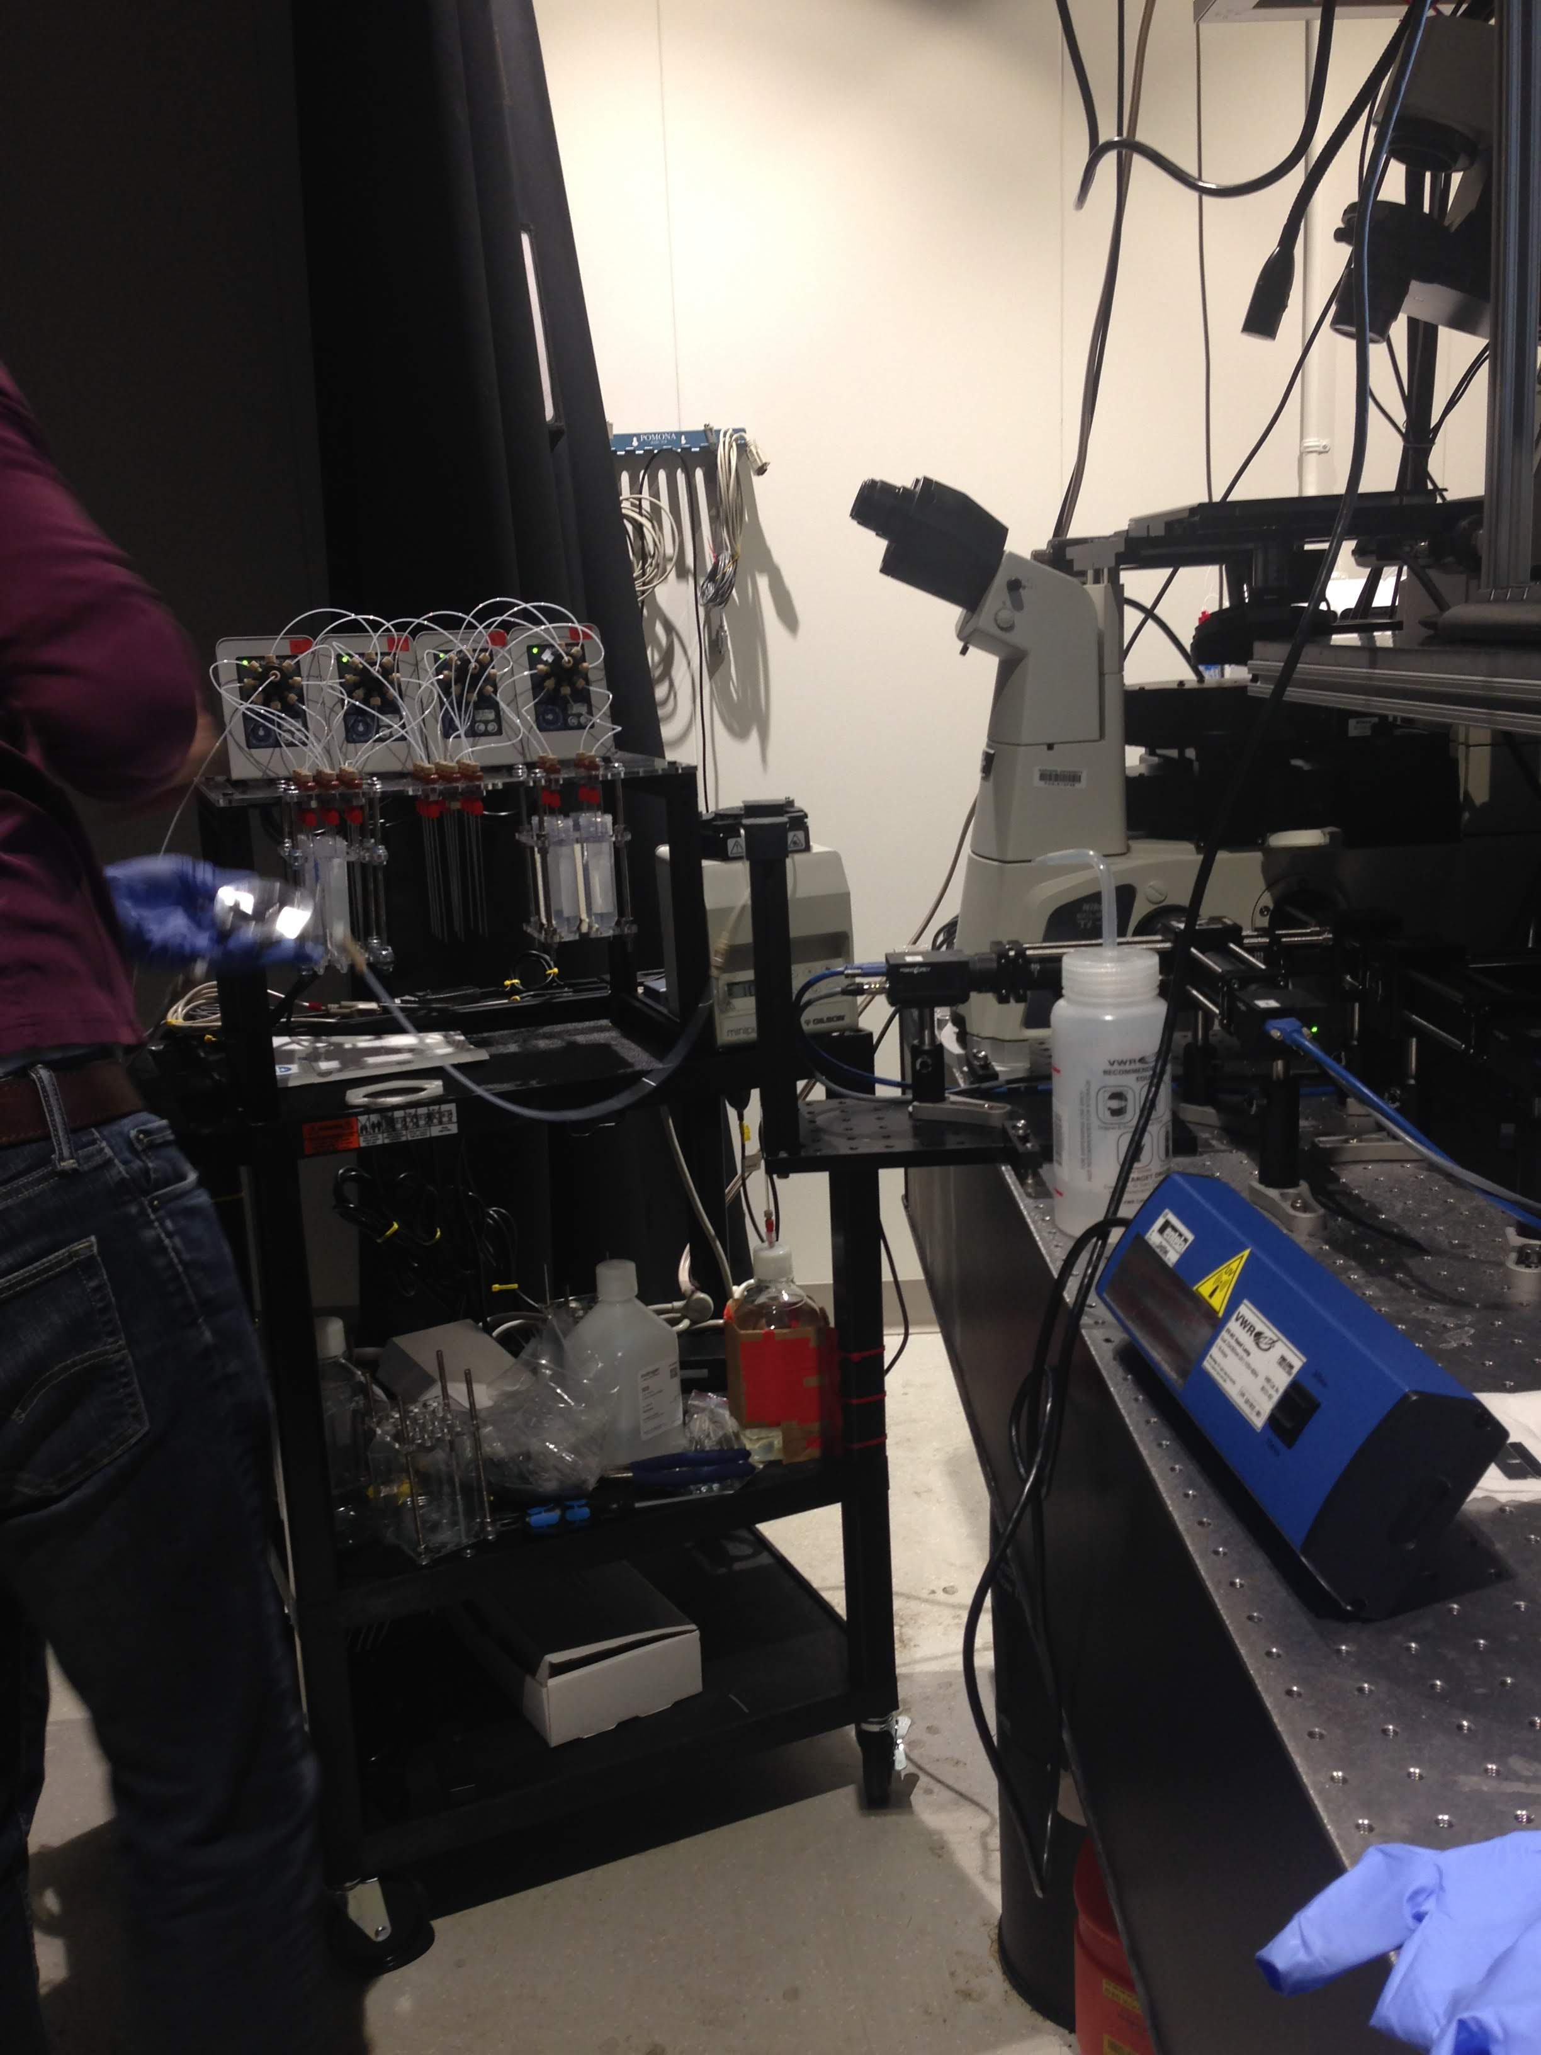
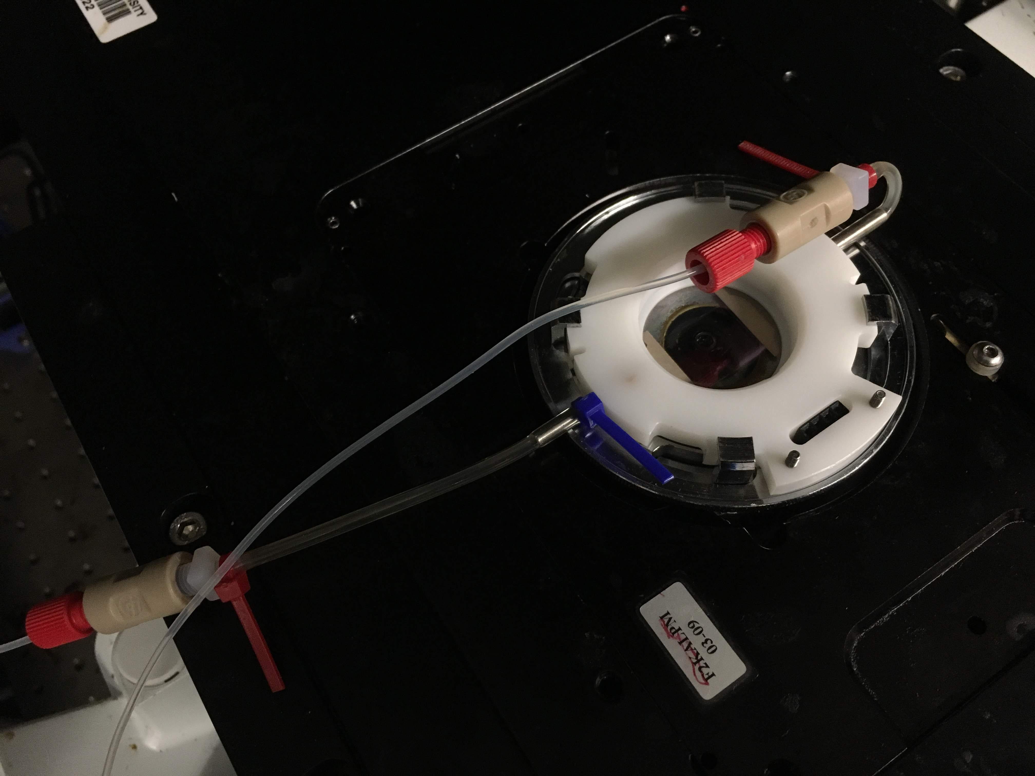
flow on readout probes using microfluidics, wait a few minutes, wash away unbound probes

Slide 6
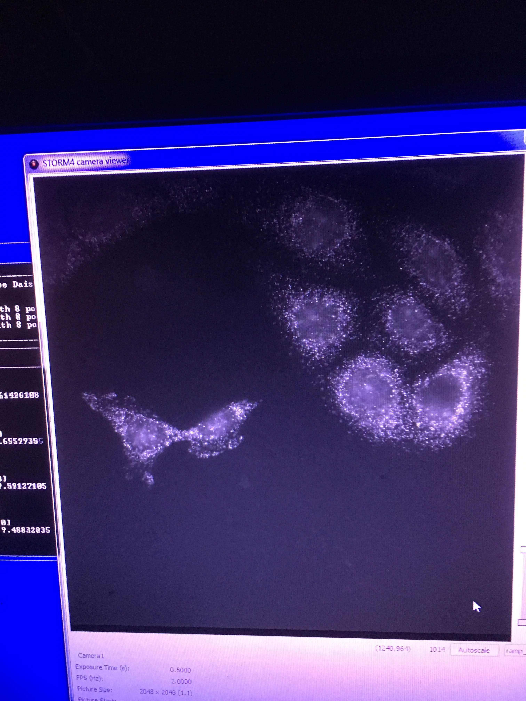
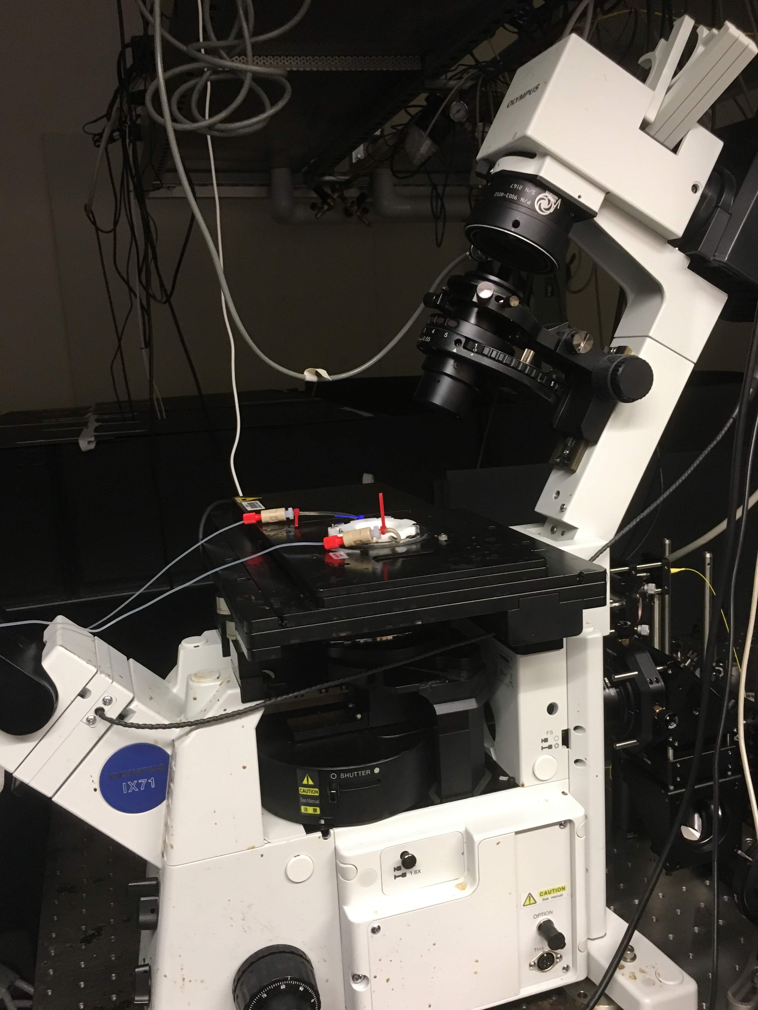
take pictures across many fields of views

Slide 7
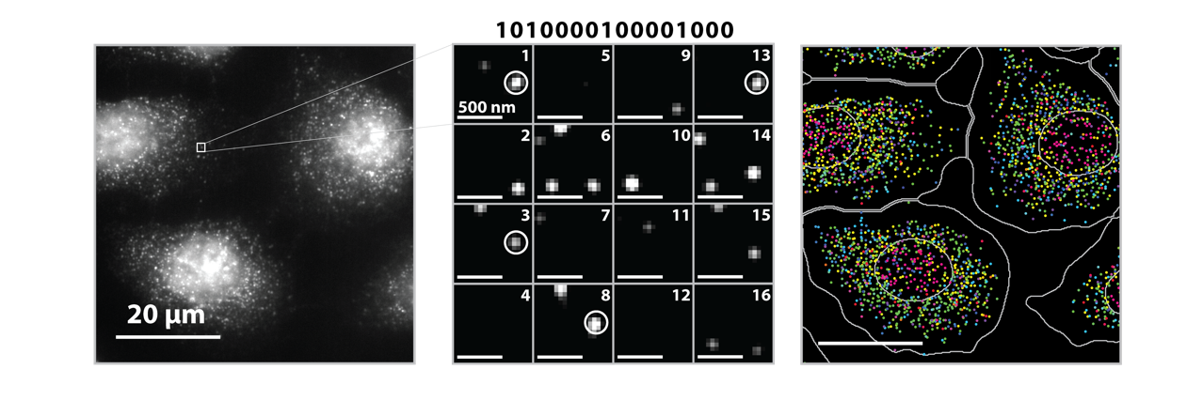
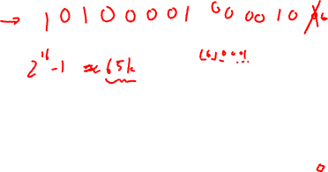
Source: Vizgen, Moffitt lab

Slide 8
(Vizgen 2021)
Notes:
What these technologies allow us to do is not only image where cells are within fixed tissues (here we have a cortical section of the mouse cortex)

Slide 9
(Vizgen 2021)
Notes:
But we can see how genes are expressed within these cells within the tissues
With red being high expression and blue being low expression f
or a targeted set of genes

Slide 10
(Vizgen 2021)
Notes:
But we can see how genes are expressed within these cells within the tissues
With red being high expression and blue being low expression f
or a targeted set of genes

Slide 11
(Vizgen 2021)
Notes:
But we can see how genes are expressed within these cells within the tissues
With red being high expression and blue being low expression f
or a targeted set of genes

Slide 12
(Vizgen 2021)
Notes:
But we can see how genes are expressed within these cells within the tissues
With red being high expression and blue being low expression f
or a targeted set of genes

Slide 13
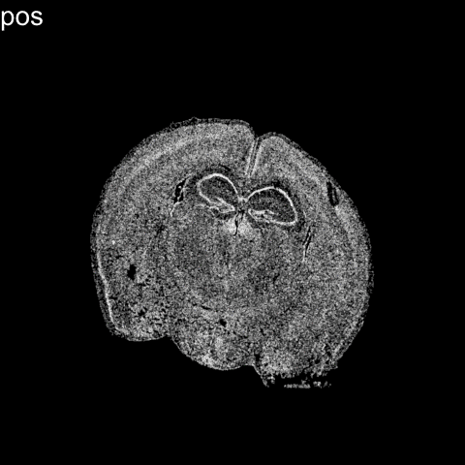


Slide 14
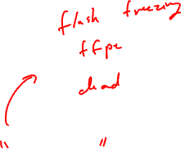
Limitation: cells are fixed
Expression measurements represent static snapshots in time

Slide 15








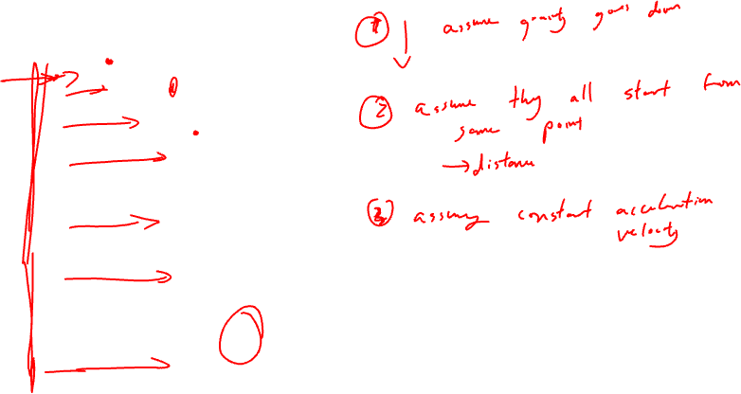

Slide 16
pseudotemporal ordering

Slide 17

directed pseudotemporal ordering

Slide 18







Distance away from the water

Slide 19
Distance away from the rock ledge

Slide 20
OPCs
Genes to be downregulated as a cell matures
Mature
Oligoden
drocytes

Slide 21
OPCs
Genes to be upregulated as a cell matures
Mature
Oligoden
drocytes

Slide 23
pseudotemporal ordering

Slide 24

Which way does it go?

Slide 25
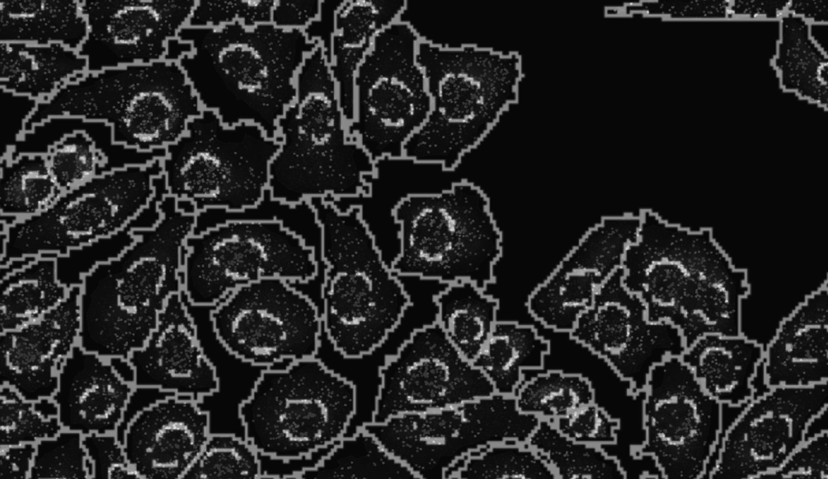


Slide 26
Nuclear vs. cytoplasmic subcellular organization of mRNAs is linked to the regulation of protein expression
(La Manno, et al Nature, August 2018)
(Xia*, Fan*, Emanuel*, et al PNAS, Sept 2019)

Slide 27

Nuclear vs. cytoplasmic subcellular organization of mRNAs is linked to the regulation of protein expression
Oligodendrocyte
maturation marker
(La Manno, et al Nature, August 2018)
(Xia*, Fan*, Emanuel*, et al PNAS, Sept 2019)

Slide 28

Nuclear vs. cytoplasmic subcellular organization of mRNAs is linked to the regulation of protein expression
(La Manno, et al Nature, August 2018)
(Xia*, Fan*, Emanuel*, et al PNAS, Sept 2019)

Slide 29
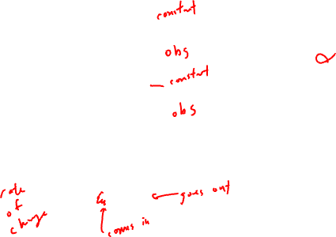
RNA velocity in situ analysis leverages
nuclear and cytoplasmic gene expression to predict the future transcriptional state of cells
(La Manno, et al Nature, August 2018)
(Xia*, Fan*, Emanuel*, et al PNAS, Sept 2019)

Slide 30

RNA velocity in situ analysis leverages
nuclear and cytoplasmic gene expression to predict the future transcriptional state of cells
(La Manno, et al Nature, August 2018)
(Xia*, Fan*, Emanuel*, et al PNAS, Sept 2019)

Slide 31
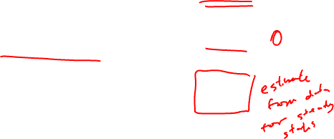
RNA velocity in situ analysis leverages
nuclear and cytoplasmic gene expression to predict the future transcriptional state of cells
(La Manno, et al Nature, August 2018)
(Xia*, Fan*, Emanuel*, et al PNAS, Sept 2019)

Slide 32
RNA velocity in situ analysis leverages
nuclear and cytoplasmic gene expression to predict the future transcriptional state of cells
Assuming constant velocity
(La Manno, et al Nature, August 2018)
(Xia*, Fan*, Emanuel*, et al PNAS, Sept 2019)

Slide 33
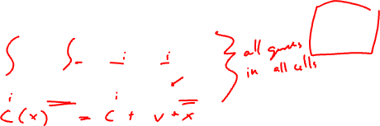
RNA velocity in situ analysis leverages
nuclear and cytoplasmic gene expression to predict the future transcriptional state of cells
Assuming constant velocity
(La Manno, et al Nature, August 2018)
(Xia*, Fan*, Emanuel*, et al PNAS, Sept 2019)

Slide 34

RNA velocity in situ analysis leverages
nuclear and cytoplasmic gene expression to predict the future transcriptional state of cells
Oligodendrocyte
maturation marker
Assuming constant velocity
(La Manno, et al Nature, August 2018)
(Xia*, Fan*, Emanuel*, et al PNAS, Sept 2019)
Notes:
What is the future c(t+dt) for cells are steady state?

Slide 35
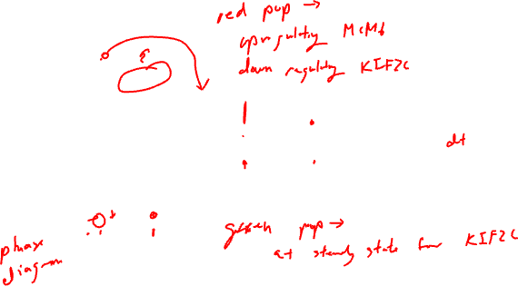
RNA velocity in situ analysis leverages
nuclear and cytoplasmic gene expression to predict the future transcriptional state of cells
(Xia*, Fan*, Emanuel*, et al PNAS, Sept 2019)
Notes:
Indeed

Slide 36
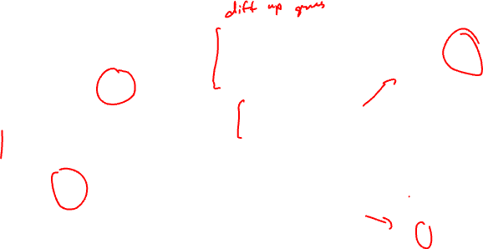
Clustering analysis identifies transcriptionally distinct cell states among cultured U2OS cells
matrix of
gene x cell
(Xia*, Fan*, Emanuel*, et al PNAS 2019)

Slide 37

Clustering analysis identifies transcriptionally distinct cell states among cultured U2OS cells
matrix of
gene x cell
(Xia*, Fan*, Emanuel*, et al PNAS 2019)

Slide 38
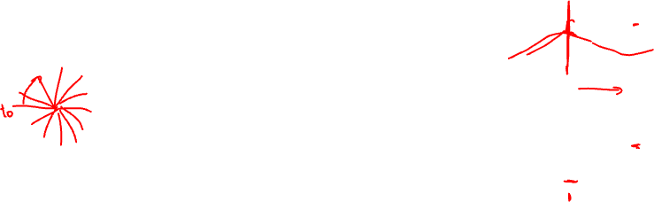
RNA velocity in situ analysis provides a directed ordering of cells so we can look at gene expression as a function of pseudotime
MCM6
KIF2C
(Xia*, Fan*, Emanuel*, et al PNAS 2019)
Notes:
MCM6: encodes a protein that is a component of the Minichromosome Maintenance Complex essential for the initiation of eukaryotic genome replication in G1/S phase transition
KIF2C: encodes a kinesin-like protein that is involved mitotic chromosome segregation during M phase

Slide 39

Pseudotime analysis identifies new cell-cycle genes and highlights gradual transcriptional change throughout select cell-cycle stages
Novel
Known
(Xia*, Fan*, Emanuel*, et al PNAS 2019)

Slide 40
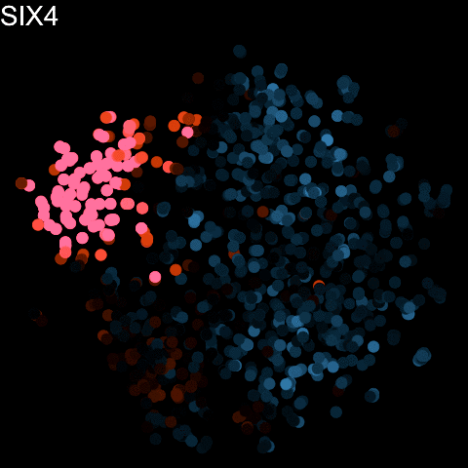

Slide 41
For those interesting in background:
RNA velocity in single-cell sequencing

Slide 42
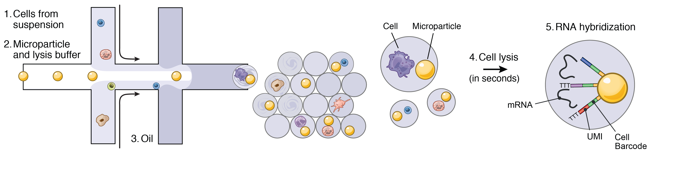
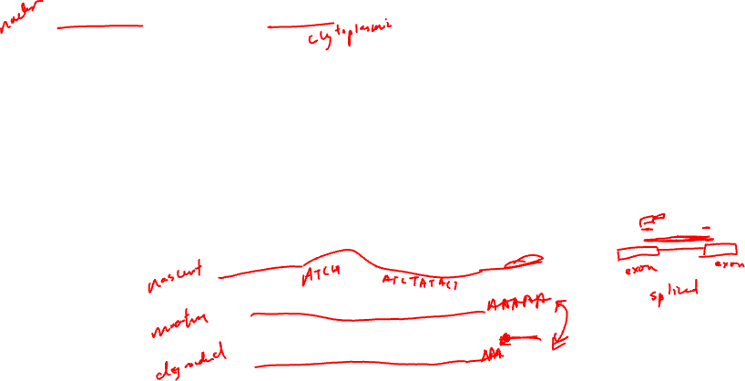
RNA Velocity analysis started with single-cell RNA sequencing…how did the authors distinguish nascent from mature RNAs?

Slide 43
RNA velocity analysis leverages spliced and unspliced gene expression to predict the future transcriptional state of cells
(La Manno, et al Nature 2018)

Slide 44
RNA velocity analysis leverages spliced and unspliced gene expression to predict the future transcriptional state of cells
(La Manno, et al Nature 2018)

Slide 45

Dimensionality reduction and clustering analysis identifies transcriptionally distinct groups of cells in single cell RNA-seq data
matrix of
gene x cell
(La Manno, et al Nature 2018)

Slide 46
RNA Velocity analysis relates these groups of cells as a part of an underlying directed cellular trajectory
matrix of
gene x cell
(La Manno, et al Nature 2018)

Slide 47

(La Manno, et al Nature 2018)
Notes:
Which cell-type is the stem-cell type that gives rise to all these other cell-types?

Slide 48
Resources
Try out the software: http://velocyto.org/
https://scvelo.readthedocs.io/en/stable/
Little challenging to install so we will skip this
Hands on component (for next class)
Interactive visualizations with gganimate → install in class and use next class (in case you run into issues)

Slide 49
Reflection card
https://bit.ly/GDV24_rc

