Slide 1
Homework Assignment 3
Follow Up

Slide 2
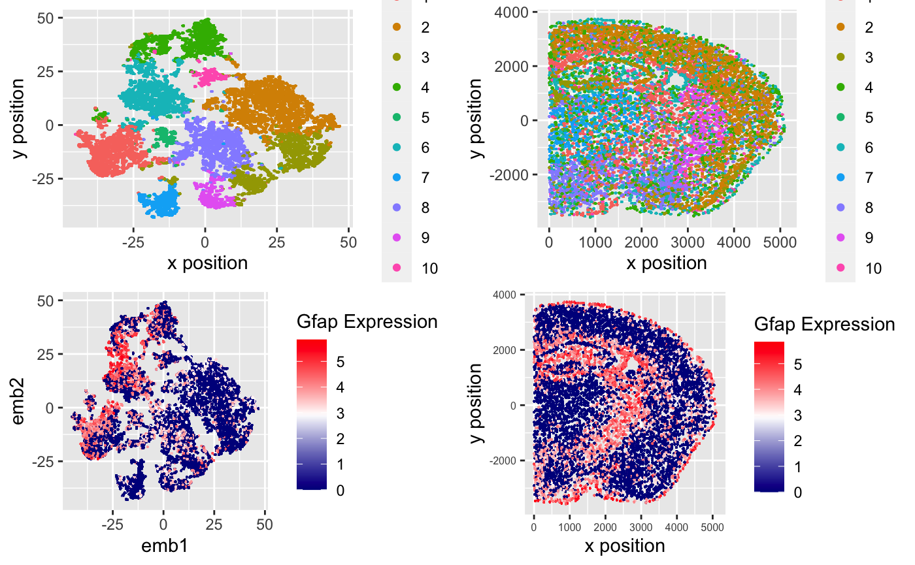
MERFISH
Visium
Source: https://jef.works/genomic-data-visualization/blog/2022/02/12/nli47/

Slide 3
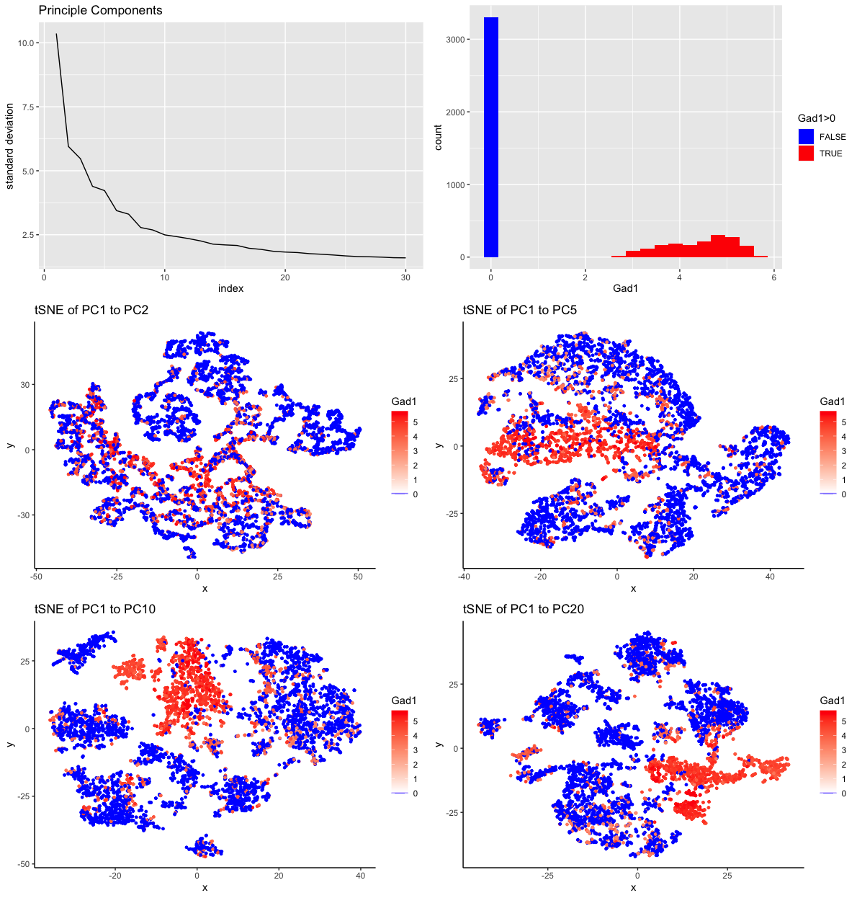
MERFISH
Visium
Source: https://jef.works/genomic-data-visualization/blog/2022/02/12/kclifto2/

Slide 4
Homework Assignment 4
Due Thursday (6pm Baltimore Time)

Slide 5
Homework
In either the MERFISH or Visium dataset, identify and visualize the spatial distribution of Mature Oligodendrocytes
Create a multi-panel data visualization with a corresponding ‘figure caption’ that describes your data visualization to convince me that you have correctly identified Mature Oligodendrocytes
Submit your HW as you did for HW1 and HW3 including your code

Slide 6
Hints
Mature Oligodendrocytes are a type of glial cell canonically marked by Olig1, Olig2, and Olig3
Mature Oligodendrocytes should also express Osp, Mbp, Mog, and Sox10 though these genes may also be expressed in other cell-types
Caution: Oligodendrocyte Progenitor Cells (OPCs) also express high levels of Olig1, Olig2, and Olig3 but also express Pdgfra
Mature oligodendrocytes do not express Pdgfra

Slide 7
Interpreting clusters
Where we left off from class 20220209

Slide 8
Interpreting clusters
Where we left off from class 20220209

Slide 9
Visualizing one gene
df <- data.frame(
value = mat[, 'Adgrl4'],
col = as.factor(vi))
ggplot(
data = df,
mapping = aes(x=col, y=value)) +
geom_point() +
theme_classic()

Slide 10
Visualizing one gene
ggplot(
data = df,
mapping = aes(x=col, y=value)) +
geom_jitter() +
theme_classic()

Slide 11
Visualizing one gene
ggplot(
data = df,
mapping = aes(x=value, fill=col)) +
geom_histogram() +
theme_classic()

Slide 12
Visualizing one gene
ggplot(
data = df,
mapping = aes(x=col, y=value,
fill=col)) +
geom_boxplot() +
theme_classic()

Slide 13
Visualizing one gene
ggplot(
data = df,
mapping = aes(x=col, y=value, fill=col)) +
geom_boxplot() +
geom_jitter(alpha = 0.1) +
theme_classic()

Slide 14
Visualizing one gene
ggplot(
data = df,
mapping = aes(x=col, y=value,
fill=col)) +
geom_violin() +
theme_classic()

Slide 15
Visualizing a few genes
df <- reshape2::melt(
data.frame(id=rownames(mat),
mat[, c('Adgrl4', 'Gad1', 'Aqp4')],
col=as.factor(vi)))
> head(df)
id col variable value
1 cell26916 FALSE Adgrl4 0.000000
2 cell36525 FALSE Adgrl4 0.000000
3 cell39227 FALSE Adgrl4 0.000000
4 cell26894 FALSE Adgrl4 3.166512
5 cell19686 FALSE Adgrl4 0.000000
6 cell36172 FALSE Adgrl4 0.000000

Slide 16
Visualizing a few genes
ggplot(data = df,
mapping = aes(x=col, y=value)) +
geom_point() +
theme_classic() +
facet_wrap(~ variable)

Slide 17
Visualizing a few genes
ggplot(data = df,
mapping = aes(x=col, y=value, fill=col)) +
geom_boxplot() +
theme_classic() +
facet_wrap(~ variable)

Slide 18
A few genes across multiple clusters
df <- reshape2::melt(
data.frame(id=rownames(mat),
mat[, c('Adgrl4', 'Gad1', 'Aqp4')],
col=as.factor(com$cluster)))
ggplot(data = df,
mapping = aes(x=col, y=value, fill=col)) +
geom_boxplot() +
theme_classic() +
facet_wrap(~ variable)

Slide 19
A few genes across multiple clusters
ggplot(data = df,
mapping = aes(x=col, y=value, fill=col)) +
geom_boxplot() +
theme_classic() +
facet_grid(variable ~ .)

Slide 20
Many genes across multiple clusters
g1 <- names(which(pvs < 0.05))
g1 <- names(sort(fcs[g1], decreasing=TRUE))
m <- mat[names(sort(com$cluster)),g1]
heatmap(as.matrix(m), Rowv=NA, Colv=NA, scale='none')

Slide 21
Many genes across multiple clusters
col = rainbow(8)[as.factor(com$cluster)]
names(col) <- names(com$cluster)
heatmap(as.matrix(m), Rowv=NA, Colv=NA, scale='none',
RowSideColors = col[rownames(m)])

Slide 22
Many genes across multiple clusters
heatmap(as.matrix(m), Rowv=NA, Colv=NA, scale='none',
RowSideColors = col[rownames(m)],
col=colorRampPalette(
c('blue', 'white', 'red'))(50))

Slide 23
Summarizing the average expression within each cluster
# source: https://jef.works/blog/2020/04/06/quickly-creating-pseudobulks/
getPseudobulk <- function(mat, celltype) {
mat.summary <- do.call(rbind, lapply(levels(celltype), function(ct) {
cells <- names(celltype)[celltype==ct]
pseudobulk <- colMeans(mat[cells, ])
return(pseudobulk)
}))
rownames(mat.summary) <- levels(celltype)
return(mat.summary)
}
celltype <- as.factor(com$cluster); names(celltype) <- rownames(mat)
mat.summary <- getPseudobulk(mat, celltype)
heatmap(as.matrix(mat.summary[,g1]), Rowv=NA, Colv=NA, scale='none',
col=colorRampPalette(c('blue', 'white', 'red'))(50))

Slide 24
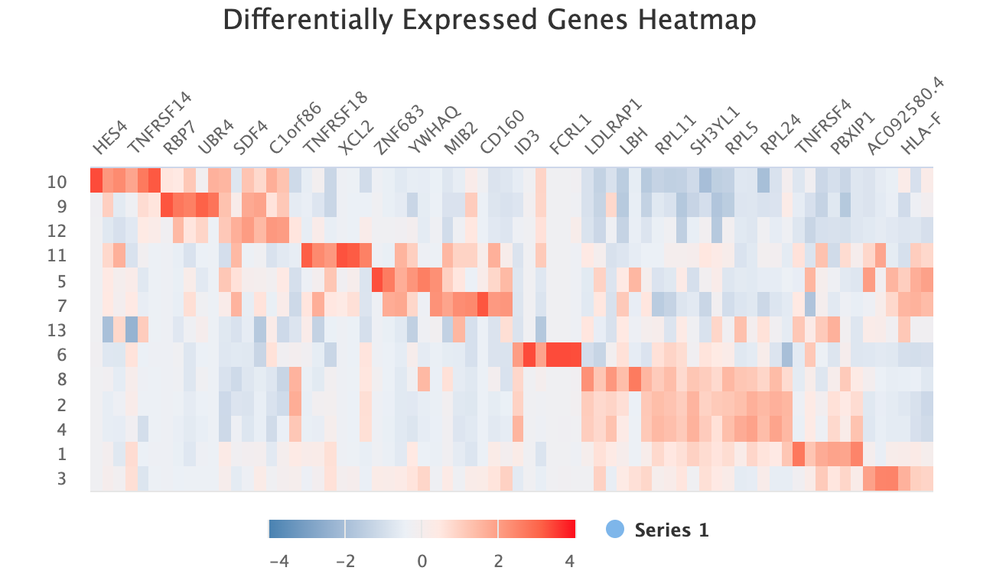
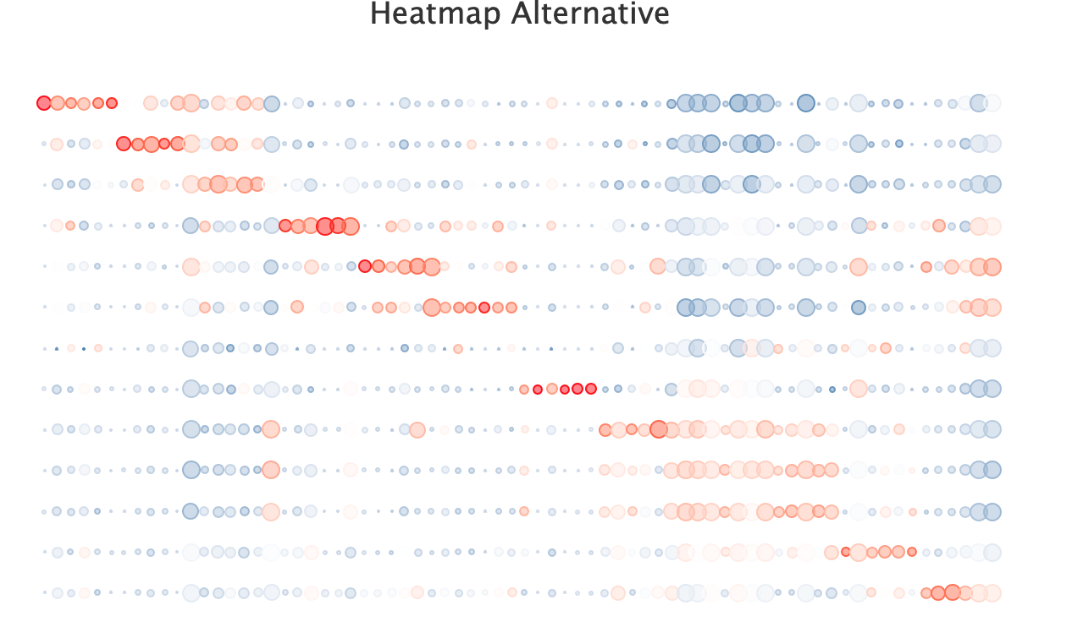
Other ideas
Source: https://jef.works/blog/2018/04/25/visually-summarizing-differential-gene-expression/

Slide 25
Which dimension should I cluster on?
A) tSNE embedding
B) 30 PCs
C) Gene expression

Slide 26
Which k should I use?
A) K=10
B) K = 20
C) K = 50

Slide 27
So how do we find the “right” number of PCs? Or the “right” k?
The right analysis is the one that allows you to discover something
There may not be a single right analysis
Ex. K
These are still an open areas of research
Nature of pushing the boundaries of science: there is no “right” answer
It’s up to you to discover the “right” answer
And convince yourself that what you discovered is “right”
(or for homework, convince me!)

Slide 28
Just because there isn’t a right answer, doesn’t mean there are not wrong ones
Clusters should be reasonably stable (cell-type doesn’t disappear if you change the parameters slightly)
I reran tSNE with a different seed
Visualized using same colors as previous
Recall our noise dataset
Clustered on the embedding

Slide 29
Animation is helpful for evaluating stability
library(gganimate)
a <- data.frame(emb, cluster2, 'emb1')
b <- data.frame(emb2, cluster2, 'emb2')
colnames(a) <- colnames(b) <- c('x', 'y', 'cluster', 'type')
df.trans <- rbind(a, b)
p <- ggplot(df.trans, aes(x = x, y = y, col=cluster)) +
geom_point(show.legend = FALSE) +
theme_void()
anim <- p +
transition_states(type,
transition_length = 5,
state_length = 1) +
labs(title = '{closest_state}') +
theme(plot.title = element_text(size = 28)) +
enter_fade()
anim

Slide 30
Other ways to use animation?
For today’s hands on component, we will apply animation to our real datasets

Slide 31
Some biology-specific rules
Clusters should have at least a few differentially upregulated genes
Clusters should ideally be reproduced by orthogonal measurements
In a second tissue, I can find the same cell-types, perhaps even by a different technique

Slide 32
Additional potentially helpful resources
ggforce: https://ggforce.data-imaginist.com/index.html
For annotating clusters ex. https://ggforce.data-imaginist.com/reference/geom_mark_circle.html
ggrepel: https://cran.r-project.org/web/packages/ggrepel/vignettes/ggrepel.html
For labeling volcano plots or plots with many points
ggcorplot: http://www.sthda.com/english/wiki/ggcorrplot-visualization-of-a-correlation-matrix-using-ggplot2
For heatmaps in ggplot

