Slide 1
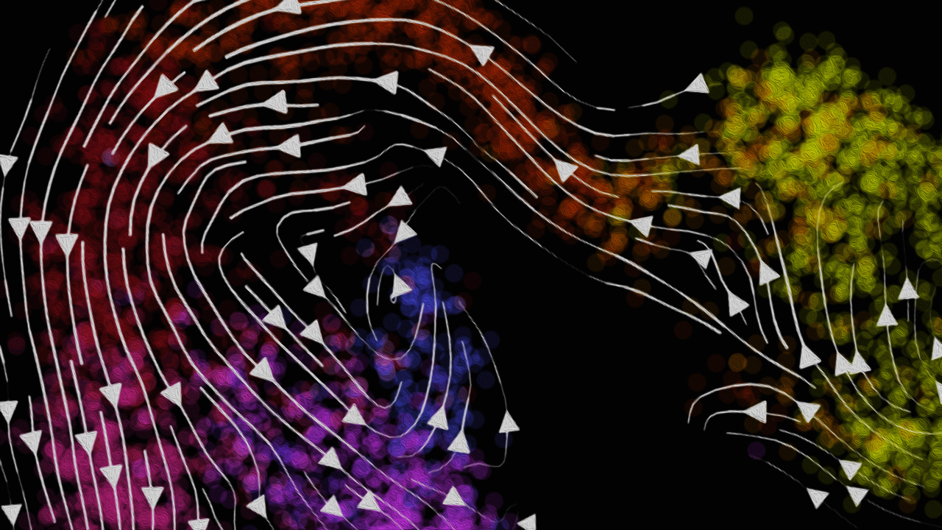
Modeling and Visualizing
RNA Velocity of Single Cells
Jean Fan, PhD
Assistant Professor
Center for Computational Biology
Department of Biomedical Engineering
Johns Hopkins University

Slide 2
MERFISH Review

Slide 3
Source: Vizgen, Moffitt lab

Slide 4
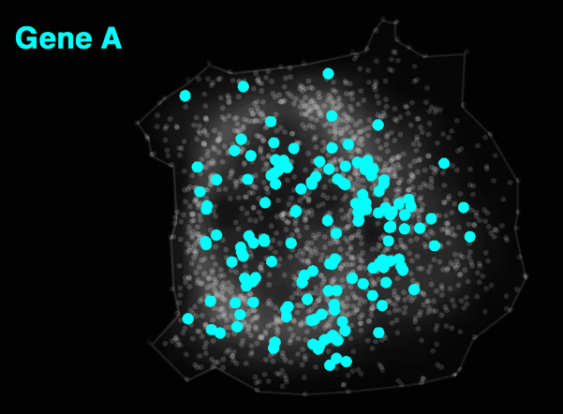
Decoded Data
Notes:
But effectively what MERFISH allows us to do is image RNA molecules that correspond to Gene A
And simultaneously also
...

Slide 5
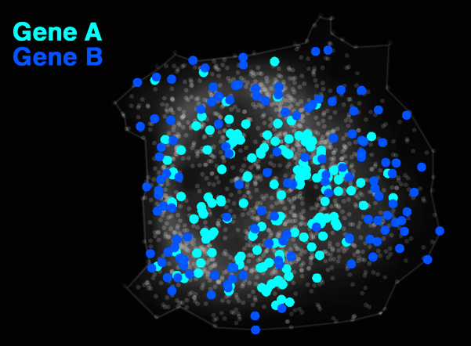
Decoded Data

Slide 6
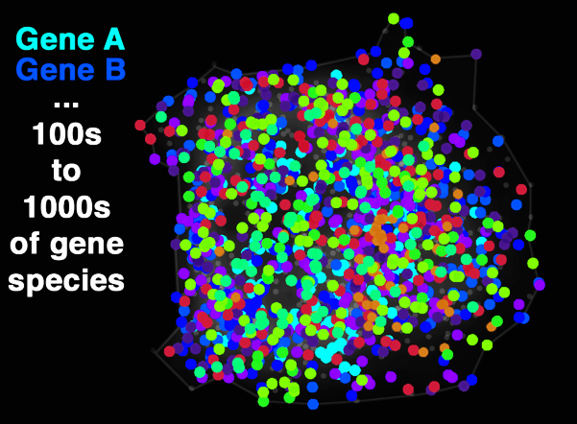
Decoded Data
Notes:
16 to 64 rounds of imaging

Slide 7
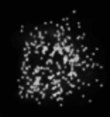

Slide 8
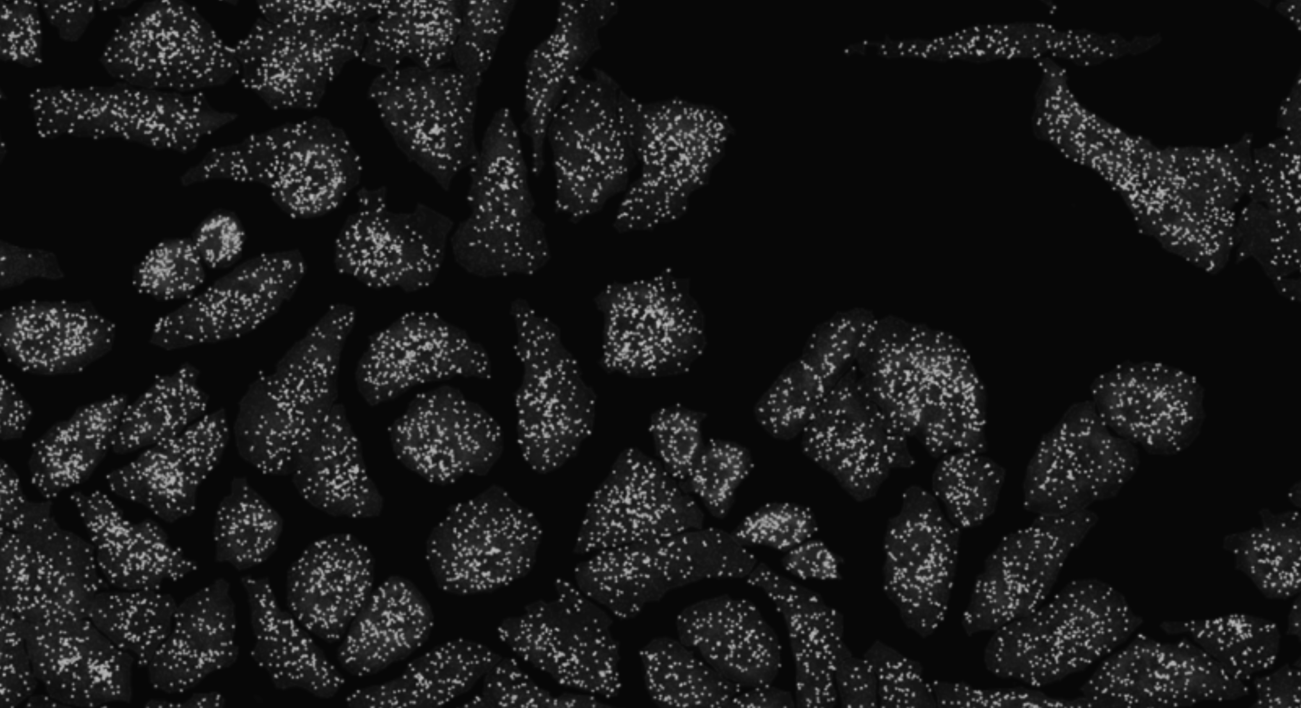

Slide 9
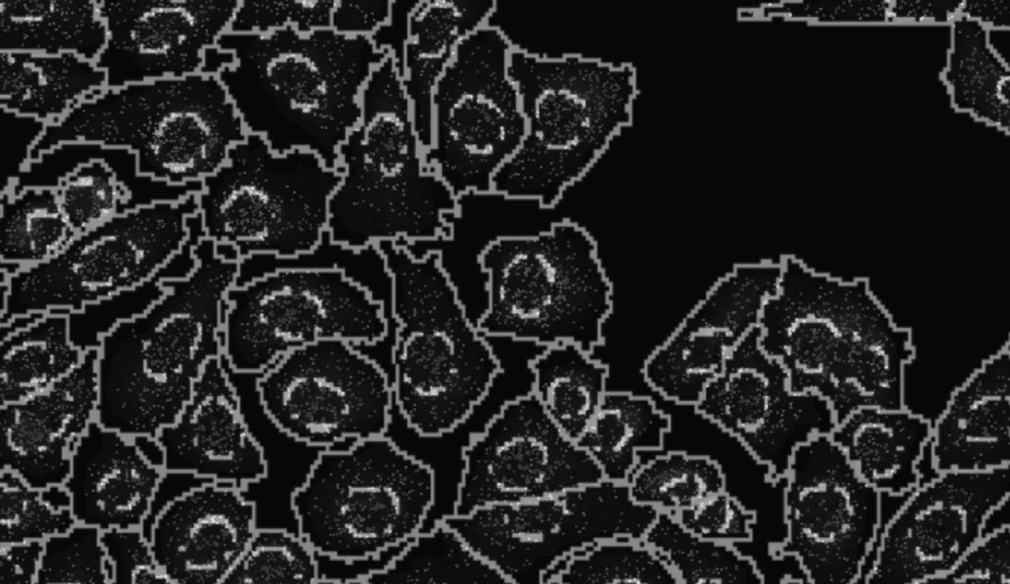

Slide 10
(Vizgen 2021)
Notes:
What these technologies allow us to do is not only image where cells are within fixed tissues (here we have a cortical section of the mouse cortex)

Slide 11
(Vizgen 2021)
Notes:
But we can see how genes are expressed within these cells within the tissues
With red being high expression and blue being low expression f
or a targeted set of genes

Slide 12
(Vizgen 2021)
Notes:
But we can see how genes are expressed within these cells within the tissues
With red being high expression and blue being low expression f
or a targeted set of genes

Slide 13
(Vizgen 2021)
Notes:
But we can see how genes are expressed within these cells within the tissues
With red being high expression and blue being low expression f
or a targeted set of genes

Slide 14
(Vizgen 2021)
Notes:
But we can see how genes are expressed within these cells within the tissues
With red being high expression and blue being low expression f
or a targeted set of genes

Slide 15
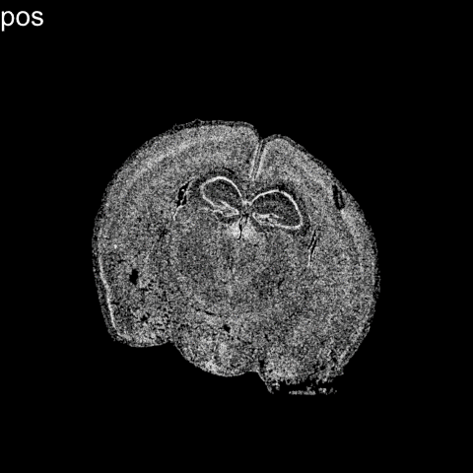
Notes:
Further we can perform dimensionality reduction and clustering analysis as we do with non-spatially resolved single-cell transcriptomics data to identify transcriptionally distinct cell-types
But now we can further explore how these cell-types are spatially organize in the original tissue

Slide 16
Notes:
So we can see that different cell-types within tissues such as the brain are often spatially organized
And given these cell-types are transcriptionally distinct, we would expect genes that mark these different cell-types to also be spatially organized
However, if we focus on an individual cell-type

Slide 17
Limitation: cells are fixed
Expression measurements represent static snapshots in time

Slide 18
Notes:
One limitation of these single-cell transcriptome profiling technologies is fixed cells

Slide 19
pseudotemporal ordering

Slide 20
directed pseudotemporal ordering
Notes:
Predict future x,y positioning
Based on assumed downway gravity and angular jumpoff from other people
So from this static image, we can infer certain dynamics regarding the spatial position of people given certain assumptions of gravity and similar angular momentum

Slide 21
Distance away from the water

Slide 22
Distance away from the rock ledge

Slide 23
OPCs
Genes to be downregulated as a cell matures
Mature
Oligoden
drocytes

Slide 24
OPCs
Genes to be upregulated as a cell matures
Mature
Oligoden
drocytes

Slide 26
pseudotemporal ordering

Slide 27
Which way does it go?

Slide 28
Notes:
What is something in this static snapshot that can inform us about directionality?
Where are genes born? Where are new genes made?

Slide 29
Nuclear vs. cytoplasmic subcellular organization of mRNAs is linked to the regulation of protein expression
(La Manno, et al Nature, August 2018)
(Xia*, Fan*, Emanuel*, et al PNAS, Sept 2019)
Notes:
We also know something about dynamic cellular processes from a static image when we look at subcellular organization of mRNAs

Slide 30
Nuclear vs. cytoplasmic subcellular organization of mRNAs is linked to the regulation of protein expression
Oligodendrocyte
maturation marker
(La Manno, et al Nature, August 2018)
(Xia*, Fan*, Emanuel*, et al PNAS, Sept 2019)
Notes:
We also know something about dynamic cellular processes from a static image when we look at subcellular organization of mRNAs

Slide 31
Nuclear vs. cytoplasmic subcellular organization of mRNAs is linked to the regulation of protein expression
(La Manno, et al Nature, August 2018)
(Xia*, Fan*, Emanuel*, et al PNAS, Sept 2019)
Notes:
We also know something about dynamic cellular processes from a static image when we look at subcellular organization of mRNAs

Slide 32
RNA velocity in situ analysis leverages nuclear and cytoplasmic gene expression to predict the future transcriptional state of cells
(La Manno, et al Nature, August 2018)
(Xia*, Fan*, Emanuel*, et al PNAS, Sept 2019)

Slide 33
RNA velocity in situ analysis leverages nuclear and cytoplasmic gene expression to predict the future transcriptional state of cells
(La Manno, et al Nature, August 2018)
(Xia*, Fan*, Emanuel*, et al PNAS, Sept 2019)

Slide 34
RNA velocity in situ analysis leverages nuclear and cytoplasmic gene expression to predict the future transcriptional state of cells
(La Manno, et al Nature, August 2018)
(Xia*, Fan*, Emanuel*, et al PNAS, Sept 2019)

Slide 35
RNA velocity in situ analysis leverages nuclear and cytoplasmic gene expression to predict the future transcriptional state of cells
Assuming constant velocity
(La Manno, et al Nature, August 2018)
(Xia*, Fan*, Emanuel*, et al PNAS, Sept 2019)

Slide 36
RNA velocity in situ analysis leverages nuclear and cytoplasmic gene expression to predict the future transcriptional state of cells
Assuming constant velocity
(La Manno, et al Nature, August 2018)
(Xia*, Fan*, Emanuel*, et al PNAS, Sept 2019)

Slide 37
RNA velocity in situ analysis leverages nuclear and cytoplasmic gene expression to predict the future transcriptional state of cells
Oligodendrocyte
maturation marker
Assuming constant velocity
(La Manno, et al Nature, August 2018)
(Xia*, Fan*, Emanuel*, et al PNAS, Sept 2019)
Notes:
What is the future c(t+dt) for cells are steady state?

Slide 38
RNA velocity in situ analysis leverages nuclear and cytoplasmic gene expression to predict the future transcriptional state of cells
(Xia*, Fan*, Emanuel*, et al PNAS, Sept 2019)
Notes:
Indeed

Slide 39
Clustering analysis identifies transcriptionally distinct cell states among cultured U2OS cells
matrix of
gene x cell
(Xia*, Fan*, Emanuel*, et al PNAS 2019)

Slide 40
Clustering analysis identifies transcriptionally distinct cell states among cultured U2OS cells
matrix of
gene x cell
(Xia*, Fan*, Emanuel*, et al PNAS 2019)
Notes:
Clusters represent ordinal data
And not categorical data
So the rainbow ordering matters
Can any tell me what they think this may be
MCM6: encodes a protein that is a component of the Minichromosome Maintenance Complex essential for the initiation of eukaryotic genome replication in G1/S phase transition
KIF2C: encodes a kinesin-like protein that is involved mitotic chromosome segregation during M phase

Slide 41
RNA velocity in situ analysis provides a directed ordering of cells so we can look at gene expression as a function of pseudotime
MCM6
KIF2C
(Xia*, Fan*, Emanuel*, et al PNAS 2019)
Notes:
MCM6: encodes a protein that is a component of the Minichromosome Maintenance Complex essential for the initiation of eukaryotic genome replication in G1/S phase transition
KIF2C: encodes a kinesin-like protein that is involved mitotic chromosome segregation during M phase

Slide 42
Pseudotime analysis identifies new cell-cycle genes and highlights gradual transcriptional change throughout select cell-cycle stages
Novel
Known
(Xia*, Fan*, Emanuel*, et al PNAS 2019)

Slide 43
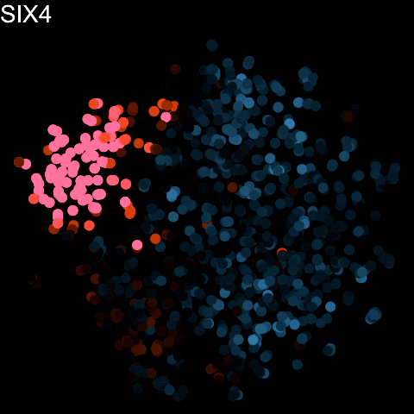

Slide 44
Visium Review

Slide 46
Tells us where this read came from
Prevents duplicates
Is the actual mRNA

Slide 48
Gene Annotations
Notes:
Can we tell where in the cell each gene is?
What is something else about this sequence that can tell us about whether it’s a new transcript or an old one

Slide 49
RNA velocity analysis leverages spliced and unspliced gene expression to predict the future transcriptional state of cells
(La Manno, et al Nature 2018)

Slide 50
RNA velocity analysis leverages spliced and unspliced gene expression to predict the future transcriptional state of cells
(La Manno, et al Nature 2018)

Slide 51
Dimensionality reduction and clustering analysis identifies transcriptionally distinct groups of cells in single cell RNA-seq data
matrix of
gene x cell
(La Manno, et al Nature 2018)

Slide 52
RNA Velocity analysis relates these groups of cells as a part of an underlying directed cellular trajectory
matrix of
gene x cell
(La Manno, et al Nature 2018)

Slide 53
(La Manno, et al Nature 2018)
Notes:
Which cell-type is the stem-cell type that gives rise to all these other cell-types?

