Slide 1
Quiz Review

Slide 2
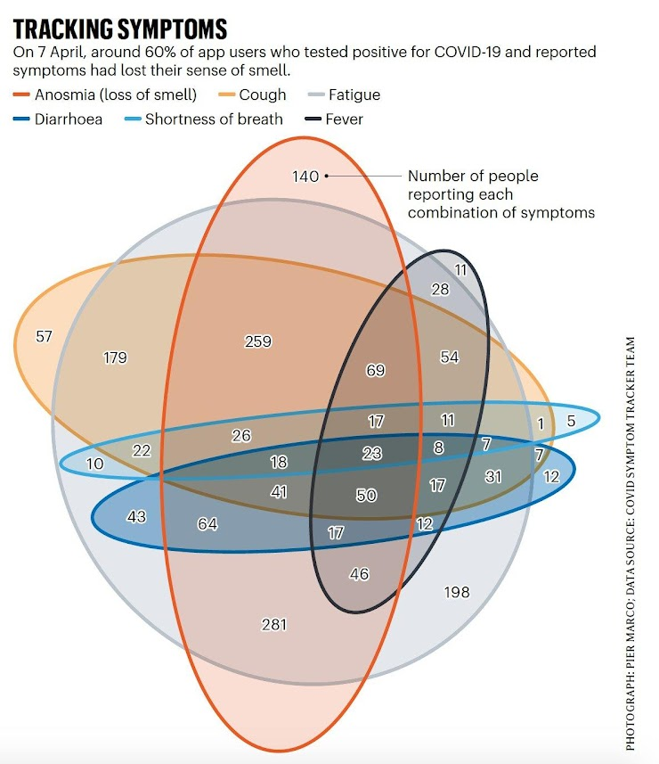
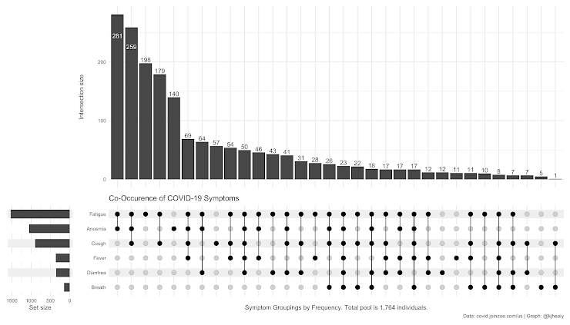
Data visualization research in the real world
UPSET plot (https://upset.app/)
Made by Jake R. Conway in Nils Gehlenborg’s lab
when he was an undergraduate summer intern in 2015

Slide 3
Dimensionality reduction

Slide 4
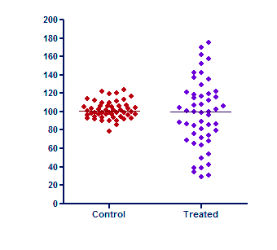
Differential expression

Slide 5
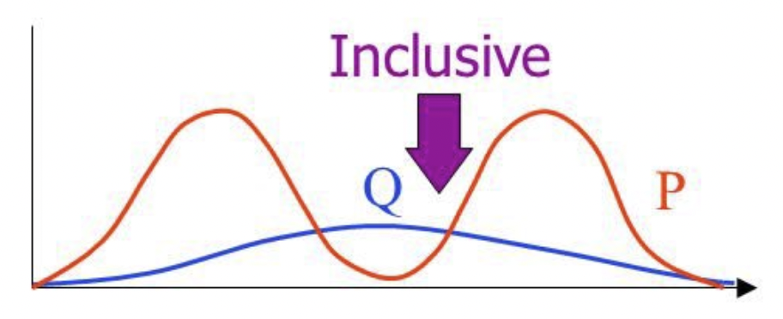
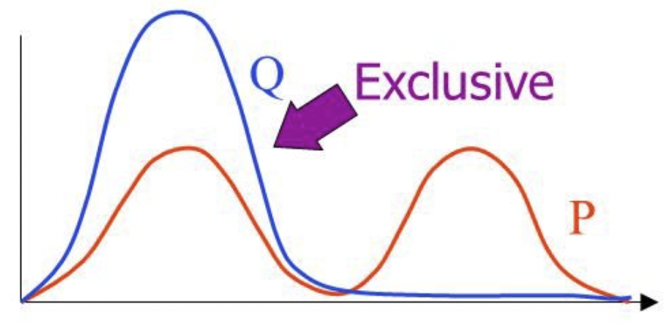
KL Divergence
Asymmetry: making points close in P far apart in Q is penalized more
than making points far apart in P close in Q
Points with small distance in P should have small distance in Q
(Inclusive KL)
Points with large distance in P should have large distance in Q
(Exclusive KL)
Source: https://timvieira.github.io/blog/post/2014/10/06/kl-divergence-as-an-objective-function/

Slide 6
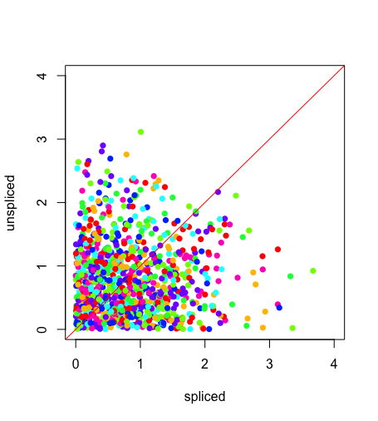
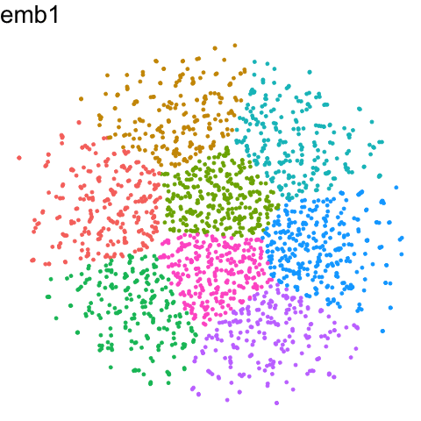
RNA velocity on noise
No correlation between spliced and unspliced (suspicious)
Arrows would not be stable as tSNE is not stable

Slide 7
Extra credit homework
Deadline is 3/11 6pm

Slide 8
Interpret another cluster in the MERFISH or Visium datasets
In either the MERFISH or Visium dataset, perform clustering analysis.
Pick a cluster.
Perform differential expression analysis to identify genes upregulated in this cluster. Interpret this cluster. What cell-type do you think it is? You will likely need to read about the genes upregulated in this cluster to determine the cell-type.
Visualize the spatial distribution this cell-type.

Slide 9
Spatial Proteomics

Slide 10
Why protein?
Give us a sense of what is driving the cell
If we can measure what proteins are being expressed in a cell, then that could tell us something about (cell-type, cell-state)

Slide 11
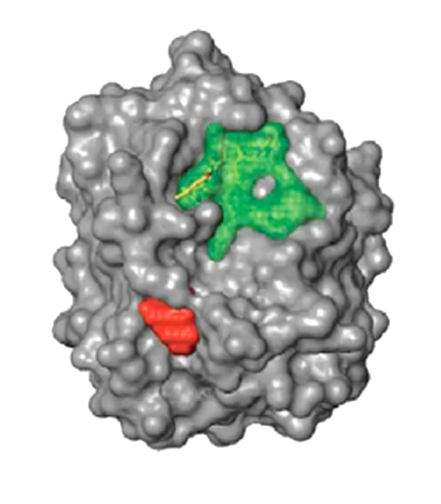
How can we detect proteins?
Protein
Epitope
(antigenic determinant)

Slide 12
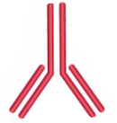
Protein epitopes can be identified with antibodies
(primary) Antibody

Slide 13
Ex. Immunofluorescence

Slide 14
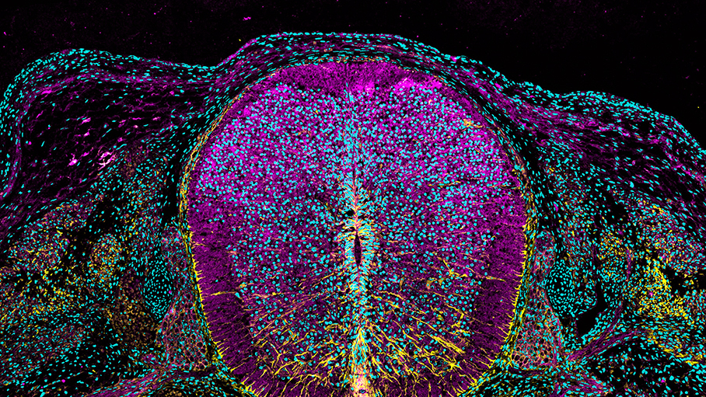
https://www.cell.com/pictureshow/immunofluorescence-ii
Vimentin (yellow)
N-cadherin (magenta)
Dapi (cyan)

Slide 15
What are antibodies? How are they made?
Antibodies are made by B cells
Made by rabbits, mouse, goat,

Slide 16
What are antibodies? How are they made?
Can stop here
but b-cells
are polyclonal
+ don’t live long
Source: https://blog.addgene.org/antibodies-101-monoclonal-antibodies

Slide 17
What are antibodies? How are they made?
1970s (Nobel Prize of 1984)
Source: https://blog.addgene.org/antibodies-101-monoclonal-antibodies

Slide 18
How many proteins can we image at once?
On the order of ones
Not just spectral overlap -> on the order of ~10

Slide 19
CODEX (CO-Detection by indEXing)
Dr. Gary Nolan at Stanford
Black, et al. Nat Protoc 2021

Slide 20
CODEX (CO-Detection by indEXing)
Dr. Gary Nolan at Stanford
Black, et al. Nat Protoc 2021

Slide 21
CODEX (CO-Detection by indEXing)
Akoya. Technical Note. Validation of CODEX Antibodies

Slide 22
CODEX (CO-Detection by indEXing)
~40 proteins
Akoya. Technical Note. Validation of CODEX Antibodies

Slide 23
Quick Question
We want to measure 18 proteins in a tissue
Using CODEX with 3 colors, we can measure 3 proteins in each imaging round
How many rounds of imaging do we need to image all 18 proteins?
6 rounds

Slide 24
Quick Question
Recall: MERFISH used a multiplexing scheme to increase the number of different genes that can be measured
Why do we not using multiplexing for proteins?
Black is 2^N
Purple is with modified hamming distance
Source: https://www.sciencedirect.com/science/article/abs/pii/S0076687916001324

Slide 25
What are some potential challenges for characterizing the proteome?
Proteins are big -> “crowding” (steric hindrance)
> 20k needed to measure the whole proteome
Very hard to get good antibodies
Good specificity

Slide 26
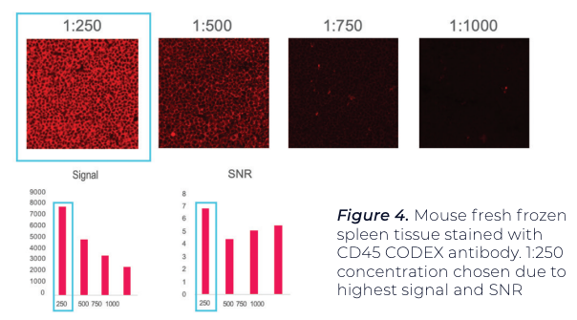
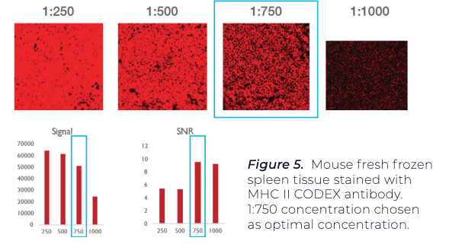
Antibody titration needed to minimize non-specific binding and improve signal to noise ratio
Using positive test tissue, maximize signal-to-noise ratio (SNR) and average signal.
A threshold is set for both signal and noise.
A binary map is used to confirm that pixels associated with signal and noise
Antibody A
Antibody B

Slide 27
Antibodies may interfere with each other (steric hindrance)
Even if it works well by itself, it may not give the same performance when used in combination with others. Therefore need to test:
Individually
In the presence of a few other antibodies (positive and negative counterstains)
In the presence of many other antibodies
1
2
3

Slide 28
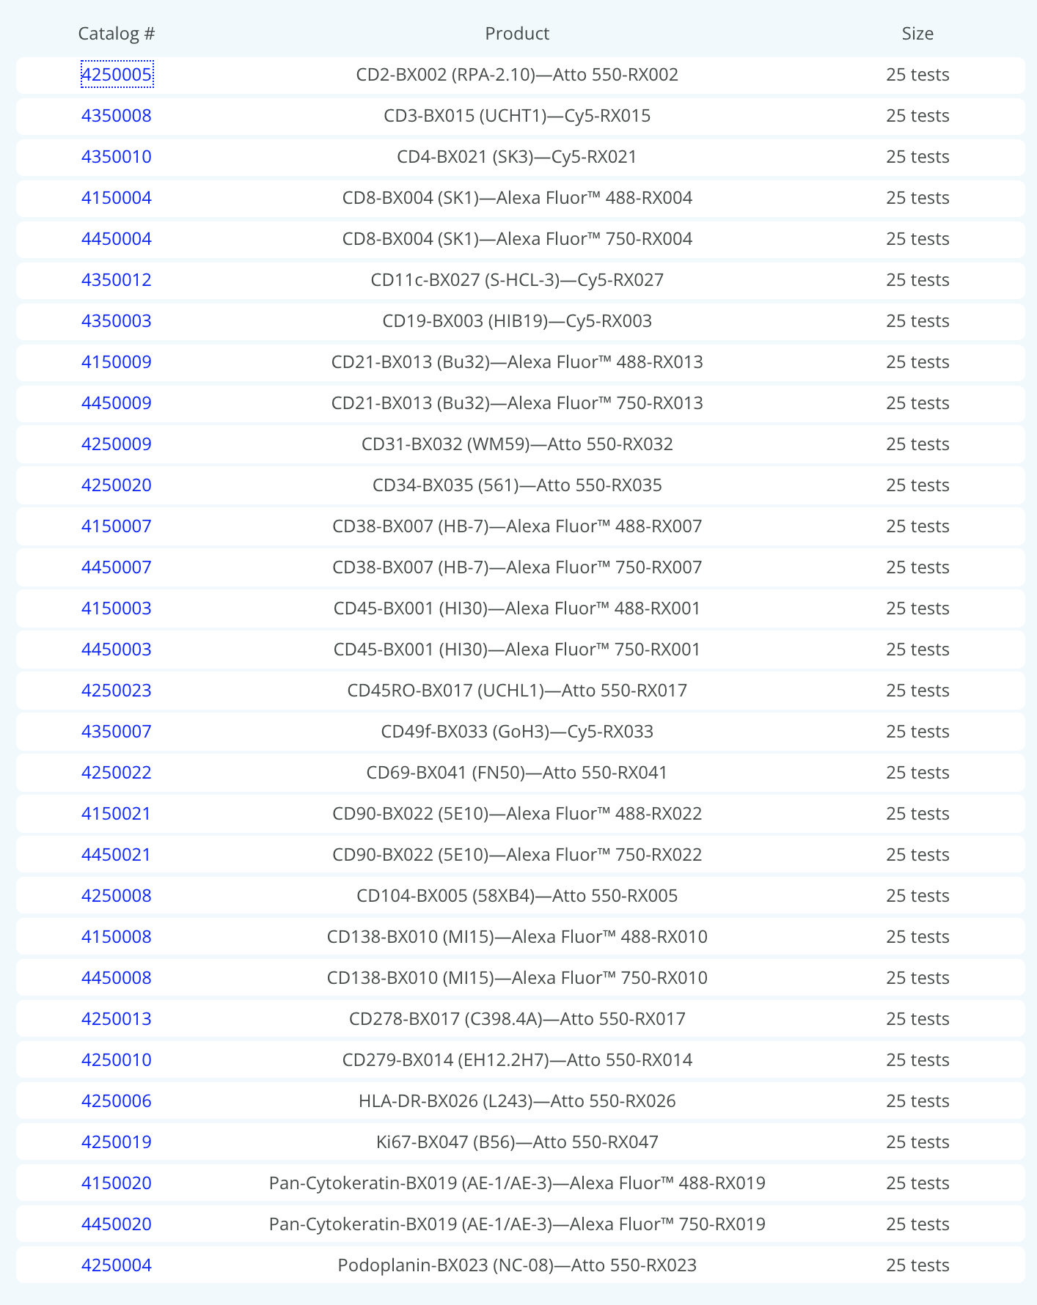
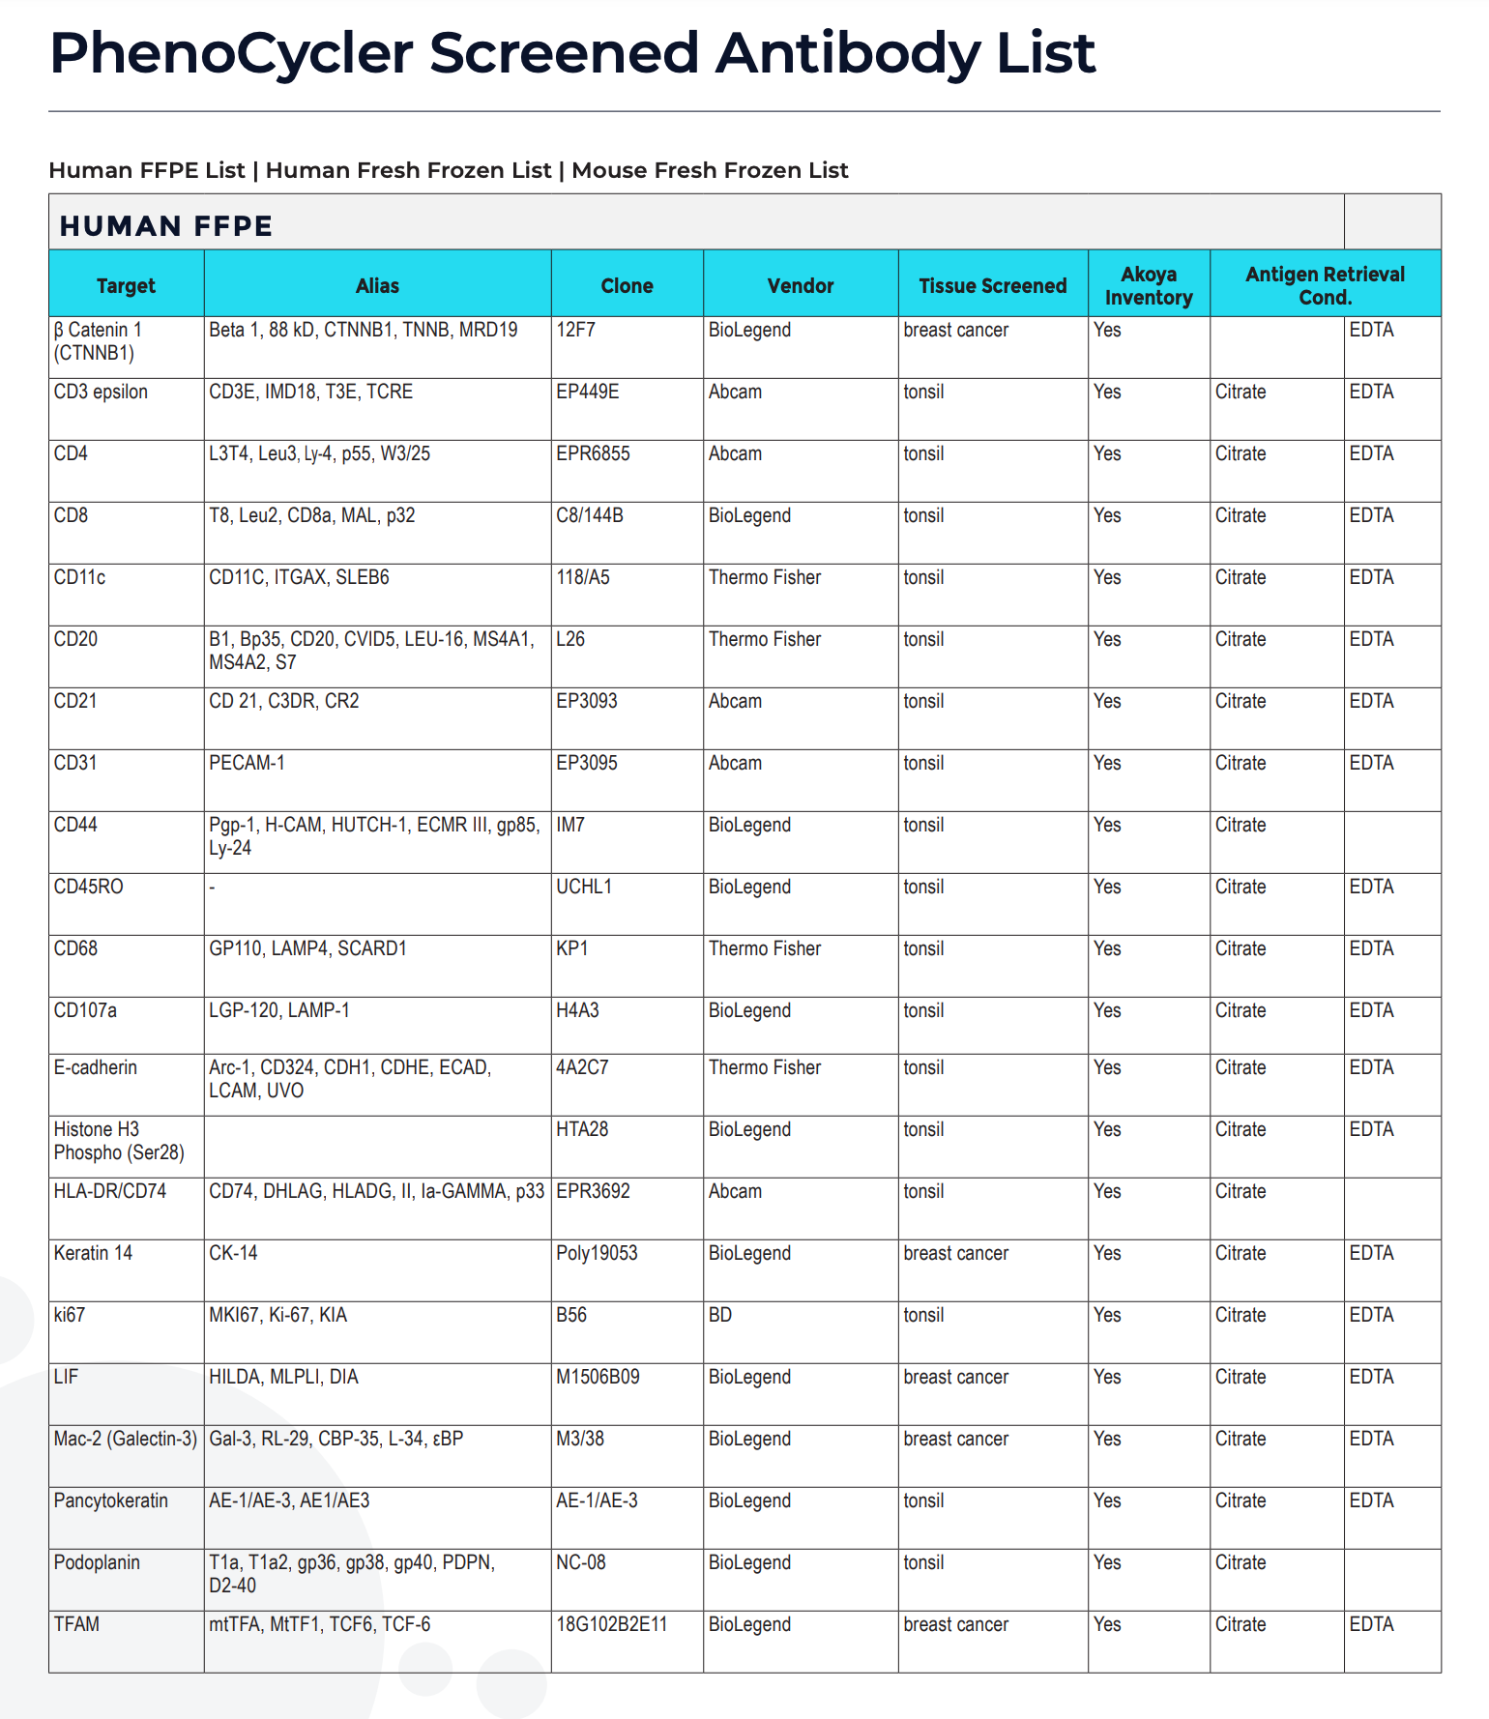
Antibodies for proteins of interest may not be available
~ 30 approved (work well together)
~ 300 screened (unclear if will work well together)
How many different proteins are in the proteome?
(on the order of)
Recall we have ~20k different RNAs
Notes:
80,000 to 400,000 proteins

Slide 29
Today’s hands on component: Look at spatial proteomics data Homework Assignment 5
Due Thursday (6PM Baltimore Time)

Slide 30
Homework
Analyze the CODEX dataset (start together in class)
Your goal is to figure out what you’re looking at
Your homework is to perform analyses and create a multi-panel data visualization with a corresponding ‘figure caption’ that describes your data visualization to convince me that you are correct
You are welcome to work together with classmates as a team
Submit your HW as you did for HW1 and HW3 including your code

Slide 31
Hints
You will likely want to perform clustering analysis to identify proteomically distinct cell-types
You will likely want to visualize how these cell-types are organized in the tissue
You will likely need to read about the proteins that you are looking at to characterize these cell-types
This is a healthy human tissue

Slide 32
bit.ly/GDV_codex

Slide 33
bit.ly/GDV_rc

