Slide 1
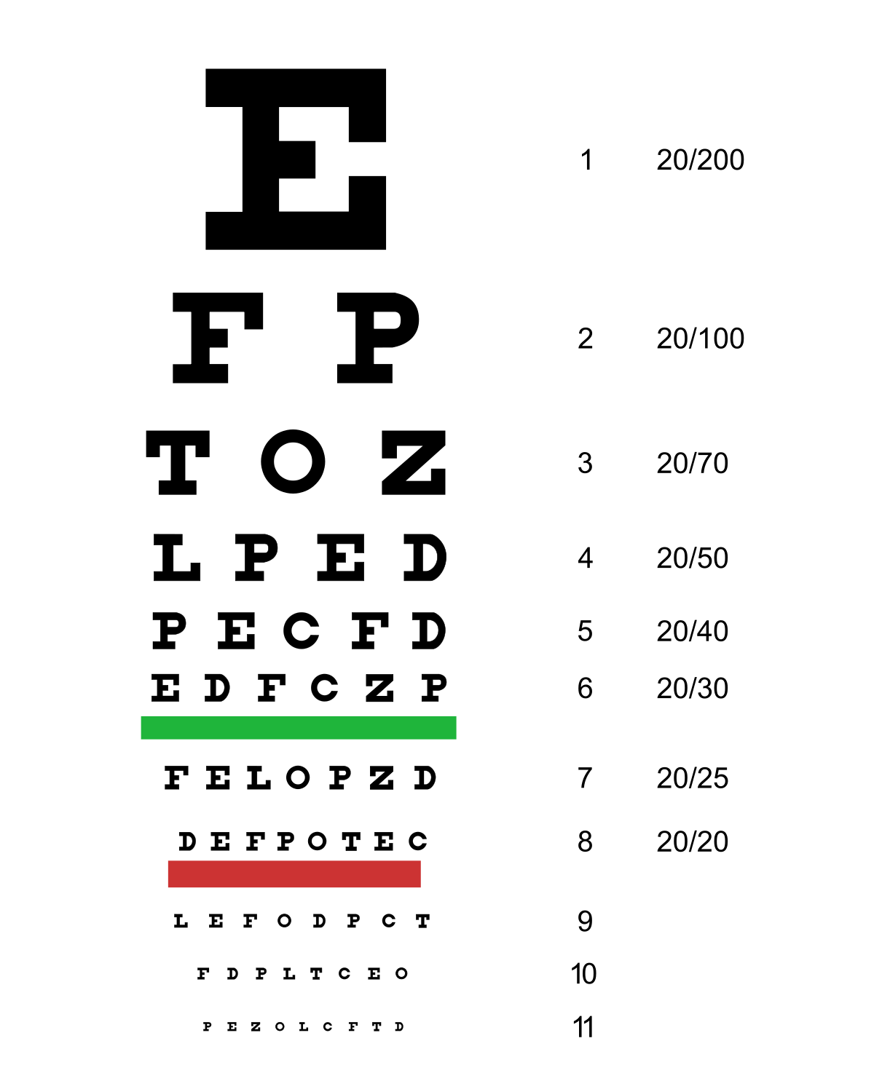
Genomic Data Visualization [Spatial] Epigenomics please move forward if you cannot read this from where you are

Slide 2
What is epigenetics? Why do we care?
Epigenetics regulates gene expression -> affect cell, organism
Environmental impact?
Inheritance
There’s more information in epigenetics than transcriptomics (phenocopying)
Lots of different things we call epigenetics
DNA accessibility
DNA modifications
DNA conformation
etc

Slide 3
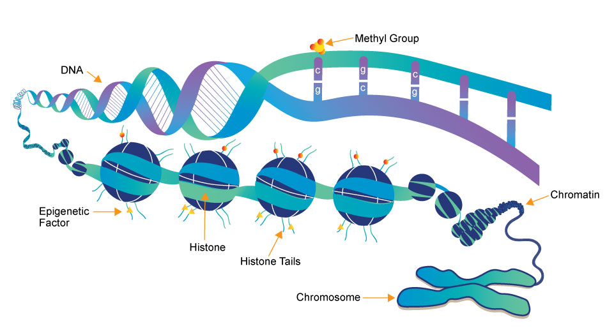
(a type of
protein)
Source: https://www.whatisepigenetics.com/fundamentals/

Slide 4
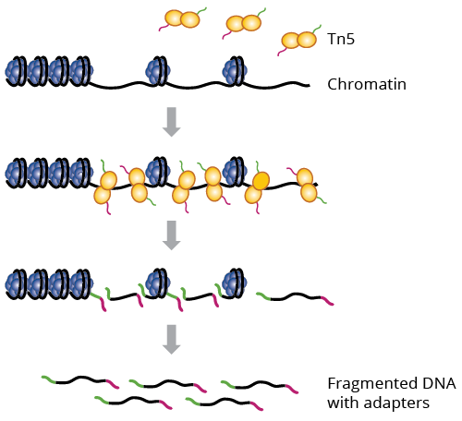
What parts of DNA are accessible for transcription?
a genetically engineered hyperactive Tn5 transposase (2013) that simultaneously cuts open chromatin leaving a staggered nick and ligates sequencing adapters to these regions
ATAC-seq: Assay for Transposase-Accessible Chromatin using Sequencing
Why could this be interesting?

Slide 5
Interpreting ATAC-seq data
Sequence:
Alignment:
Genome

Slide 6
Visualizing ATAC-seq data
Cell-type A
Cell-type B
genes
Genome

Slide 7
Questions before we move on?
to DNA organization

Slide 8
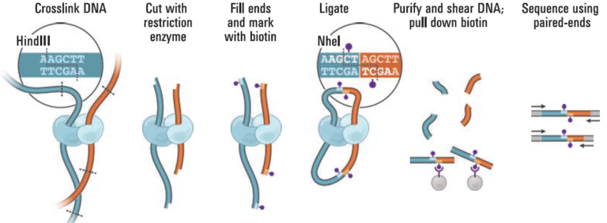
How is DNA organized?
Hi-C: chromosome conformation capture by high-throughput sequencing
Why could this be interesting?
Source: https://www.science.org/doi/10.1126/science.1181369

Slide 9
Interpreting Hi-C data
Sequence:
Alignment:
Genome

Slide 10
Visualizing Hi-C data
Source: https://www.nature.com/articles/s41467-017-02386-3

Slide 11
Interpreting Hi-C data visualizations
One chromosome

Slide 12
Interpreting Hi-C data visualizations
One chromosome

Slide 13
Questions before we move on?
to DNA interactions

Slide 14
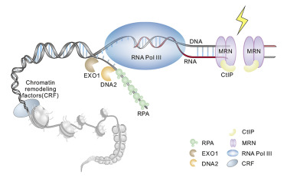
Where are certain proteins (like RNA polymerase) interacting with DNA?
CUT&Tag = Cleavage Under Targets & Tagmentation
Why could this be interesting?
Source: https://www.sciencedirect.com/science/article/abs/pii/S009286742100091X

Slide 15
CUT&Tag
Source: NYU School of Medicine

Slide 16
Visualizing CUT&Tag data
Poly II Chip-Seq under 3 time points for a select gene (BNIP3)
Source: https://www.nature.com/articles/srep09737

Slide 17
Visualizing CUT&Tag data
RNA-seq under 3 different time points for a select gene (BNIP3)
Source: https://www.nature.com/articles/srep09737

Slide 18
Questions before we move on?
to single cell and spatial resolution

Slide 19
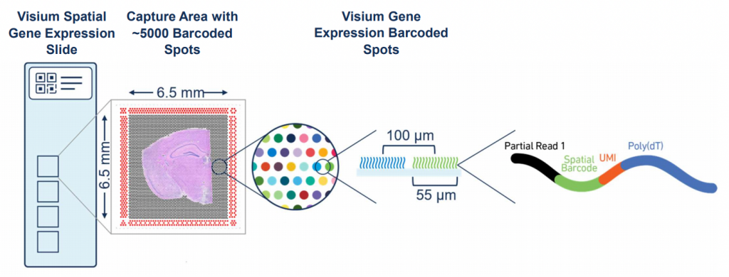
How do we get to spatially resolved?
Sequencing?
Imaging?

Slide 20
Getting to spatially resolved by sequencing (via DBiT-seq)
Source: https://www.sciencedirect.com/science/article/pii/S0092867420313908

Slide 21
Getting to spatially resolved by sequencing (spatial ATAC-seq via DBiT-seq)
Source: https://www.biorxiv.org/content/10.1101/2021.06.06.447244v1

Slide 22
Getting to spatially resolved by sequencing (spatial CUT&Tag via DBiT-seq)
Just out 2/10!
Source: https://www-science-org.proxy1.library.jhu.edu/doi/10.1126/science.abg7216

Slide 23
Getting to spatially resolved DNA conformation by imaging
Source: https://www.nature.com/articles/s41467-020-16732-5
Notes:
After the DNA fragments were generated by Tn5 transposition, those tagged fragments were transcribed into RNAs using the T7 RNA polymerase. This in situ transcription step amplifies a single copy of DNA fragment into many copies of RNA, which not only greatly increases the signal of epigenomic loci to confer detection specificity, but also allows us to detect short DNA locus that would otherwise be difficult to image by FISH. To ensure efficient transcription, we embedded the sample in polyacrylamide gel and digested the sample by proteinase K in order to remove DNA-interacting proteins that could impede T7 transcription (Figure 1A). This embedding and clearing procedure improved T7 amplification and generated more RNAs for better capturing of the histone modification peaks

Slide 24
Quick question
Chromosome 19 is ~50 million base pairs
From MERFISH, we’ve seen that error robust multiplexed imaging can allow us to measure 10,000 unique RNA species in a single day experiment
If I wanted to use error robust multiplexed imaging to measure 10,000 unique regions along chromosome 19 to trace out its conformation, what resolution can I trace out chromosome 19?
Can I tell if base pair 1,000,059 is touching 2,002,394 and not 1,000,238?

Slide 25
Questions before we move on?
to practical analysis

Slide 26
Single cell [spatial] ATAC-seq
Still get count and position matrix
Instead of cell by gene, we get cell by region
Peaks
100kb windows along genome
In theory, we can cluster and do all the same analyses as spatial transcriptomics

Slide 27
Quick Question
In spatial transcriptomics analysis, clusters of cells are transcriptionally similar (express similar genes). What do these spatial ATAC-seq clusters mean?

Slide 28
Quick Question
In spatial transcriptomics analysis, differential testing could help us identify which genes were upregulated in clusters. Can we do differential testing with ATAC-seq?

Slide 29
Food for thought
Many many RNA molecules are in a mammalian cell?
How many accessible regions are in the genome?
Notes:
Approximately 360,000 mRNA molecules are present in a single mammalian cell, made up of approximately 12,000 different transcripts with a typical length of around 2 kb.

Slide 30
Food for thought
If I want to sequence every molecule, at least how many reads do I need to sequence?
If I want to sequence every accessible region, at least how many reads do I need to sequence?

Slide 31
Food for thought
We’ve seen a range of measurements for gene expression (0 to X copies)
What is the range of measurements for accessibility data in single cells?
Are we more likely to get false positives or false negatives?
(by understanding where your data comes from, you can do analysis better)

Slide 32
Today’s hands on component: spatial epigenomics data (explore together) Homework Assignment 5
Due Thursday (6PM Baltimore Time)

Slide 33
bit.ly/GDV_rc

