Slide 1
Genomic Data Visualization [Spatial] Genomics and multi-omics please move forward if you cannot read this from where you are

Slide 2
Reflection Card Review
If we image a region along DNA in a single cell, which of the following will our picture most likely look like?
A
B
C

Slide 3
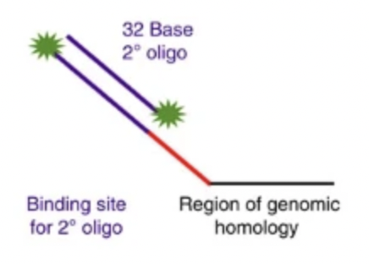
Reflection Card Review
If we image a region along DNA in a single cell, which of the following will our picture most likely look like?
Oligopaint technique
DAPI in blue
Source: https://www.nature.com/articles/ncomms8147

Slide 4
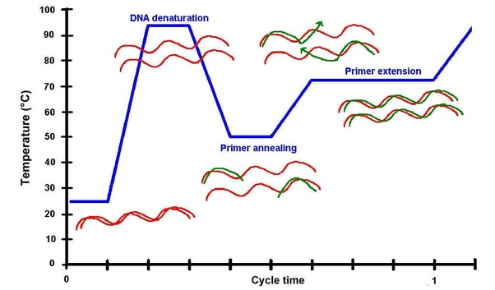
Reflection Card Review
In imaging, how do we get single-stranded probes to hybridize to double-stranded DNA?
Recall PCR
Polymerase + dNTPs

Slide 5
Genomics

Slide 6
Why genetics in single cells?
In certain cell-types, DNA can actually be different in healthy cells
Brain, retrotransposons, other things
Immune system
Germline
Cancer cells
Somatic mutations

Slide 7
Why genetics in single cells? One reason may be intra-tumoral heterogeneity
Source: https://jef.works/assets/papers/natureemm101038.pdf

Slide 8
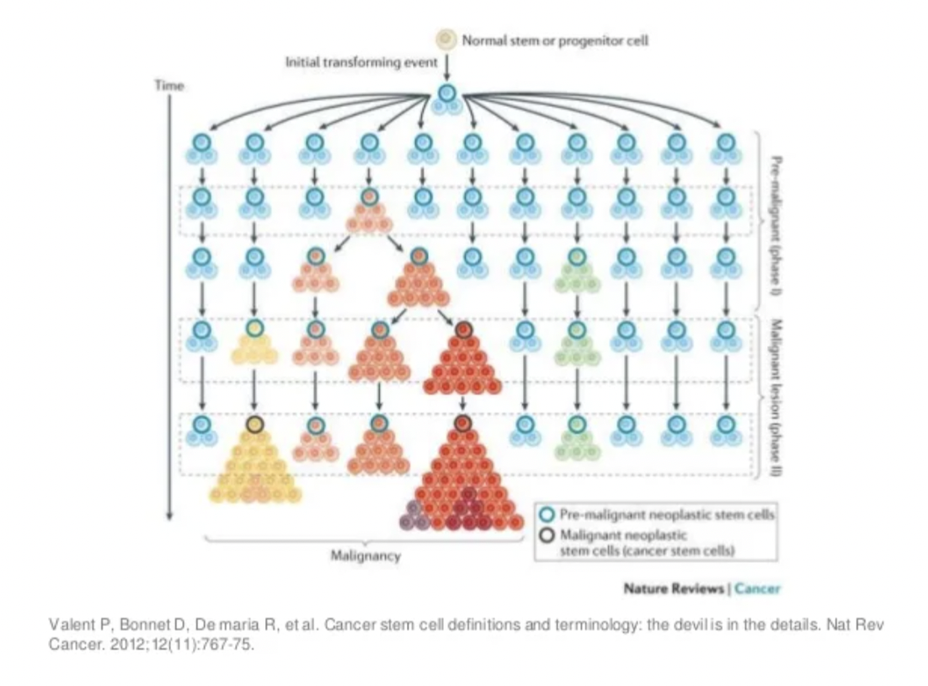
How does intra-tumoral heterogeneity change over time? In response to treatment?

Slide 9
Whole genome DNA-sequencing (bulk)
3 billion base pairs
If each read is 300 base pairs long, how many reads at least do I need to cover a single genome 1x
Short read
sequence
Genome
1X coverage
2X coverage
Notes:
ten million reads
Not uncommon to have to sequence to 100s of million reads…per cell

Slide 10
Quick question
I perform whole genome sequencing on a homogenous breast cancer sample
I sequence to an average of 1x coverage
I look at the genomic region of the BRCA gene
The read there does not have the BRCA mutation
I conclude that this sample does not have the BRCA mutation
What do you think of my conclusion?

Slide 11
Visualizing mutations
Source: https://software.broadinstitute.org/software/igv/

Slide 12
Quick question: why aren’t all reads the same?
Source: https://software.broadinstitute.org/software/igv/

Slide 13
Visualizing mutations
Source: https://www.nature.com/articles/nature25480

Slide 14
Visualizing CNVs
Source: https://www.frontiersin.org/articles/10.3389/fgene.2020.505441/full
Notes:
Instead of color, try enclosure

Slide 15
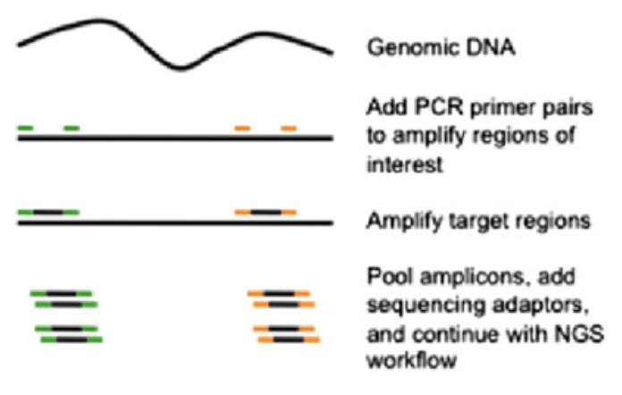
Targeted DNA detection
Know what you’re looking for (like BRCA)

Slide 16
Visualizing mutations
Source: https://www.nature.com/articles/s41586-020-1969-6

Slide 17
Quick question
I perform targeted genome sequencing on a heterogeneous breast cancer sample
I use primers to specifically target and amplify the region around BRCA and get 100x coverage
About ~½ of my reads have the BRCA mutation
I conclude that 50% of breast cancer cells in my sample have a homozygous BRCA mutation
What do you think of my conclusion?
BRCA

Slide 18
BRCA

Slide 19
Quick question
I perform targeted genome sequencing on a heterogeneous breast cancer sample
I use primers to specifically target and amplify the region around BRCA, KRAS, and TP53 at high coverage
About ~½ of my reads have the BRCA mutation, ~¼ have the KRAS mutation, and ~¼ have the TP53 mutation
I conclude that 25% of the cancer cells have all 3 mutations, and 25% of the cancer cells have only a BRCA mutation, and the rest do not have any of these 3 mutations
What do you think of my conclusion?

Slide 20
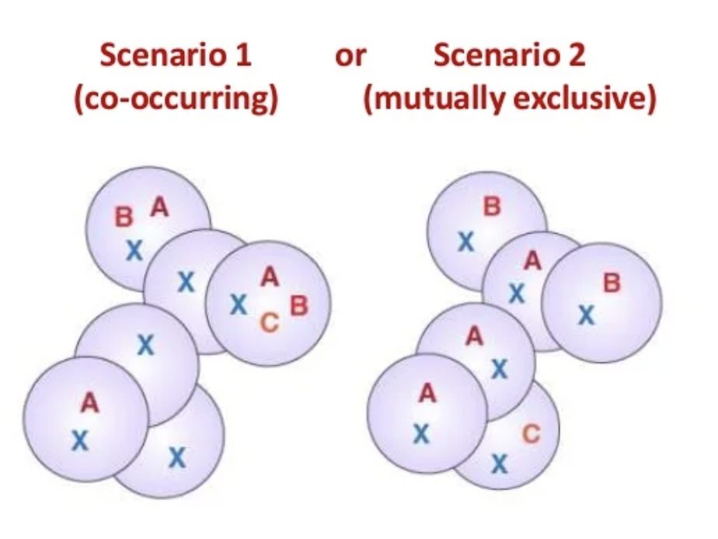

Slide 21
Questions before we move on?
to single cell

Slide 22
Going down to single cells
Resolve heterozygous mutations impacting all cells vs. mutations impacting only ½ of cells
For multiple mutations at low subclonal frequencies, resolve whether they are co-occurring or mutually exclusive
Reconstruct phylogenetic relationship among cells
Notes:
1 ng to 1 μg needed
6 pg per cell
Probably need 10,000 cells to get enough DNA
So if I need to sequence DNA from a single cell, need to amplify

Slide 23
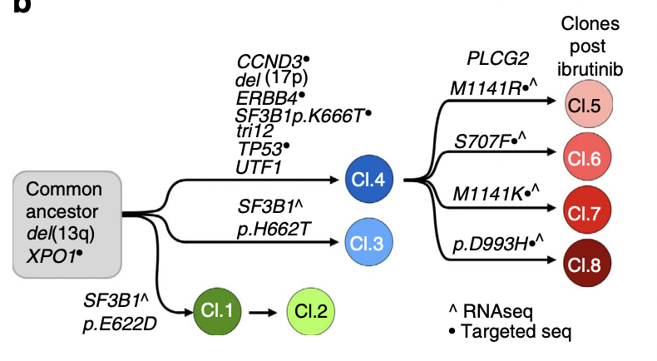
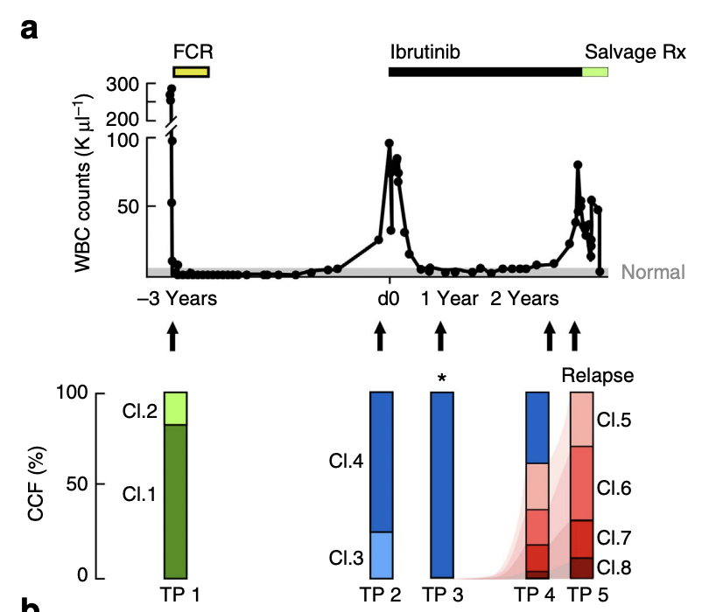
Are multiple mutations co-occurring or mutually exclusive?
Source: https://jef.works/assets/papers/ncomms11589.pdf

Slide 24
Are multiple mutations co-occurring or mutually exclusive?
Source: https://jef.works/assets/papers/ncomms11589.pdf

Slide 25
Going down to single cells
How much DNA (in grams) is needed for sequencing?
How much DNA (in grams) is in a single cell?
Notes:
1 ng to 1 μg needed
6 pg per cell
Probably need 10,000 cells to get enough DNA
So if I need to sequence DNA from a single cell, need to amplify

Slide 26
Amplification is required

Slide 27
Quick question
I have a breast cancer cell
I perform many rounds of PCR amplification with primers targeting the BRCA gene and sequence the resulting reads to 100X
I end up with 75% of my reads having a BRCA mutation, and 25% reads without
I conclude that this must mean that my cell has a CNV number alternation where the allele with the BRCA mutation is amplified, resulting in 4 copies of the BRCA gene, 3 with mutation, and 1 without
What do you think of my conclusion?

Slide 28
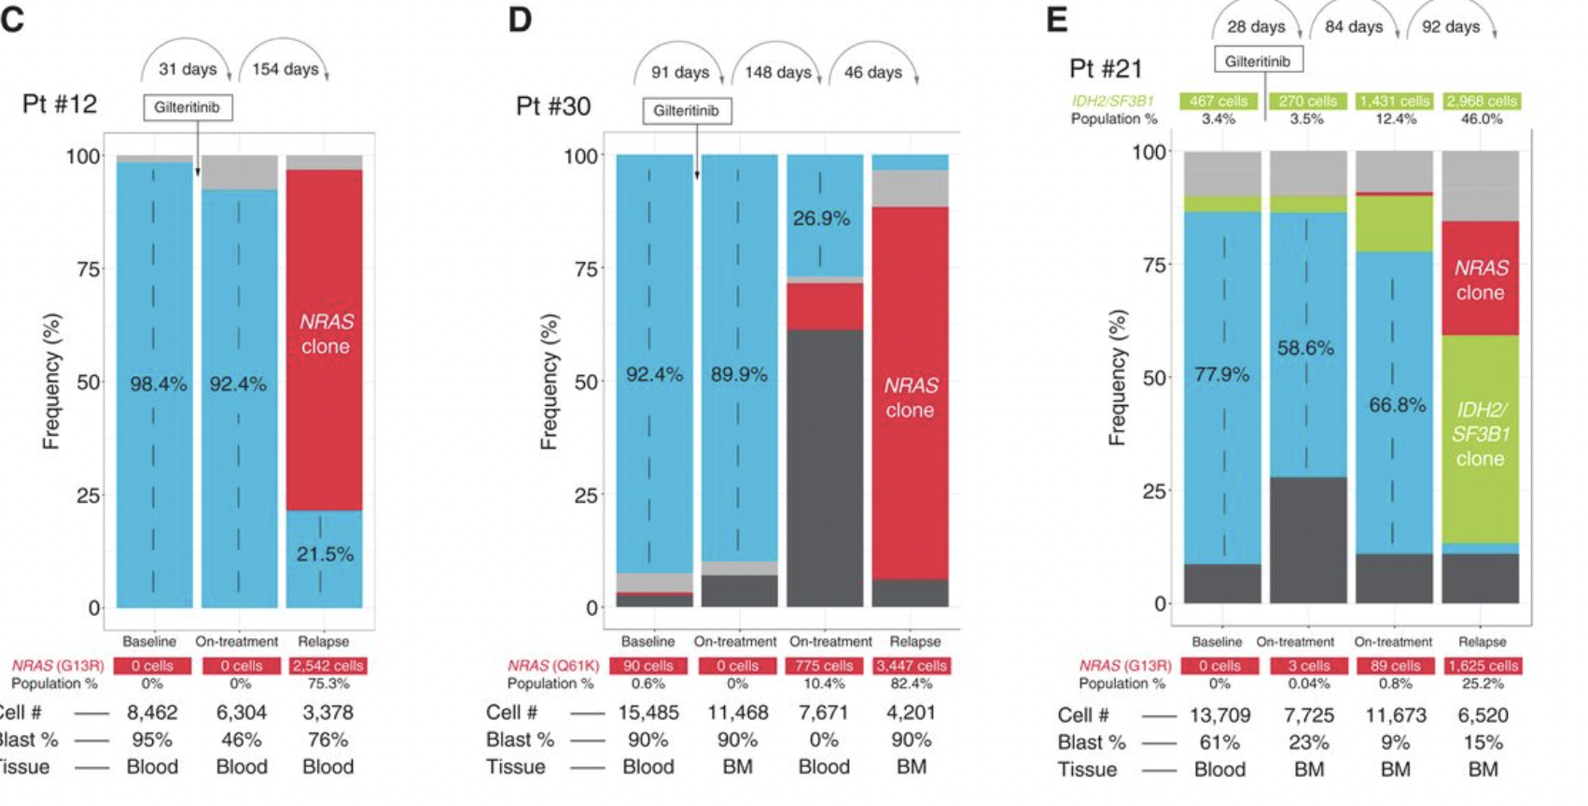
Visualizing single cell mutations
Source: https://aacrjournals.org/cancerdiscovery/article/9/8/1050/41997/Clonal-Selection-with-RAS-Pathway-Activation

Slide 29
Visualizing single cell mutations
Source: https://aacrjournals.org/cancerdiscovery/article/9/8/1050/41997/Clonal-Selection-with-RAS-Pathway-Activation

Slide 30
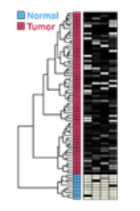
Visualizing single cell CNVs
…

Slide 31
Questions before we move on?
to multi-omics

Slide 32
Multi-omics
You’ve now learned about different ways to measure, analyze, and visualize transcriptomic, proteomic, epigenomic, or genetic information
What about measuring these things together in the same cells?

Slide 33
Single cell RNA + Protein (Cite-seq)
Source: https://www.nature.com/articles/nmeth.4380

Slide 34
Quick question: why do we want to bother we measuring both protein and gene expression from the same single cells?
Source: https://www.nature.com/articles/nmeth.4380

Slide 35
CD45RO vs. CD45RA
CD45RA and CD45RO are isoforms of the CD45 antigen that are typically expressed on T Cells
CD45RA+ T cells have "naive" characteristics
CD45RO+ T cells are considered "memory" T cells

Slide 36
Single cell RNA + DNA (G&T-seq)
Source: https://www.nature.com/articles/nmeth.3370

Slide 37
Quick question: why do we want to bother we measuring both DNA and RNA from the same single cells?
Source: https://www.nature.com/articles/nmeth.3370

Slide 38
Today’s hands on component: Peer review: bit.ly/GDV_pr
Partner up with the person sitting closest to you into groups of 2. (Lyla will partner if there is an odd number)
Peer review each other’s visualizations. Also discuss what you think the structure you’re looking at is. Before the end of class, you will be asked for your team’s answer and the mystery will be revealed.
If not completed in class, please complete as HW6. Will be graded as HW6.
Due Monday (8PM Baltimore Time)

Slide 39
bit.ly/GDV_rc

