Slide 1
Genomic Data Visualization Applications in Neuroscience please move forward if you cannot read this from where you are

Slide 2
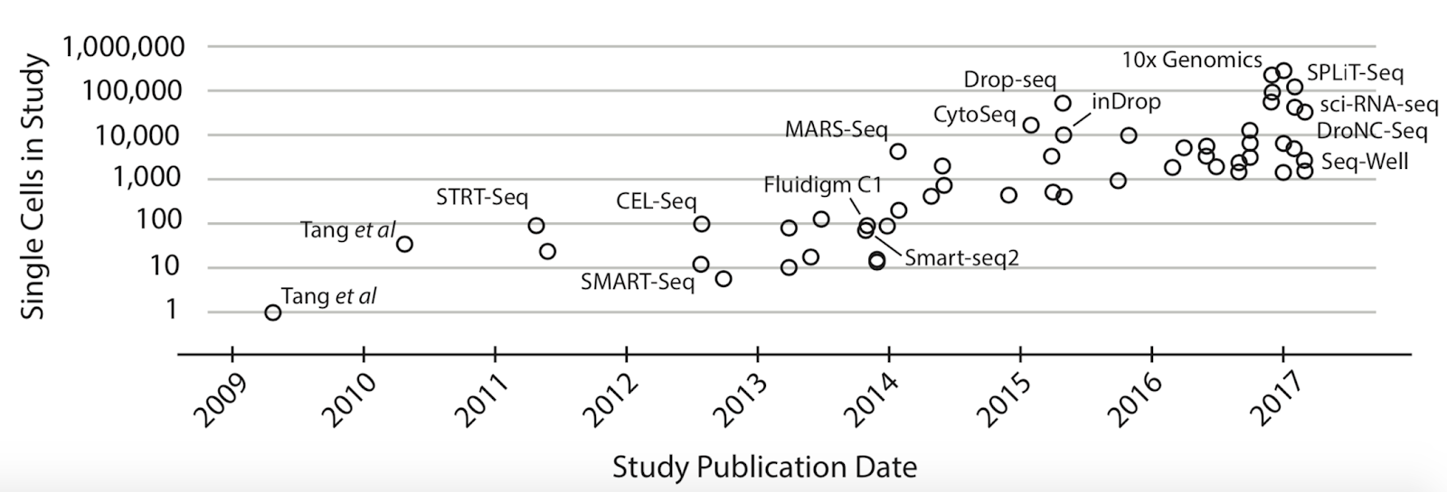
Today: Applications of single-cell omics in the study of neuroscience
(Svensson V, Vento-Tormo R and Teichmann SA. (2018) Exponential scaling of single-cell RNA-seq in the past decade. Nature protocols 13;4;599-604)

Slide 3
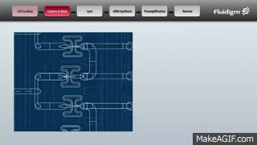
Context (the year is 2013)
Full transcriptome characterization in single cells was just starting to go from 10s of cells to 100s of cells
Measurements were very noisy
How to analyze such big data was still unclear
Source: https://jef.works/assets/papers/nmeth3734.pdf

Slide 4
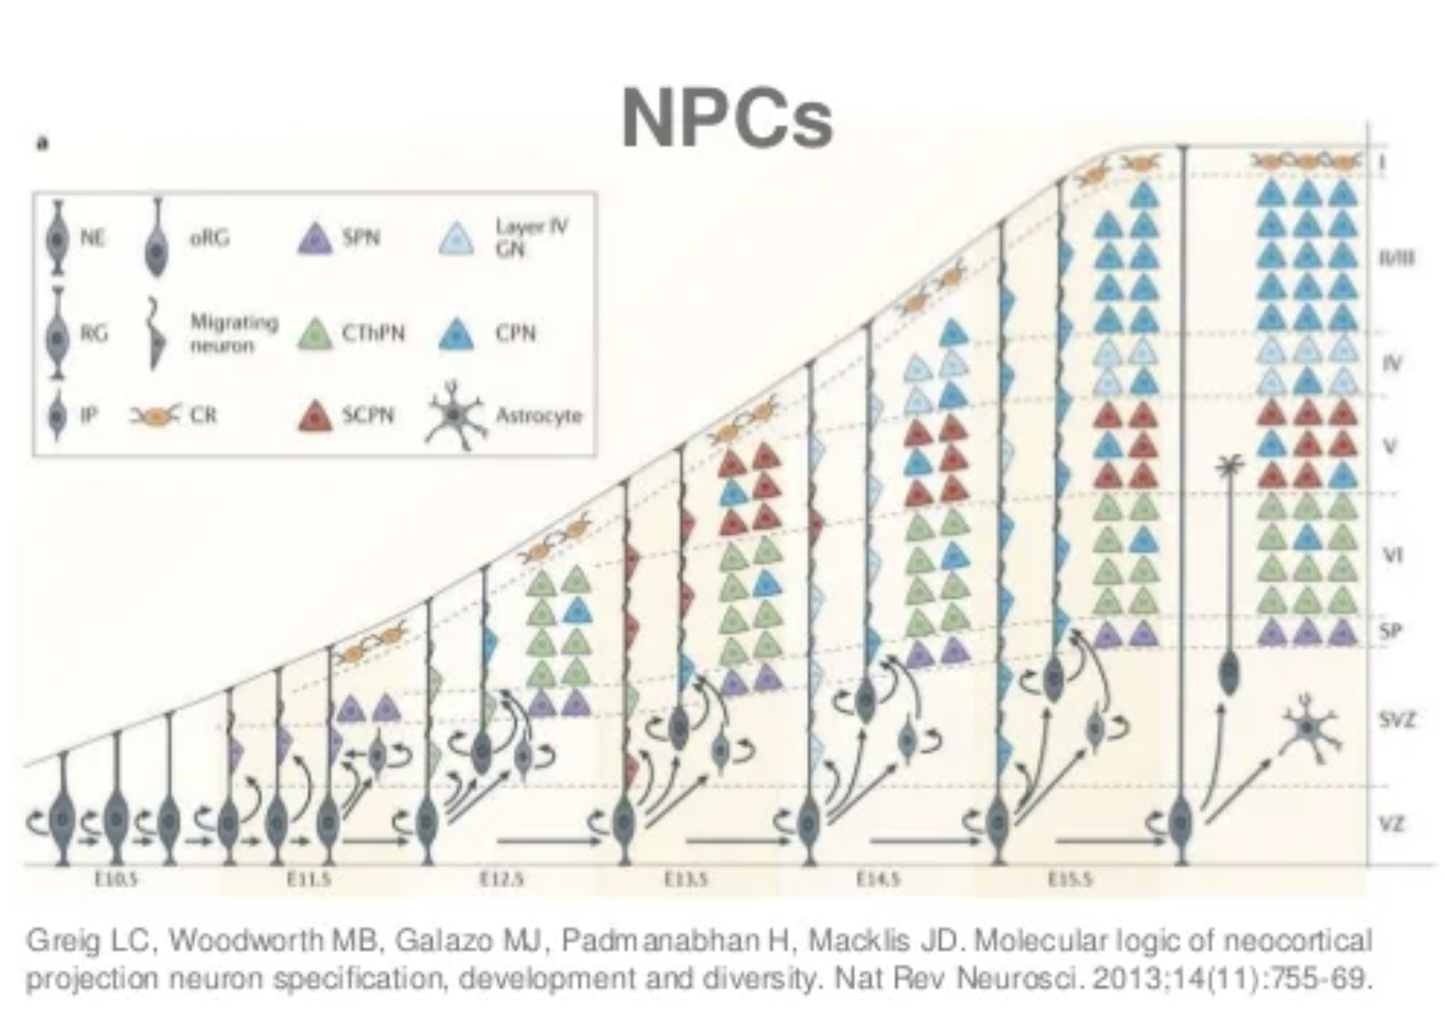
Goal: How can we identify and characterize transcriptionally distinct cell-types in the developing mouse brain?

Slide 5
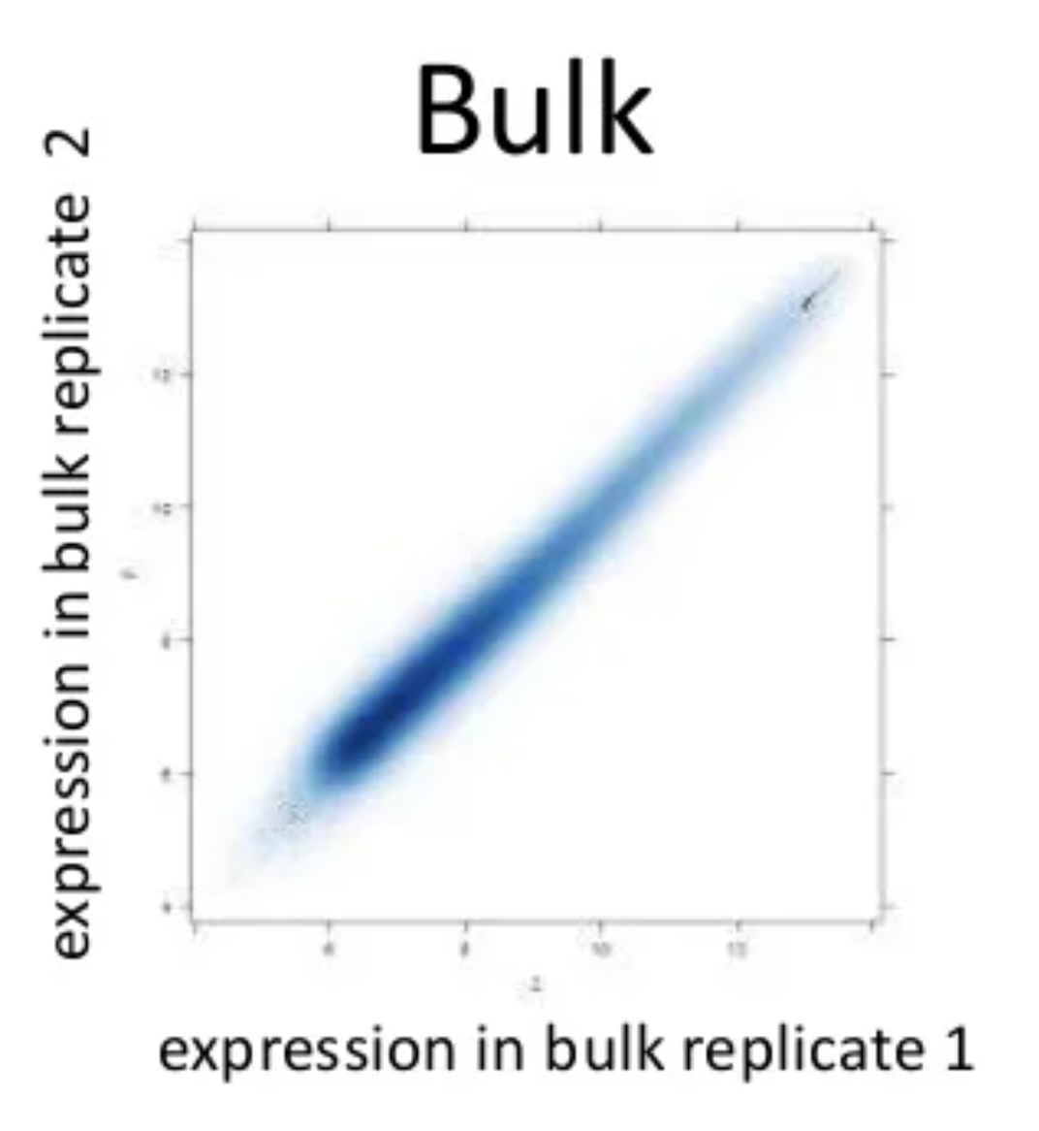
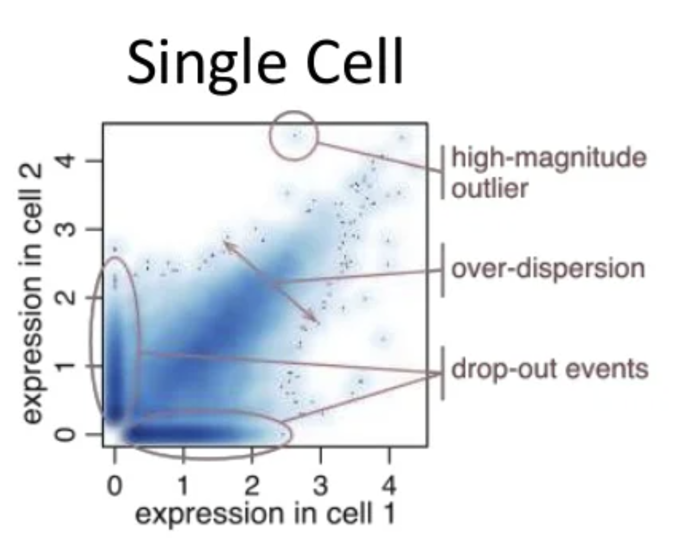
Challenge: gene expression measurements in single cells were much noisier than what we had been used to seeing in bulk RNA-seq
Why?

Slide 6
Approach: Pathway and gene set overdispersion analysis (PAGODA)

Slide 9
We wanted to summarize gene expression within many annotated pathways, so we took the first principal component
PC1

Slide 10
So then we could perform hierarchical clustering on cells based on pathway scores, rather than just noisy gene expression
tSNE was still new and had not been applied in single cell context yet

Slide 11
Quick question: why use the first PC to summarize gene expression within a pathway rather than just taking an average?
PC1

Slide 12
Quick question: why use the first PC to summarize gene expression within a pathway rather than just taking an average?
Hint: what happens if we compute the average gene expression within this pathway?

Slide 13
We apply PAGODA to single-cell RNA-seq of neuro-progenitor cells in the developing mouse brain

Slide 14
We apply PAGODA to single-cell RNA-seq of neuro-progenitor cells in the developing mouse brain

Slide 15
Quick question: How can I validate that I have identified early and intermediate+mature NPCs?
Hint: Previous neuroscience studies have shown that early NPCs are spatially close to the SVZ of the brain and intermediate+mature NPCs are spatially close to the CP of the brain. However, keep in mind we do not have spatial transcriptomics yet….

Slide 16
All mouse brains are kind of the same…
We can align measurements across many animals
Where do you think Neurod1+ Sowaha+ Prox1+ cells would be?

Slide 20
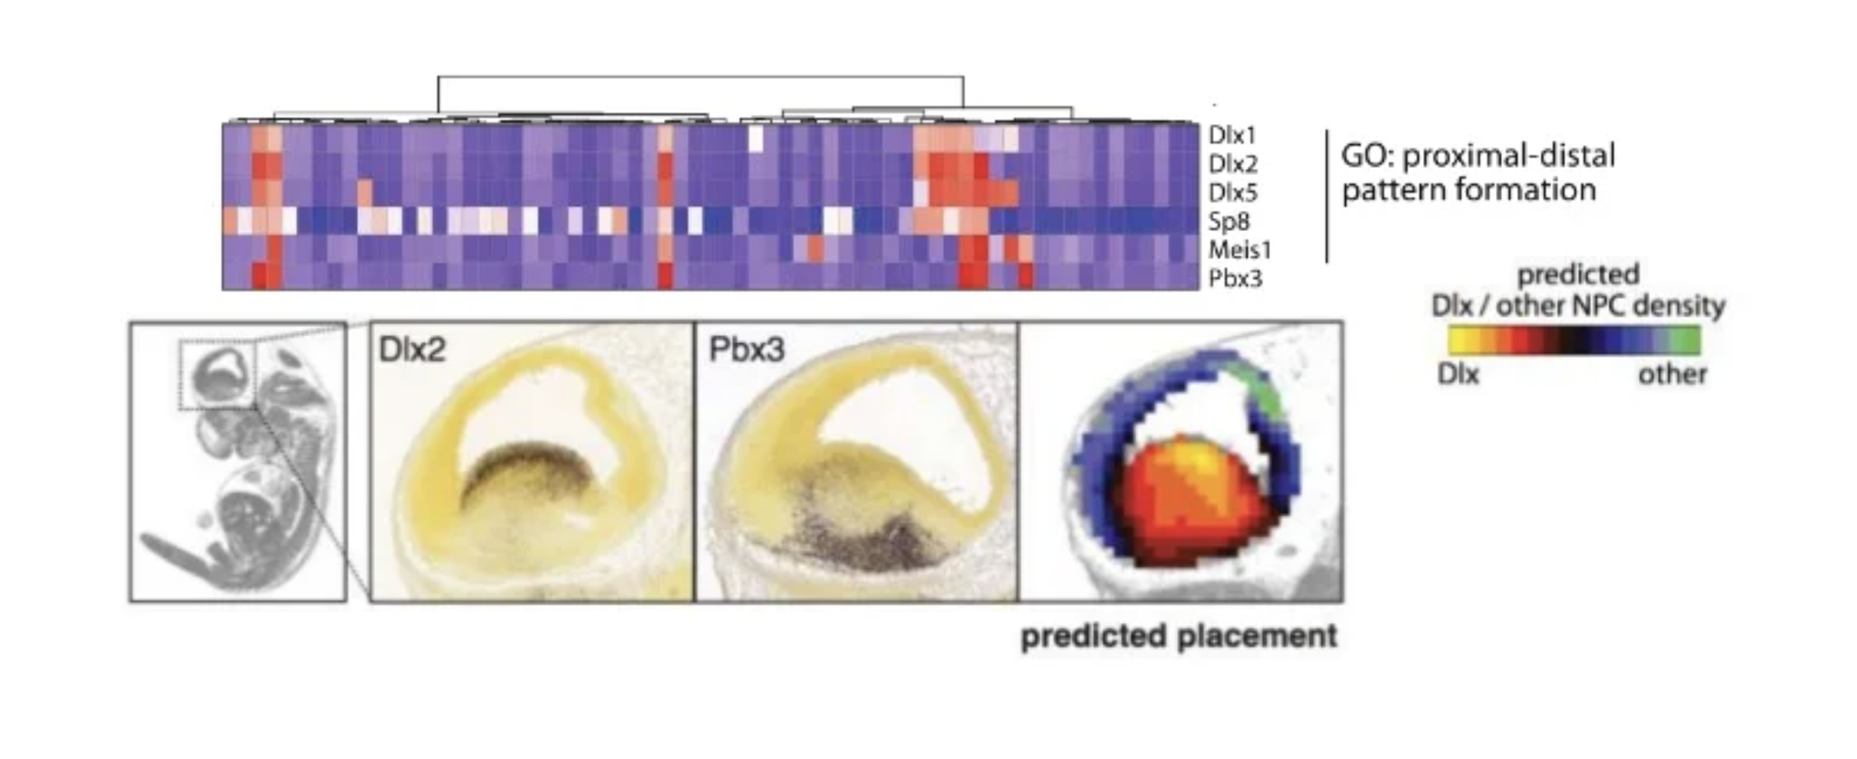

Slide 21
Questions before we move on?
to another neuroscience application

Slide 22
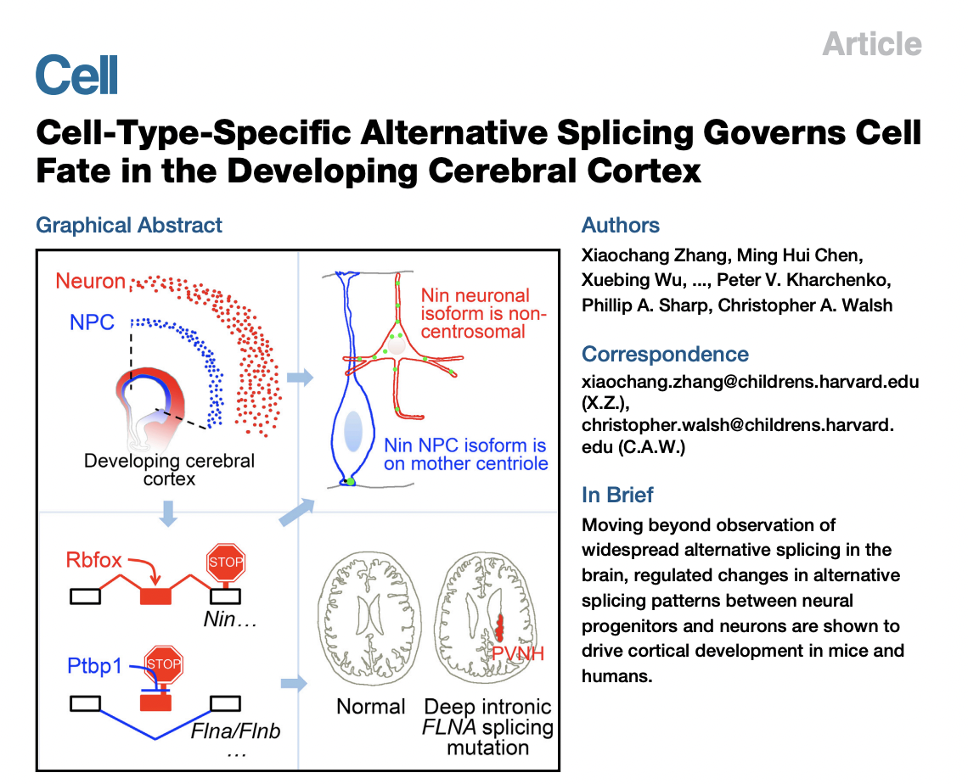
Goal: We’ve looked at gene expression and predicted spatial placement, but what about alternative splicing?
Source: jef.works/assets/papers/jcell201607025.pdf

Slide 23
Challenge: single-cell RNA-seq reads still had pretty shallow coverage
I want to figure out if a single cell expresses the A or B isoform of a particular gene
So I look at the reads from this single cell
I see that there are no reads from this single cell that are in the exon unique to A
I conclude that this single cell must express isoform B
What do you think of my conclusion?
two
splice
isoforms
A
B

Slide 24
Approach: pool reads from single cells of each cell-type

Slide 25
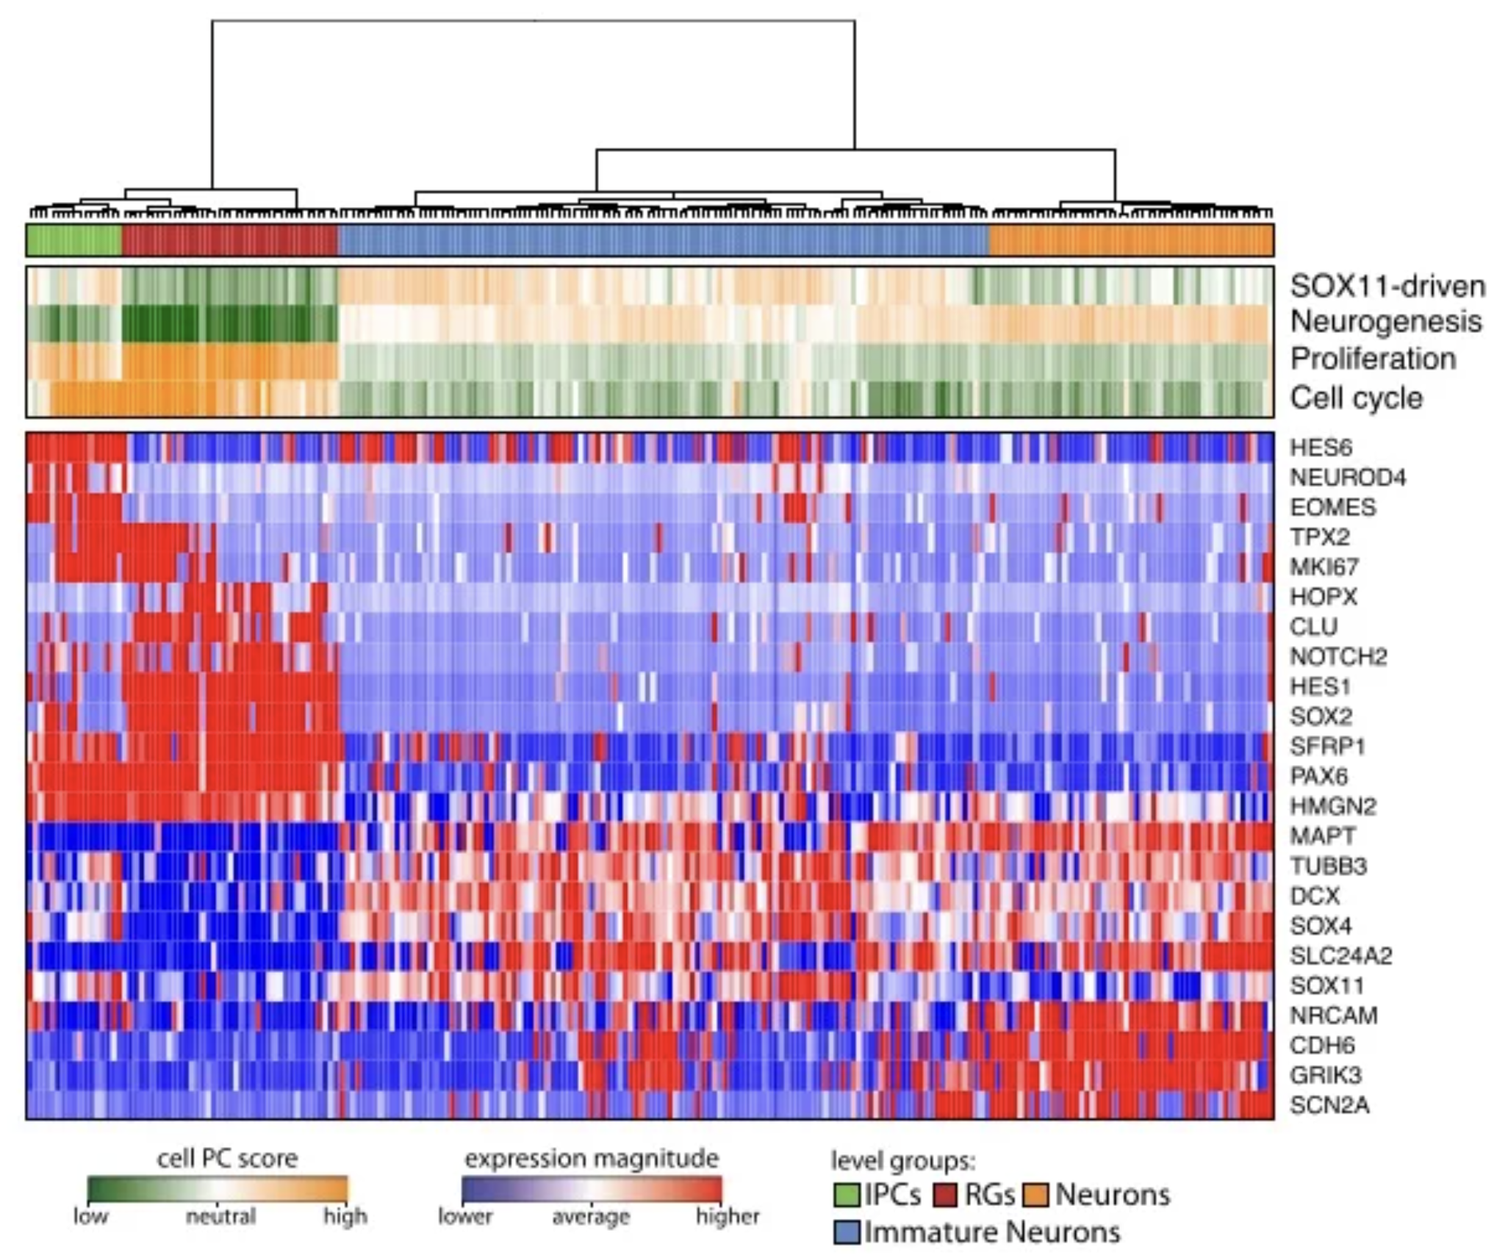
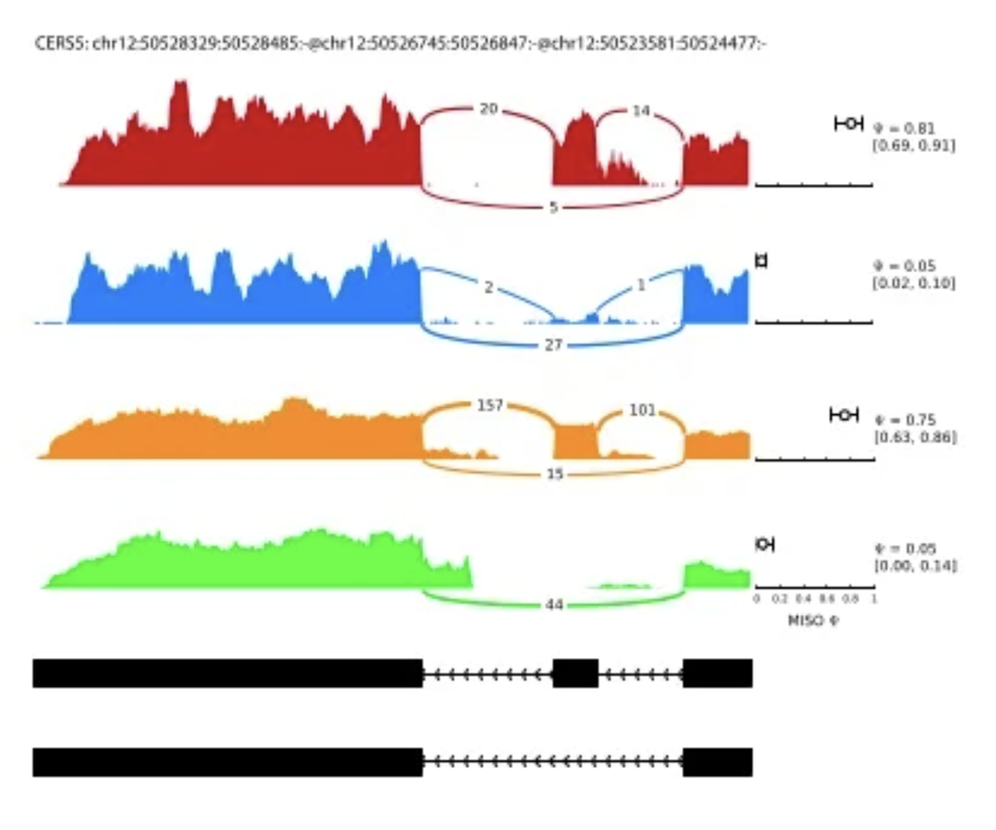
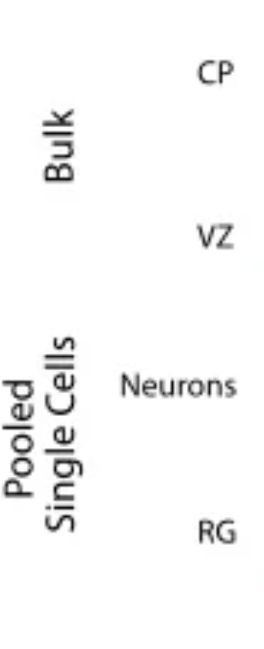
By pooling together single cells, we can indeed identify distinct alternative splicing in NPCs vs. mature neurons

Slide 26
We also compare to micro-dissected bulk RNA-seq of the SVZ and CP

Slide 27
Quick question: knowing what we know now about spatial transcriptomics, what else could we do to validate?

Slide 28
Questions before we move on?
to another neuroscience application

Slide 29
Goal: We’ve looked at genes, what about accessibility?
Source: https://jef.works/assets/papers/nbt4038.pdf

Slide 30
Context (the year is 2016)
Droplet-based single-cell sequencing has been developed enabling 10000s of single cells to be characterized
tSNE has entered the mainstream
However, multi-omics has not been developed yet (so we can only look at RNA and accessibility in different cells (but from the same tissue, so we should see the same cell-types)

Slide 31
snDrop-seq and scTHS-seq resolve intra- and inter-regional cellular diversity in the adult human brain
Why do these tSNEs look different?

Slide 32
Use differentially expressed genes to predict differentially accessible promoters to improve clustering of scTHS-seq data

Slide 33
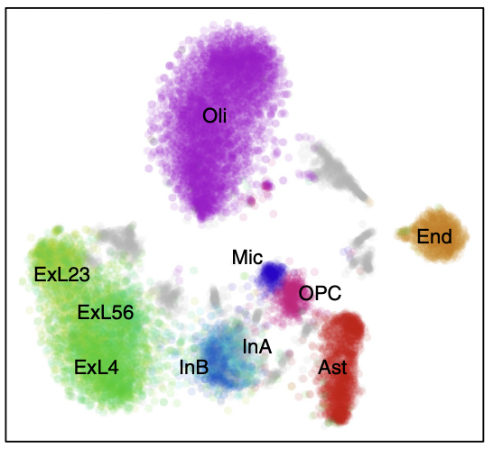
Use differentially expressed genes to predict differentially accessible promoters to improve clustering of scTHS-seq data

Slide 34
Focused analysis characterizes trajectory from OPCs to mature oligodendrocytes

Slide 35
Focused analysis characterizes trajectory from OPCs to mature oligodendrocytes

Slide 36
Focused analysis characterizes trajectory from OPCs to mature oligodendrocytes

Slide 37
Questions before we move on?
to another neuroscience application

Slide 38
Fast forward in time (2015 to current) and the rise in high-throughput spatially resolved transcriptomics
Source: https://www.cell.com/trends/biotechnology/fulltext/S0167-7799(20)30140-2

Slide 39
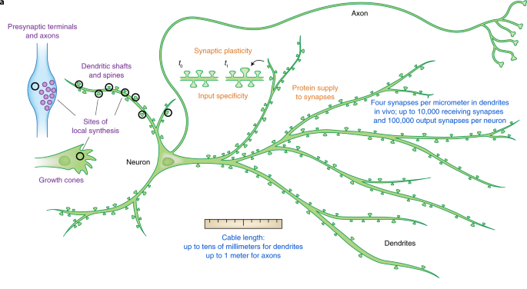
Goal: How are genes organized in highly polarized cells like the neuron? (why do we care?)
Source: https://www.nature.com/articles/s41594-019-0263-5

Slide 40
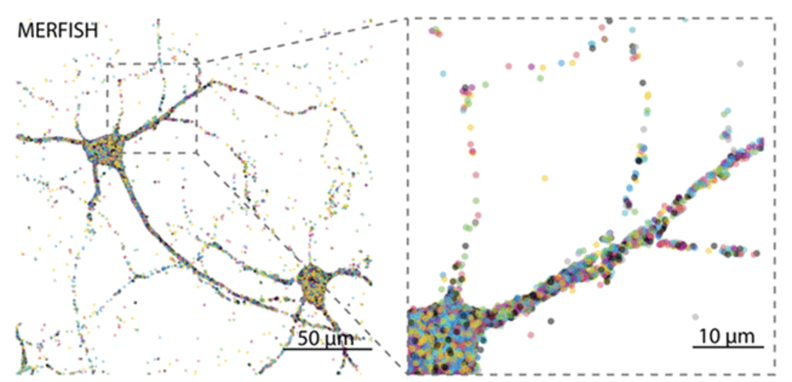
Source: https://www.biorxiv.org/content/10.1101/2020.12.07.414060v1

Slide 41
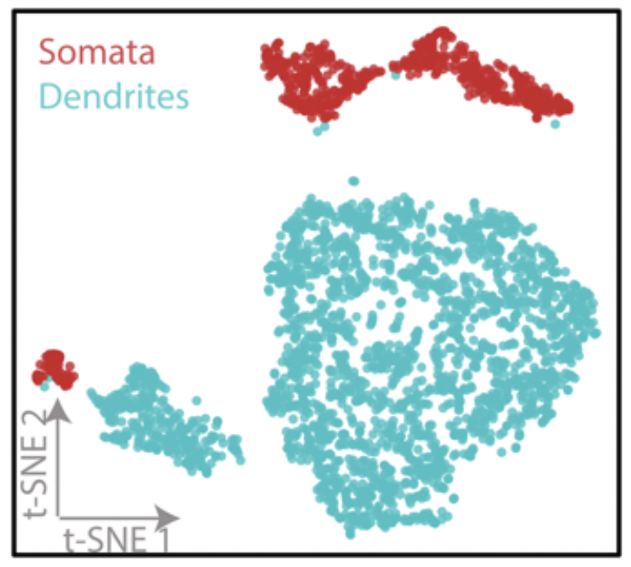
Are dendrites transcriptionally distinct from the soma? (manually segment)
Why are there two clusters of dendrites and soma?
Tau is axon; Map2 is dendrite

Slide 42
Are dendrites transcriptionally distinct from the soma? (manually segment)

Slide 43
Is gene expression variable along dendrites?
Align neurons:
Look at expression within a
binned distance to soma center

Slide 44
Quick question: should we normalize by dendritic length? Why or why not?
Not normalized:
Normalized

Slide 45
Questions before we move on?
to hw

Slide 46
Homework 7 (due Thursday 8pm Baltimore time)
Find a spatially resolved omics paper
Can be transcriptomics, proteomics, etc
Can be neuroscience, cancer, etc
Whatever you’re interested in
Pick one of the main figures (if the figure is very complex, you can focus on a set of specific panels)
Peer review the figure*
Submit a writeup as [jhed-hw7].txt to the hw7/ folder
Include in your writeup, a link to the paper
Which figure you’re reviewing
See hw7/jfan9-hw7.txt for a template

Slide 47
*Peer review criteria
Your peer review must address the following questions:
Why did the authors carry out the study?
What did the authors do?
What did the authors find out?
How did the authors visualize their result?
What data visualization principals did they apply?
What do you think was effective in the way the author made this data visualization? Why?
How could the original author improve this data visualization? Why should they do this?

Slide 48
bit.ly/GDV_rc

