Slide 1
Genomic Data Visualization Final Review please move forward if you cannot read this from where you are

Slide 2
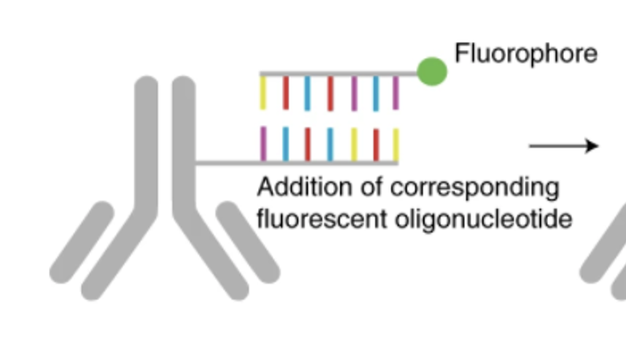
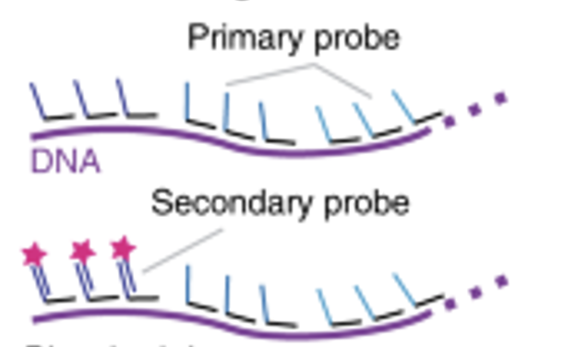
Spatial omics imaging technologies
RNA
Protein
Coarse resolution chromatin tracing

Slide 3
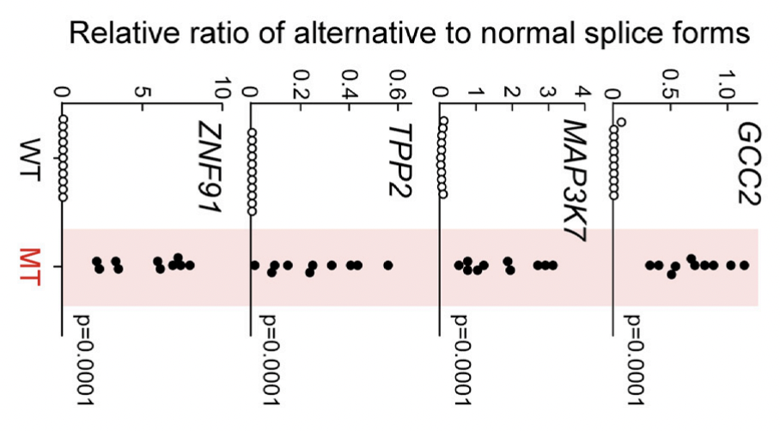
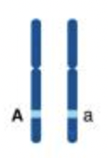
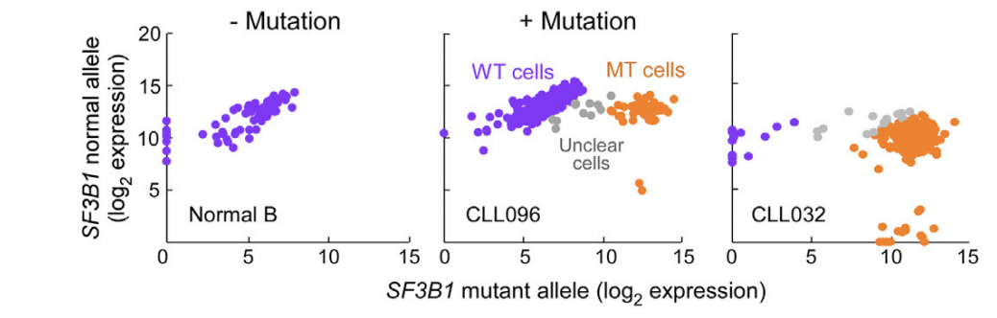
Other probe-based technologies
Detect splice variants
Detect mutations

Slide 4
Group review
Do you think we can distinguish between splice isoforms via imaging? How and when?

Slide 5
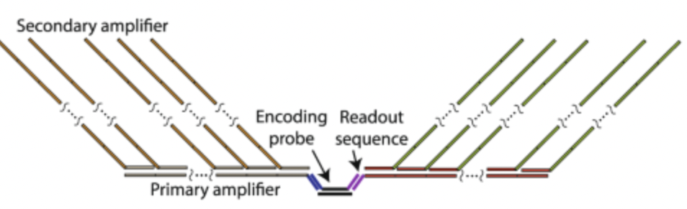
Group review
Do you think we can distinguish between splice isoforms via imaging? How and when?

Slide 6
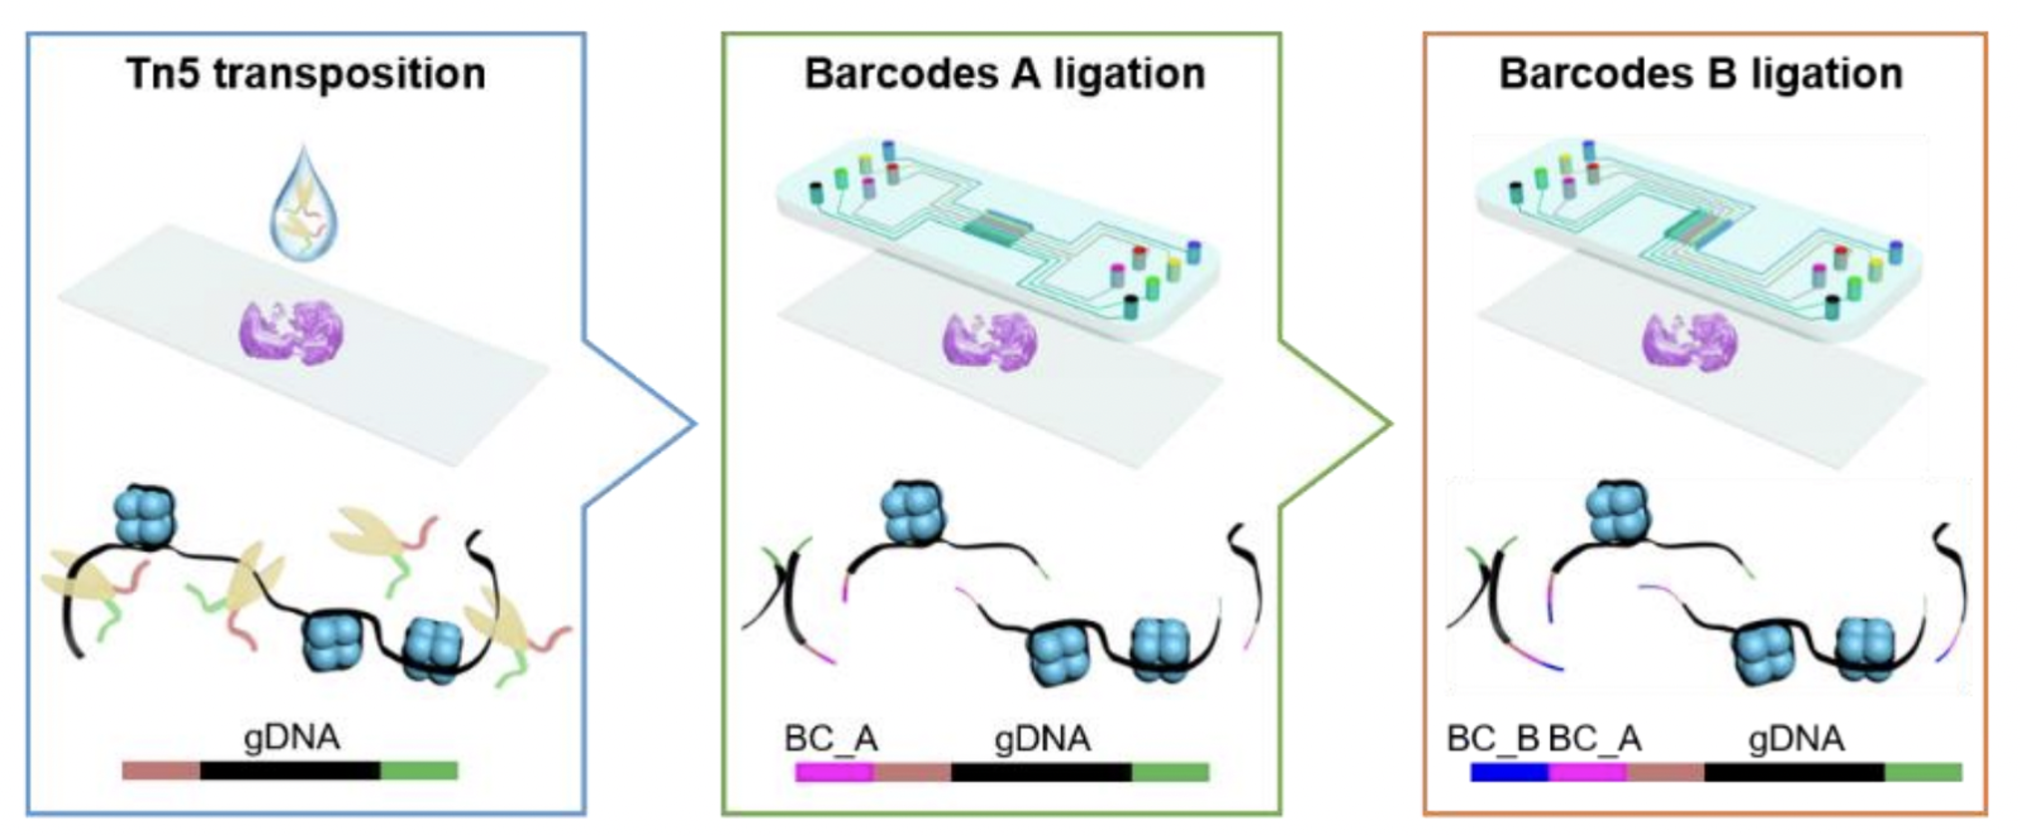
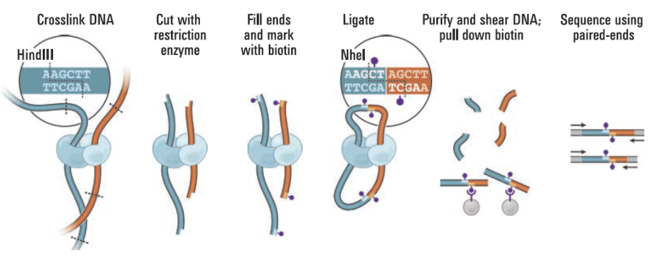
Spatial omics sequencing technologies
RNA
Protein
DNA accessibility
Chromatin structure

Slide 7
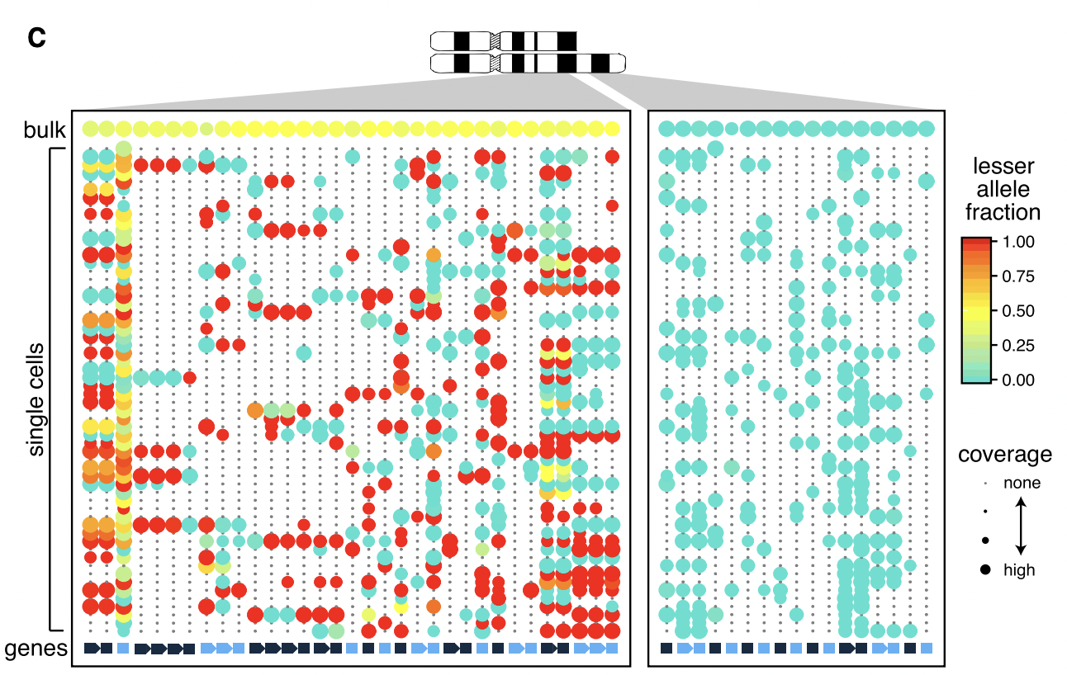
Other sequencing-based analyses
Alternative splicing
CNV Inference from RNA sequences

Slide 8
Mystery: (First a review) which chromosomes are affected by CNVs in this tumor sample?
Quick review: each column presents a SNP site that is detected to be heterozygous among this population of cells
A persistent depletion of one allele is suggestive of a deletion

Slide 9
Actual mystery: we have myeloid cells from an AML patient at two time points (pre and post operation). What operation did the patient get?
Again each column presents a SNP site that is detected to be heterozygous among this population of cells

Slide 10
Group review
Do you think we can identify single nucleotide somatic mutations in spatially resolved transcriptomics sequencing data? How and when?

Slide 11
Looking ahead
Next week 2 guest presentations on their own research
Provide feedback to guest speakers
Friday you will be given final projects
Assigned to teams
Choose from multiple unique, unpublished spatial omics datasets of tissues
Goal is to perform analyses, conduct research, and potentially discover some interesting biology
Following Friday will be final presentation
Provide feedback to each other

Slide 12
bit.ly/GDV_quizfinal
You have until 9:45
I will give you a 15 minute warning
If you finish early, you are welcome to be dismissed

