Slide 1
Spatial epigenomics
Prof. Jean Fan

Slide 3
Quick review of spatial proteomics
Based on spatially unresolved single-cell RNA-seq of the brain, Prof. Fan finds GeneA and GeneB to be upregulated in microglia, her cell-type of interest
GeneA encodes for a secreted protein ProteinA
GeneB encodes for a nuclear protein ProteinB
Good antibodies are available for both proteins
Prof. Fan wants to stain for one of these proteins to identify microglia in the brain and study their spatial organization
Which protein should she stain for and why?

Slide 4
Quick review of spatial proteomics
Based on spatially unresolved single-cell RNA-seq of the brain, Prof. Fan finds GeneA and GeneB to be upregulated in Purkinje neurons, her cell-type of interest
GeneA encodes for an axonal protein ProteinA
GeneB encodes for a nuclear protein ProteinB
Good antibodies are available for both proteins
Prof. Fan wants to stain for one of these proteins to identify Purkinje neurons in the brain and study their spatial organization
Which protein should she stain for and why?

Slide 6
This is an ongoing challenge

Slide 7
Why epigenetics?

Slide 8
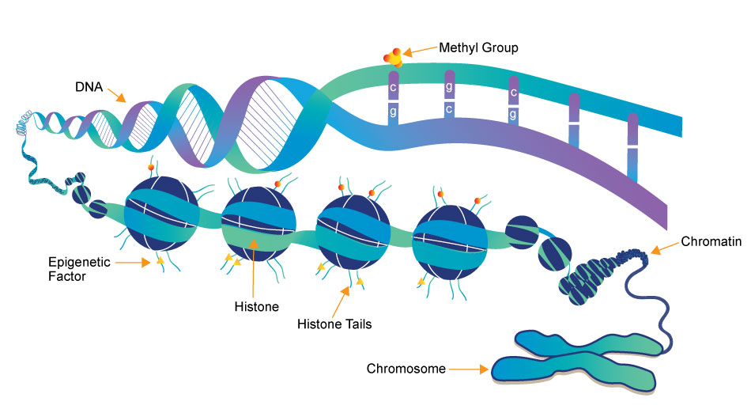
(a type of
protein)
Source: https://www.whatisepigenetics.com/fundamentals/

Slide 9
First: epigenetic profiling in a non-spatially resolved manner in bulk tissue

Slide 10
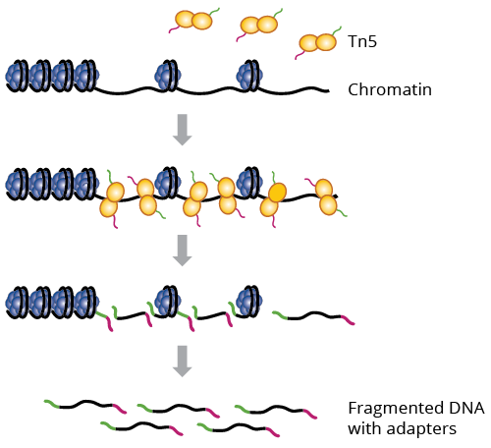
What parts of DNA are accessible for transcription?
ATAC-seq: Assay for Transposase-Accessible Chromatin using Sequencing
Why could this be interesting?
a genetically engineered hyperactive Tn5 transposase (2013) that simultaneously cuts open chromatin leaving a staggered nick and ligates sequencing adapters to these regions

Slide 11
Interpreting ATAC-seq data
Sequence:
Alignment:
Genome

Slide 12
Visualizing ATAC-seq data
Cell-type A
Cell-type B
genes
Genome

Slide 13
Food for thought
Many many RNA molecules are in a typical mammalian cell?
How many accessible regions are in the genome of a mammalian cell?
Notes:
Approximately 360,000 mRNA molecules are present in a single mammalian cell, made up of approximately 12,000 different transcripts with a typical length of around 2 kb.

Slide 14
Food for thought
If I want to sequence every RNA molecule, at least how many reads do I need to sequence?
If I want to sequence every accessible region, at least how many reads do I need to sequence?

Slide 15
Food for thought
We’ve seen a range of measurements for gene expression (0 to X copies) in a single cell
What is the range of measurements you expect for accessibility data in a single cell?

Slide 16
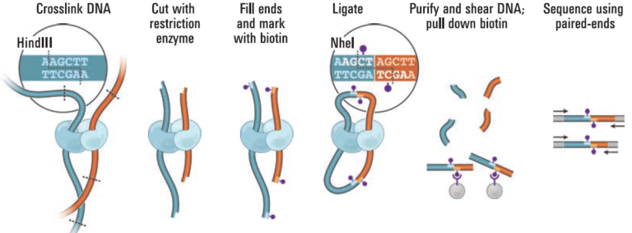
How is DNA organized in 3D? Which parts are touching?
Hi-C: chromosome conformation capture by high-throughput sequencing
Why could this be interesting?
Source: https://www.science.org/doi/10.1126/science.1181369

Slide 17
Interpreting Hi-C data
Sequence:
Alignment:
Genome

Slide 18
Visualizing Hi-C data
Source: https://www.nature.com/articles/s41467-017-02386-3

Slide 19
Interpreting Hi-C data visualizations
One chromosome

Slide 20
Interpreting Hi-C data visualizations
One chromosome

Slide 21
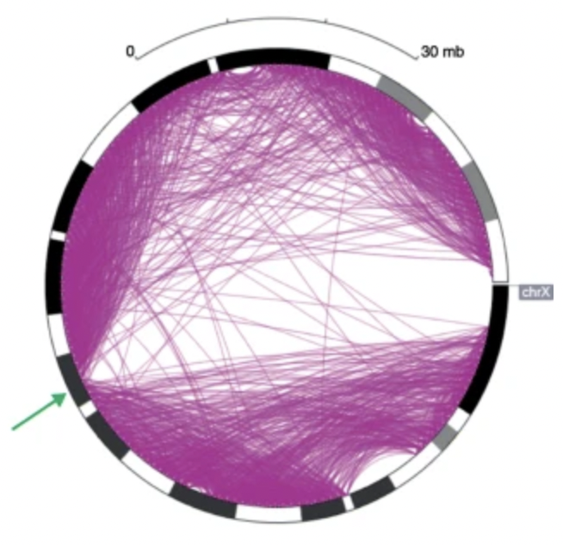
Other visualizations people have made
A
C
B

Slide 22
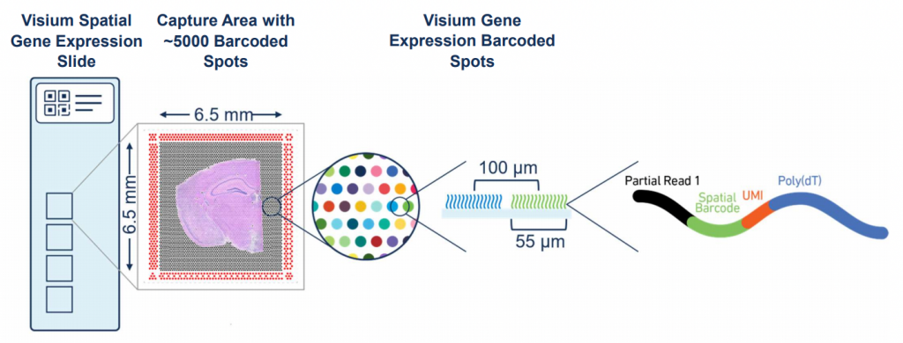
How do we get to spatially resolved?
Sequencing?
Imaging?

Slide 23
Getting to spatially resolved by sequencing (via DBiT-seq)
Source: https://www.sciencedirect.com/science/article/pii/S0092867420313908

Slide 24
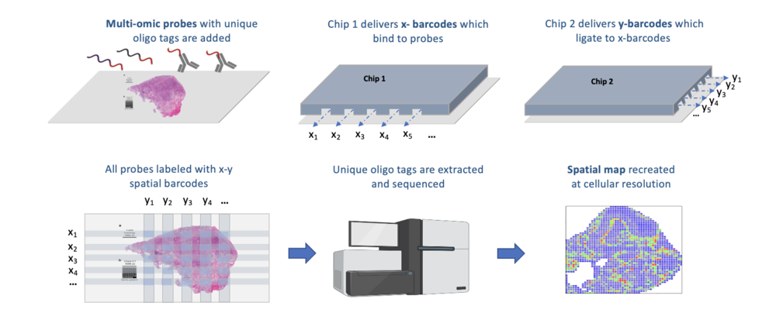

Slide 25
Getting to spatially resolved by sequencing (spatial ATAC-seq via DBiT-seq)
Source: https://www.biorxiv.org/content/10.1101/2021.06.06.447244v1

Slide 26
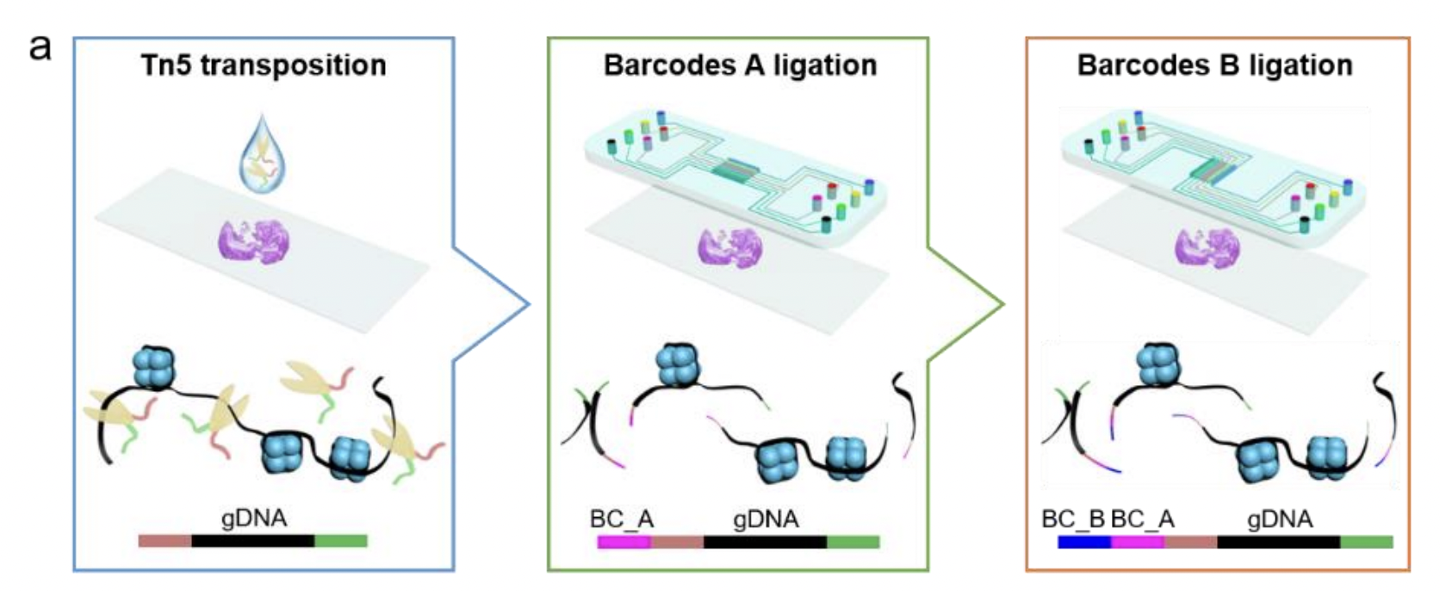

Slide 27
Spatial ATAC-seq
Still get count and position matrix
Instead of spot by gene, we get spot by DNA region
In theory, we can cluster and do all the same analyses as spatial transcriptomics

Slide 28
Quick Question
In spatial transcriptomics analysis, clusters of cells are transcriptionally similar (express similar genes). What do these spatial ATAC-seq clusters mean?

Slide 29
Quick Question
In spatial transcriptomics analysis, differential testing could help us identify which genes were upregulated in clusters. Can we do differential testing with ATAC-seq?
How would you interpret the results?

Slide 30
Food for thought
In spatial proteomics, we talked about how if we don’t titrate antibodies appropriately, we can get a lot of non-specific binding resulting in false positives (detecting proteins where there are none)
Are we more likely to get false positives or false negatives with spatial atac-seq?

Slide 31
Quick check: can we use this technology to do other spatially resolved omics?

Slide 32
Getting to spatially resolved DNA conformation by imaging
Source: https://www.nature.com/articles/s41467-020-16732-5

Slide 34
Quick question
Chromosome 19 is ~50 million base pairs
From MERFISH, we’ve seen that error robust multiplexed imaging can allow us to measure 10,000 unique RNA species in a single day experiment
If I wanted to use error robust multiplexed imaging to measure 10,000 unique regions along chromosome 19 to trace out its conformation, what resolution can I trace out chromosome 19?
Can I tell if base pair 1,000,059 is touching 2,002,394 but not 1,000,238?
Notes:
5 kb resolution

Slide 35
bit.ly/GDV23_quizfinal
Due Saturday Noon

