Slide 1
History of single cell omics and applications in neuroscience
Prof. Jean Fan

Slide 2
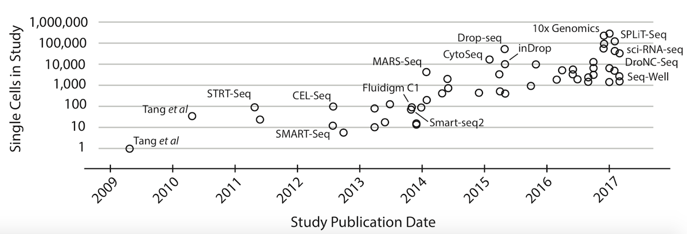
Today: Applications of single-cell omics in the study of neuroscience
Spatial
Transcriptomics
From 2019
(Svensson V, Vento-Tormo R and Teichmann SA. (2018) Exponential scaling of single-cell RNA-seq in the past decade. Nature protocols 13;4;599-604)

Slide 3
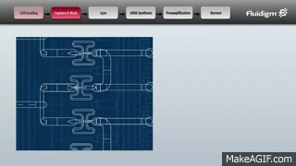
Blast from the past
Context (the year is 2013)
Full transcriptome characterization in single cells was just starting to go from 10s of cells to 100s of cells
No UMIs yet
How to analyze such “big data” was still unclear

Slide 4
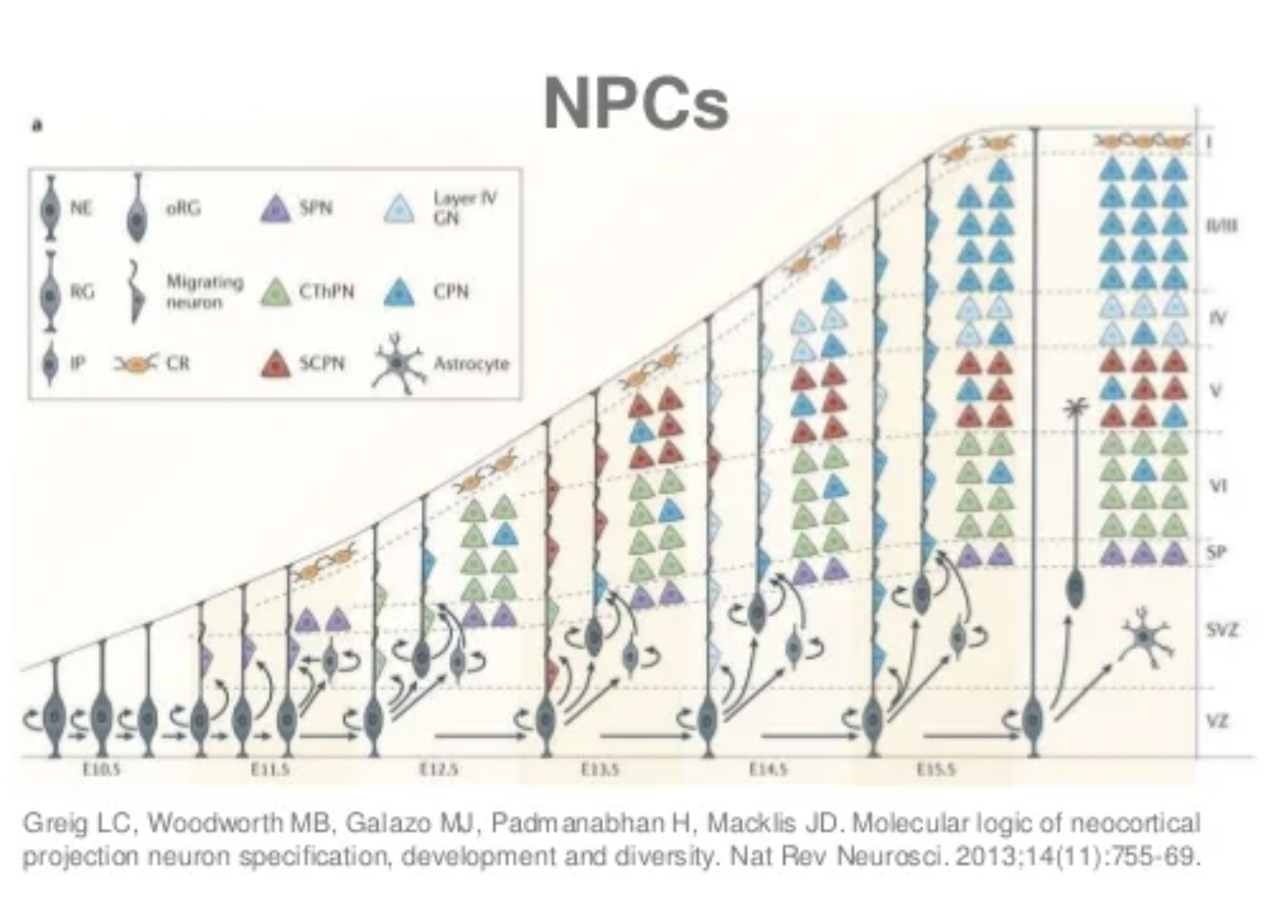
Goal: How can we identify and characterize transcriptionally distinct cell-types in the developing mouse brain?

Slide 5
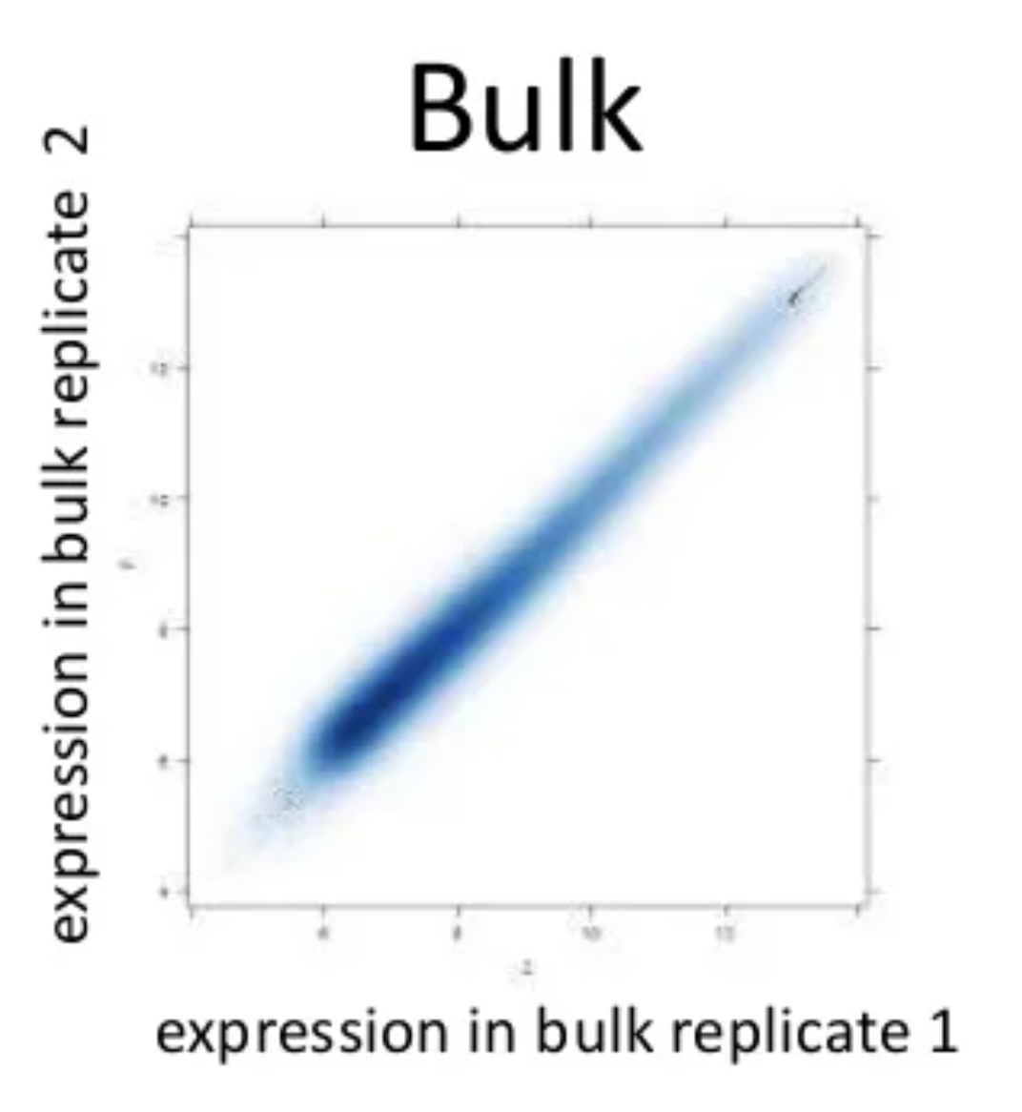
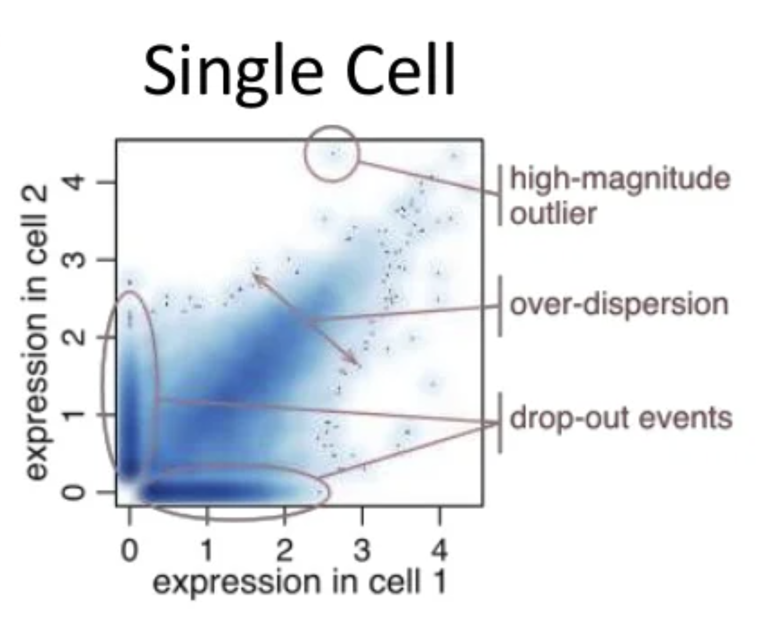
Challenge: gene expression measurements in single cells were much noisier than what we had been used to seeing in bulk RNA-seq
Why?

Slide 6
Approach: Pathway and gene set overdispersion analysis (PAGODA)
Source: https://jef.works/assets/papers/nmeth3734.pdf

Slide 9
We wanted to summarize gene expression within many annotated pathways, so we took the first principal component
PC1

Slide 10
So then we could perform hierarchical clustering on cells based on pathway scores, rather than just noisy gene expression
tSNE was still new and had not been applied in single cell context yet

Slide 11
Quick question: why use the first PC to summarize gene expression within a pathway rather than just taking an average?
PC1

Slide 12
Quick question: why use the first PC to summarize gene expression within a pathway rather than just taking an average?
Hint: what happens if we compute the average gene expression within this pathway?

Slide 13
We apply PAGODA to single-cell RNA-seq of neuro-progenitor cells in the developing mouse brain

Slide 14
We apply PAGODA to single-cell RNA-seq of neuro-progenitor cells in the developing mouse brain

Slide 15
Quick question: How can I validate that I have identified early and intermediate+mature NPCs?
Hint: Previous neuroscience studies have shown that early NPCs are spatially close to the SVZ of the brain and intermediate+mature NPCs are spatially close to the CP of the brain.

Slide 16
All mouse brains are kind of the same…
We can align measurements across many animals
Where do you think Neurod1+ Sowaha+ Prox1+ cells would be?

Slide 20
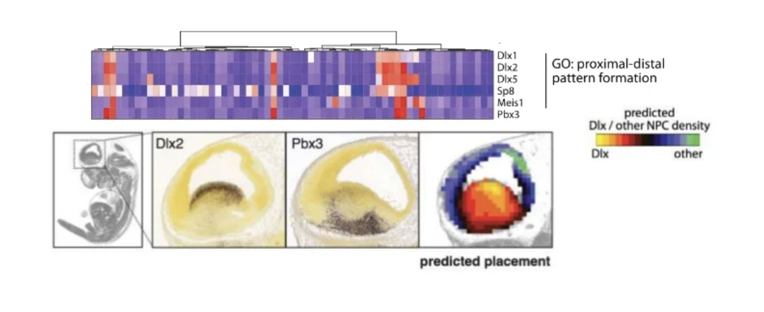

Slide 21
Context (the year is 2016)
Droplet-based single-cell sequencing has been developed enabling 10000s of single cells to be characterized
tSNE has entered the mainstream
However, multi-omics has not been developed yet (so we can only look at RNA and accessibility in different cells (but from the same tissue, so we should see the same cell-types)

Slide 22
Goal: want to characterize different cell-types in the human brain. Perform single-cell RNA-seq and single-cell accessibility in different cells
Source: https://jef.works/assets/papers/nbt4038.pdf

Slide 23
snDrop-seq and scTHS-seq resolve intra- and inter-regional cellular diversity in the adult human brain
Why do these tSNEs look different?
Source: https://jef.works/assets/papers/nbt4038.pdf

Slide 24
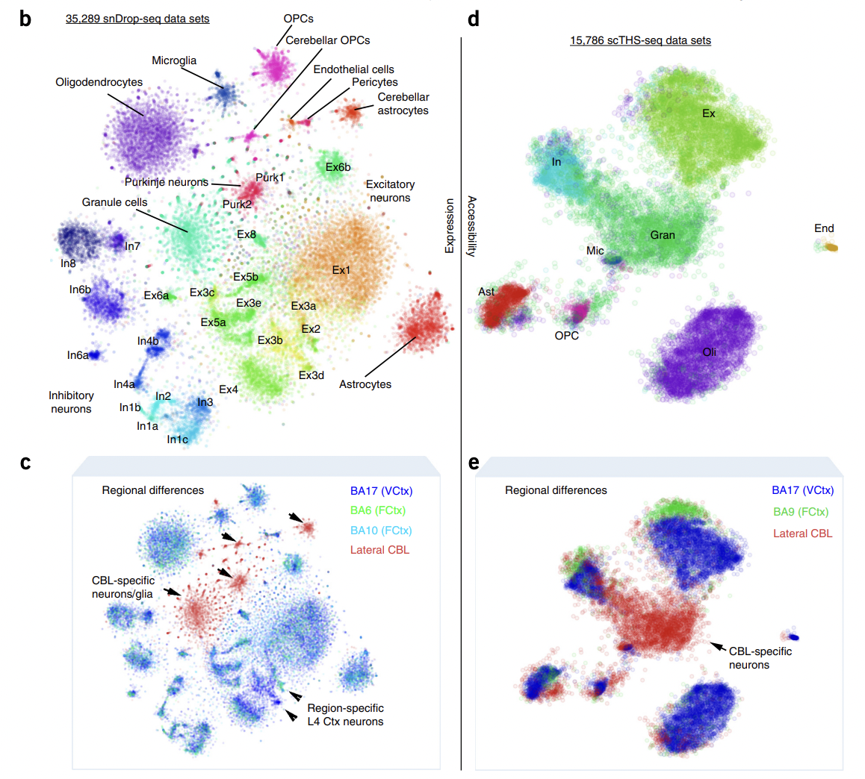
snDrop-seq and scTHS-seq resolve intra- and inter-regional cellular diversity in the adult human brain
Why do these tSNEs look different?
Source: https://jef.works/assets/papers/nbt4038.pdf

Slide 25
Use differentially expressed genes to predict differentially accessible promoters to improve clustering of scTHS-seq data

Slide 26
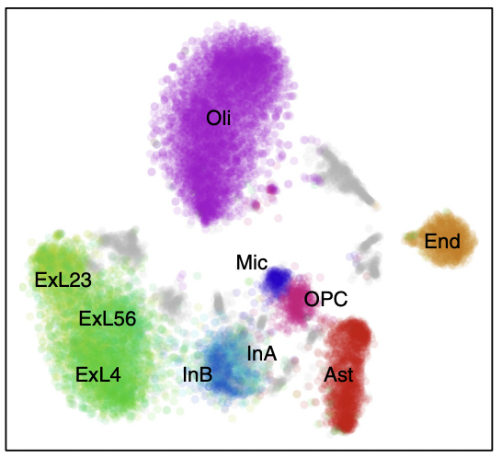
Use differentially expressed genes to predict differentially accessible promoters to improve clustering of scTHS-seq data

Slide 27
Fast forward in time and the rise in high-throughput spatially resolved transcriptomics
Source: https://www.cell.com/trends/biotechnology/fulltext/S0167-7799(20)30140-2

Slide 28
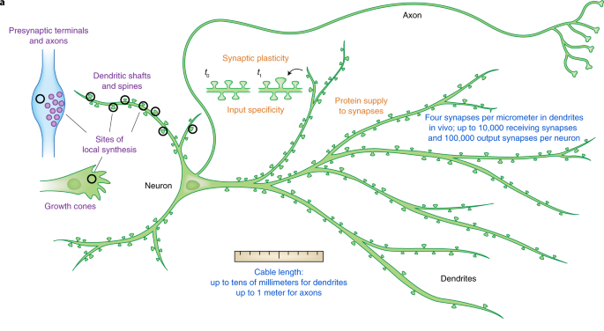
Goal: How are genes organized in highly polarized cells like the neuron? (why do we care?)
Source: https://www.nature.com/articles/s41594-019-0263-5

Slide 29
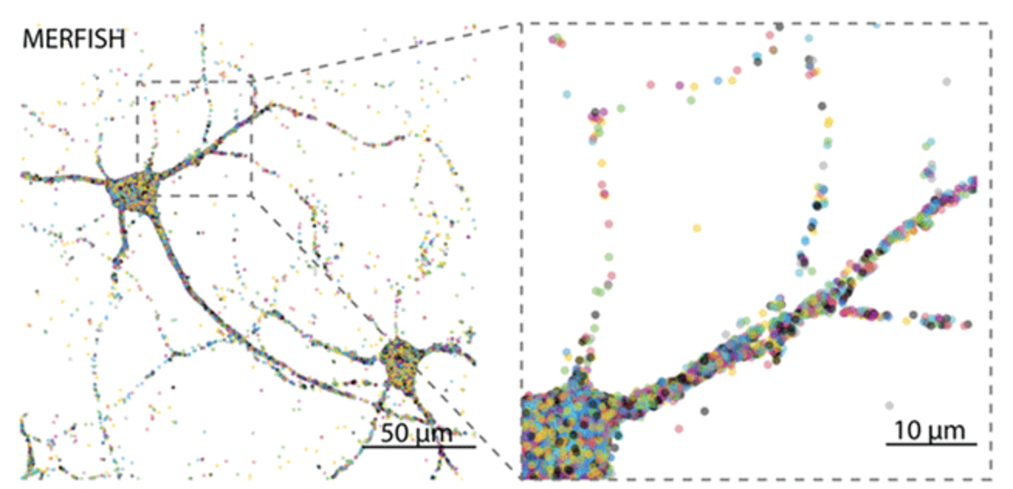
Approach: MERFISH to characterize subcellular organization of cultured hippocampal neurons
Source: https://www.biorxiv.org/content/10.1101/2020.12.07.414060v1

Slide 30
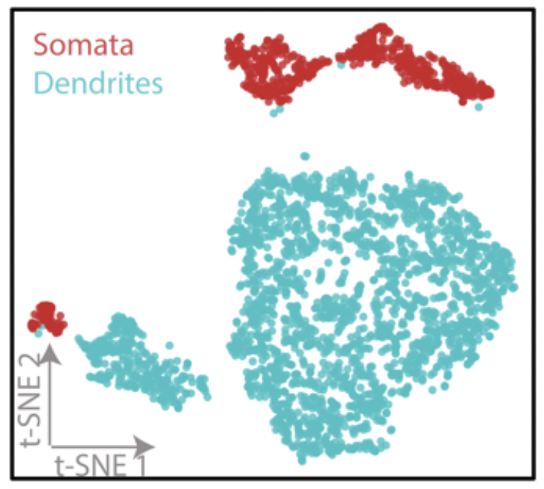
Are dendrites transcriptionally distinct from the soma? (manually segment)
Why are there two clusters of dendrites and soma?
Tau is axon; Map2 is dendrite

Slide 31
Are dendrites transcriptionally distinct from the soma? (manually segment)

Slide 32
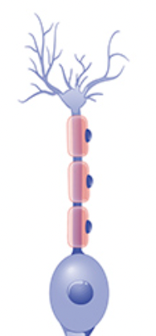
Is gene expression variable along dendrites?
Align neurons:
Look at expression within a
binned distance to soma center

Slide 33
Quick question: should we normalize by dendritic length? Why or why not?
Not normalized:
Normalized

Slide 34
bit.ly/GDV23_rc
Extra credit HW assignment -> due March 10th

