Slide 1
History of single cell omics and applications in cancer
Prof. Jean Fan

Slide 2
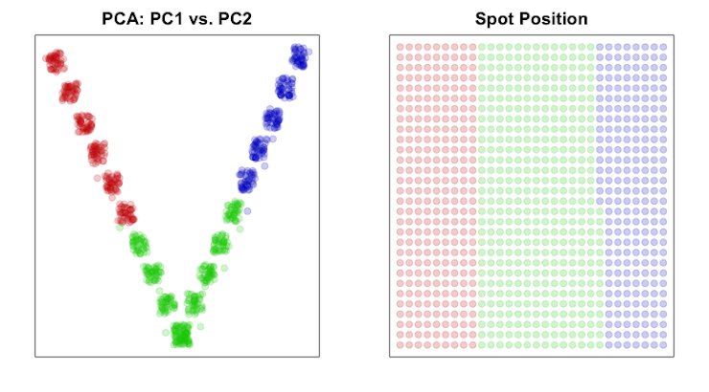
https://jef.works/blog/2022/07/11/deconvolution-vs-clustering-2/
Kmeans

Slide 3
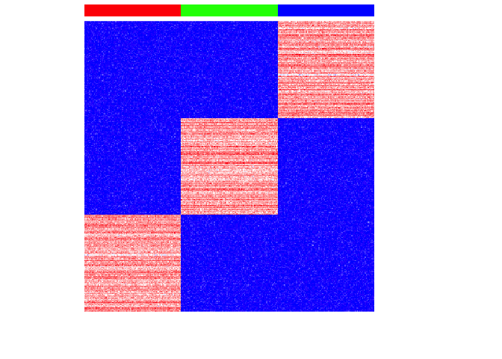
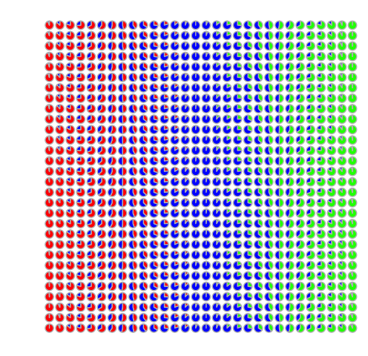
https://jef.works/blog/2022/07/11/deconvolution-vs-clustering-2/
Ground Truth

Slide 5
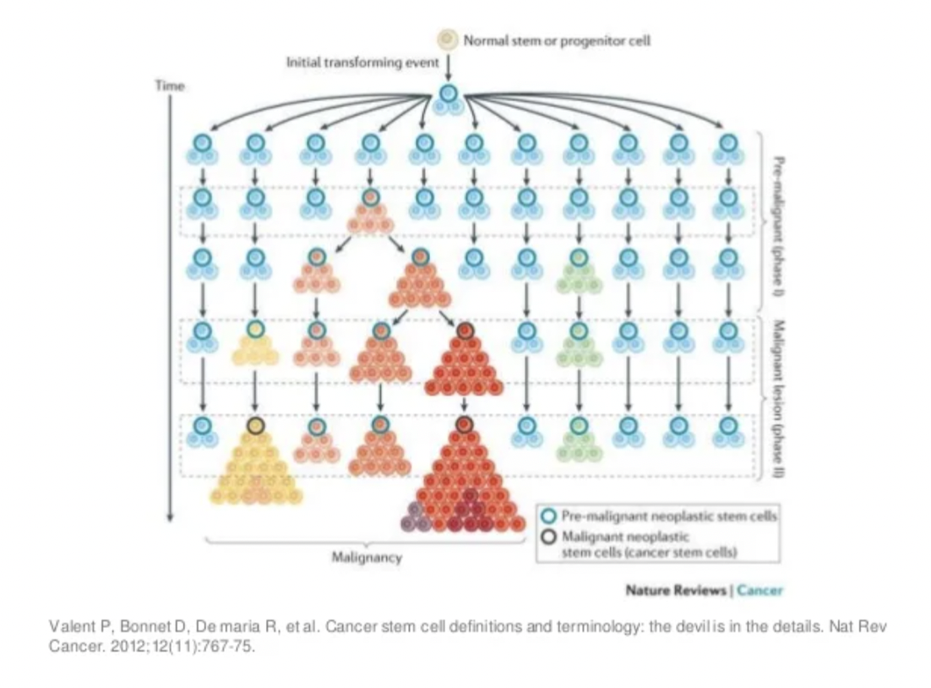
Today: Applications of single-cell and spatial omics in the study of cancer

Slide 6
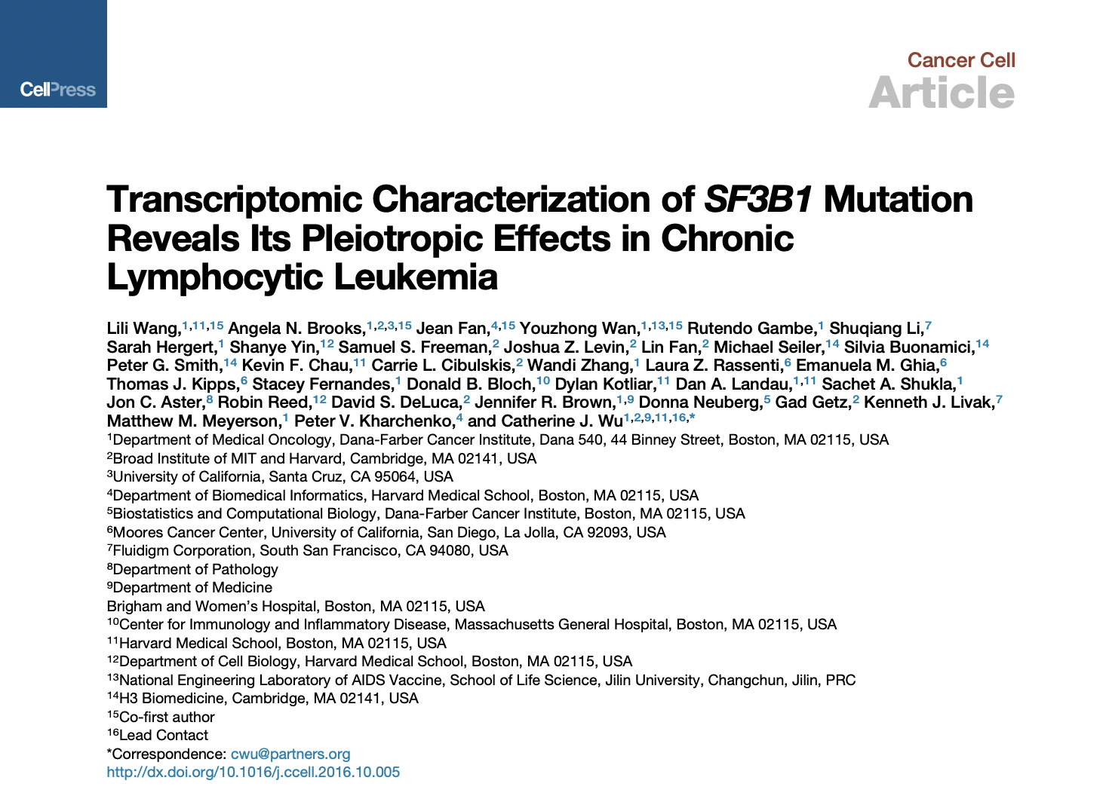
Goal: how do putative driver mutations impact gene expression in cancer cells at single cell level?
Context:
The year is 2014
Single cell RNA-seq is still new (other single cells omics were still being developed)
Applications in cancer are limited due to concerns of technical noise
Source: https://jef.works/assets/papers/jccell201610005.pdf

Slide 7
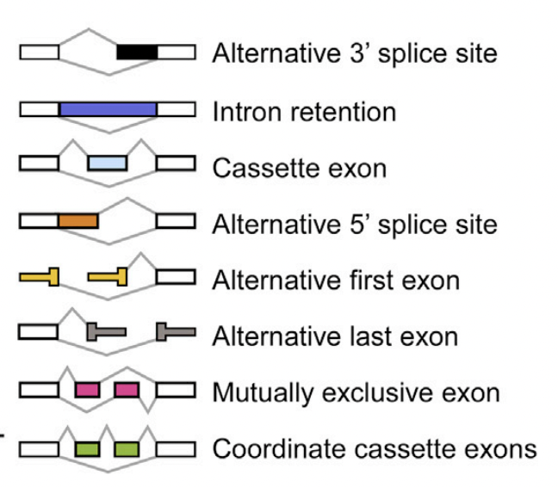
(B cell cancer)
Context:
Collaborator Catherine Wu’s lab had just used bulk Whole Genome Sequencing to identify a reoccurring mutation in the gene SF3B1 in ~15% of CLL patients and is associated with poor prognosis
SF3B1 encodes a protein that is part of the splicing machinery
So we hypothesized SF3B1 mutation may be impacting alternative splicing -> first use bulk RNA-seq
Healthy
SF3B1 WT
SF3B1 mut

Slide 8
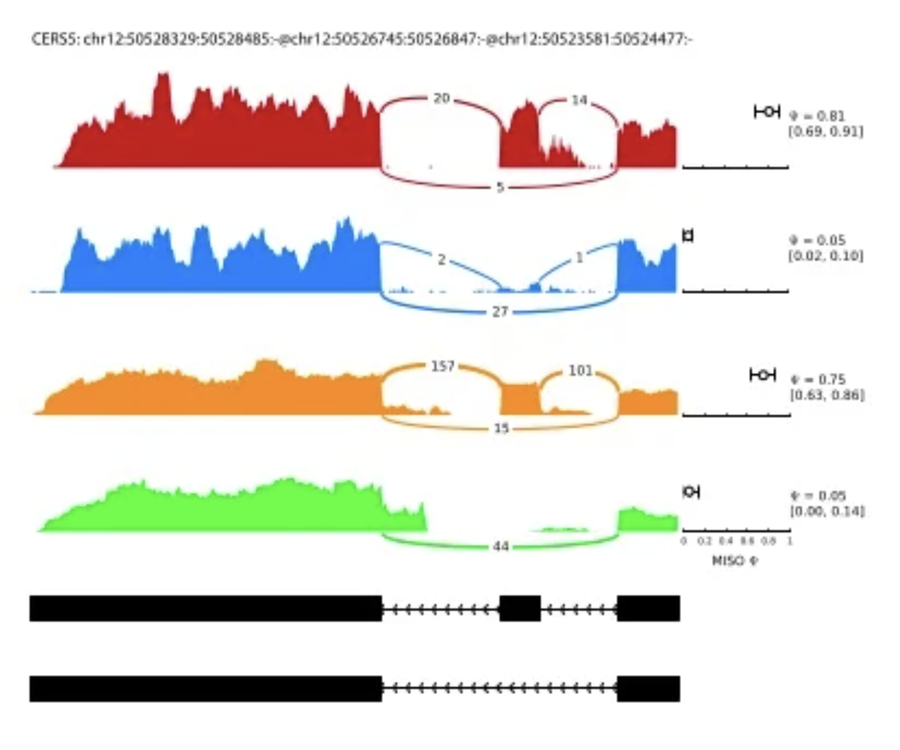
Visualizing alternative splicing: sashimi plots
How do we visualize 100s of splice events in 100s of samples?
Sashimi plots: https://www.ncbi.nlm.nih.gov/pmc/articles/PMC4542614/
Source: jef.works/assets/papers/jcell201607025.pdf

Slide 9
Summarize the data by calculating a Percent Spliced In (PSI): percentage of reads including specific gene sequences (cryptic exon)
For a cryptic exon:

Slide 10
Quick question: what is the PSI for exon 2 of this gene in this sample given these reads?

Slide 11
Quick question: what is the PSI for exon 2 of this gene in this sample given these reads?

Slide 12
Results
Healthy
SF3B1 WT
SF3B1 mut
PSI:

Slide 13
Quick question: what would you think if my data visualization looked instead like this?

Slide 14
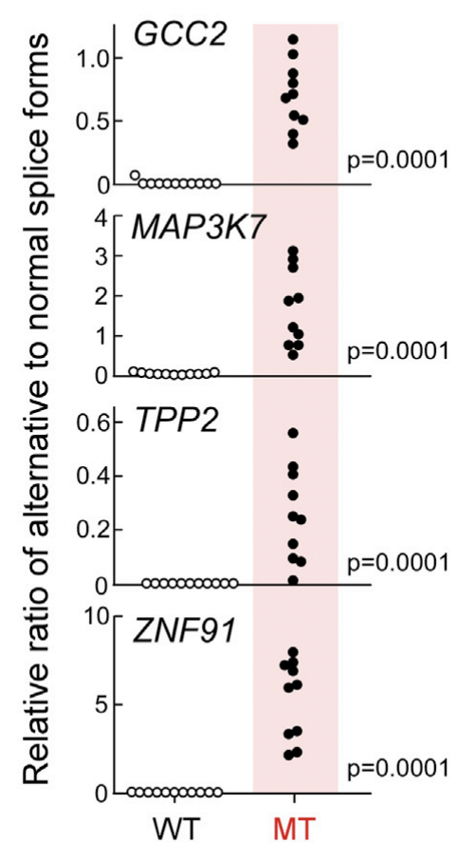
Validation by PCR on additional samples using specific primers complementary to unique sequence in splice variant
PSI:

Slide 15
Validation by PCR on additional samples using specific primers complementary to unique sequence in splice variant
Real missed opportunity for which Gestalt principal?
PSI:

Slide 16
We wanted to validate in single cells but this was the early days of single-cell sequencing…
We needed to figure out which single cells has the SF3B1 mutation (and which variant)
AND evaluate alternative splicing in these single cells…
Profiling DNA and RNA in the same single cells not yet available

Slide 17
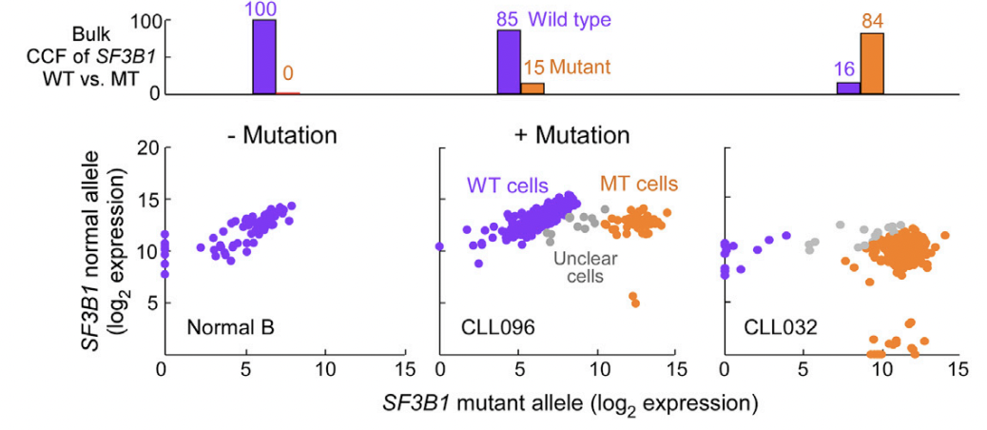
Invented an approach based on PCR
Use primer unique to normal allele -> try to detect
Use primer unique to mutant allele -> try to detect
Look at ratio of normal to mutant allele detection
Why are there mutant alleles detected in healthy B cells?

Slide 18
Invented an approach based on PCR
Use primer unique to normal allele -> try to detect
Use primer unique to mutant allele -> try to detect
Look at ratio of normal to mutant allele detection

Slide 19
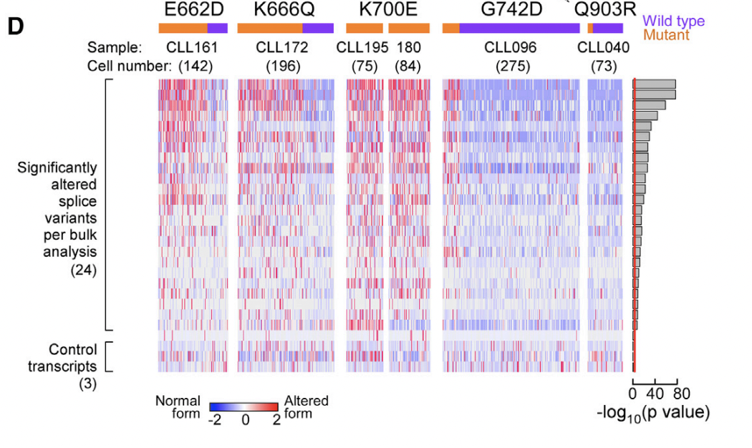
Invented an approach based on PCR
Use primer targeting unique sequence in splice variant we anticipate to be differentially spliced in for cells with SF3B1 mutation
What do you think the results will look like?

Slide 20
Invented an approach based on PCR
Use primer targeting unique sequence in splice variant we anticipate to be differentially spliced in for cells with SF3B1 mutation

Slide 21
And that’s how we showed SF3B1 mutation in CLL causes aberrant alternative splicing (impacting a variety of pathways and processes) Questions before we move on?
to another cancer application

Slide 22
Goal: how do CNVs impact gene expression in cancer cells at the single cell level?
Context
The year is 2018
Simultaneous DNA and RNA sequencing not available yet
Approach: infer CNVs from single-cell RNA-seq
Source: https://jef.works/assets/papers/gr228080117.pdf

Slide 23
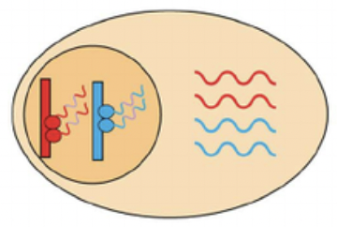
Background: in diploid mammalian cells, we have two copies of autosomal genes

Slide 24
Quick question: how can we tell these two copies apart?

Slide 25
Quick question: how can we tell these two copies apart?
G
C
C
T

Slide 26
Quick question: if the cell had a deletion (1x copy number loss), how would this affect the observed alleles in the expressed genes?

Slide 27
Quick question: if the cell had a deletion (1x copy number loss), how would this affect the observed alleles in the expressed genes?
G
C
G
C
G
C
G
C

Slide 28
Follow-up: Look at the RNA-seq reads for this cell. Do you think it has a deletion in this region?

Slide 29
Follow-up: If we focus on SNPs that are supposed to be heterozygous in this sample, what do you think the region affected by deletion will look like?
???

Slide 30
Indeed, in bulk RNA-seq, if we focus on known heterozygous SNP sites, diploid regions show 2 different allele and deletion regions show 1 allele

Slide 31
Indeed, when we look at single-cell RNA-seq, deletion regions show 1 allele
Why do some single cells not have coverage?

Slide 32
However, when we look at single-cell RNA-seq, even diploid regions some times show only 1 allele
Why do you think this is?

Slide 33
Random mono-allelic expression/detection presents challenges but if we look across a large enough region, we can calculate probabilities
Consider that we estimate random mono-allelic expression/detection in single cells occur 50% of the time
For a single gene in a single cell, I observe 1 allele
I conclude that this cell must have a deletion
What do you think of my conclusion?

Slide 34
Random mono-allelic expression/detection presents challenges but if we look across a large enough region, we can calculate probabilities
Consider that we estimate random mono-allelic expression/detection in single cells occur 50% of the time
Across 100 genes that are sequential to each each along the genome in a single cell, I observe the same single allele
I conclude that this cell must have a deletion
What do you think of my conclusion?

Slide 35
Approach: use patterns of allelic imbalance in a Bayesian hierarchical model to predict the probability a cell has a deletion

Slide 36
Validate using FISH imaging
IGH is on chromosome 14
MAF is on chromosome 16
Our single-cell CNV analysis suggests there is a deletion of chromosome 16 but not chromosome 14. What would we expect to see if there was a deletion on chromosome 16 but not chromosome 14?

Slide 37
Apply to sequential multiple myeloma sample

Slide 38
Remind me: why did I infer CNVs from single cell RNA-seq data? What can I do now?

Slide 39
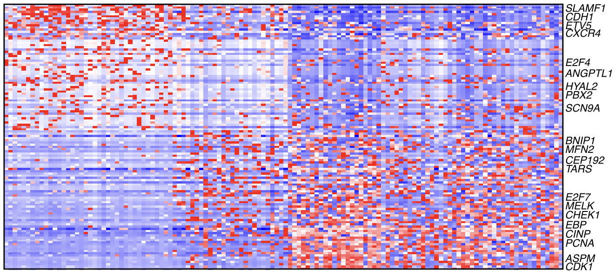
Remind me: why did I infer CNVs from single cell RNA-seq data? What can I do now?

Slide 40
And that’s how we inferred CNVs from single cell RNA-seq to interrogate the impact of CNVs on gene expression in multiple myeloma at the single cell level Questions before we move on?
to another cancer application

Slide 41
Goal: how are transcriptionally distinct GBM subtypes spatially organized in tumors?
Context
The year is 2020
Collaborator Mario Suva’s lab used single-cell RNA-seq to identify transcriptionally distinct subtypes of GBM cells
But how they were organized spatially in tumors is unclear
Approach:
Target 155 genes relevant for distinguishing between GBM subtypes and cells in tumor microenvironment
Apply MERFISH to characterize spatial organization
(Hara et al, Cancer Cell, June 2021)

Slide 42
Using single-cell RNA-seq data, design panel of genes to distinguish between GBM subtypes and cells in tumor microenvironment

Slide 43
Apply MERFISH imaging to profile the expression of these genes. Cluster together with single-cell RNA-seq data to identify same cell-types.

Slide 44
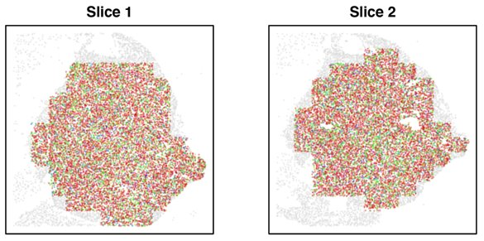
See how cell-types are organized in different GBM tumor slices

Slide 45
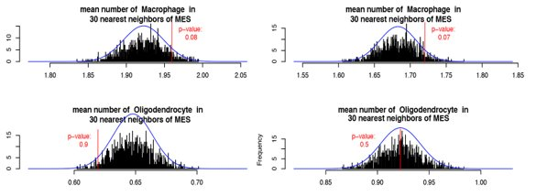
Quantify spatial relationships to find macrophages to be spatially enriched in around MES GBM cells

Slide 46
Quick question: there are many kinds of macrophages (M1/M2, microglia, etc). Do you think we can distinguish them here?

Slide 47
And that’s how we characterized the spatial organization of cell-types and cancer cell states in GBM Questions before we move on?

Slide 48
bit.ly/GDV23_rc

