Slide 1
EN.580.428 Genomic Data Visualization Lesson 2 Spatially Resolved Transcriptomic Data
Prof. Jean Fan

Slide 2
Lesson learning objectives
understand what is spatially resolved transcriptomic data
different kinds of spatial transcriptomics technologies
how the data is generated
begin visualizing and interacting with the data
assign HW datasets

Slide 3
What are some different cell-types?

Slide 4
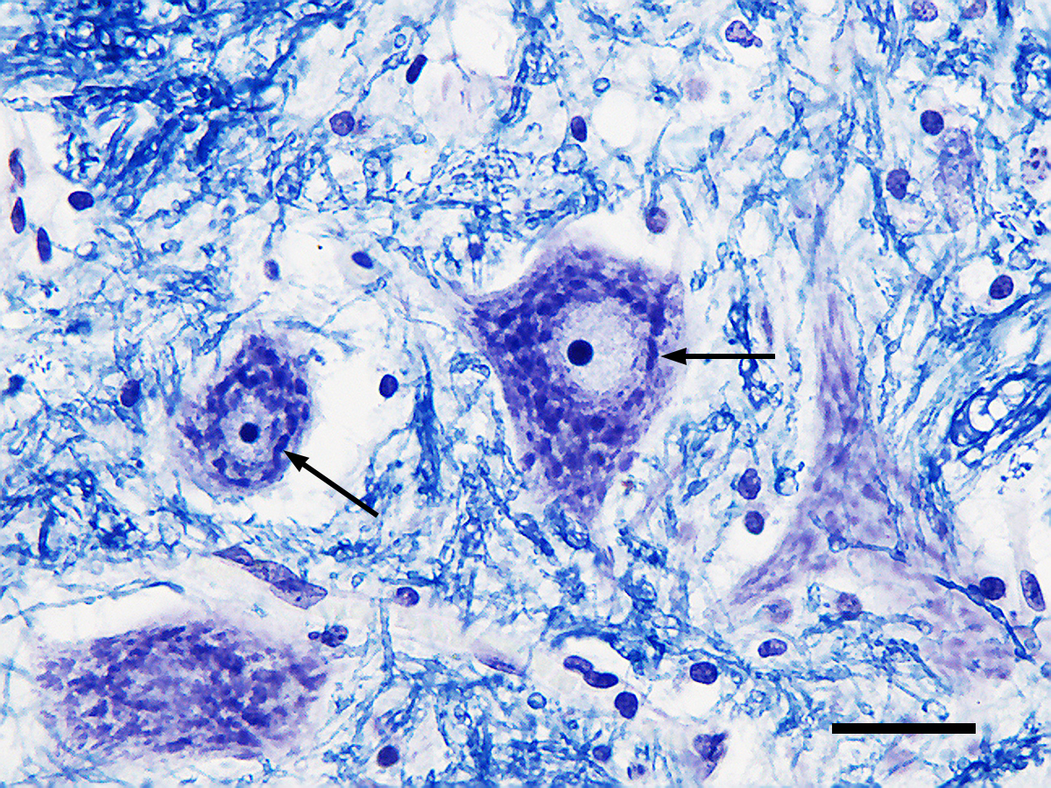
What are some different cell-types?
H&E
Nissl
(Source: Wikipedia)

Slide 5
How can we distinguish these cell-types (and cell-states) from each other?

Slide 6
Why spatially-resolved profiling?

Slide 7
Low-throughput imaging-based spatial transcriptomic profiling techniques: single molecule fluorescence in situ hybridization

Slide 8
Question: I design 5 smFISH probes to target the same gene. How many spots will I see when I take a picture? (hint: how far apart are these spots assuming one base pair corresponds to 3.4 Å or 0.34 nanometers)

Slide 9
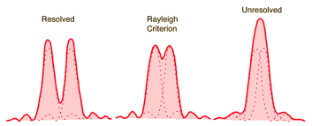
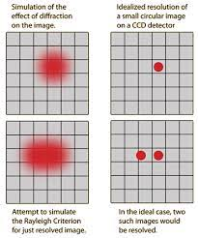
Recall: diffraction limit
1D
2D
diffraction limit for a microscope ~ 250nm

Slide 10
Question: I design 5 smFISH probes to target the same gene. How many spots will I see when I take a picture?

Slide 11
How many genes can we image simultaneously with smFISH? (hint: how many colors we can visually distinguish?)

Slide 12
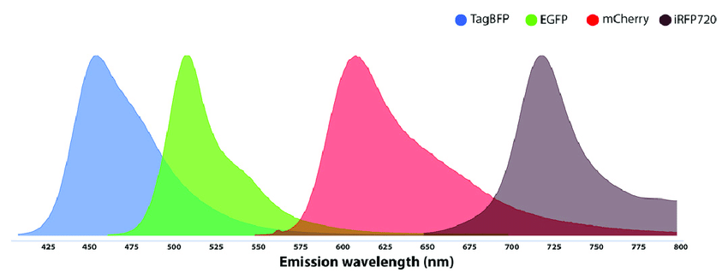
Recall: Spectral overlap
Spectral overlap

Slide 13
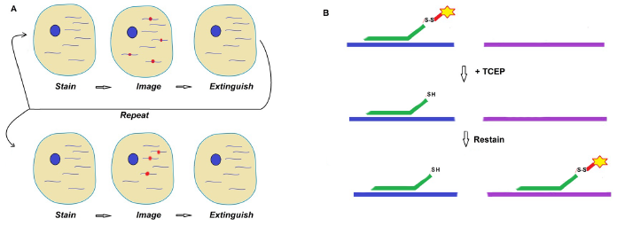
Sequential smFISH

Slide 14
Sequential smFISH
Practice
Consider I am imaging 1 fluorescence probe color. I can do 10 rounds of imaging.
Using sequential smFISH, how many different gene species can I detect?

Slide 15
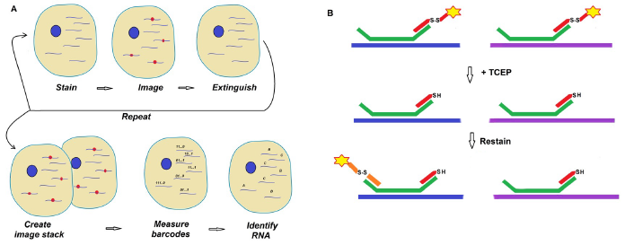
Multiplexed smFISH

Slide 16
Sequential vs multiplexed smFISH
Practice
Consider I am imaging 1 fluorescence probe color. I can do 10 rounds of imaging.
Using multiplexed smFISH, how many different gene species can I detect? (recall combinatorics)

Slide 17
(Xia*, Fan*, Emanuel*, et al PNAS 2019)

Slide 18
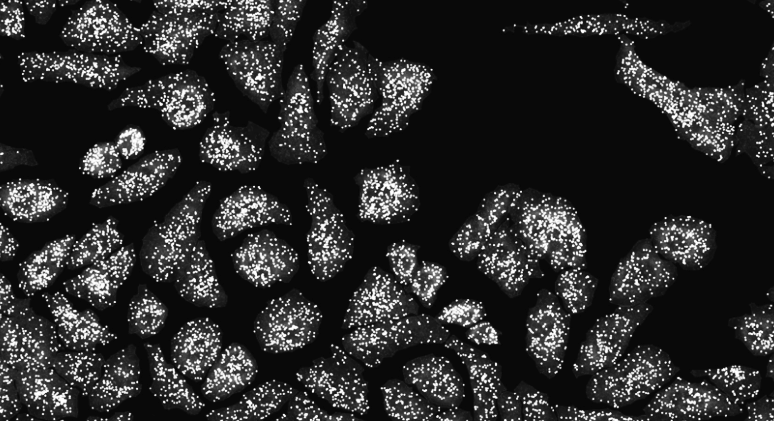

Slide 19
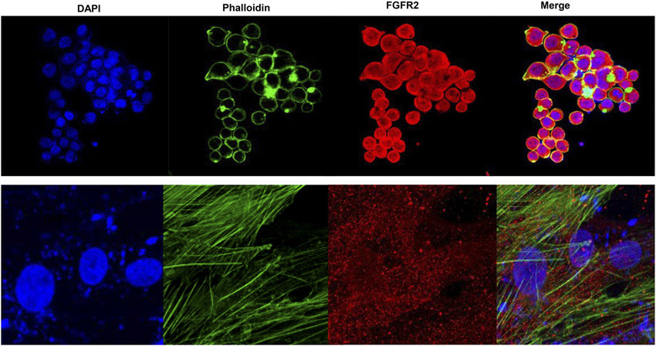
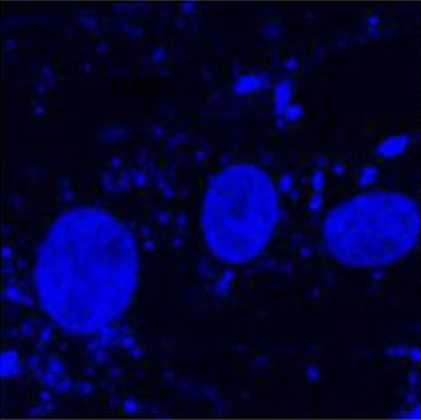
Water-shedding dapi-based cell segmentation

Slide 20
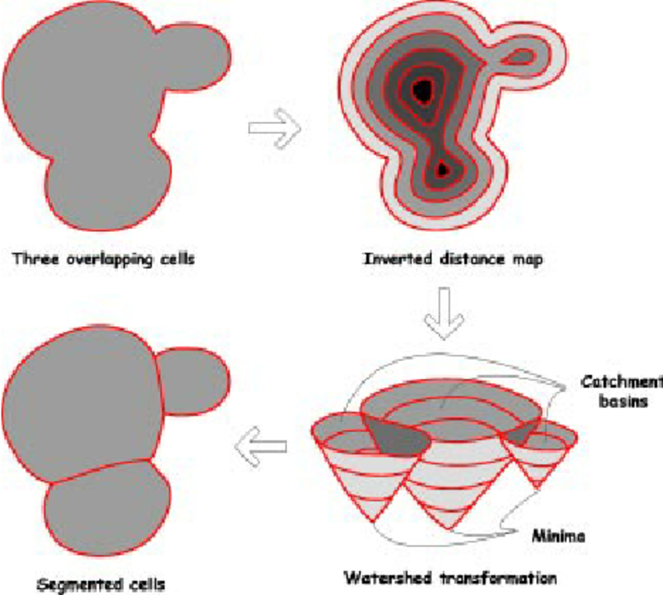
Water-shedding dapi-based cell segmentation

Slide 21
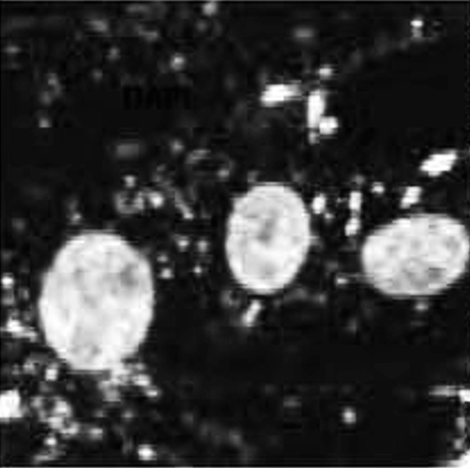
Water-shedding dapi-based cell segmentation

Slide 22
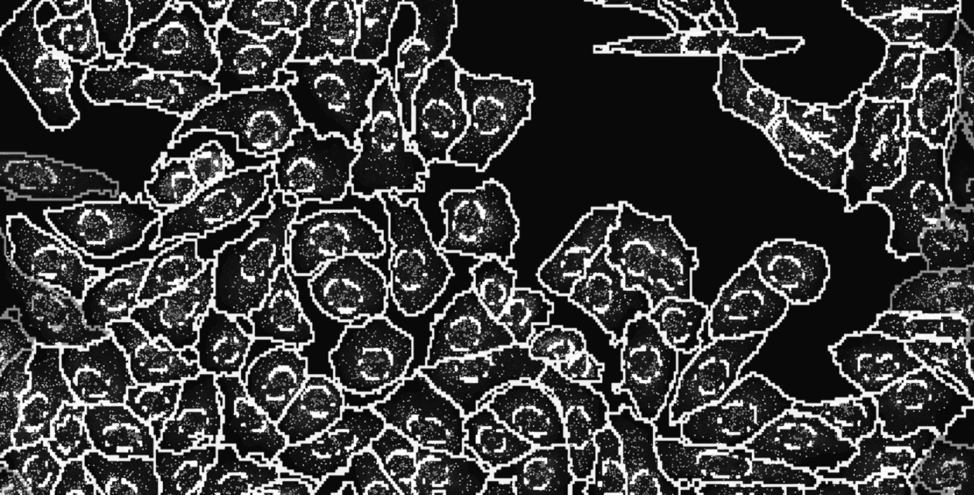
Notes:
and count how many copies of each gene we detect in each cell

Slide 23
Cell segmentation + spot detection + gene counting within cells = cell x gene count matrix

Slide 24
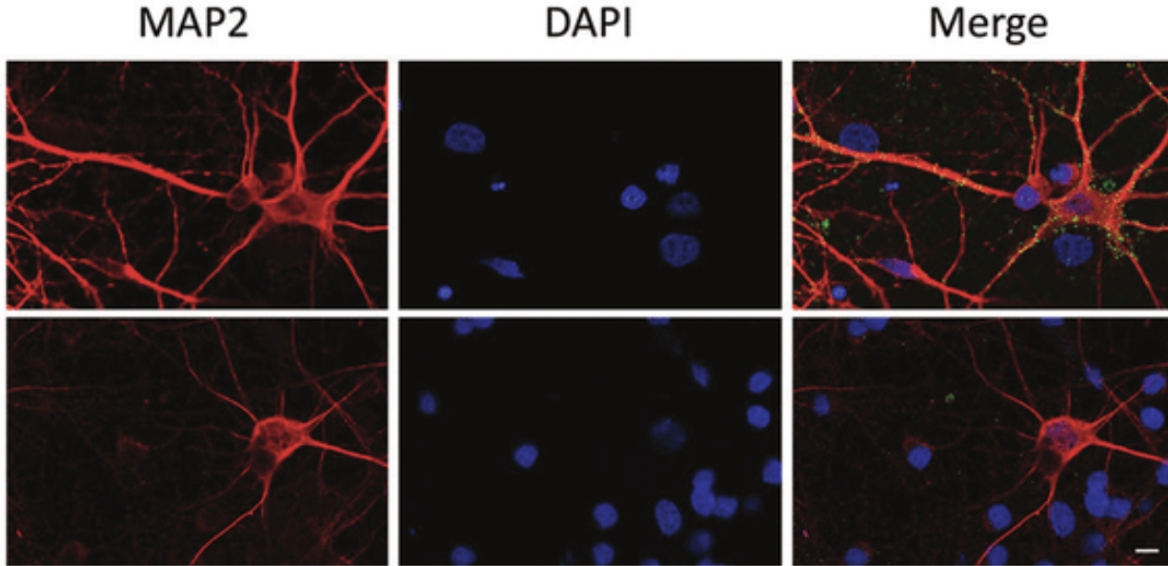
What if you have a cell like a neuron with axon and dendrites?
Practice

Slide 25
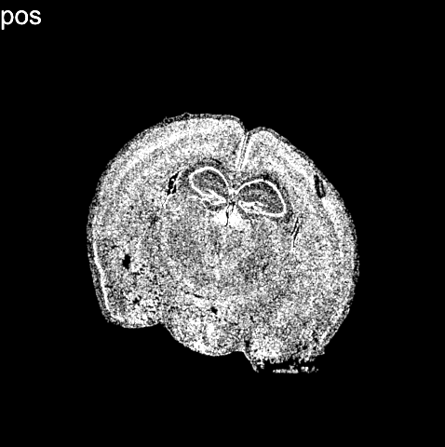
(Vizgen data)
Notes:
What we end up with is not only an image of where cells are within fixed tissues (here we have a cortical section of the mouse cortex)

Slide 26
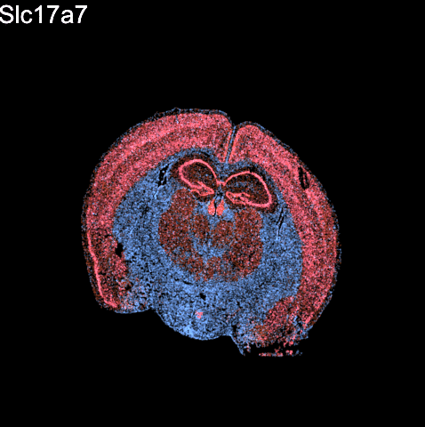
(Vizgen data)
Notes:
But we can see how targeted sets of genes are expressed within these cells within the tissues

Slide 27
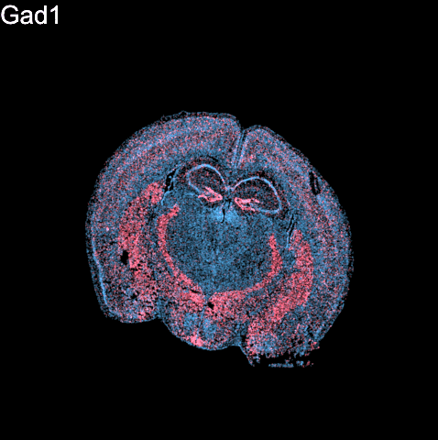
(Vizgen data)
Notes:
But we can see how targeted sets of genes are expressed within these cells within the tissues
For 100s to 1000s genes

Slide 28
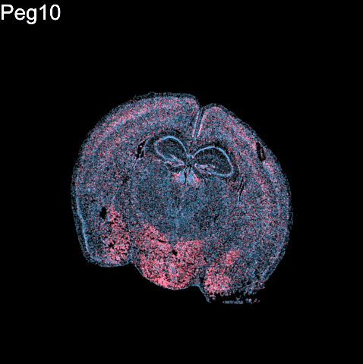
(Vizgen data)
Notes:
But we can see how targeted sets of genes are expressed within these cells within the tissues
For 100s to 1000s genes

Slide 29
Questions before we move onto sequencing-based spatial transcriptomics?

Slide 30
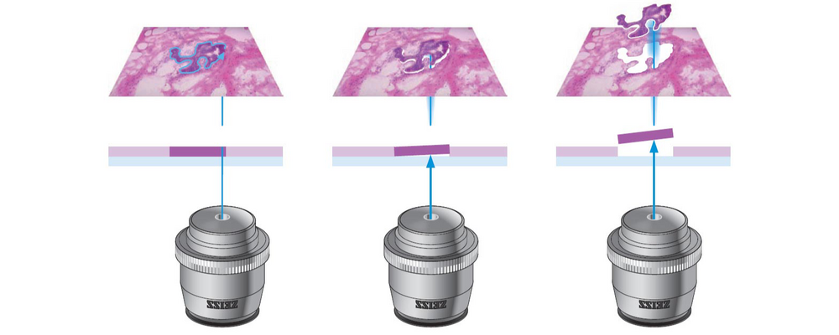
Low-throughput sequencing-based spatial transcriptomic profiling techniques: micro-dissection

Slide 31
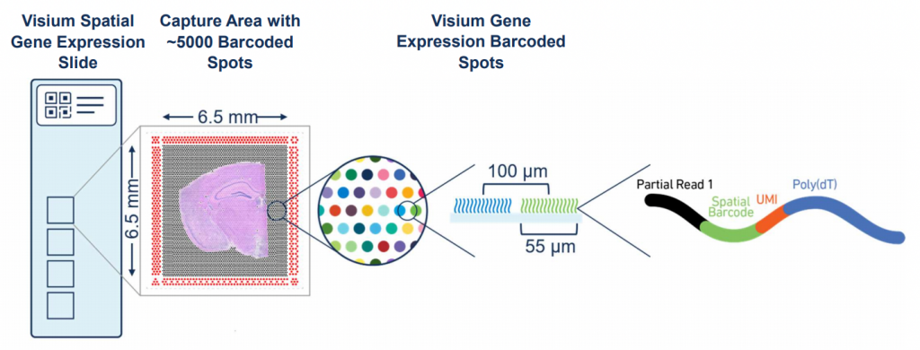
Spatial-barcode bead capture

Slide 32
Recall: mRNAs have poly(A)-tails

Slide 33
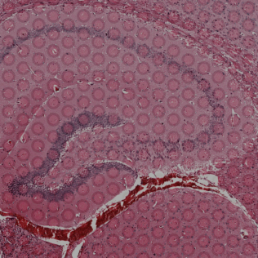
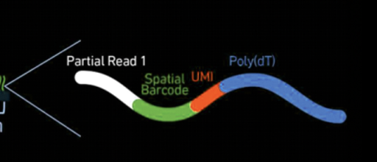
Spatial-barcode bead capture

Slide 34
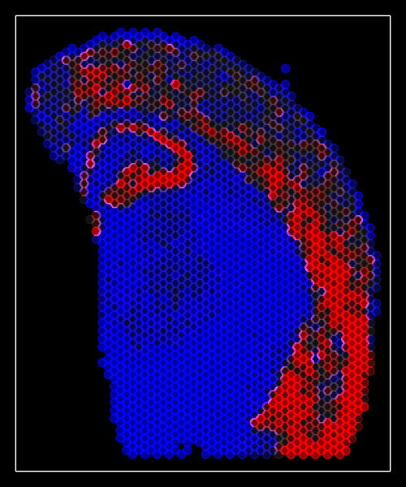
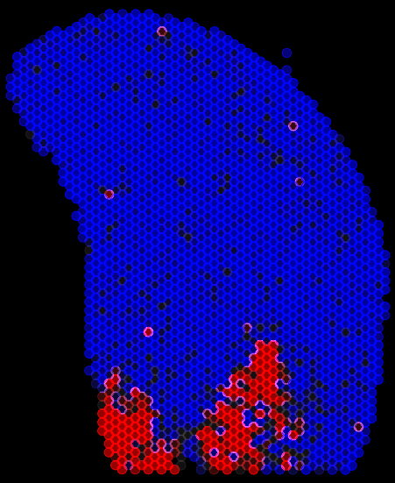
Spatial-barcode bead capture
Slc17a7
Peg10
…

Slide 35
What happens if you have multiple cells in the same spatial spot?
Practice

Slide 36
Questions before we move analyzing our own spatial transcriptomics datasets?

Slide 37
begin your adventure with your starter pokemon dataset
imaging
sequencing
Ataes Aggarwal
Meera Bhat
Carol Li
Yuxiang Li
Yunzhou Liu
Nga Man Looi
Kevin Meza Landeros
Kamie Kueller
Itsuki Ogihara
Maya Sharma
Ayan Vaishnav
(if you don’t see your name, add here)
Daniel Chen
Nikhil Choudhary
Siddhi Date
Alexandra Gorham
Sanchin Kammula
Yanyan Mo
Kevin Nguyen
Sidharth Raghavan
Sabahat Rahman
Hannah Tauchi
Ishita Unde
Yi Yang
(if you are an auditor, add here)

Slide 38
HW1

Slide 39
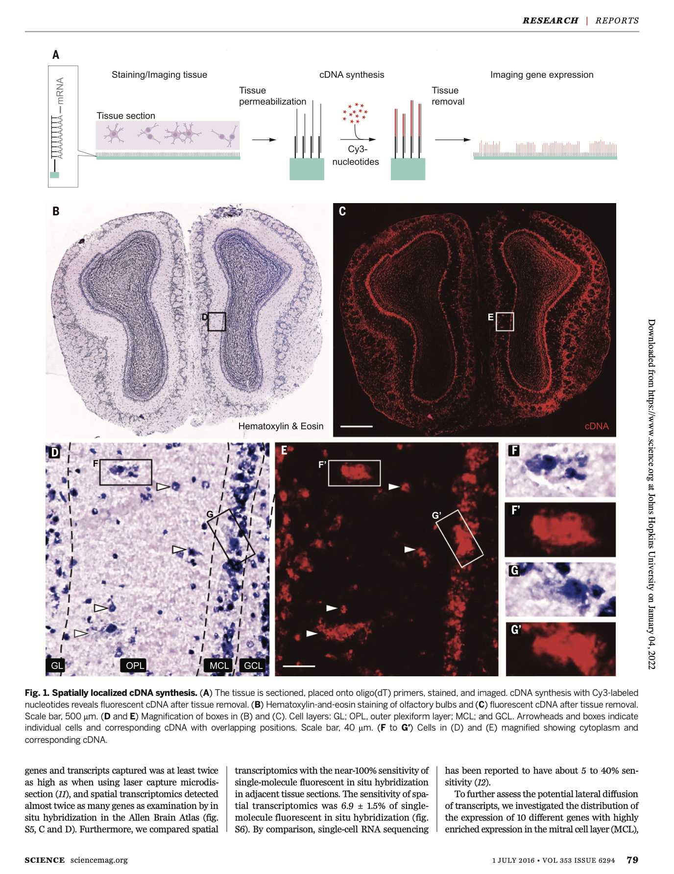
If you want to learn more, original scientific papers are available on class website

Slide 40
Fill out your reflection card
Take Home Quiz Friday

