Slide 1
EN.580.428 Genomic Data Visualization Lesson 3 Quality Control and Summary Statistics
Prof. Jean Fan

Slide 2
Lesson learning objectives
Review our understanding of spatial transcriptomics data based on the datasets we now have access to
Perform quality control analysis using data visualization
Compute various summary statistics

Slide 3
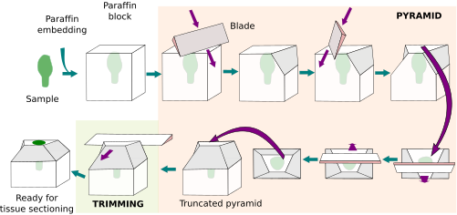
You’re working with 15um thin sections of breast cancer tissue

Slide 5
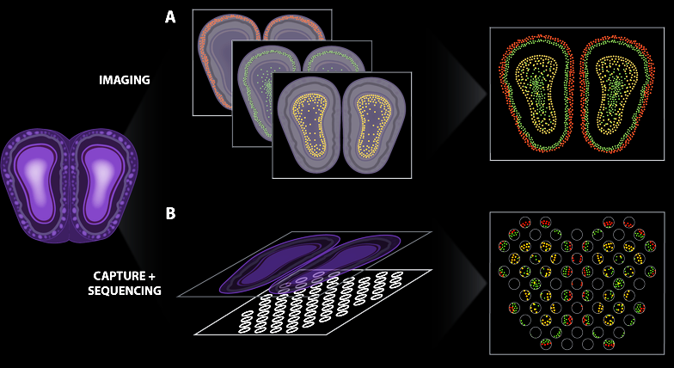
Spatially resolved transcriptomic technologies enable us to profile what genes are expressed by cells in tissues
Lyla Atta
(Atta and Fan, Nature Communications, Sept 2021)
Notes:
different technologies
vary in terms of throughput, sensitivity, resolution
statistical analysis methods will be different
7

Slide 6
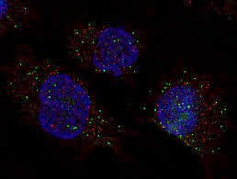
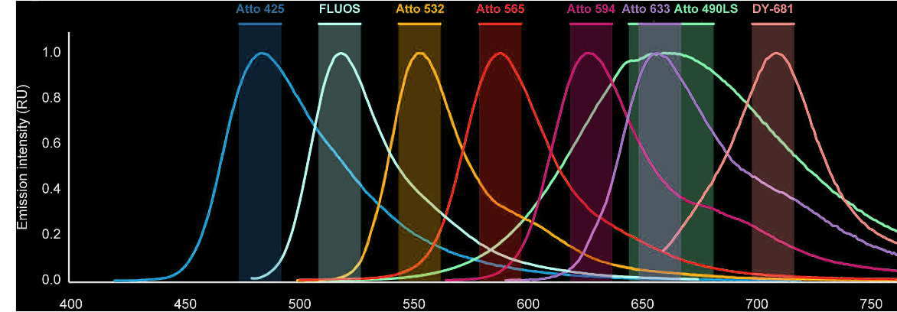
smFISH enables imaging of single mRNA molecules
Fluorophore
Oligonucleotide
gene1
gene2
gene3
(Femino et al., Science, 1998)
(Raj et al., Nature Methods, 2008)
(Lukumbuzya et al., Front. Microbiol, 2019)

Slide 7
Practice
Fluorophore
Oligonucleotide
gene1
Cell B
gene2
gene3
Cell A
Convert to count matrix →

Slide 8
(Slide courtesy of Chenglong Xia)

Slide 9
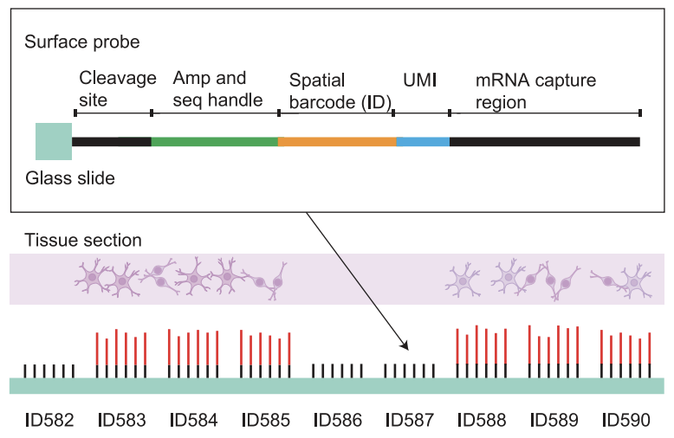
(Stahl et al 2016)

Slide 10
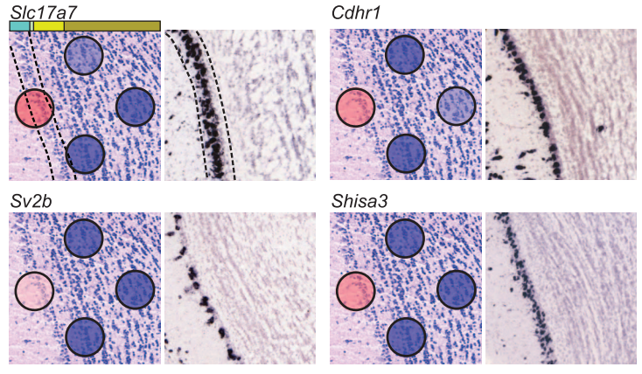
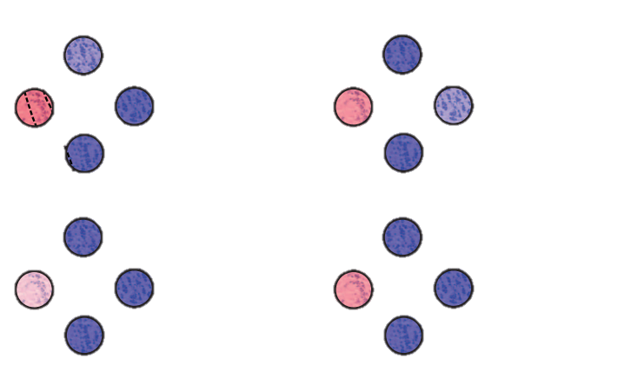
Observed count matrix →
(Stahl et al 2016)

Slide 11
(Stahl et al 2016)

Slide 12
What are the pros and cons of each spatial transcriptomic approach?
Practice

Slide 13
Common quality control metrics
How many total genes are detected per cell/spot?
How many unique genes are detected per cell/spot?
What is the total expression of each gene across all cells/spots?
What is the average expression of each gene across all cells/spots?
How many cells/spots is a particular gene detected in?

Slide 14
Consider an imaging smFISH-based spatial transcriptomics dataset
Practice
Prof. Fan calculates how many total genes are detected per cell
She notices a cell has 0 genes detected
She concludes the cell is dead
Do you agree?

Slide 15
Consider an imaging smFISH-based spatial transcriptomics dataset
Practice
Prof. Fan calculates the total expression of each gene across all cells
She notices a gene for which this total expression is 0
She concludes that the probes she designed for this gene must have all failed
Do you agree?

Slide 16
Consider a spot sequencing-based spatial transcriptomics dataset
Practice
Prof. Fan calculates how many total genes are detected per spot
She notices a spot has 0 genes detected
She concludes all the cell in this spot are dead
Do you agree?

Slide 17
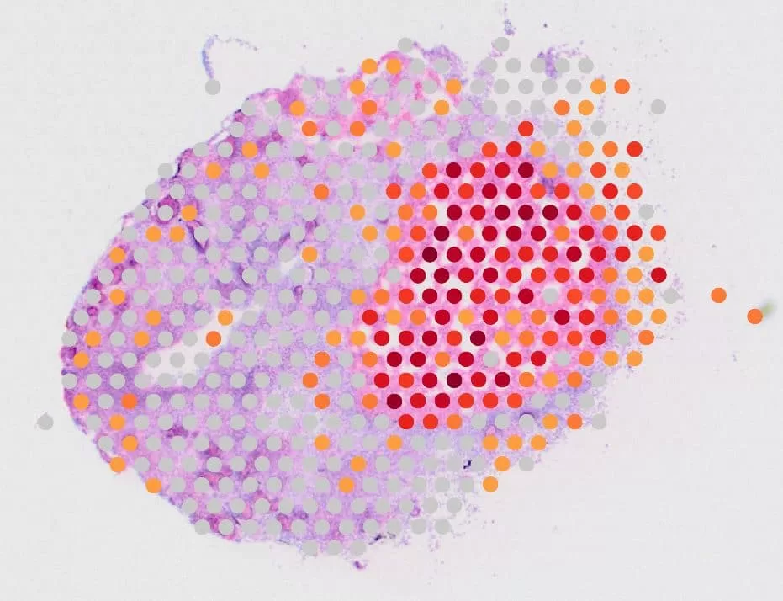

Slide 18
Hands-on component
Writing loops
Calculating summary statistics
How many total genes are detected per cell/spot?
How many unique genes are detected per cell/spot?
What is the total expression of each gene across all cells/spots?
What is the average expression of each gene across all cells/spots?
How many cells/spots is a particular gene detected in?
Histograms

Slide 19
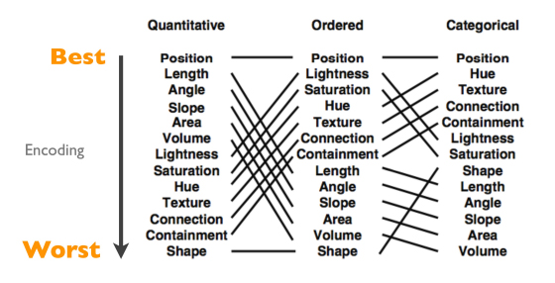
Fill out your reflection card
HW1 due tonight
Hint: justify your choices. If you used a particular visual channel, why did you do it? Could you have chosen something else?
Take Home Quiz Friday

