Slide 1

EN.580.428
Genomic Data Visualization
Lesson 3
Linear Dimensionality Reduction: Principal Components Analysis
Prof. Jean Fan

Slide 2
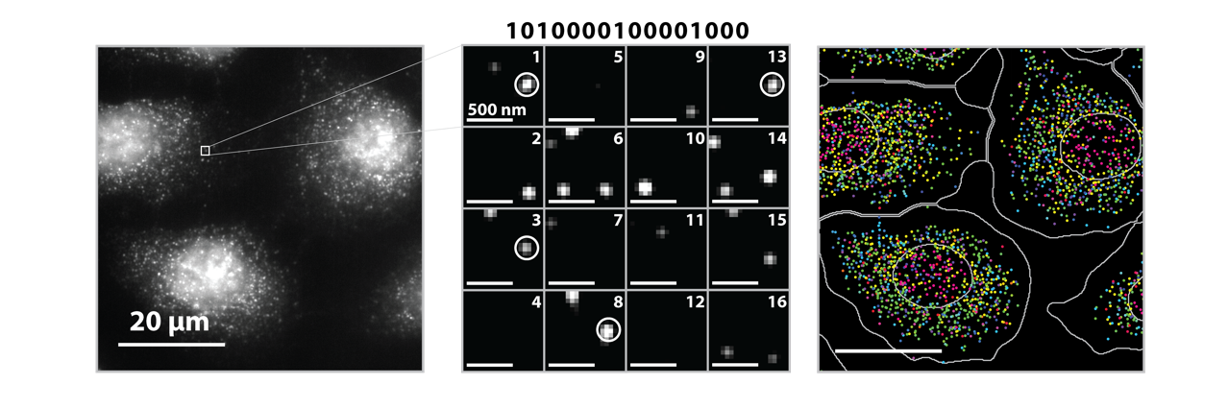
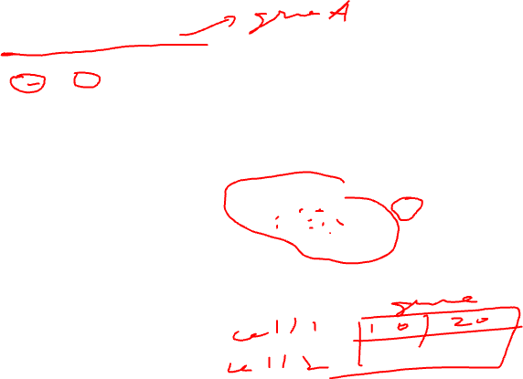
Imaging smFISH-based Spatial Transcriptomics
Source: Vizgen, Moffitt lab

Slide 3
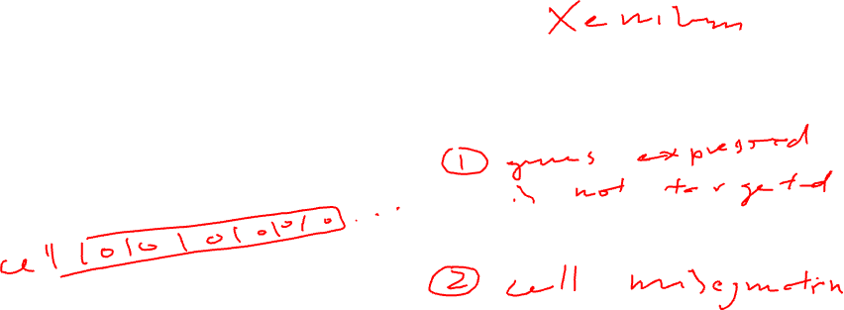
Consider an imaging smFISH-based spatial transcriptomics dataset
Practice
Prof. Fan calculates how many total genes are detected per cell
  She notices a cell has 0 genes detected
  She concludes the cell is dead
  Do you agree?

Slide 4
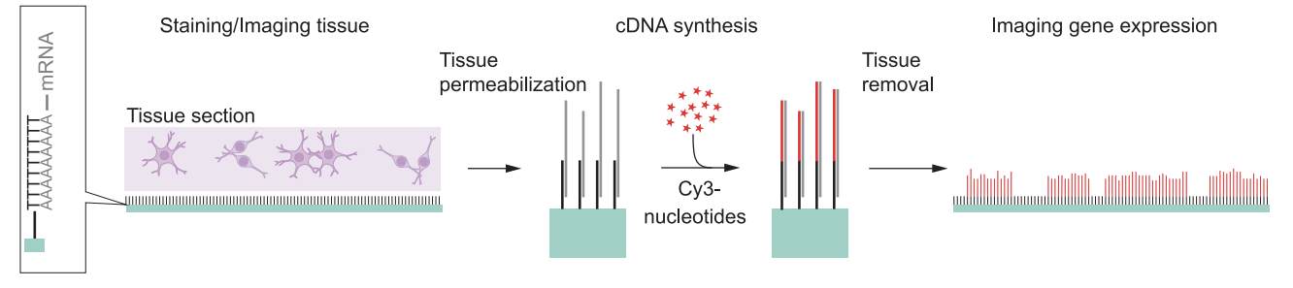
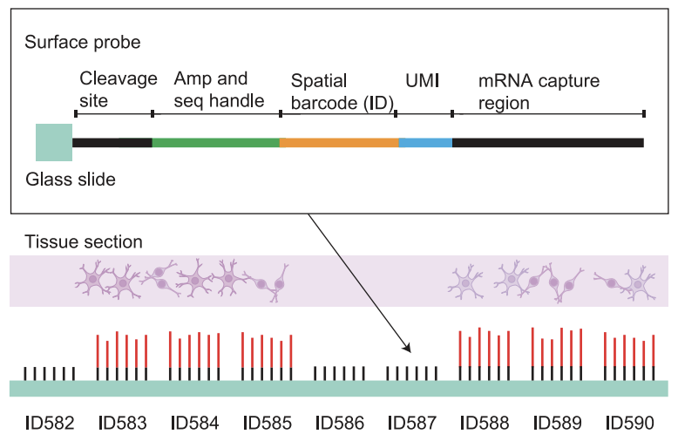

Spot-based capture sequencing-based spatial transcriptomics
(Stahl et al 2016)

Slide 5
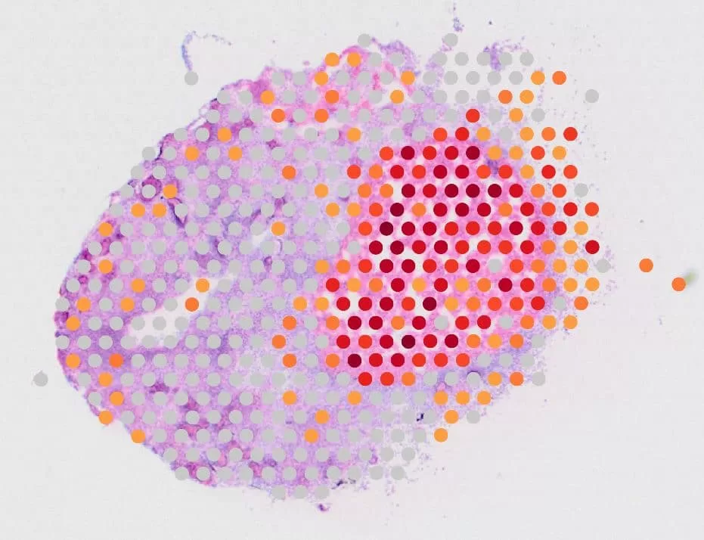

Consider a spot sequencing-based spatial transcriptomics dataset
Practice
Prof. Fan calculates how many total genes are detected per spot
  She notices a spot has 0 genes detected
  She concludes all the cell in this spot are dead
  Do you agree?

Slide 6
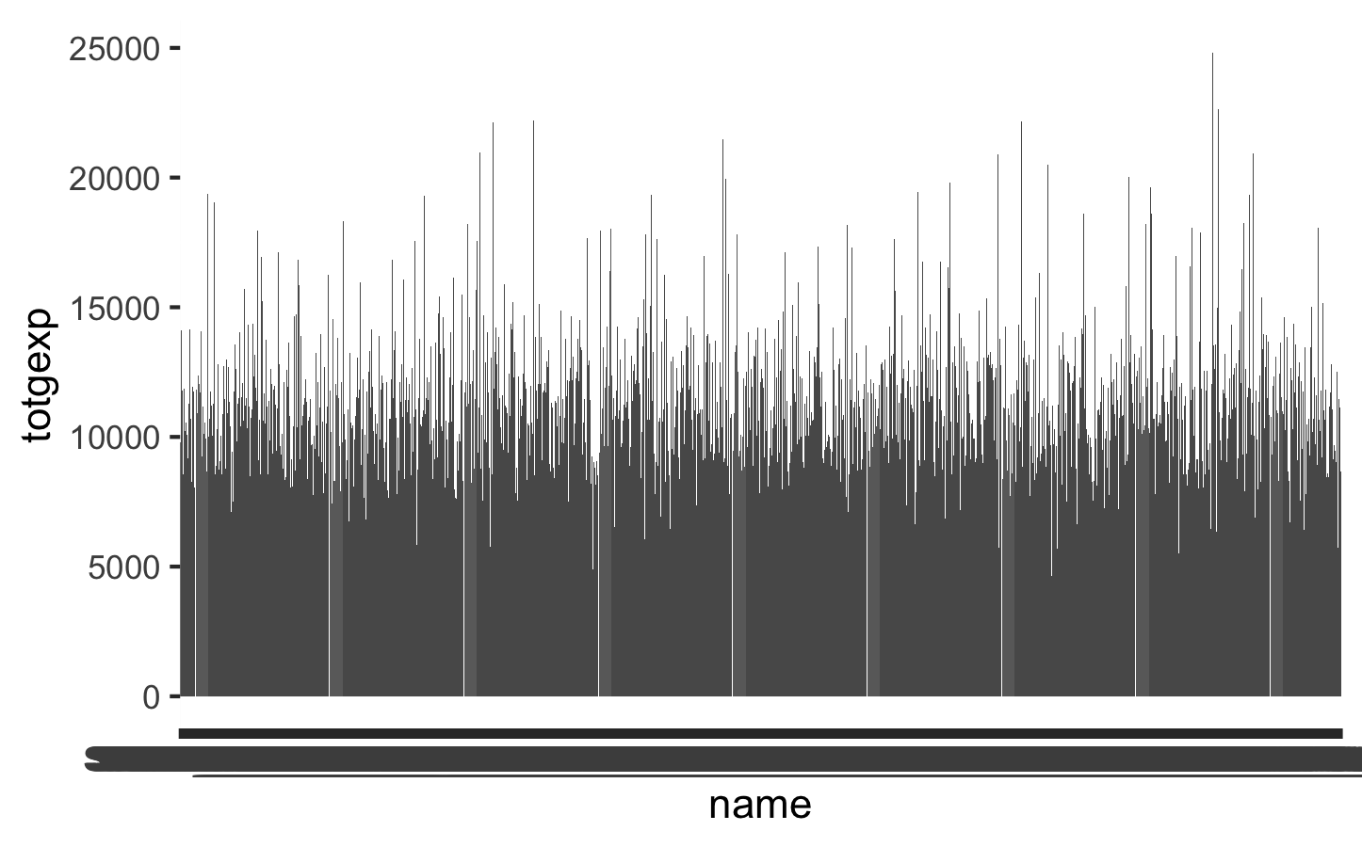

Common quality control metrics
How many total genes are detected per cell/spot?
data <- read.csv('~/Desktop/genomic-data-visualization-2026/data/Visium-IRI-ShamR_matrix.csv.gz')
pos <- data[,c('x', 'y')]
rownames(pos) <- data[,1]
gexp <- data[, 4:ncol(data)]
rownames(gexp) <- data[,1]
library(ggplot2)
df <- data.frame(
name = rownames(gexp),
totgexp = rowSums(gexp)
)
ggplot(df,
aes(x = name, y = totgexp)) +
geom_col()

Slide 7
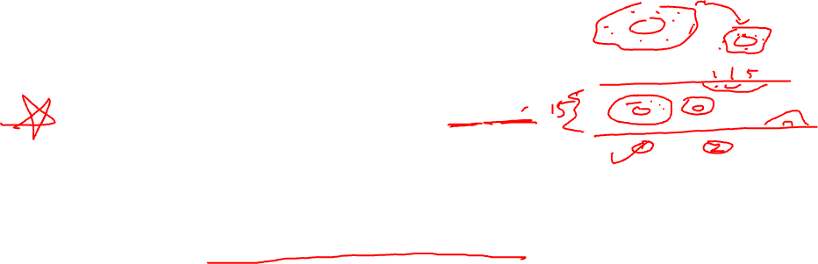
Common quality control metrics
How many total genes are detected per cell/spot?
How many unique genes are detected per cell/spot?
What is the total expression of each gene across all cells/spots?
What is the average expression of each gene across all cells/spots?
How many cells/spots is a particular gene detected in?

Slide 8
Lesson learning objectives
Learn about and apply linear dimensionality reduction via principal components analysis

Slide 9

Why do we need dimensionality reduction?

Slide 10
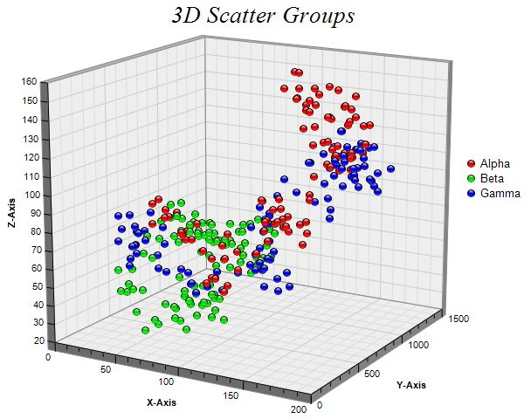

Why do we need dimensionality reduction?
4D?

Slide 11
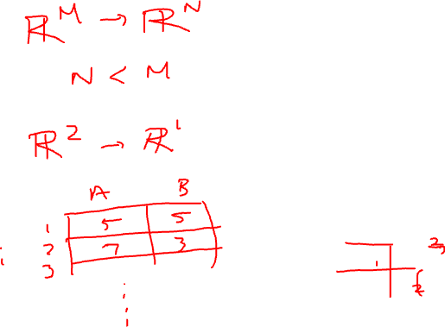
Linear dimensionality reduction: principal components analysis
Gene B
Gene A

Slide 12
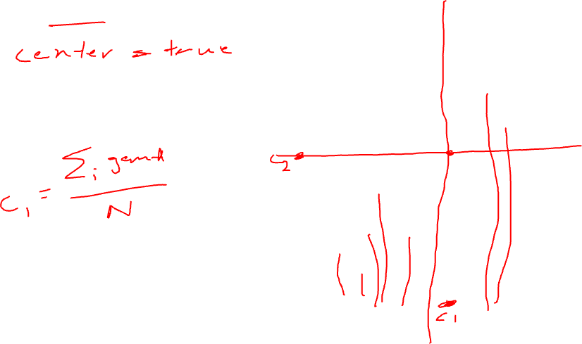
Step 1: center the data
Gene B
Gene A

Slide 13
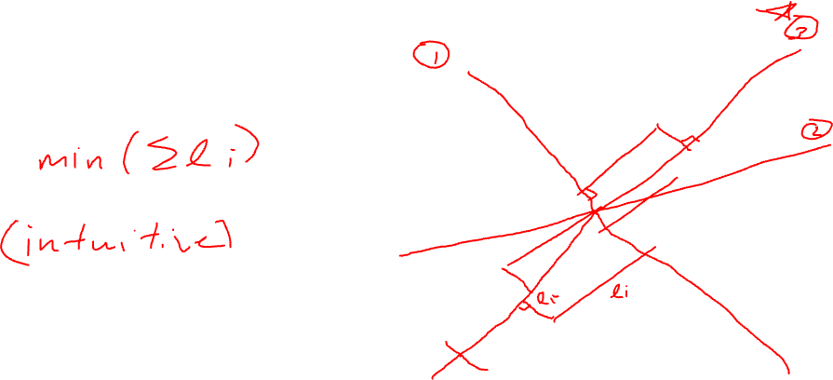
Step 2: find the of best fit
(minimization approach)
Gene B
Gene A

Slide 14
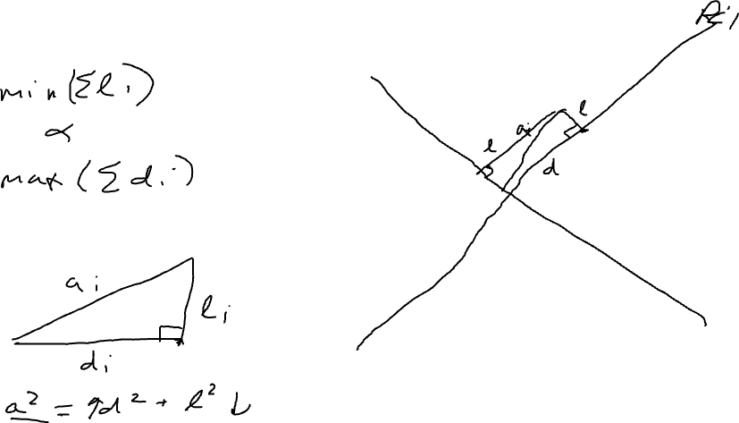
Equivalent Step 2: find the line of best fit (maximization approach)
Gene B
Gene A

Slide 15
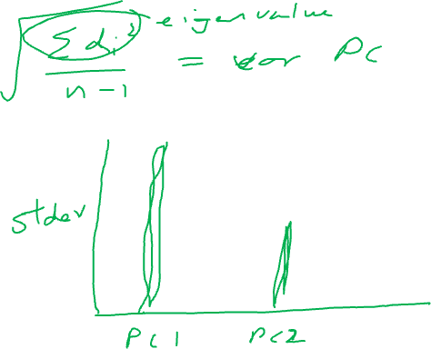
Scree plot: PC# vs stdev

Slide 16
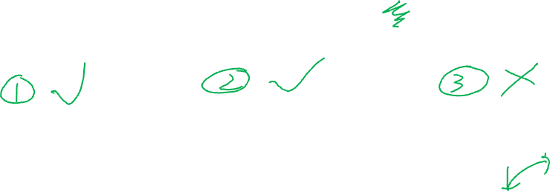
Which of these can be screen plots?
Practice
Stdev
Stdev
Stdev
1 2 3 4
1 2 3 4
1 2 3 4
PC
PC
PC

Slide 17
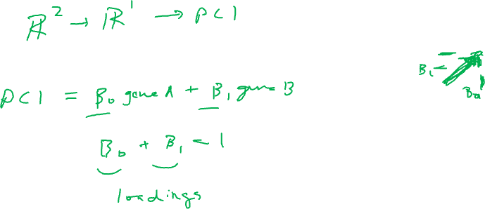
PCs are linear combinations of genes
(why this is linear dimensionality reduction)
PC1
Gene B
PC2
Gene A

Slide 18
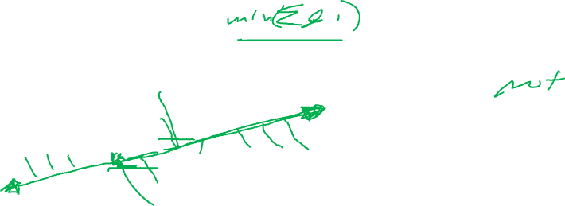
Consider the following centered gene expression
Practice
Are solutions unique?
Gene B
Gene A

Slide 19
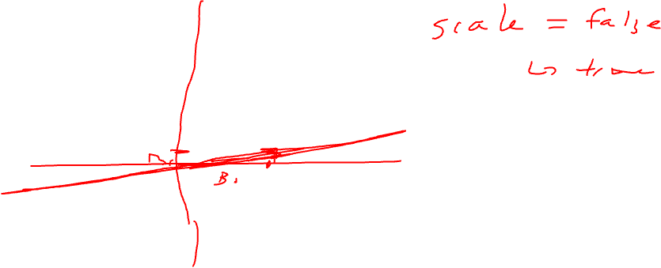
Genes that are more highly expressed tend to be more variable. How does this impact our PCs?
Practice
Gene B
Gene A

Slide 20
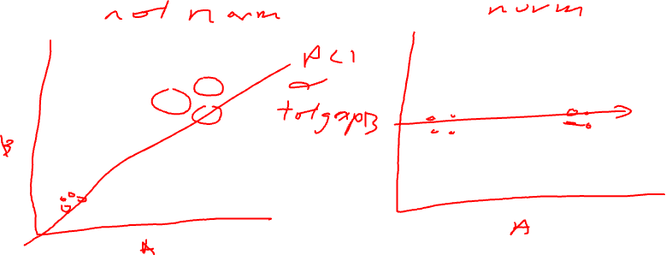
Gene expression is correlated with cell size (for imaging-based ST) or number of cells per spot (for sequencing-based ST). How does this impact our PCs?
Practice

