Slide 1

Spatially variable gene (SVG) expression analysis
Jean Fan, PhD
Associate Professor
JEFworks Lab
Center for Computational Biology
Department of Biomedical Engineering
Johns Hopkins University

Slide 2

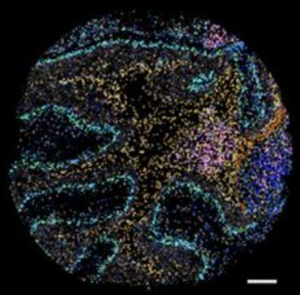
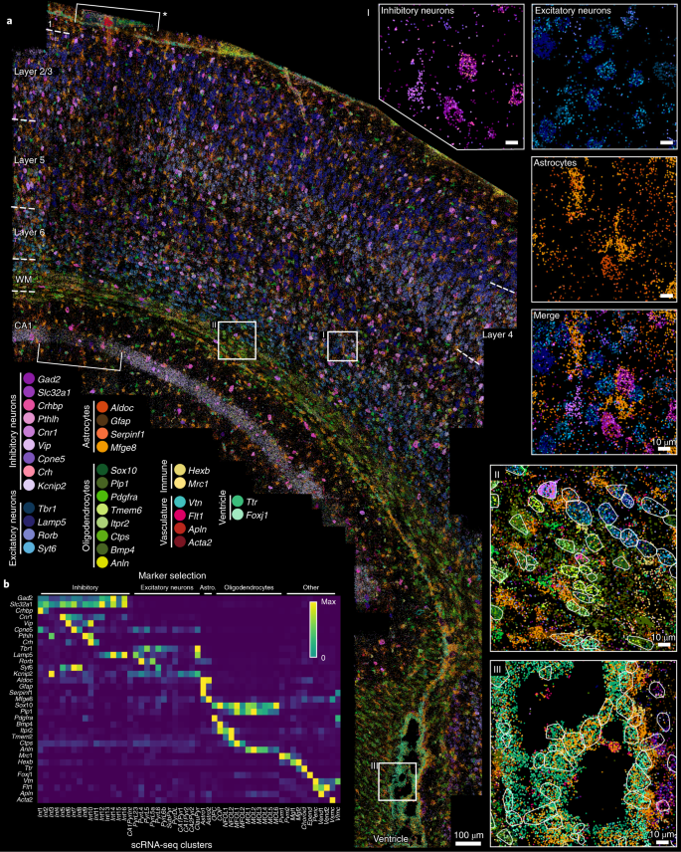
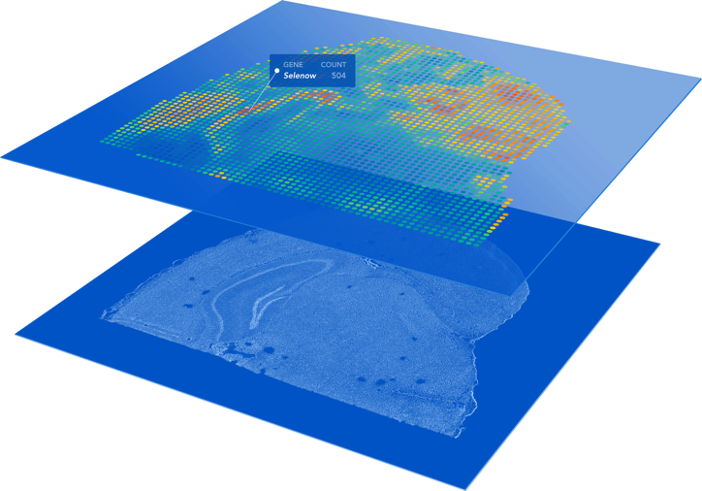

preoptic region (MERFISH)
(Moffitt*, Bambah-Mukku*
et al., Science 2018)
motor cortex (MERFISH)
(Zhang et al., bioRxiv 2020)
somatosensory cortex (osmFISH)
(Codeluppi et al, Nature Methods 2018)
embryo (DBiT-seq)
(Liu et al, Cell 2020)
cerebellum (SlideSeq)
(Rodriques et al, Science 2019)
olfactory bulb (Spatial Transcriptomics)
(Stahl et al, Science 2016)
SVZ (seqFISH/seqFISH+)
(Eng et al, Nature 2019)
V1 cortex (STARmap)
(Wang et al, Science 2018)
cortex (Visium)
liver (XYZeq)
Lee et al, Science Advances 2021)
embryo (sci-space)
Lee et al, Science Advances 2021)
… and
more!

Slide 3
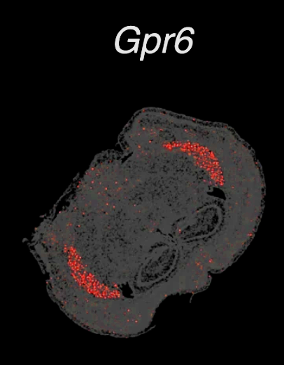
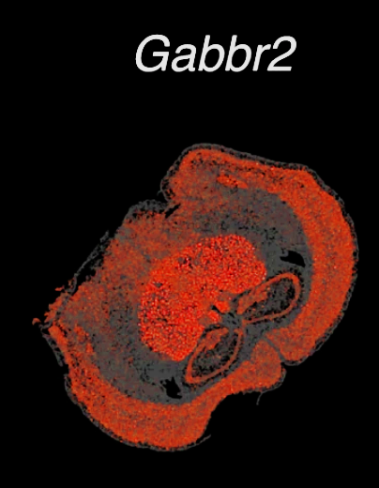

Spatially Variable Genes (SVGs)

Slide 4
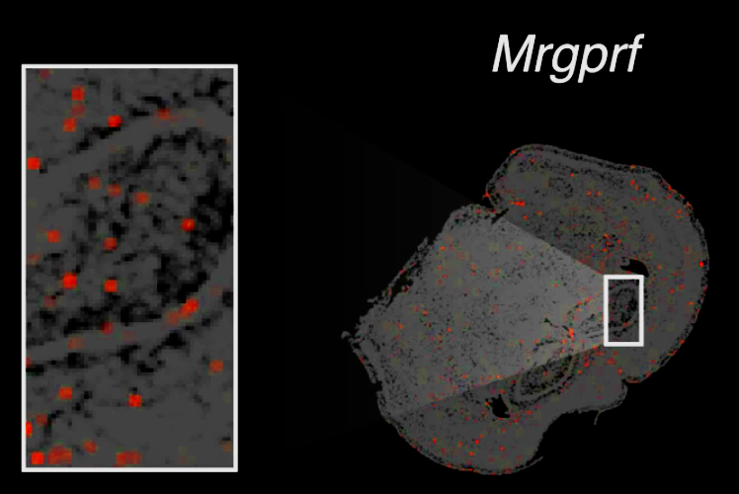
Non-Spatially Variable Genes

Slide 5
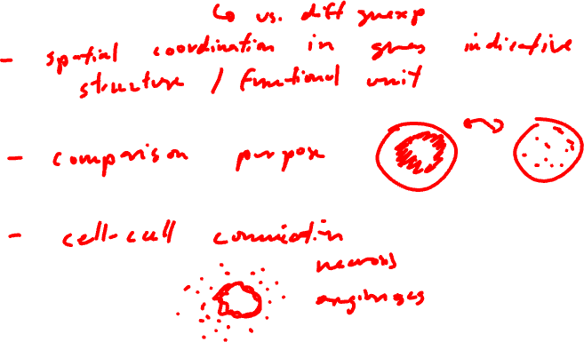
Motivation: Why might we be interested in identifying (cell-type-specific) spatially variable genes/proteins/markers?

Slide 6
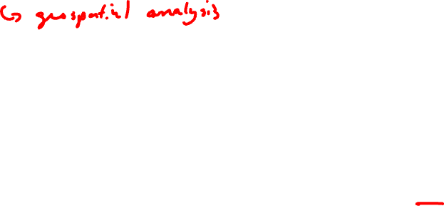
Moran’s I
(Patrick AP Moran, June 1950)
(Brendan F Miller ... Jean Fan, May 2021)
Notes:
MERINGUE draw inspiration from Geospatial analysis
Where a statistic called Moran's I has been used to evaluate whether a particular quantity, say income, exhibits significant non-random spatial variation via spatial autocorrelation
In this case, each square is a county
Color denotes income level
We can see in this visualization that income isn’t random
it is highly correlated with the income of the neighboring county
(income exhibits high spatial autocorrelation and this high spatial autocorrelation can be quantified as a high Moran’s I)
For us of course, we're not as interested in income, but we are interested in gene expression
So if a cell's expression for a particular gene is highly correlated with that gene's expression in the cell's neighbors, then the gene would be highly spatially autocorrelated
distinguish genes that are variable in a spatial coordinated manner
with genes that are variable but not in a spatially coordinated manner

Slide 7
Moran’s I
(Patrick AP Moran, June 1950)
(Brendan F Miller ... Jean Fan, May 2021)
Notes:
MERINGUE draw inspiration from Geospatial analysis
Where a statistic called Moran's I has been used to evaluate whether a particular quantity, say income, exhibits significant non-random spatial variation via spatial autocorrelation
In this case, each square is a county
Color denotes income level
We can see in this visualization that income isn’t random
it is highly correlated with the income of the neighboring county
(income exhibits high spatial autocorrelation and this high spatial autocorrelation can be quantified as a high Moran’s I)
For us of course, we're not as interested in income, but we are interested in gene expression
So if a cell's expression for a particular gene is highly correlated with that gene's expression in the cell's neighbors, then the gene would be highly spatially autocorrelated
distinguish genes that are variable in a spatial coordinated manner
with genes that are variable but not in a spatially coordinated manner

Slide 8
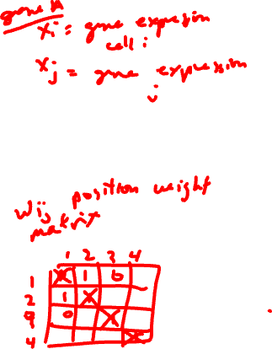
Moran’s I
(Patrick AP Moran, June 1950)
(Brendan F Miller ... Jean Fan, May 2021)
Notes:
MERINGUE draw inspiration from Geospatial analysis
Where a statistic called Moran's I has been used to evaluate whether a particular quantity, say income, exhibits significant non-random spatial variation via spatial autocorrelation
In this case, each square is a county
Color denotes income level
We can see in this visualization that income isn’t random
it is highly correlated with the income of the neighboring county
(income exhibits high spatial autocorrelation and this high spatial autocorrelation can be quantified as a high Moran’s I)
For us of course, we're not as interested in income, but we are interested in gene expression
So if a cell's expression for a particular gene is highly correlated with that gene's expression in the cell's neighbors, then the gene would be highly spatially autocorrelated
distinguish genes that are variable in a spatial coordinated manner
with genes that are variable but not in a spatially coordinated manner

Slide 9
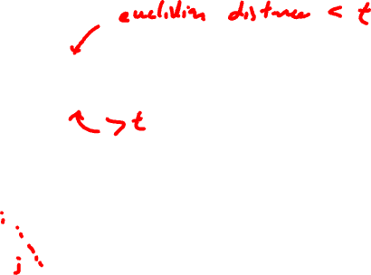
Moran’s I
(Patrick AP Moran, June 1950)
(Brendan F Miller ... Jean Fan, May 2021)
Notes:
MERINGUE draw inspiration from Geospatial analysis
Where a statistic called Moran's I has been used to evaluate whether a particular quantity, say income, exhibits significant non-random spatial variation via spatial autocorrelation
In this case, each square is a county
Color denotes income level
We can see in this visualization that income isn’t random
it is highly correlated with the income of the neighboring county
(income exhibits high spatial autocorrelation and this high spatial autocorrelation can be quantified as a high Moran’s I)
For us of course, we're not as interested in income, but we are interested in gene expression
So if a cell's expression for a particular gene is highly correlated with that gene's expression in the cell's neighbors, then the gene would be highly spatially autocorrelated
distinguish genes that are variable in a spatial coordinated manner
with genes that are variable but not in a spatially coordinated manner

Slide 10

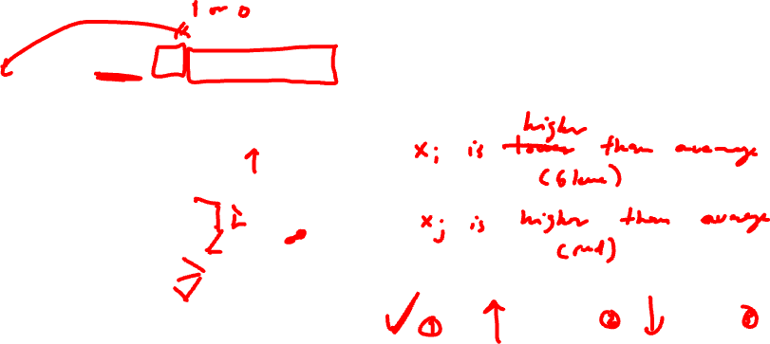
Moran’s I
x_{i} = expression of a particular gene in cell_{i}
x_{j} = expression of a particular gene in cell_{j}
(Patrick AP Moran, June 1950)
(Brendan F Miller ... Jean Fan, May 2021)
Notes:
MERINGUE draw inspiration from Geospatial analysis
Where a statistic called Moran's I has been used to evaluate whether a particular quantity, say income, exhibits significant non-random spatial variation via spatial autocorrelation
In this case, each square is a county
Color denotes income level
We can see in this visualization that income isn’t random
it is highly correlated with the income of the neighboring county
(income exhibits high spatial autocorrelation and this high spatial autocorrelation can be quantified as a high Moran’s I)
For us of course, we're not as interested in income, but we are interested in gene expression
So if a cell's expression for a particular gene is highly correlated with that gene's expression in the cell's neighbors, then the gene would be highly spatially autocorrelated
distinguish genes that are variable in a spatial coordinated manner
with genes that are variable but not in a spatially coordinated manner

Slide 11
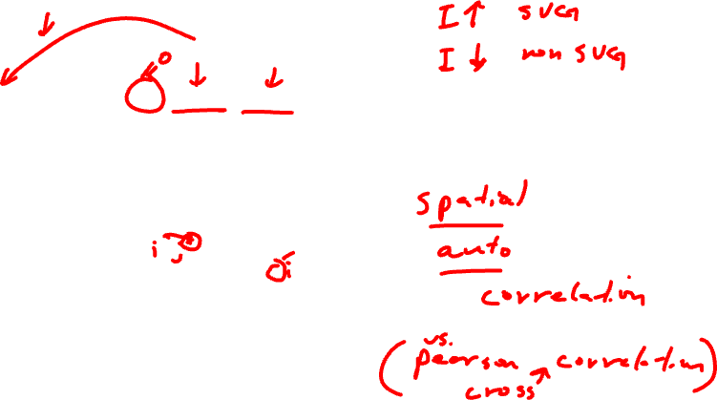
Moran’s I
x_{i} = expression of a particular gene in cell_{i}
x_{j} = expression of a particular gene in cell_{j}
(Patrick AP Moran, June 1950)
(Brendan F Miller ... Jean Fan, May 2021)
Notes:
MERINGUE draw inspiration from Geospatial analysis
Where a statistic called Moran's I has been used to evaluate whether a particular quantity, say income, exhibits significant non-random spatial variation via spatial autocorrelation
In this case, each square is a county
Color denotes income level
We can see in this visualization that income isn’t random
it is highly correlated with the income of the neighboring county
(income exhibits high spatial autocorrelation and this high spatial autocorrelation can be quantified as a high Moran’s I)
For us of course, we're not as interested in income, but we are interested in gene expression
So if a cell's expression for a particular gene is highly correlated with that gene's expression in the cell's neighbors, then the gene would be highly spatially autocorrelated
distinguish genes that are variable in a spatial coordinated manner
with genes that are variable but not in a spatially coordinated manner

Slide 12
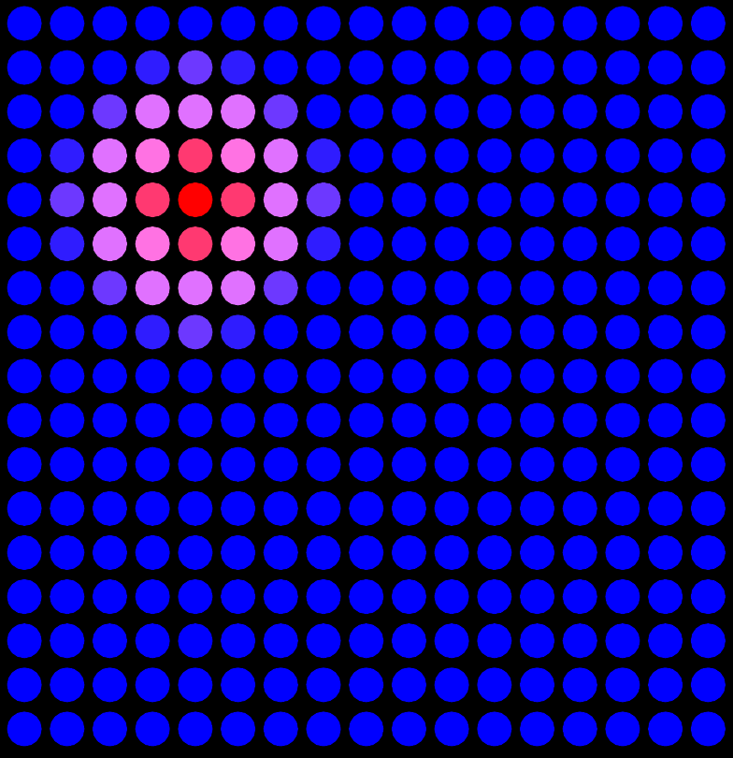
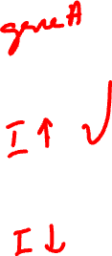
Practice

Slide 13
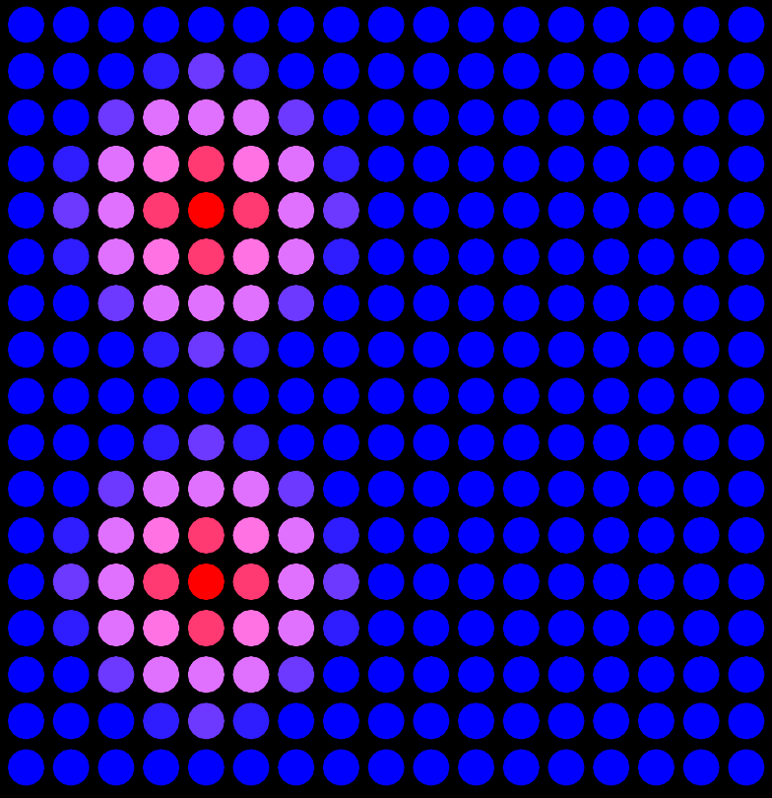
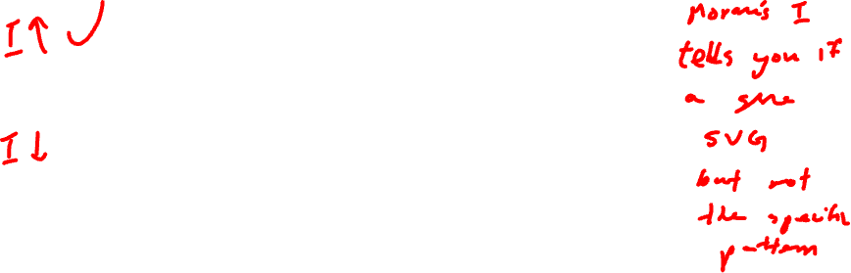
Practice

Slide 14
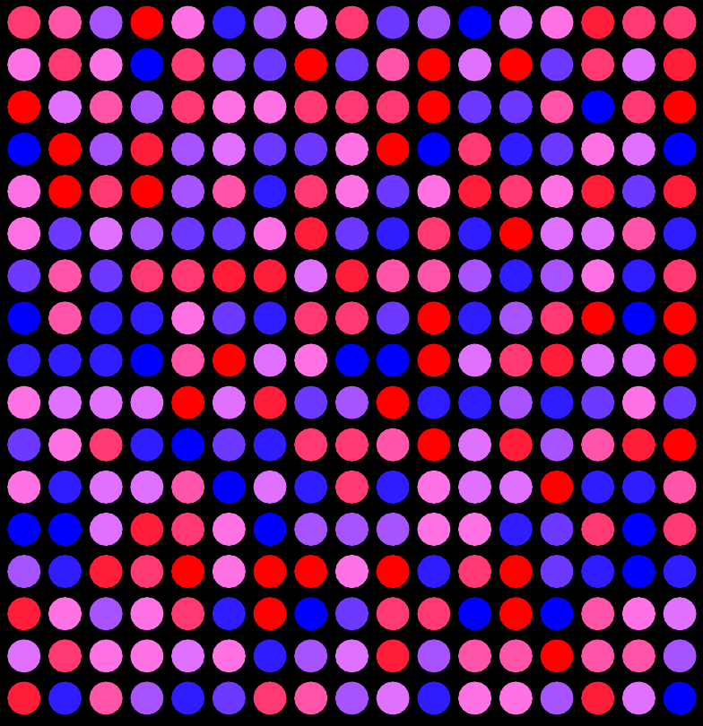
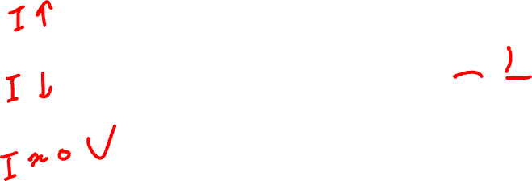
Practice

Slide 15

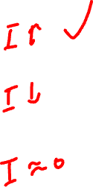
Practice

Slide 16
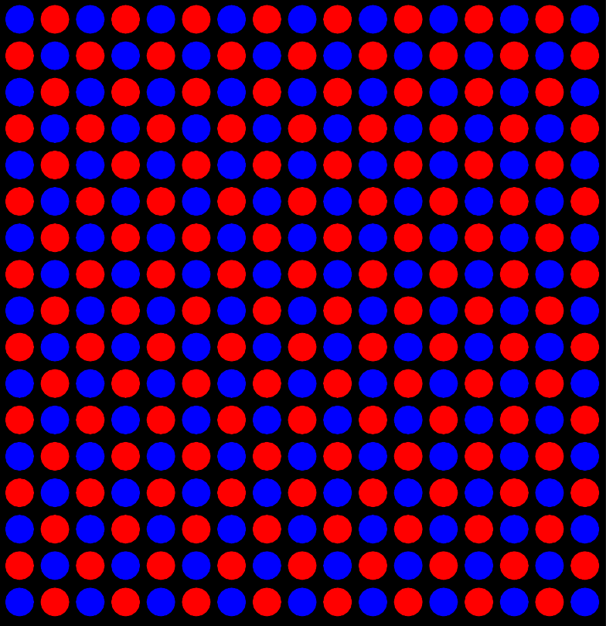
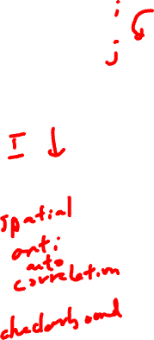
Practice

Slide 17
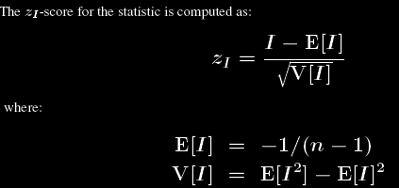
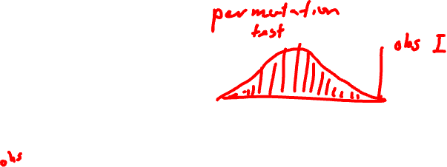
Moran’s I has a closed form that we can compute to solve for the distribution and obtain a p-value

Slide 18
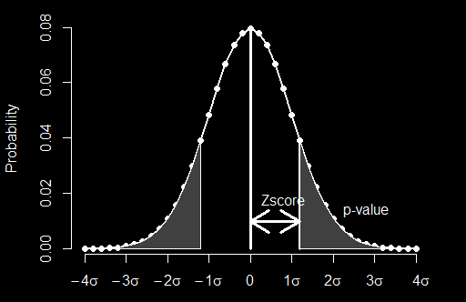


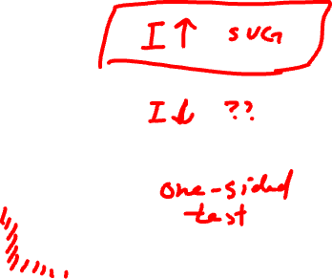
H₀ = gene is not spatially variable
H_{A} = gene is spatially variable
Observed I
(Patrick AP Moran, June 1950)
(Brendan F Miller ... Jean Fan, May 2021)
Notes:
MERINGUE draw inspiration from Geospatial analysis
Where a statistic called Moran's I has been used to evaluate whether a particular quantity, say income, exhibits significant non-random spatial variation via spatial autocorrelation
In this case, each square is a county
Color denotes income level
We can see in this visualization that income isn’t random
it is highly correlated with the income of the neighboring county
(income exhibits high spatial autocorrelation and this high spatial autocorrelation can be quantified as a high Moran’s I)
For us of course, we're not as interested in income, but we are interested in gene expression
So if a cell's expression for a particular gene is highly correlated with that gene's expression in the cell's neighbors, then the gene would be highly spatially autocorrelated
distinguish genes that are variable in a spatial coordinated manner
with genes that are variable but not in a spatially coordinated manner

Slide 19
H₀ = gene is not spatially variable
H_{A} = gene is spatially variable
(Patrick AP Moran, June 1950)
(Brendan F Miller ... Jean Fan, May 2021)
Notes:
MERINGUE draw inspiration from Geospatial analysis
Where a statistic called Moran's I has been used to evaluate whether a particular quantity, say income, exhibits significant non-random spatial variation via spatial autocorrelation
In this case, each square is a county
Color denotes income level
We can see in this visualization that income isn’t random
it is highly correlated with the income of the neighboring county
(income exhibits high spatial autocorrelation and this high spatial autocorrelation can be quantified as a high Moran’s I)
For us of course, we're not as interested in income, but we are interested in gene expression
So if a cell's expression for a particular gene is highly correlated with that gene's expression in the cell's neighbors, then the gene would be highly spatially autocorrelated
distinguish genes that are variable in a spatial coordinated manner
with genes that are variable but not in a spatially coordinated manner

Slide 20
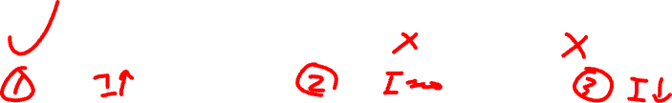
Practice

Slide 21
Moran’s I
(Patrick AP Moran, June 1950)
(Brendan F Miller ... Jean Fan, May 2021)
Notes:
MERINGUE draw inspiration from Geospatial analysis
Where a statistic called Moran's I has been used to evaluate whether a particular quantity, say income, exhibits significant non-random spatial variation via spatial autocorrelation
In this case, each square is a county
Color denotes income level
We can see in this visualization that income isn’t random
it is highly correlated with the income of the neighboring county
(income exhibits high spatial autocorrelation and this high spatial autocorrelation can be quantified as a high Moran’s I)
For us of course, we're not as interested in income, but we are interested in gene expression
So if a cell's expression for a particular gene is highly correlated with that gene's expression in the cell's neighbors, then the gene would be highly spatially autocorrelated
distinguish genes that are variable in a spatial coordinated manner
with genes that are variable but not in a spatially coordinated manner

Slide 22
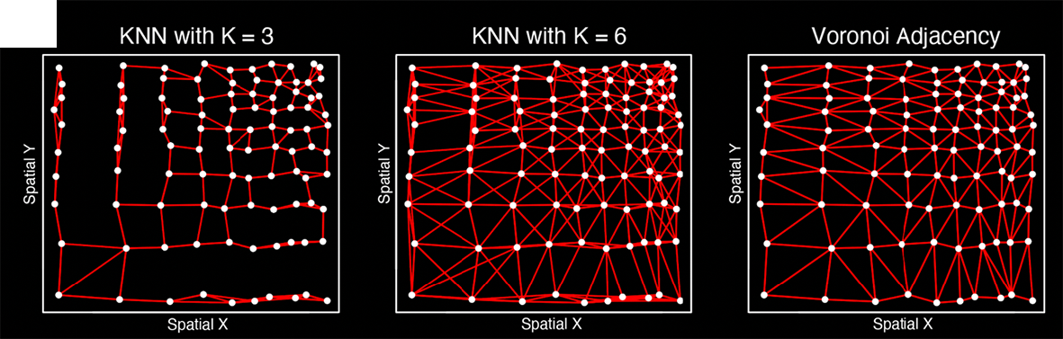
Moran’s I
(Patrick AP Moran, June 1950)
(Brendan F Miller ... Jean Fan, May 2021)
Notes:
MERINGUE draw inspiration from Geospatial analysis
Where a statistic called Moran's I has been used to evaluate whether a particular quantity, say income, exhibits significant non-random spatial variation via spatial autocorrelation
In this case, each square is a county
Color denotes income level
We can see in this visualization that income isn’t random
it is highly correlated with the income of the neighboring county
(income exhibits high spatial autocorrelation and this high spatial autocorrelation can be quantified as a high Moran’s I)
For us of course, we're not as interested in income, but we are interested in gene expression
So if a cell's expression for a particular gene is highly correlated with that gene's expression in the cell's neighbors, then the gene would be highly spatially autocorrelated
distinguish genes that are variable in a spatial coordinated manner
with genes that are variable but not in a spatially coordinated manner

Slide 23
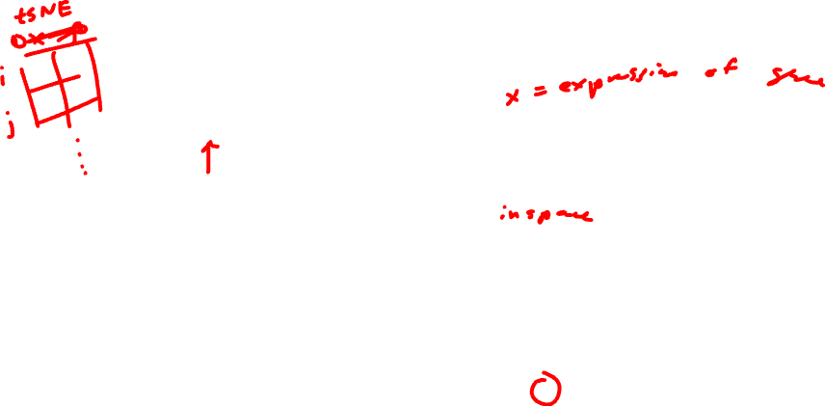
Moran’s I
1/(distance between cell_{i} and cell_{j} ) for K-nearest neighbors
0 for non-K-nearest neighbors
1/(distance between cell_{i} and cell_{j} )²
(Patrick AP Moran, June 1950)
(Brendan F Miller ... Jean Fan, May 2021)
Notes:
MERINGUE draw inspiration from Geospatial analysis
Where a statistic called Moran's I has been used to evaluate whether a particular quantity, say income, exhibits significant non-random spatial variation via spatial autocorrelation
In this case, each square is a county
Color denotes income level
We can see in this visualization that income isn’t random
it is highly correlated with the income of the neighboring county
(income exhibits high spatial autocorrelation and this high spatial autocorrelation can be quantified as a high Moran’s I)
For us of course, we're not as interested in income, but we are interested in gene expression
So if a cell's expression for a particular gene is highly correlated with that gene's expression in the cell's neighbors, then the gene would be highly spatially autocorrelated
distinguish genes that are variable in a spatial coordinated manner
with genes that are variable but not in a spatially coordinated manner

Slide 24
https://JEF.works/MERINGUE/
(Brendan F Miller ... Jean Fan, May 2021)
Notes:
So this is a question we sought out to tackle:
How can we characterize spatial gene expression heterogeneity within cell-types in tissues?
And we were particular interested in developing an approach that was robust to the nonuniform density of cells within tissues
Such that we don’t mistake spatial variations in cell density for spatial variations in gene expression
So we developed an approach called MERINGUE

Slide 25
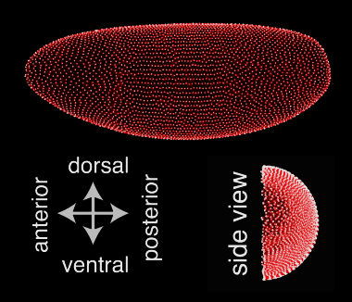
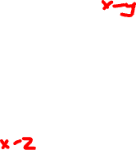
We apply MERINGUE to identify genes with spatially heterogeneous patterns in 2D, 3D, multi-section, and more
(Fowlkes et al, Cell 2008;
Karaiskos et al Science, 2017)
3D drosophila
(Brendan F Miller ... Jean Fan, May 2021)
Notes:
In our paper, we apply MERINGUE to many organisms, technologies,
In particular the Moran’s I equation is also very flexible and amenable to adaptations that allow us to
To identify genes with spatially heterogeneous gene expression patterns in 3D,
In multi-section data where we can specifically look for spatial patterns that are consistent across sections
Or even between pairs of receptor and ligand genes among spatially co-localized cell-types to look for potential cell-cell communication
Please check out…

Slide 26
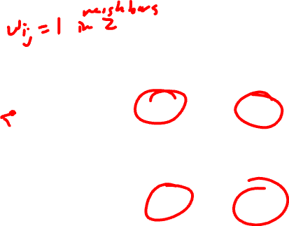
We apply MERINGUE to identify genes with spatially heterogeneous patterns in 2D, 3D, multi-section, and more
Multi-section breast cancer
(Stahl et al, Science 2016)
(Brendan F Miller ... Jean Fan, May 2021)
Notes:
In our paper, we apply MERINGUE to many organisms, technologies,
In particular the Moran’s I equation is also very flexible and amenable to adaptations that allow us to
To identify genes with spatially heterogeneous gene expression patterns in 3D,
In multi-section data where we can specifically look for spatial patterns that are consistent across sections
Or even between pairs of receptor and ligand genes among spatially co-localized cell-types to look for potential cell-cell communication
Please check out…

Slide 27

We apply MERINGUE to identify genes with spatially heterogeneous patterns in 2D, 3D, multi-section, and more
Within cell-types in the hypothalamic preoptic region
(Moffitt*, Bambah-Mukku*
et al., Science 2018)
(Brendan F Miller ... Jean Fan, May 2021)
Notes:
In our paper, we apply MERINGUE to many organisms, technologies,
In particular the Moran’s I equation is also very flexible and amenable to adaptations that allow us to
To identify genes with spatially heterogeneous gene expression patterns in 3D,
In multi-section data where we can specifically look for spatial patterns that are consistent across sections
Or even between pairs of receptor and ligand genes among spatially co-localized cell-types to look for potential cell-cell communication
Please check out…

Slide 28
Notes:
So returning to our hippocampal pyramidal cells
when we apply MERINGUE

Slide 29
Gpr161
Notes:
We indeed can find additional aspects of gene expression heterogeneity that are coordinated in a spatial manner

Slide 30
Amigo2
Notes:
We indeed can find additional aspects of gene expression heterogeneity that are coordinated in a spatial manner

Slide 31
Tmem108
Notes:
We indeed can find additional aspects of gene expression heterogeneity that are coordinated in a spatial manner
Appear to visually correspond with different hippocampal subfields which receive inputs from different regions of the brain

Slide 32
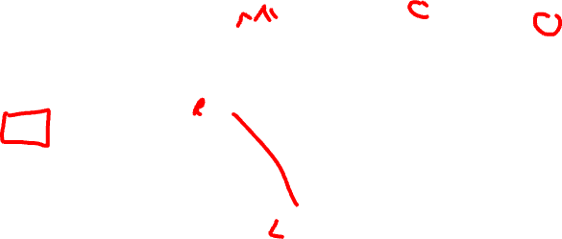
MERINGUE proposes an inter-cell-type spatial cross correlation statistic to identify gene expression patterns indicative of cell-cell communication
Moran’s I (spatial auto-correlation)
inter-cell-type spatial cross-correlation
(Miller et al, Genome Research Oct 2021)
Notes:
Finally, building on Moran's I, we can modify this equation slightly
and take advantage of the flexibility of this adjacency weight matrix definition
to specifically propose an inter-cell-type spatial cross correlation statistic
To look for genes that are cross correlated for spatially co-localized cell-types that may be indicative of cell-cell communication
Rather than autocorrelation x with itself, we now have a second gene
W is limited to spatial neighbors of different cell-types
So consider cell-type A and B that spatially adjacent to each other
Cell-type A expresses a gene, perhaps a receptor
and Cell-type B expresses the complementary ligand
and we are looking to find situations where cells of cell-type A
expressing the receptor are always co-localized with cells of
cell-type B expressing the correpsonding ligand
even though these receptor and ligand genes are expressed in different cells
so their expressions across cells are actually negatively correlated
when we evaluate their inter-cell-type spatial cross-correlation,
it is very significantly positive
potentially indicative of cell-cell communication via this particular receptor-ligand interaction

Slide 33
MERINGUE identifies spatial gene expression heterogeneity suggestive communication between spatially co-localized cells
(Miller et al, Genome Research Oct 2021)
Notes:
We first apply our approach identify gene expression patterns that may be indicative of putative 399 cell-cell communication between cells on beads corresponding to the Purkinje layer with cells on spatially 400 adjacent beads in Slide-Seq data of the mouse cerebellum (Fig. 5A). We use a set of over 2,500 known 401 receptor-ligand pairs previously supported by orthogonal biological validations (Ramilowski et al. 402 2015a). Restricting to well detected (CPM > 0 in more than 30 cells) receptor genes in the Purkinje layer 403 beads and well detected ligand genes in the spatially adjacent beads, we applied MERINGUE to test for 404 significant spatial cross correlation between all receptor and ligand gene pairs.
We identified statistically significant inter-cell-type spatial cross-correlation between expression of Ptprz1 (Protein Tyrosine 406 Phosphatase Receptor Type Z1 i.e. PTPζ) in beads corresponding to Purkinje layer and expression of its ligand Ptn (secreted growth factor pleiotrophin) in spatially adjacent beads (Fig. 5B-C). Ptprz1 has been previously identified to be expressed by Purkinje neurons while Ptn has been previously identified to distribute along Bergmann glial fibers in postnatally developing cerebellum (

Slide 34
Resources
Try out the software: https://github.com/JEFworks-Lab/MERINGUE
Many other ways to calculate Moran’s I: https://jef.works/blog/2024/08/29/the-many-ways-to-detect-svgs-using-moransI/

Slide 35


https://jef.works/MERINGUE/
# install.packages(remotes)
require(remotes)
remotes::install_github('JEFworks-Lab/MERingue', build_vignettes = FALSE)
## given position matrix
W <- getSpatialNeighbors(pos)
plotNetwork(pos, W)
## given gene expression vector
moranTest(gene, W)

